Slide 1



BACH DANG SECONDARY SCHOOL
WELCOME TO OUR CLASS 8A3

Slide 2
KIM’S GAME

Slide 3
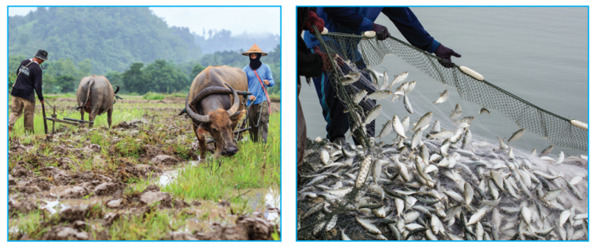
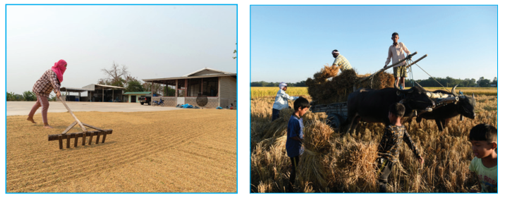

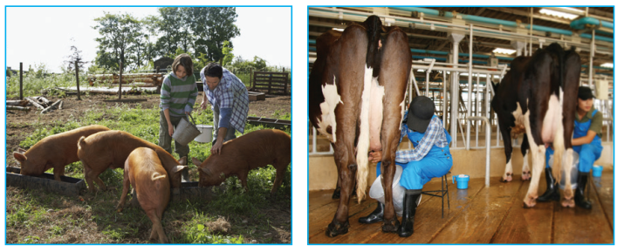
2
3
1
4
5
6

Slide 4



Slide 5
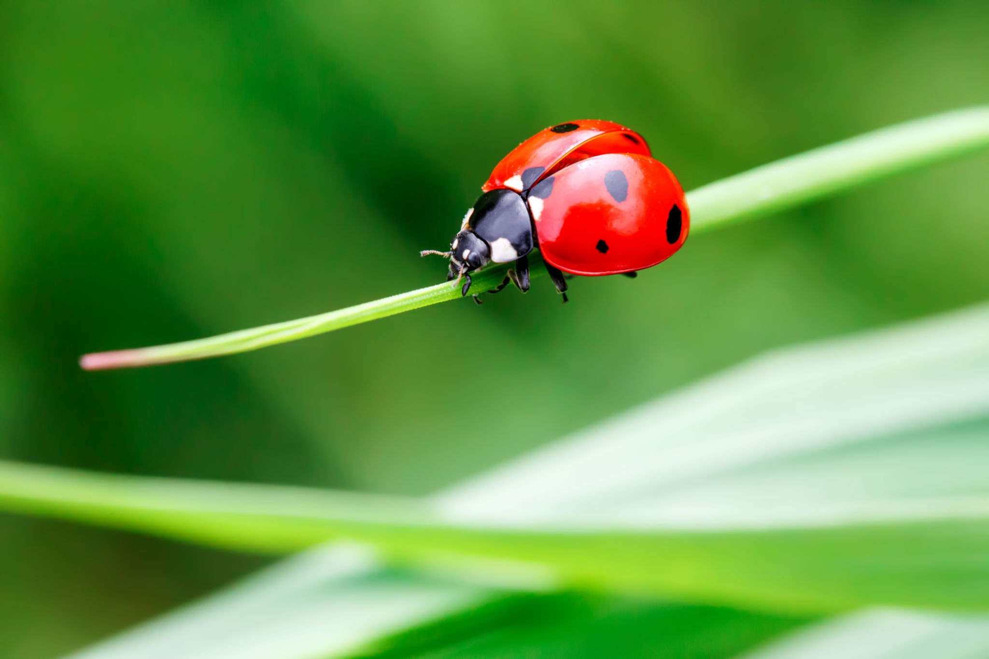
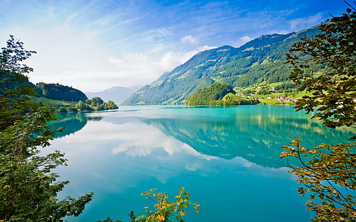

Slide 6
1.ploughing fields
2.catching fish
3.drying rice
4.unloading rice
5.feeding pigs
6.milking cows

Slide 7

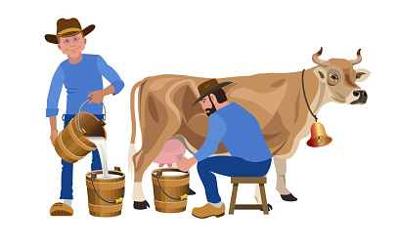
Unit
2
LIFE IN THE COUNTRYSIDE
LESSON 7: LOOKING BACK & PROJECT

Slide 8
REVISION
- words about life in the countryside
- the sounds /ə/ and /ɪ/ in words and sentences
- comparative forms of adverbs
Reading and talking about the village or town where someone lives

Slide 9
Choose the best answer
1.It rained (heavily) _____ today than it did yesterday. more heavily B. heavier C. more heavy D. heavilier 2.There is a huge cloud _____ as far as the eye can see. A. stretching B. vast C. surrounded D. cover 3.I speak French (fluently) ___now than I did last year. fluentlier B. more fluently C. most fluently D. more fluent 4.People in my village are really _____; they are always generous and friendly to visitors. A. funny B. hospitable C. bad D. well-trained 5.The development of cities destroys _____ areas of countryside. A.surrounded B.stretching C.vast D. destroyed | 6.You'll find your way around the village (easily) _____ if you have a good map. Easier B. more easy C.easilier D. more easily 7.The workers in our factory are very __ because they took a lot of good training courses. Kind B. well-trained C. Hospitable D. hard-working 8.The area around the village is famous for its _____ landscape. A. Boring B. picturesque C. Dull D. terrible 9.Every morning Nick gets up ten minutes (early) _____ than his sister. Earlier B. more earlier C.more early D. earliest 10.If you work (hard),you will do (well)in your exam. A. harder, weller B. more hardly, better C. harder, better D. hardlier, more well

Slide 10
Underline the mistakes in the sentences and correct them.
1. I run faster as my brother does.
2. People in the city seem to react quicklier to
changes than those in the country.
→ than
→ more quickly
3. We need to work more hardly, especially at exam time.
4. You must finish harvesting the rice the earlier this year than you did last year.
5. As they climbed more highly up the mountain, the air became cooler.
→ harder
→ earlier
→ higher

Slide 11
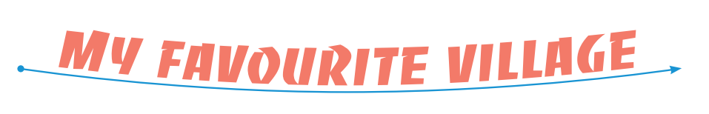
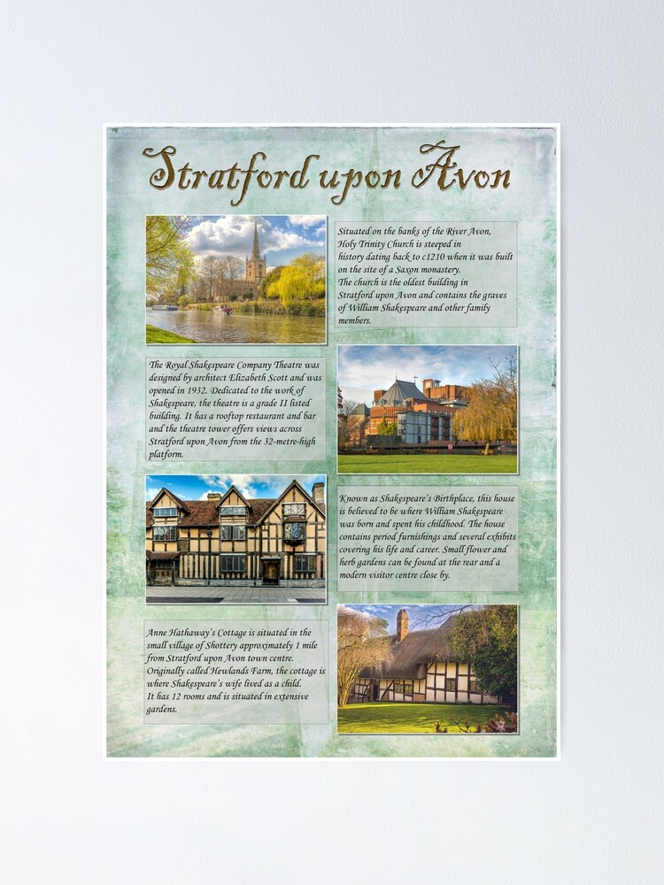
PROJECT
- Show your group’s presentation about a village that you would like to visit.
- Present your preparation to the class.

Slide 12
The criteria and scoring scale
Scoring scale | Content | Grammar | Fluency | Pronunciation | Creativity
2.0 pts
TOTAL

Slide 13

Website: hoclieu.vn
Fanpage: facebook.com/www.tienganhglobalsuccess.vn/

