Slide 2

ENGLISH 6
Unit 1:
MY NEW SCHOOL
SKILL 1

Slide 3
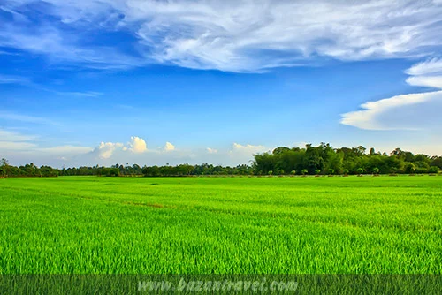

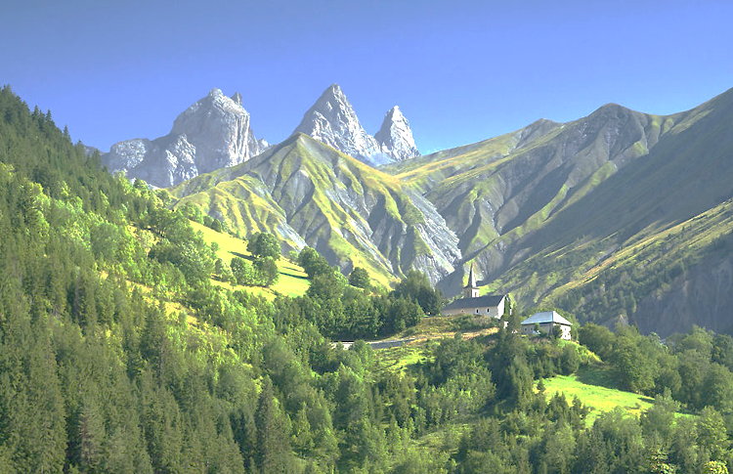
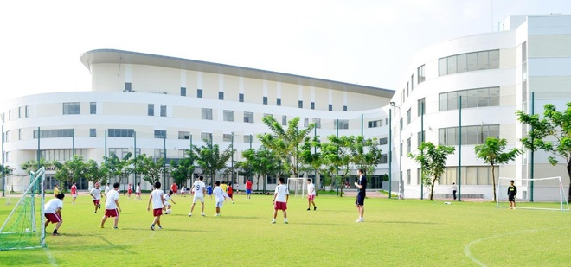
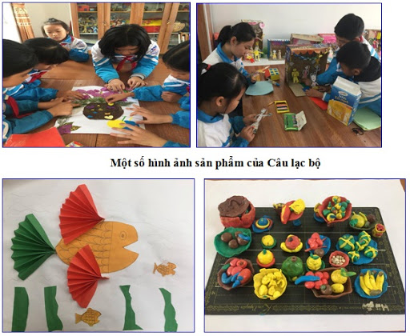
I. Reading
* Vocabulary:
- a green field:
đồng lúa
- a mountain:
ngọn núi
- A computer room:
phòng máy tính
- (to) join:
tham gia
- International (adj):
quốc tế
- An art club:
câu lạc bộ mĩ thuật
- A playground:
sân chơi

Slide 4


Reading

Slide 5


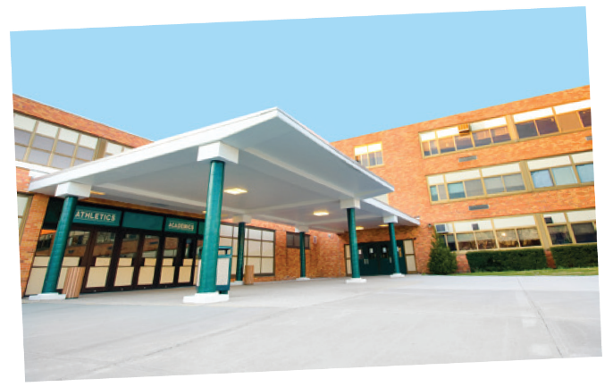
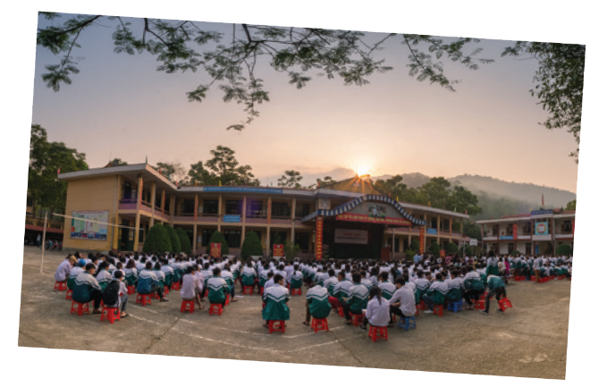

Look at the pictures and quickly read the passages. Match 1-3 with A-C.
1. Sunrise is a boarding school in Sydney. Students study and live there. About 1,200 boys and girls go to Sunrise. It has students from all over Australia. They study subjects like maths, science and English.
2. An Son is a lower secondary school in Bac Giang. It has only 8 classes. There are mountains and green fields around the school. There is a computer room and a library. There is also a school garden and a playground.
3. Dream is an international school. Here students learn English with English-speaking teachers. In the afternoon, they join many interesting clubs. They play sports and games. Some students do paintings in the art club.

Slide 6
Look at the pictures and quickly read the passages. Match 1-3 with A-C.
1. Sunrise
A. a school in Bac Giang
C. a boarding school in Sydney
2. An Son
B. an international school
A. a school in Bac Giang
3. Dream
C. a boarding school in Sydney
B. an international school

Slide 7

Read the passages again and complete these sentences.
Students live and study in a school. They only go home at weekends.
1.
boarding
Sunrise is a school in .
2.
Sydney
3.
There are
mountain and green fields
around An Son School.
around An Son School.
Dream school
has an art club.
4.
has an art club.
5.
At Dream School, students learn English with
English-speaking
.
teachers.

Slide 8

Answer the questions.
1
Which school is a boarding school?
Sunrise.
2
Where is An Son School?
It is in Bac Giang.
3
Is there a school garden in An Son School?
Yes. There is.
4
What do Dream School students do
in the afternoon?
They join many interesting clubs.

Slide 9
Speaking

Slide 10

Which school in 1 would you like to go to? Why or Why not? Complete the table.
Name of school | Reasons you like it | Reason you don’t like it
Then discuss your choice with a friend.
Example:
A: Which school would you like to go to?
B: I’d like to go to Dream School.
A: Why?
B: Because I’d like to paint in the art club.

Slide 11
Name of school | Reasons you like it | Reasons you don't like it
Sunrise | It is a boarding school | Not have school garden
An Son | It has school garden. It has mountains and green fields. | It's small
Dream | It is modern and it has many interesting clubs | - It is expensive

Slide 12
PHẦN VIẾT BÀI
1/P12 Look at …
1. C 2. A 3. B
2/P12 Read the passage ….
1. boarding 2. Sydney 3. mountain and green fields
4. Dream school 5. English-speaking teachers.
3/P12 Answer the questions:
1. Sunrise
2. It is in Bac Giang.
3. Yes. There is. 4. They join many interesting clubs.
- a green field:
đồng lúa
- a mountain:
ngọn núi
- A computer room:
phòng máy tính
- (to) join:
tham gia
- International (a):
quốc tế
- An art club:
câu lạc bộ mĩ thuật
- A playground:
sân chơi

Slide 13


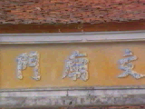
HOMEWORK
- Learn the new words by heart.
- Read the passages again.
- Prepare for the next lesson.
(Unit 1-Skills 2)
+

Slide 14







