Slide 1


Warmly welcome to our class!

Slide 2
PRESENT or FUTURE ?

Slide 3
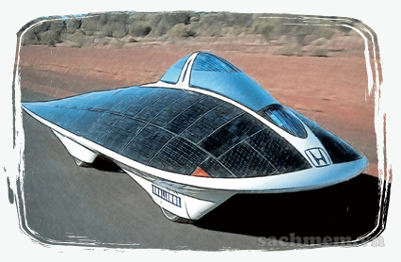
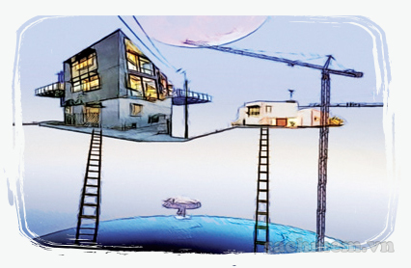
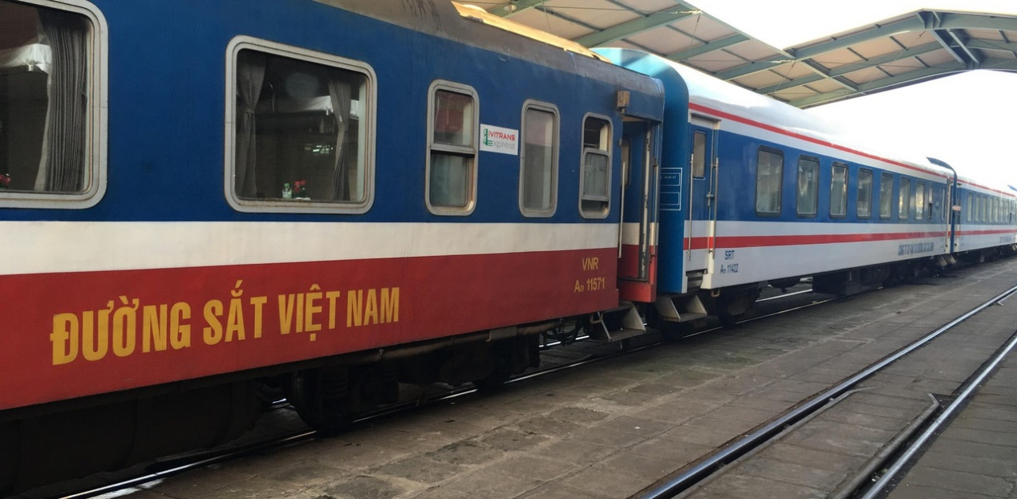
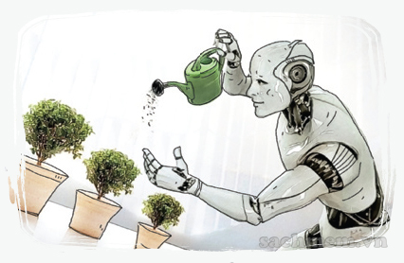

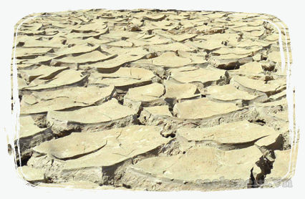

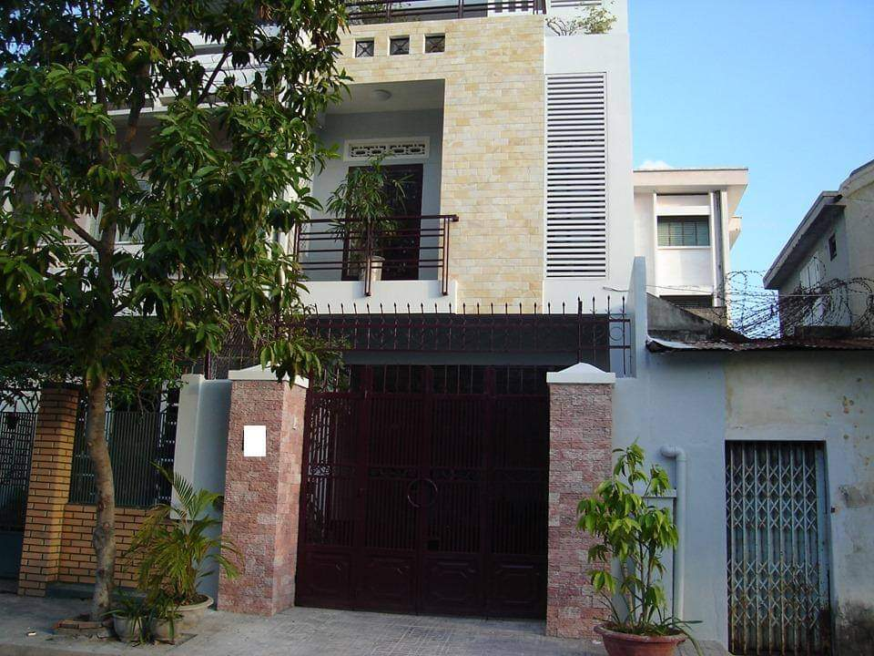
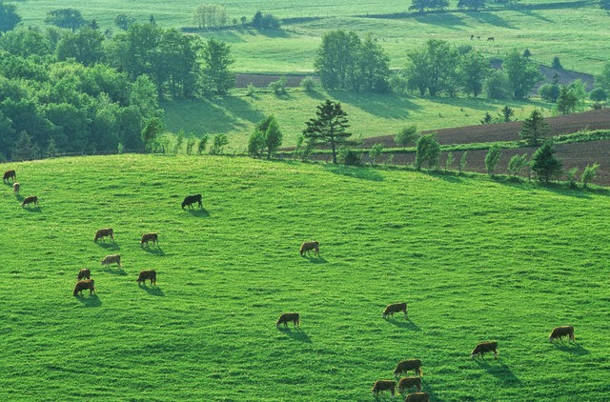
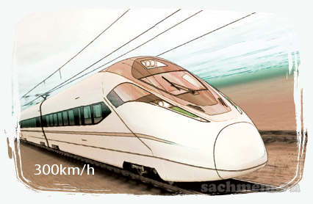

Slide 4
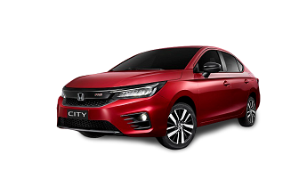

PRESENT

Slide 5
Period 66
Unit 11: CHANGING ROLES IN SOCIETY
Lesson 1: GETTING STARTED
Into the future
Wednesday, February 15th 2023

Slide 6
THIS UNIT INCLUDES:
VOCABULARY
The changing roles in society.
PRONUNCIATION
Agreeing and disagreeing tones.
GRAMMAR
Future passive review.
Non-defining relative clauses.
SKILLS
Reading for specific information about the changing roles of women in society and its effects.
Talking about roles in the future.
Listening for specific information about the changes that women in Kenya are going through.
Writing about the roles of teenagers in the future.
COMMUNICATION
Describing the changing roles of schools.

Slide 7

Lesson 1: GETTING STARTED
Into the future
Beyond 2030 forum

Slide 8
LISTEN AND READ
Task 1 ( Act 2/p60): Listen and read, underline these following words or phrases. Then tick the correct explanation for each one.
- Facilitator
- Information provider
- Breadwinner
- Application
- Externally employed
- Drastically

Slide 9
Words | Explanations
1. facilitator | A. a person who provides facilities like the projector, the interactive whiteboard. B. a person who helps somebody to do something more easily by discussing and giving guidance.
2. information provider | A. a person who gathers information and uses it to teach others. B. a machine which sells newspapers.
3. breadwinner | A. a person who makes bread to feed the family. B. a person who supports the family with the money he/she earns.
4. application | A. an official request for something. B. a way in which something can be used for a particular purpose.
5. externally employed | A. stay at home and do housework. B. work outside the home.
6. drastically | A. An adverb to the greatest degree. B. An adverb to the lowest degree.

Slide 10




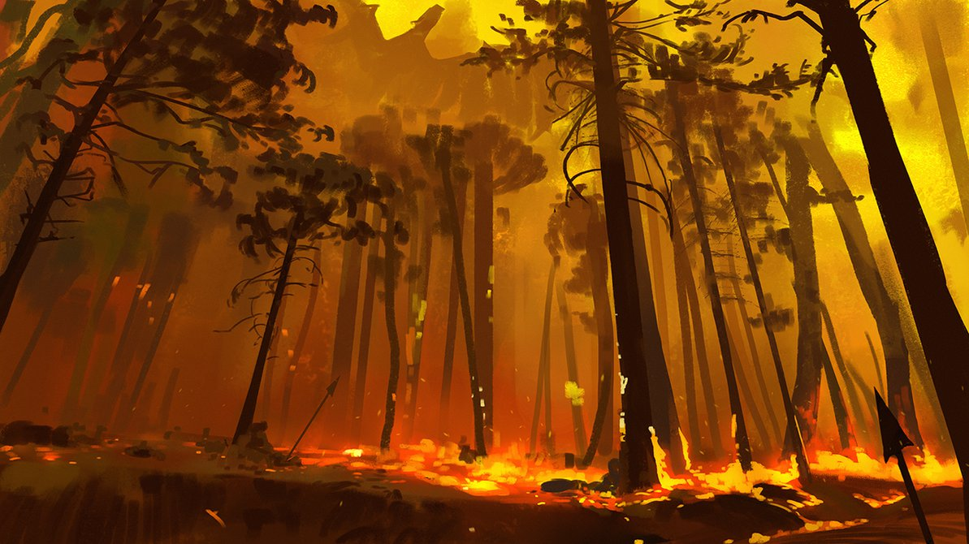




LET’S SAVE THE JUNGLE!

Slide 11


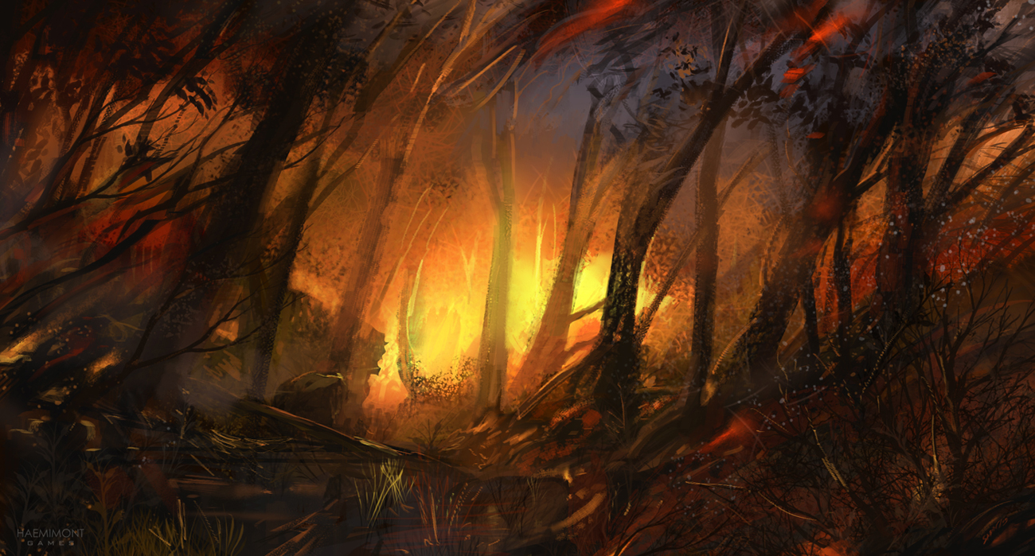



3. BREADWINNER
A. a person who makes bread to feed the family.
B. a person who supports the family with the money he/she earns.

Slide 12


1. FACILITATOR
A. a person who provides facilities like the projector, the interactive whiteboard.
B. a person who helps somebody to do something more easily by discussing and giving guidance.

Slide 13
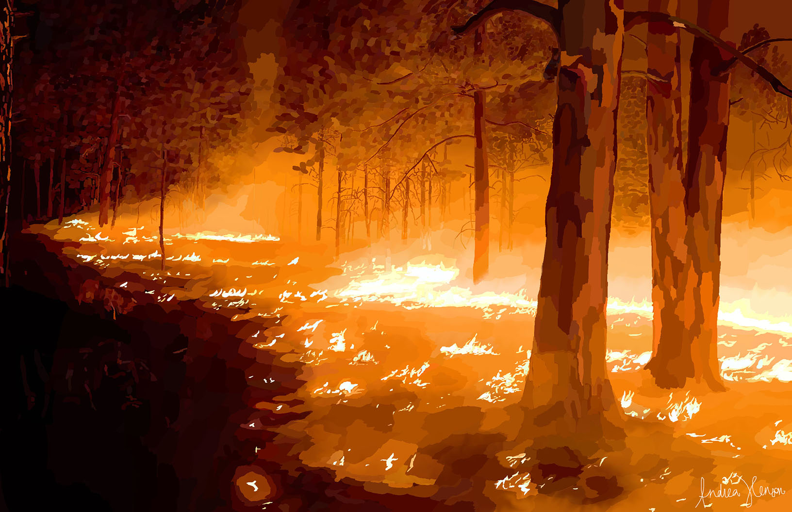

2. INFORMATION PROVIDER
A. a person who gathers information and uses it to teach others.
B. a machine which sells newspapers.

Slide 14
6. DRASTICALLY
A. An adverb to the greatest degree.
B. An adverb to the lowest degree.

Slide 15
4. APPLICATION
A. an official request for something.
B. a way in which something can be used for a particular purpose.

Slide 16
5. EXTERNALLY EMPLOYED
A. stay at home and do housework.
B. work outside the home.

Slide 17
2. Task 2 (Act 1a/ p60): Tick the person who has this idea.
 | Idea | Phong | Nguyen | Mai
1 | Students will learn from a real workplace.
2 | Students love seeing themselves as part of the process.
3 | The teacher will act more like a facilitator.
4 | The father will not necessarily be the breadwinner of the family.
5 | With the in involvement of fathers in the home, they will develop a closer bond with their chidren.

Slide 18
LET’S PLAY KHOOT!

Slide 19
 | Idea | Phong | Nguyen | Mai
1 | Students will learn from a real workplace.
2 | Students love seeing themselves as part of the process.
3 | The teacher will act more like a facilitator.
4 | The father will not necessarily be the breadwinner of the family.
5 | With the in involvement of fathers in the home, they will develop a closer bond with their chidren.
√
√
√
√
√

Slide 20
3. Task 2 (Act 1c/ p60):Find the meaning of the phrases and sentences.
1. Beyond 2030.
2. Vision of the future .
3. It's work, paid or not, isn't it?
4. I love every moment, I spend with him.
After the year 2030.
Ideas/ views about what life will be in the future.
Both housework and paid work are worthy of respect.
I love being with my father

Slide 21
4. Task 3 (Act 1b/ p60): Answer the questions
1. What is the purpose of the Beyond 2030 forum?
It's for people to share their vision of the future.
2. Who has been invited to the discussion?
- Some students from Oak Tree School in Happy Valley.
3. What does Phong think about classes in the future?
- He thinks that learning will also take place outside school.
4. Why might students like having classes outside school?
- It will give them a sense of participation and of being part of the process.
5. Will the father of the future always stay at home?
- No, he won't. He may still go to work.
6. Does Nguyen feel negative about a man doing housework?
- No, he doesn't.
E:\cattaleya\2022 - 2023\GRADE 9\GVG\vòng quay may mắn.pptx

Slide 22
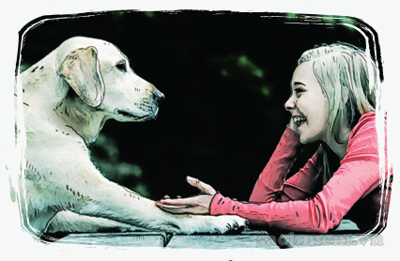
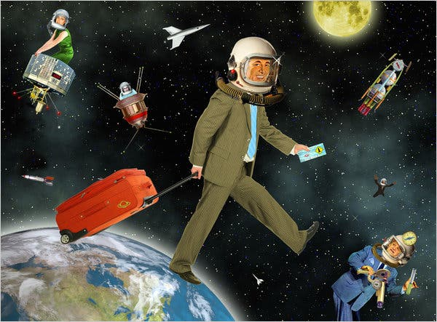
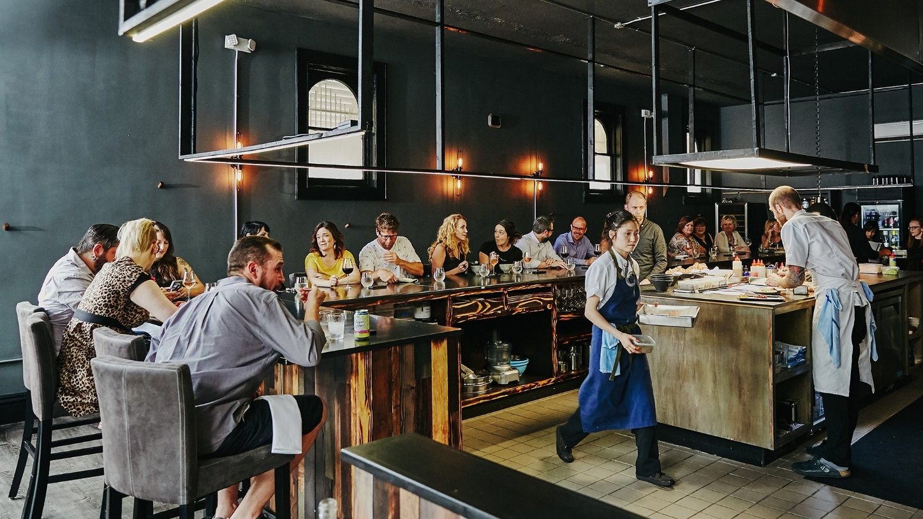
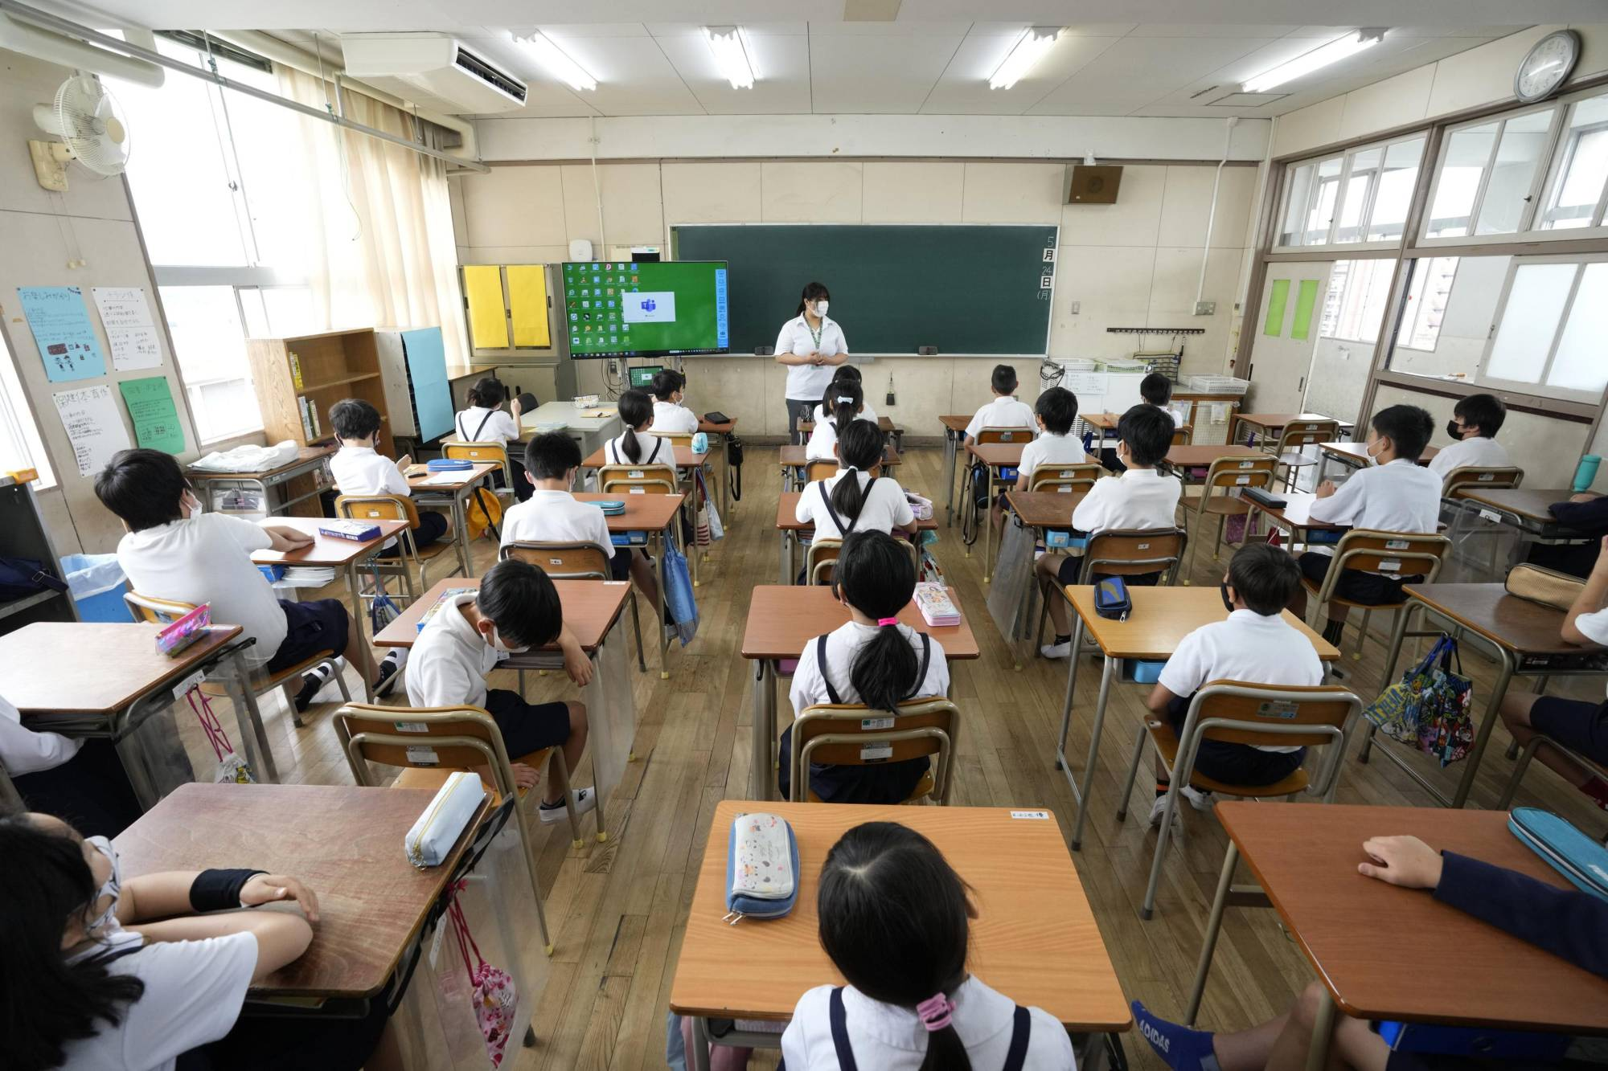

Slide 23
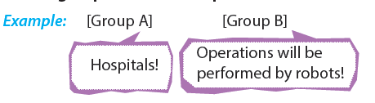
GAME
5. Task 5:

Slide 25
TODAY YOU’VE LEARNT:
VOCABULARY
The changing roles in society.
SKILLS
Listening and Reading for specific information about the changing roles of fathers and teachers in the future.
Sharing your vision of the life in the future.

Slide 26
HOME ASSIGNMENTS:
- Rewrite Task 1c into your notebooks.
Talk about your own vision of our life in the future.

Slide 27



