Slide 1

UNIT 5 : WONDERS OF VIET NAM
A CLOSER LOOK 2

Slide 2
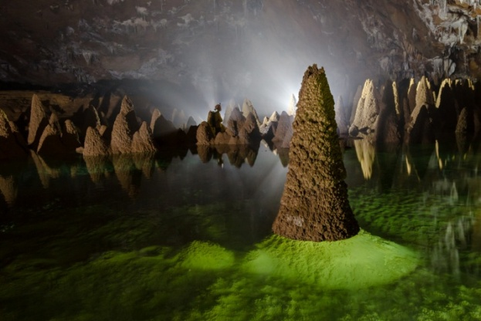


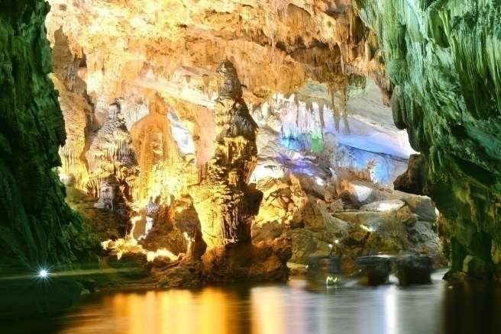

Slide 3
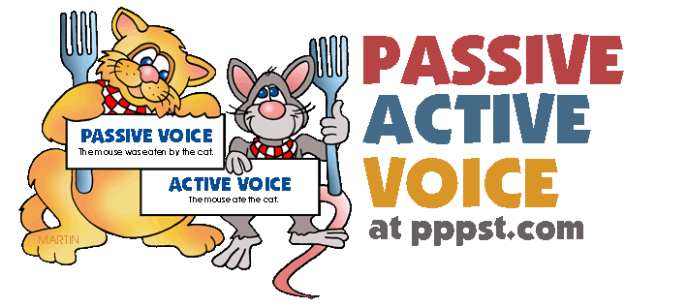
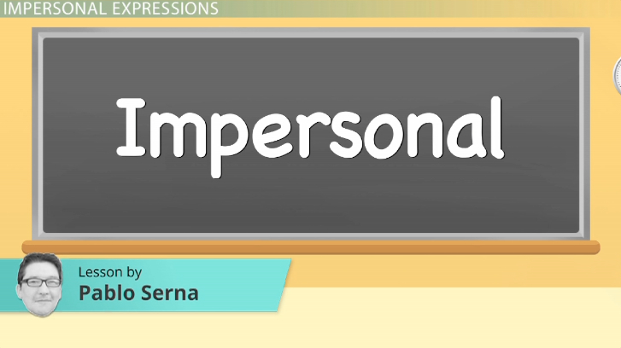
Grammar
The impersonal passive

Slide 4
1a. Read part of the conversation. Pay attention to the underlined part.
Veronica: Great thanks. What’s the best way to get around?
Mi: It’s probably best to use rickshaws. It’s said that they’re quicker and cheaper than taxis.
Form: It + to be + past participle + that + S + V
Can you find another example of the impersonal passive in the conversation?
It is said that this complex of monuments is one of the wonders of Viet Nam.

Slide 5
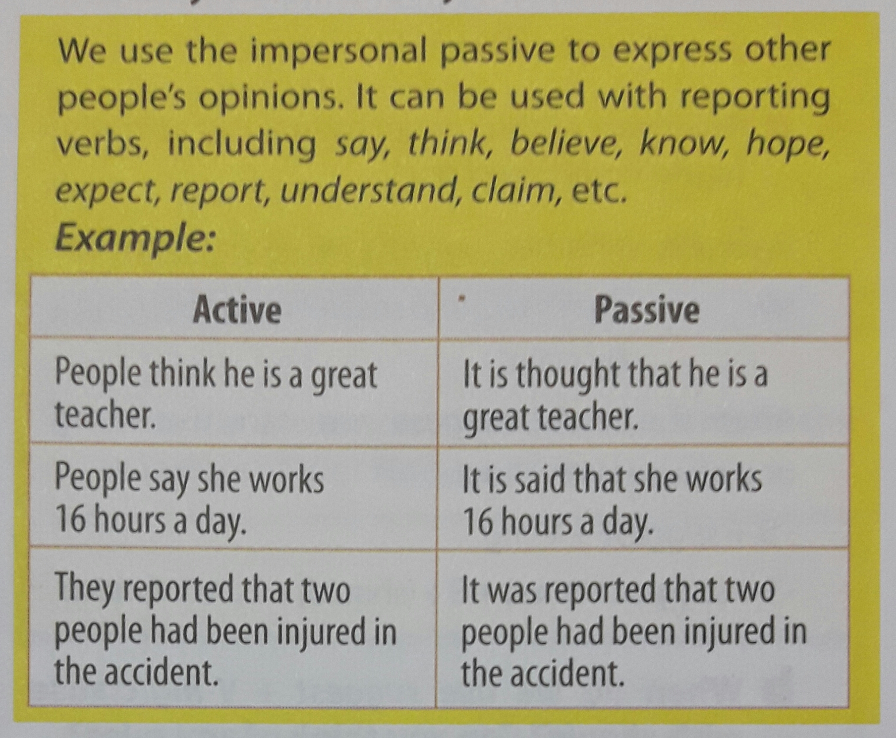
a. When do we use the impersonal passive? Can you think of any rules?

Slide 6
2. Complete the sentences using the correct passive form of the verbs in brackets. The first one has been completed for you.
It is known
1. (know) ................... that ha Long Bay was recognised as a World Heritage Site by UNESCO in 1994.
It is believed
2. (believe) ...................... the best time to visit the complex of Hue Monuments is in April.
3. (report) ...................... thousands of visitors come to enjoy breathtaking views of Ha Long Bay every year.
It is reported

Slide 7
It is claimed
4. (claim) ...................... Phong Nha – Ke Bang can be compared to a huge geological museum.
It is understood
5. (understand) ........................... Binh Dai Fortress was designed to control movement on the perfumed River.
It is expected
6. (expect) ........................ The government will have measures to protect and preserve our man-made wonders.

Slide 8
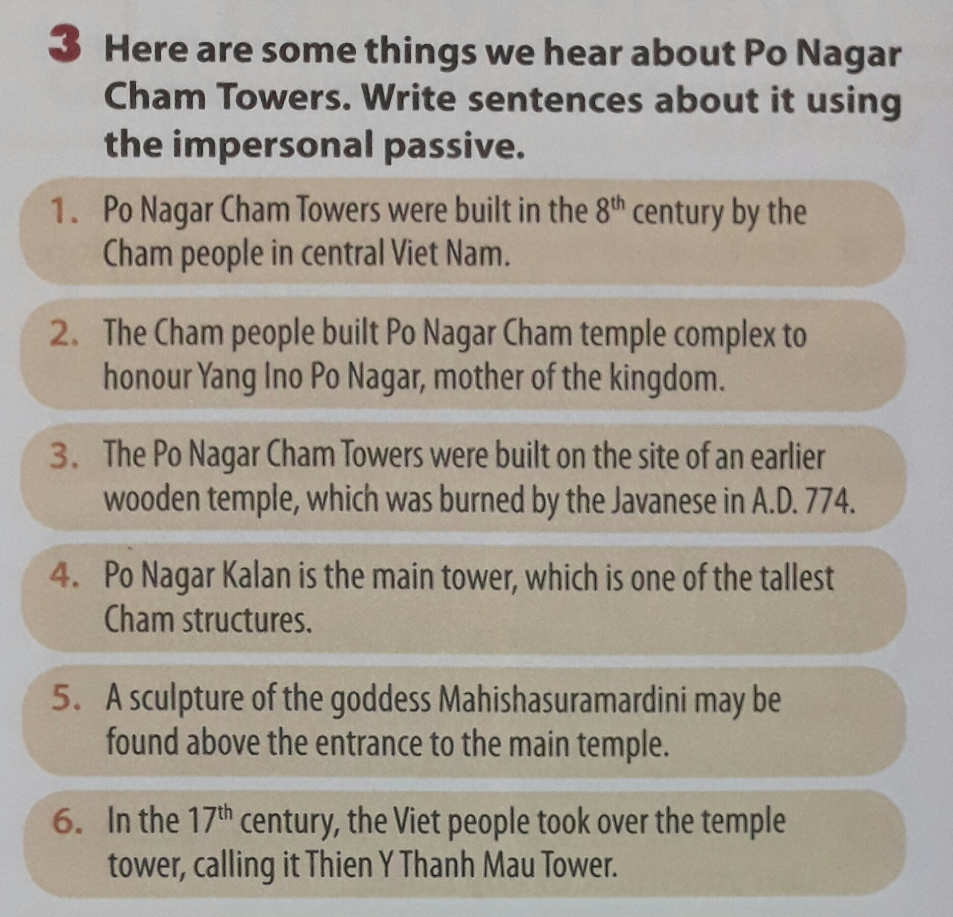
3. Here are some things we hear about Po Nagar Cham Towers. Write sentences about it using the impersonal passive.

Slide 9
-> It is claimed that Po Nagar Cham Towers were built in the 8th century by the Cham people in central Viet Nam.

Slide 10
-> It is said that the Cham people built Po Nagar Cham temple complex to honour Yang Ino Po Nagar mother of the kingdom.

Slide 11
-> It is believed that the Po Nagar Cham Towers were built on the site of an earlier wooden temple which was burned by the Javanese in A.D. 774.

Slide 12
-> It is understood that the Po Nagar Kalan is the main tower, which is one of the tallest Cham structures.

Slide 13
-> It is known that a sculpture of the goddess Mahishasuramardini may be found above the entrance to the main temple.

Slide 14
-> It is thought that in the 17th century, the Viet people took over the temple tower, calling it Thien Y Thanh Mau Tower.

Slide 15
suggest + V-ing/clause with should
4 a. Read part of the conversation. Pay attention to the underlined part.
Veronica: My father suggests we should go by air.
Mi: That’s too expensive! I suggest going by train.
After the verb suggest we can use V-ing or a clause with should:
• S + suggest + V-ing
• S + suggest + (that) + S + (should) + bare infinitive

Slide 16
b. When do we use suggest + V-ing/clause with should? Can you think of any rules?
We use suggest + V-ing/clause with should to tell someone our ideas about what they should do where they should go, etc.
Example:
I suggest that we should go out to eat.
I suggested going in my car.

Slide 17
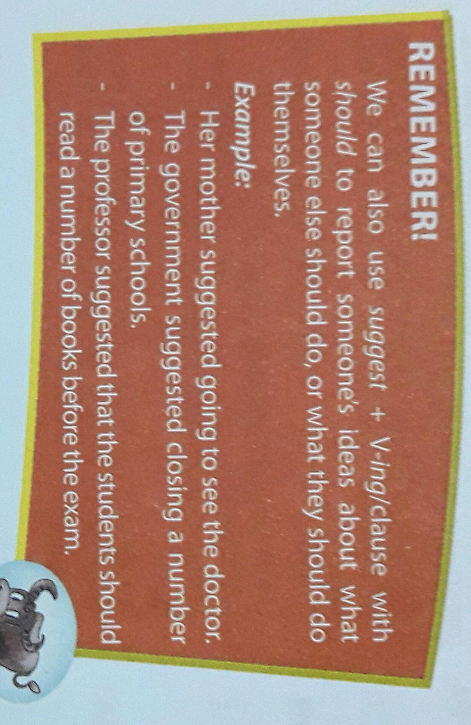

Slide 18
5. Write answers to the following questions using suggest + V-ing/clause with should and the prompts in brackets. Then practise them with your partner. The first one has been completed for you.
1. A: Have you thought of recycling?
B: I suggest recycling things such as bags cans, and bottles (recycle things such as bags, cans, and bottles)

Slide 19
2. A: What should we do to protect and preserve our man-made wonders?
B: I suggest ...........................................
(the government/ limit the number of visitors/ every day.)
the government should
limit/ limiting the number of visitors every day.
3. A: What should we do to conserve forests?
B: .....................................................................
(control/ deforestation)
I suggest the government should control/ controlling the deforestation.

Slide 20
4. A: What should we do to protect valuable things in pagodas and temples?
B: ...................................................................
(put/ these valuable things/ in high-security places).
I suggest we should put/ putting these valuable things in high-security places.
5. A: What should we do to restore our aging man-made wonders?
B: ....................................................................
(raise/ money)
I suggest we should raise/ raising some money.

Slide 21
6. A: What should we do to prevent global warming?
B: ...................................................................
(reduce/ smoke/ exhaust fumes).
I suggest we should reduce/ reducing smoke and exhaust fumes.

Slide 22
6 a. Work in pairs. Tell your partners what they should do in the following situations using suggest + V-ing/ clause with should.
• Your bicycle has been stolen.
• You have lost your way in the city center.
• You have left your workbook at home.
• Your laptop isn’t working.
• You have forgotten to bring your wallet when going shopping.

Slide 23
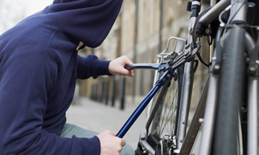
Example:
A: Oh no! My bicycle has been stolen. What should I do now?
B: I suggest calling the police./ I suggest you should call the police.

Slide 24
b. Now report your partner’s idea to another partner.
Example:
I asked B what I should do when my bicycle had been stolen. He suggested calling the police/ should call the police.

Slide 25


-Make 5 sentences with impersonal pasive.

