Slide 1
Unit 3: My friends
Lesson 5: Skills 1
Teacher: Vu Nguyen Thi Phuong Thao

Slide 2
OBJECTIVES
READING
SPEAKING
Read for specific information about friends and summer camps
Talk about friends and summer camps

Slide 3
01
READING

Slide 4
VOCABULARY

Slide 5
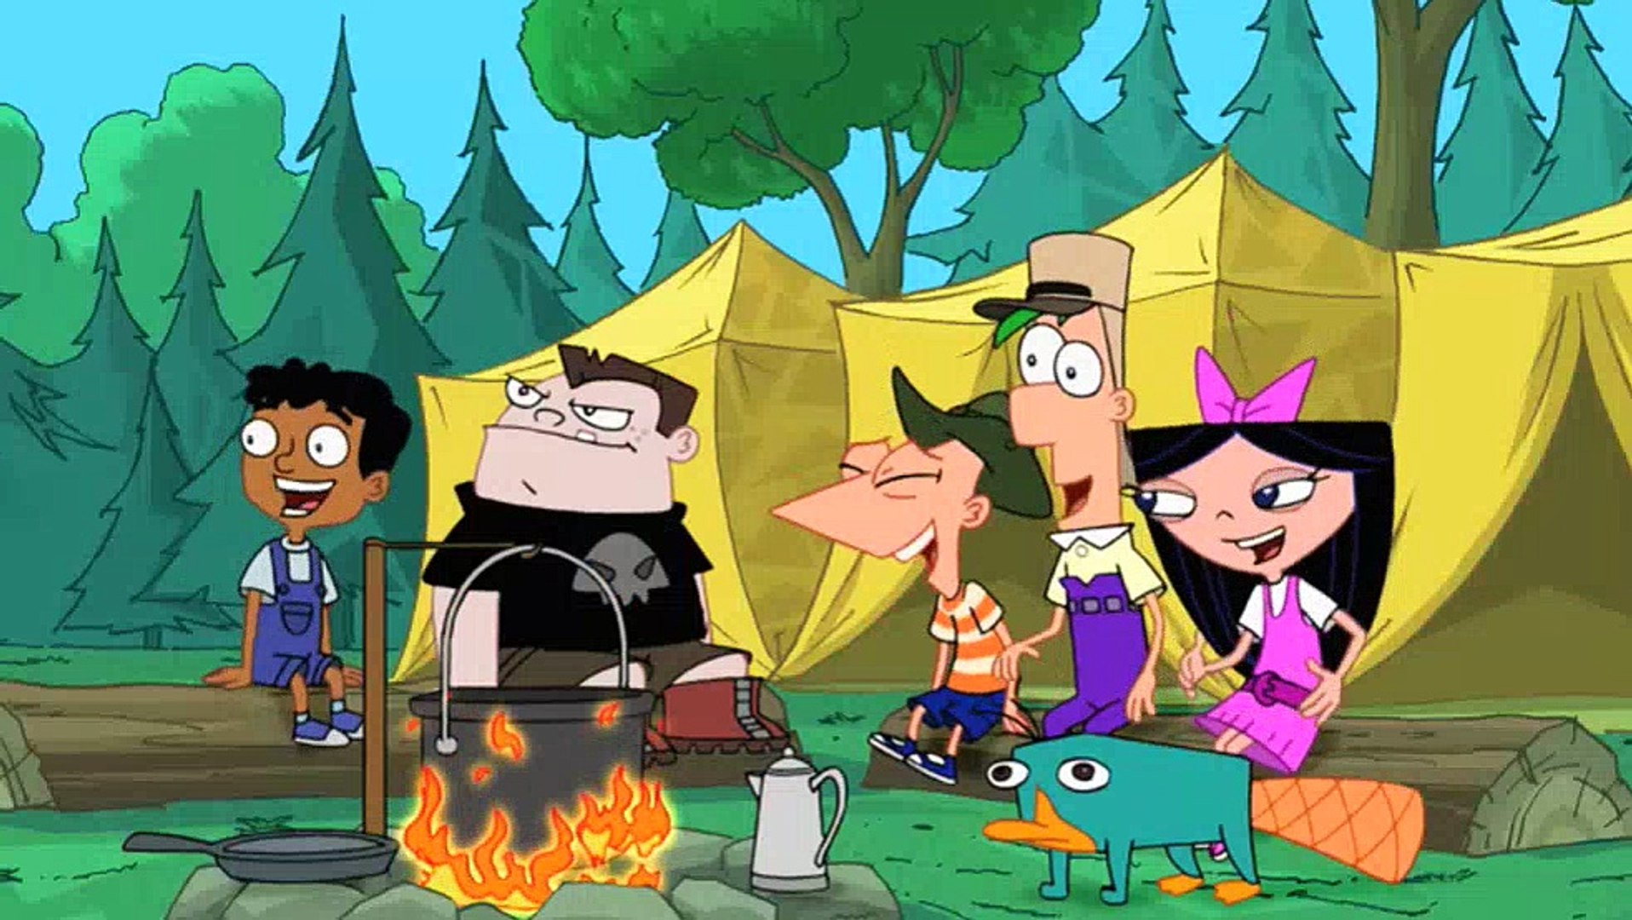
camp
(n)
/kæmp/
Trại, khu cắm trại

Slide 6
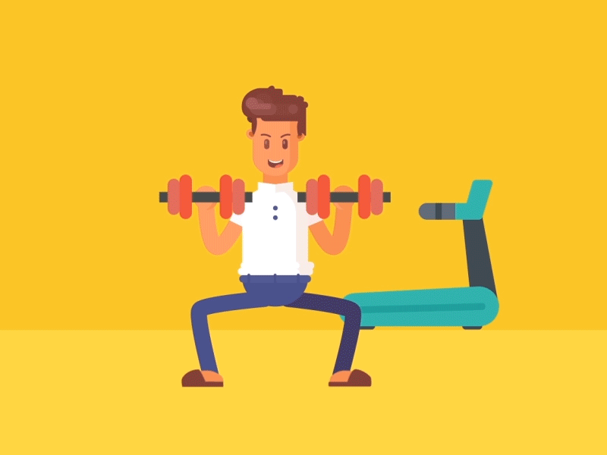
sporty
(adj)
/ˈspɔːrti/
ham thể thao

Slide 7
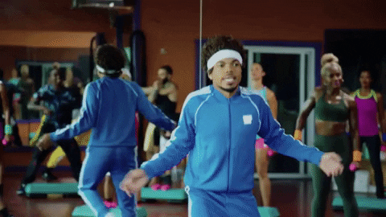
active
(adj)
/ˈæktɪv/
tích cực, nhanh nhẹn

Slide 8
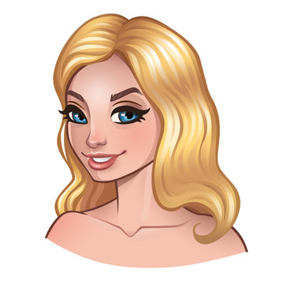
blonde (hair)
(adj)
/blɑːnd/
(mái tóc) vàng hoe

Slide 9
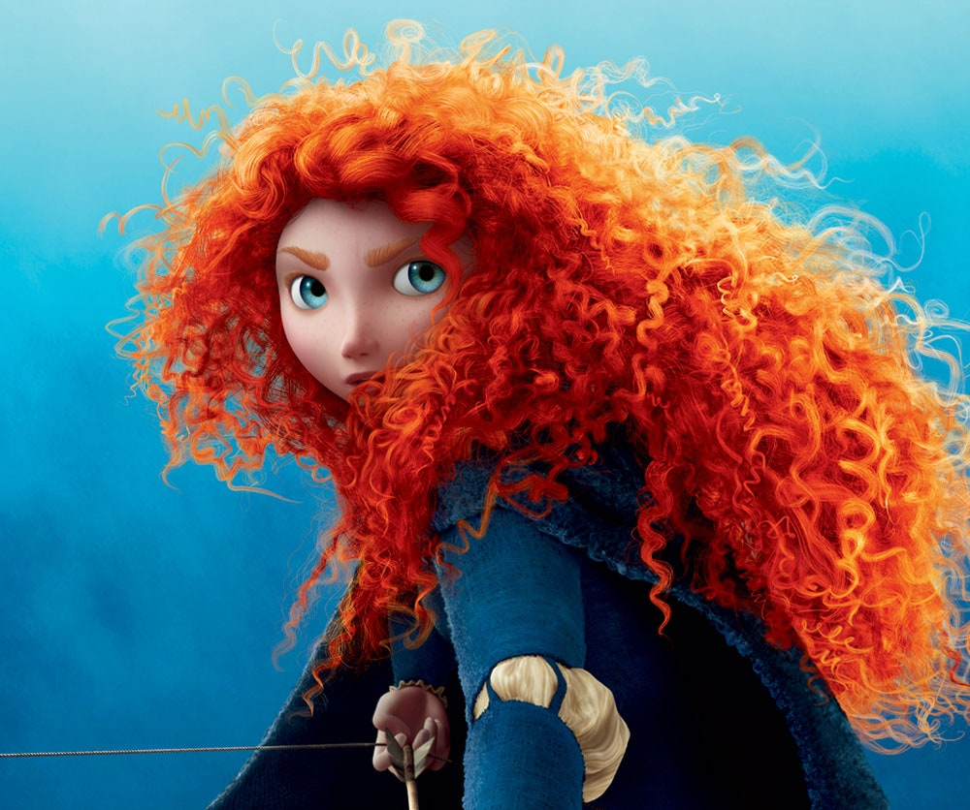
curly (hair)
(adj)
/ˈkɜːrli/
(mái tóc) xoăn

Slide 10
Vocabulary
camp (n) | /kæmp/ | Trại, khu cắm trại
sporty (adj) | /ˈspɔːrti/ | Ham thể thao
active (adj) | /ˈæktɪv/ | Tích cực, nhanh nhẹn
blonde (hair) (adj) | /blɑːnd/ | (Mái tóc) vàng hoe
curly (hair) (adj) | /ˈkɜːrli/ | (Mái tóc) xoăn

Slide 11
curly
camp
blonde
sporty
active

Slide 12
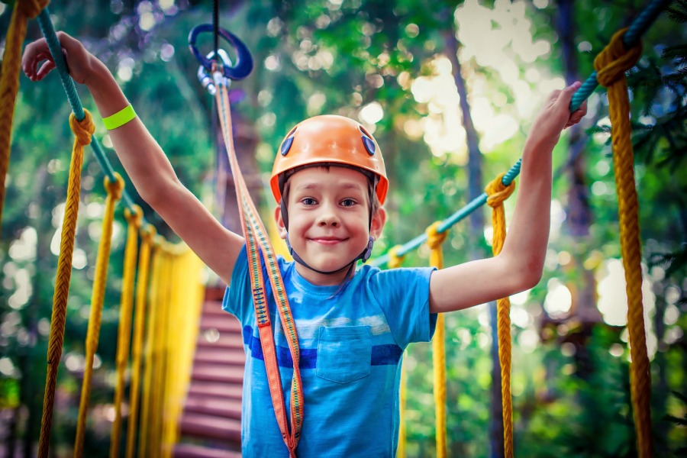
This is Nam.
This summer vacation, he is going to a new place.
Can you guess the place?

Slide 13
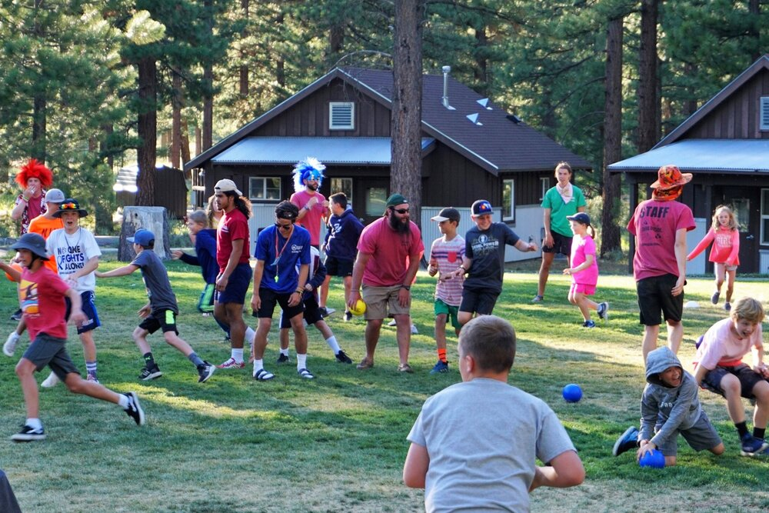
Summer camp
SHOW

Slide 14

The advertisement of the Summer Camp
1. Who is the Superb Summer Camp for?
Kids between 10 and 15 years old
2. What can people do at this summer camp?
Play sports and games, draw pictures, play music, learn life skills, go on field trips.

Slide 15
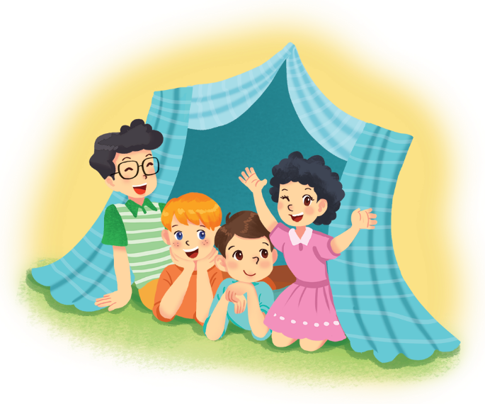
At the summer camp, Nam writes an email.
To: My parents <parents.nguyen@webmail.com>
Subject: My first day at the superb summer camp
Hi Mum and dad,
Here I am at the Superb Summer Camp. Mr Black asked us to write emails in English! Wow, everything here is in English! I have some new friends: Jimmy, Phong, and Nhung. They’re in the photo. Jimmy has blonde hair and blue eyes. He’s clever and creative. He likes taking photos. Phong is the tall boy. He’s sporty and plays basketball very well. Nhung has curly black hair. She’s kind. She shared her lunch with me today.
We’re having fun. Jimmy’s taking photos of me. Phong’s reading a comic book, and Nhung’s playing the violin. I must go now.
Please write soon.
Love,
Nam

Slide 16

Ex 2. Read and write T (True) or F (False). Correct the false statements.
Example:
Name is writing to his teacher
F
To: My parents <parents.nguyen@webmail.com>
My parents
Subject: My first day at the superb summer camp
→ Nam is writing to his parents.
Hi Mum and dad,
Here I am at the Superb Summer Camp. Mr Black asked us to write emails in English! Wow, everything here is in English! I have some new friends: Jimmy, Phong, and Nhung. They’re in the photo. Jimmy has blonde hair and blue eyes. He’s clever and creative. He likes taking photos. Phong is the tall boy. He’s sporty and plays basketball very well. Nhung has curly black hair. She’s kind. She shared her lunch with me today.
We’re having fun. Jimmy’s taking photos of me. Phong’s reading a comic book, and Nhung’s playing the violin. I must go now.
Please write soon.
Love,
Nam
1. The children can speak Vietnamese at the camp.
2. Nam has four new friends.
3. Phong likes taking photos.
4. Nam thinks Nhung is kind.
5. Phong is tall and sporty.

Slide 17
Let’s check!
1. The children can speak Vietnamese at the camp.
F
To: My parents <parents.nguyen@webmail.com>
Subject: My first day at the superb summer camp
Hi Mum and dad,
Here I am at the Superb Summer Camp. Mr Black asked us to write emails in English! Wow, everything here is in English! I have some new friends: Jimmy, Phong, and Nhung. They’re in the photo. Jimmy has blonde hair and blue eyes. He’s clever and creative. He likes taking photos. Phong is the tall boy. He’s sporty and plays basketball very well. Nhung has curly black hair. She’s kind. She shared her lunch with me today.
We’re having fun. Jimmy’s taking photos of me. Phong’s reading a comic book, and Nhung’s playing the violin. I must go now.
Please write soon.
Love,
Nam
→ The children can only speak English at the camp.
everything here is in
English!

Slide 18
Let’s check!
To: My parents <parents.nguyen@webmail.com>
2. Nam has four new friends.
F
Subject: My first day at the superb summer camp
Hi Mum and dad,
Here I am at the Superb Summer Camp. Mr Black asked us to write emails in English! Wow, everything here is in English! I have some new friends: Jimmy, Phong, and Nhung. They’re in the photo. Jimmy has blonde hair and blue eyes. He’s clever and creative. He likes taking photos. Phong is the tall boy. He’s sporty and plays basketball very well. Nhung has curly black hair. She’s kind. She shared her lunch with me today.
We’re having fun. Jimmy’s taking photos of me. Phong’s reading a comic book, and Nhung’s playing the violin. I must go now.
Please write soon.
Love,
Nam
→ Nam has three new friends.
I have some new friends : Jimmy, Phong, and
Nhung.

Slide 19
Let’s check!
To: My parents <parents.nguyen@webmail.com>
3. Phong likes taking photos.
F
Subject: My first day at the superb summer camp
Hi Mum and dad,
Here I am at the Superb Summer Camp. Mr Black asked us to write emails in English! Wow, everything here is in English! I have some new friends: Jimmy, Phong, and Nhung. They’re in the photo. Jimmy has blonde hair and blue eyes. He’s clever and creative. He likes taking photos. Phong is the tall boy. He’s sporty and plays basketball very well. Nhung has curly black hair. She’s kind. She shared her lunch with me today.
We’re having fun. Jimmy’s taking photos of me. Phong’s reading a comic book, and Nhung’s playing the violin. I must go now.
Please write soon.
Love,
Nam
→ Jimmy likes taking photos.
Jimmy
He likes taking
photos.

Slide 20
Let’s check!
To: My parents <parents.nguyen@webmail.com>
T
4. Nam thinks Nhung is kind.
Subject: My first day at the superb summer camp
Hi Mum and dad,
Here I am at the Superb Summer Camp. Mr Black asked us to write emails in English! Wow, everything here is in English! I have some new friends: Jimmy, Phong, and Nhung. They’re in the photo. Jimmy has blonde hair and blue eyes. He’s clever and creative. He likes taking photos. Phong is the tall boy. He’s sporty and plays basketball very well. Nhung has curly black hair. She’s kind. She shared her lunch with me today.
We’re having fun. Jimmy’s taking photos of me. Phong’s reading a comic book, and Nhung’s playing the violin. I must go now.
Please write soon.
Love,
Nam
Nhung
She’s
kind.

Slide 21
Let’s check!
To: My parents <parents.nguyen@webmail.com>
T
5. Phong is tall and sporty.
Subject: My first day at the superb summer camp
Hi Mum and dad,
Here I am at the Superb Summer Camp. Mr Black asked us to write emails in English! Wow, everything here is in English! I have some new friends: Jimmy, Phong, and Nhung. They’re in the photo. Jimmy has blonde hair and blue eyes. He’s clever and creative. He likes taking photos. Phong is the tall boy. He’s sporty and plays basketball very well. Nhung has curly black hair. She’s kind. She shared her lunch with me today.
We’re having fun. Jimmy’s taking photos of me. Phong’s reading a comic book, and Nhung’s playing the violin. I must go now.
Please write soon.
Love,
Nam
Phong
tall
He’s sporty

Slide 22
Let’s check!
Statements | True (T) | False (F)
1. The children can speak Vietnamese at the camp. → The children can only speak English at the camp.
2. Nam has four new friends. → Nam has three new friends.
3. Phong likes taking photos. → Jimmy likes taking photos.
4. Nam thinks Nhung is kind.
5. Phong is tall and sporty.
F
F
F
T
T

Slide 23
02
SPEAKING

Slide 24
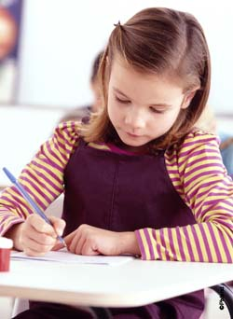
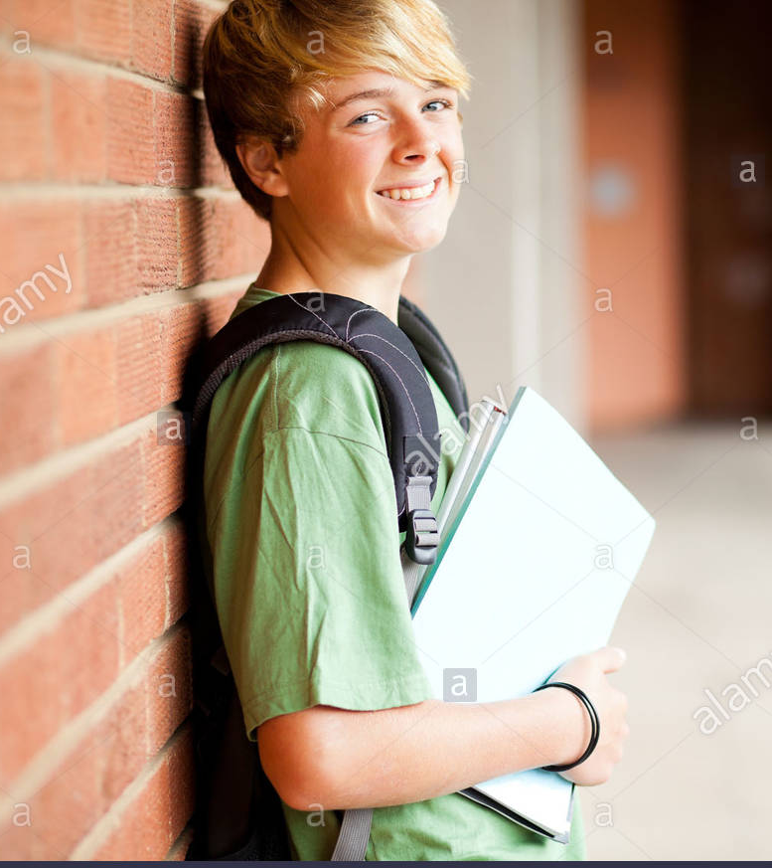
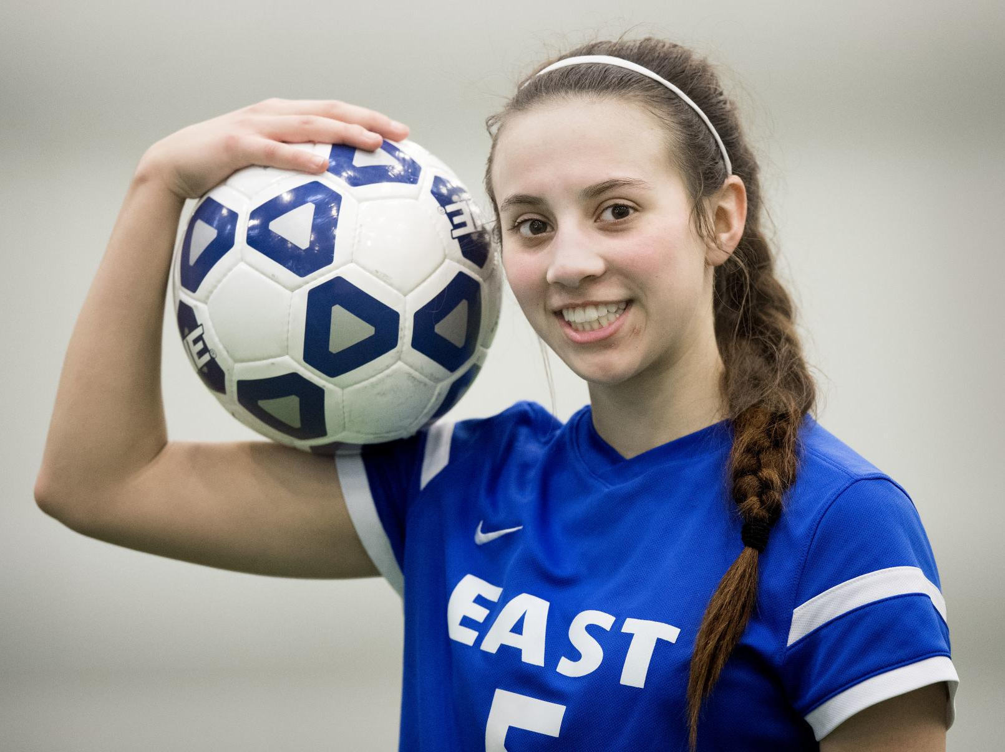
Let’s meet three friends.
3. Is the Superb Summer Camp suitable for them? Read and decide.

x

1. Mi is 12 years old. She likes drawing and writing stories. She's good at English. She's creative and friendly.
1. Mi is 12 years old. She likes drawing and writing stories. She's good at English. She's creative and friendly.
2. An is 16 years old. He doesn't know English. He's funny and kind.
2. An is 16 years old. He doesn't know English. He's funny and kind.
3. Vy is 14 years old. She likes playing sports. Her English isn't very good. She's clever, but she isn't active
3. Vy is 14 years old. She likes playing sports. Her English isn't very good. She's clever, but she isn't active

Slide 25
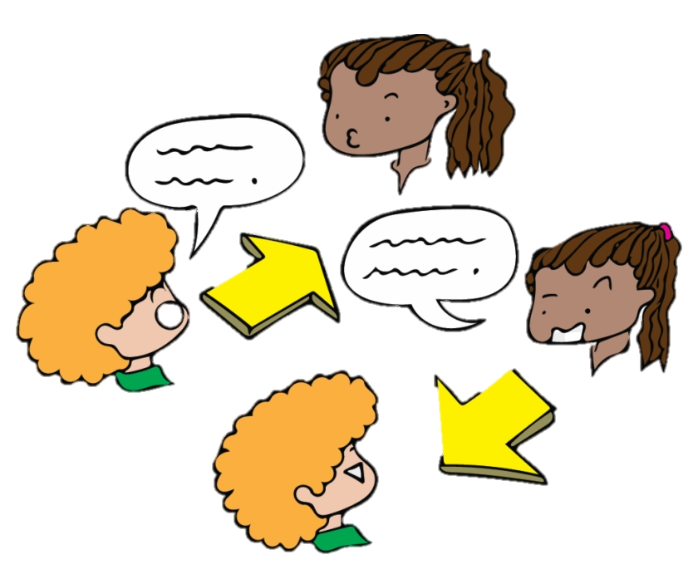
4. Work in pairs. Ask and answer.
Example:
A: Do you want to go to this kind of camp? Why/ Why not?
B: I want to go to this camp because I can speak English there.

Slide 26
What have you learnt today?

Slide 27
Homework
- Ôn tập lại từ mới đã học.
- Làm bài tập 1, bài tập 2 (trang 19), và bài tập 3 (trang 20) trong Sách bài tập.

Slide 28
Thanks!
Do you have any questions?

