Slide 1
GUESSING PICTURES

Slide 2

INSTRUCTION
+ There will be 5 pictures, which are corresponding to 5 activities. Each picture is hidden by some puzzles.
+ Each team will have to guess the activity in each picture in the fastest way and get 1 point for that turn.
+ The team having more points will be the winner.

Slide 3

READING

Slide 4
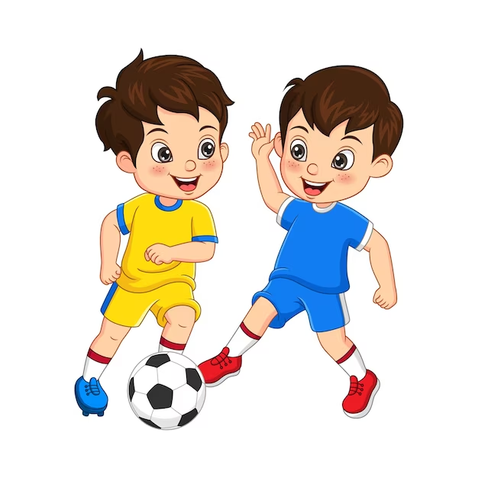
PLAYING SOCCER

Slide 5
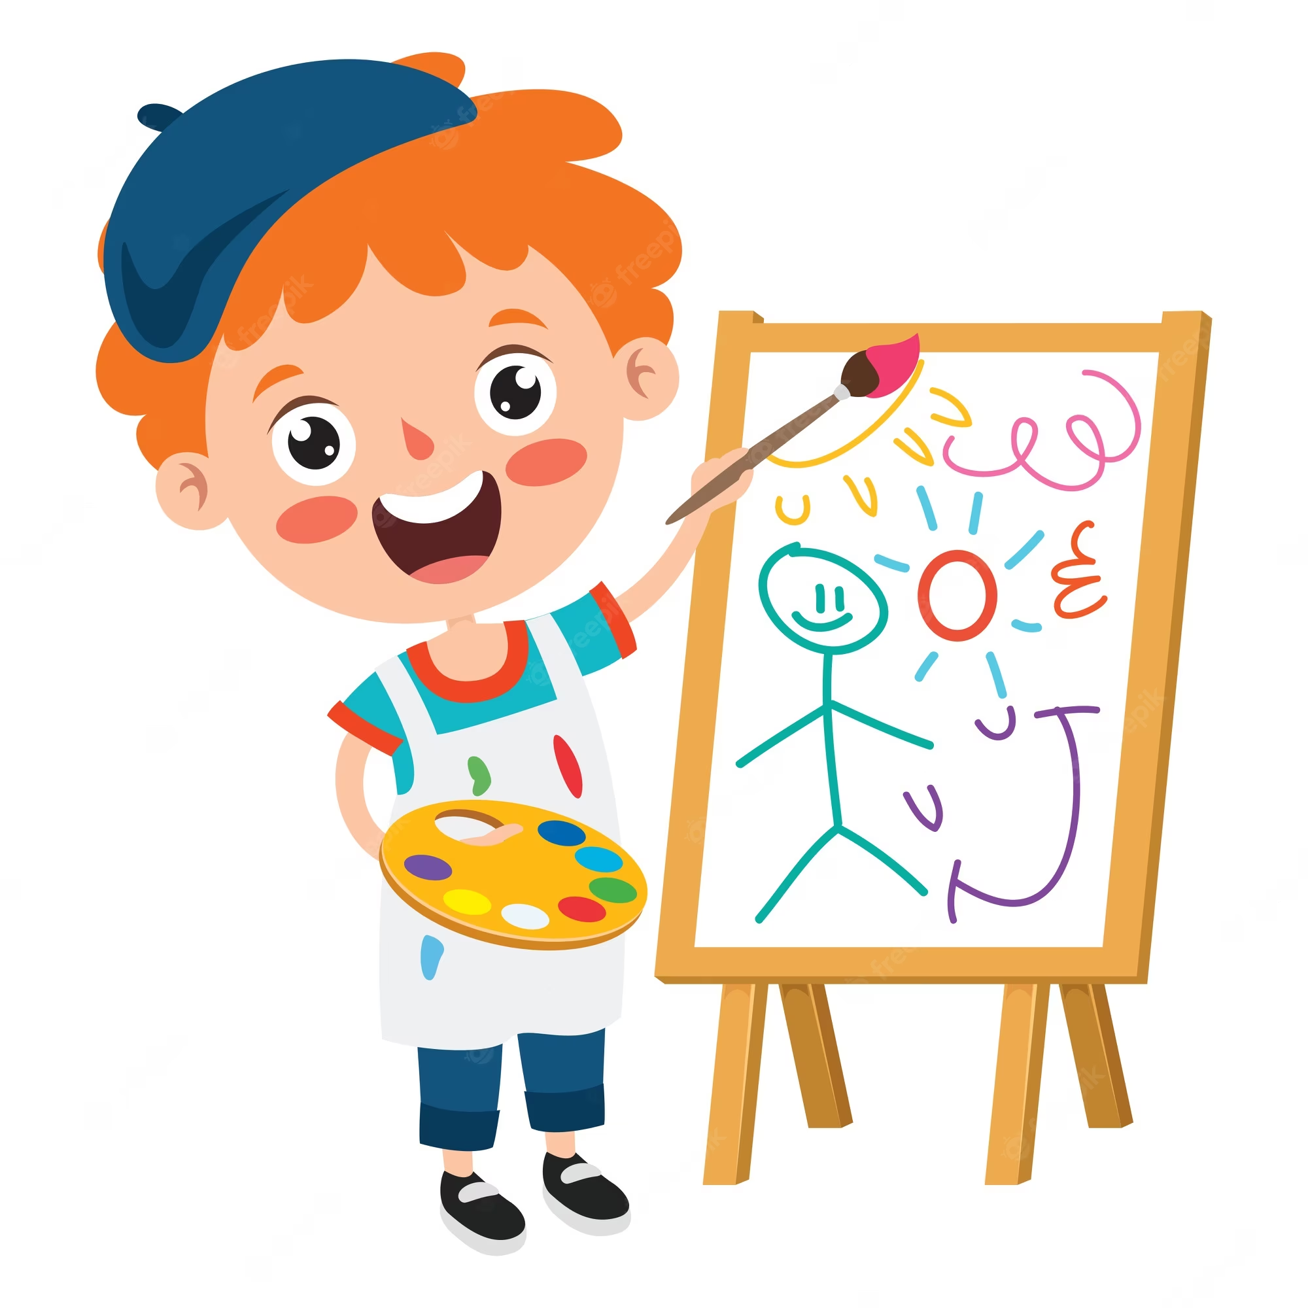
DRAWING

Slide 6
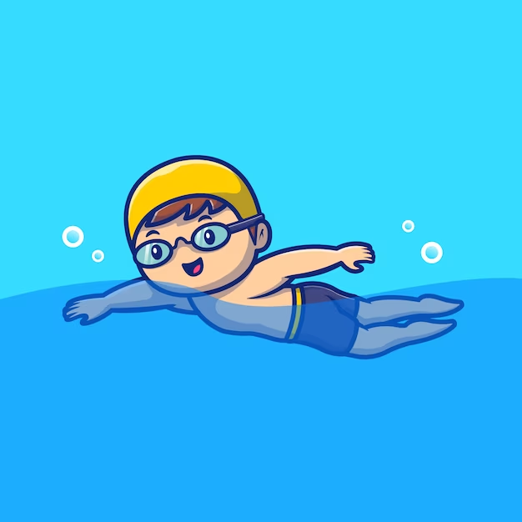
SWIMMING

Slide 7

Listening to music

Slide 8






Slide 9
Unit 1: HOBBIES Lesson 1: Getting started
My favourite hobby

Slide 10
VOCABULARY

Slide 11
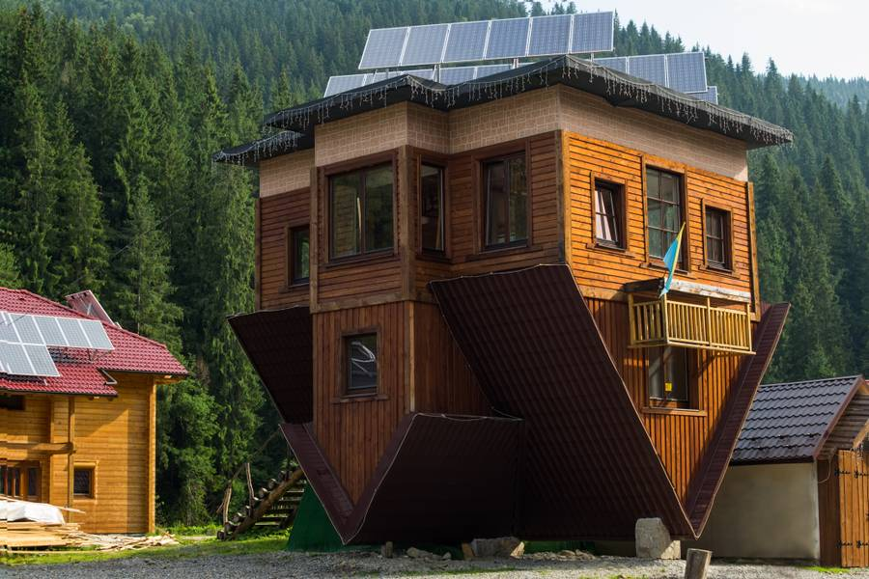
unusual
(adj)
/ʌnˈjuːʒuəl/
kì lạ, khác thường

Slide 12

creativity
(n)
/ˌkriːeɪˈtɪvəti/
sự sáng tạo

Slide 13
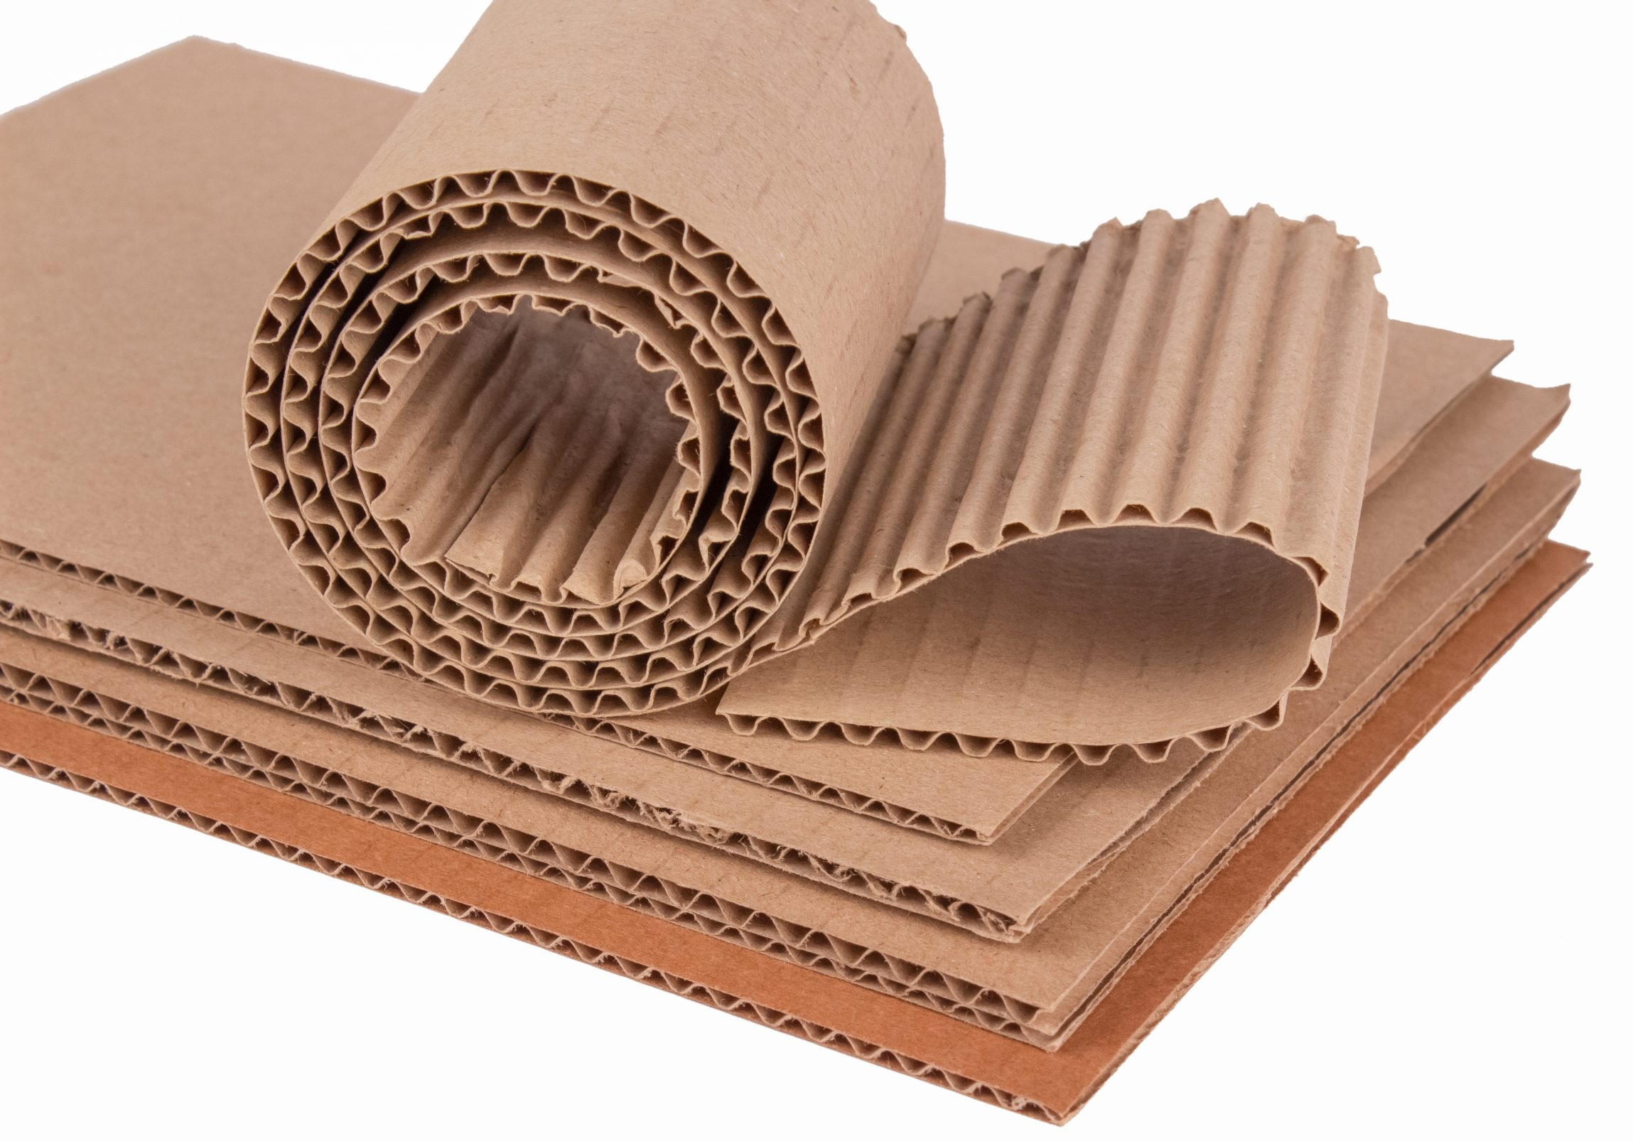
cardboard
(n)
/ˈkɑːrdbɔːrd/
bìa cứng

Slide 14
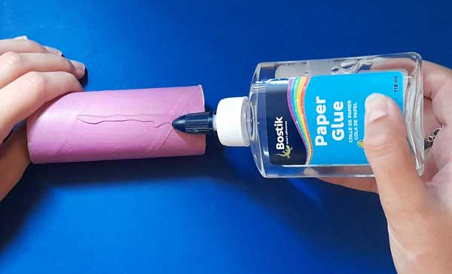
glue
(n)
/ɡluː/
keo dán

Slide 15
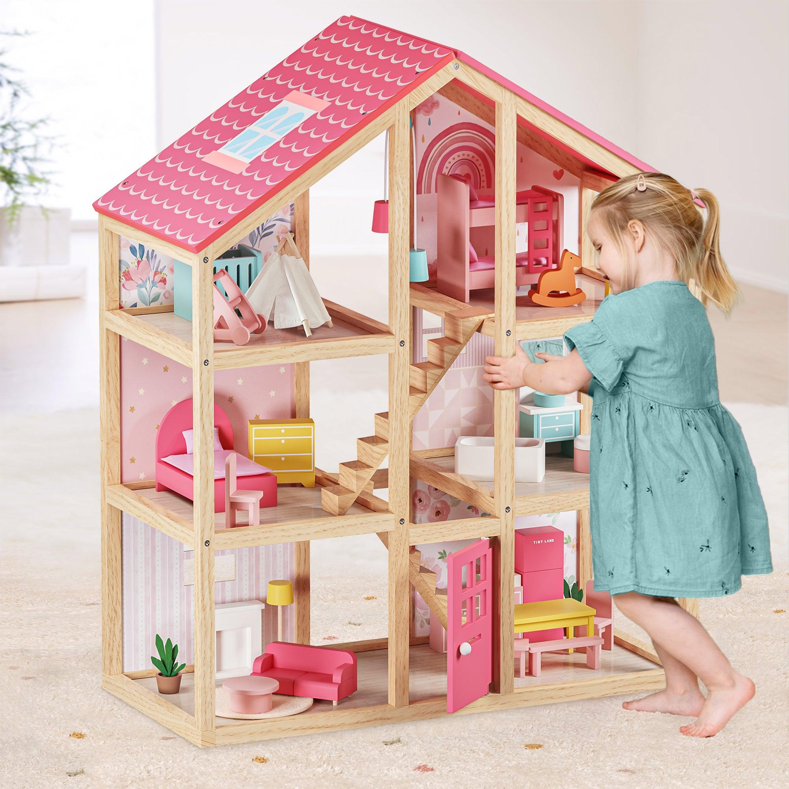
dollhouse
(n)
/ˈdɑːlhaʊs/
nhà búp bê

Slide 16
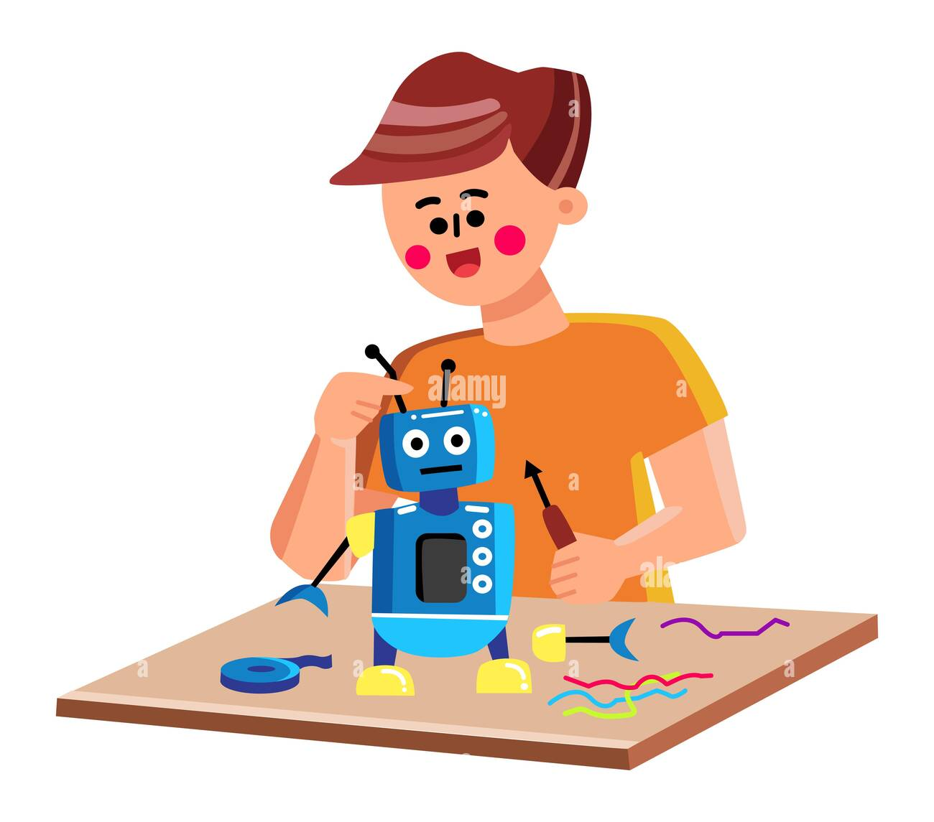
make models
(v)
/meɪk ˈmɑːdlz/
chế tạo mô hình

Slide 17
unusual (adj) | /ʌnˈjuːʒuəl/ | Kì lạ, khác thường
creativity (n) | /ˌkriːeɪˈtɪvəti/ | Sự sáng tạo
cardborad (n) | /ˈkɑːrdbɔːrd/ | Bìa cứng
glue (n) | /ɡluː/ | Keo dán
dollhouse (n) | /ˈdɑːlhaʊs/ | Nhà búp bê
make models (v) | /meɪk ˈmɑːdlz/ | Chế tạo mô hình

Slide 18
cardboard

Slide 19


Task 1
Listen and read (p8)

Slide 20
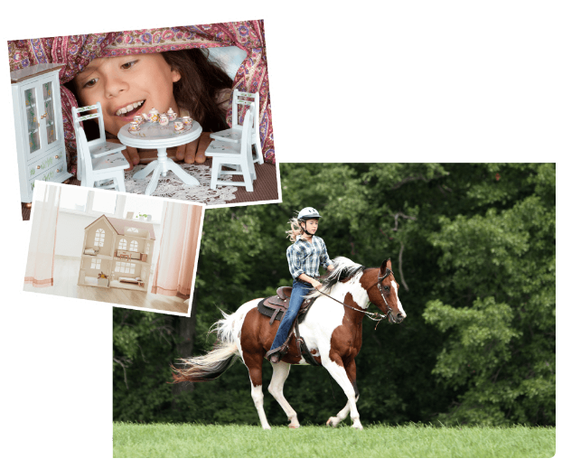

Slide 21

Ann: Your house is very nice, Trang.
Trang: Thanks! Let’s go upstairs. I’ll show you my room.
Ann: I love your dollhouse. It’s amazing. Did you make it yourself?
Trang: Yes. My hobby is building dollhouses.
Ann: Really? Is it hard to build one?
Trang: Not really. All you need is some cardboard and glue. Then just use a bit of creativity. What do you do in your free time?
Ann: I like horse riding.
Trang: That’s rather unusual. Not many people do that.
Ann: Actually, it’s more common than you think. There are some horse riding clubs in Ha Noi now. I go to the Riders’ Club every Sunday.
Trang: I’d love to go to your club this Sunday. I want to learn how to ride.
Ann: Sure. My lesson starts at 8 a.m.

Slide 22
Task 2
Read the conversation again and write true (T) or false (F). (p9)

Slide 23
 | True/ False
1. Trang needs help with building dollhouses.
2. Trang uses glue and cardboard to build her dollhouse.
3. To build a dollhouse, you need to use your creativity.
4. Ann goes to a horse riding club every Sunday.
5. Ann’s lesson starts at 8 p.m.
F

Slide 24
Ann: Your house is very nice, Trang.
Trang: Thanks! Let’s go upstairs. I’ll show you my room.
Ann: I love your dollhouse. It’s amazing. Did you make it yourself?
Trang: Yes. My hobby is building dollhouses.
Ann: Really? Is it hard to build one?
Trang: Not really. All you need is some cardboard and glue. Then just use a bit of creativity. What do you do in your free time?
Ann: I like horse riding.
Trang: That’s rather unusual. Not many people do that.
Ann: Actually, it’s more common than you think. There are some horse riding clubs in Ha Noi now. I go to the Riders’ Club every Sunday.
Trang: I’d love to go to your club this Sunday. I want to learn how to ride.
Ann: Sure. My lesson starts at 8 a.m.

Slide 25
 | True/ False
1. Trang needs help with building dollhouses.
2. Trang uses glue and cardboard to build her dollhouse.
3. To build a dollhouse, you need to use your creativity.
4. Ann goes to a horse riding club every Sunday.
5. Ann’s lesson starts at 8 p.m.
F
T

Slide 26
Ann: Your house is very nice, Trang.
Trang: Thanks! Let’s go upstairs. I’ll show you my room.
Ann: I love your dollhouse. It’s amazing. Did you make it yourself?
Trang: Yes. My hobby is building dollhouses.
Ann: Really? Is it hard to build one?
Trang: Not really. All you need is some cardboard and glue. Then just use a bit of creativity. What do you do in your free time?
Ann: I like horse riding.
Trang: That’s rather unusual. Not many people do that.
Ann: Actually, it’s more common than you think. There are some horse riding clubs in Ha Noi now. I go to the Riders’ Club every Sunday.
Trang: I’d love to go to your club this Sunday. I want to learn how to ride.
Ann: Sure. My lesson starts at 8 a.m.

Slide 27
 | True/ False
1. Trang needs help with building dollhouses.
2. Trang uses glue and cardboard to build her dollhouse.
3. To build a dollhouse, you need to use your creativity.
4. Ann goes to a horse riding club every Sunday.
5. Ann’s lesson starts at 8 p.m.
F
T
T

Slide 28
Ann: Your house is very nice, Trang.
Trang: Thanks! Let’s go upstairs. I’ll show you my room.
Ann: I love your dollhouse. It’s amazing. Did you make it yourself?
Trang: Yes. My hobby is building dollhouses.
Ann: Really? Is it hard to build one?
Trang: Not really. All you need is some cardboard and glue. Then just use a bit of creativity. What do you do in your free time?
Ann: I like horse riding.
Trang: That’s rather unusual. Not many people do that.
Ann: Actually, it’s more common than you think. There are some horse riding clubs in Ha Noi now. I go to the Riders’ Club every Sunday.
Trang: I’d love to go to your club this Sunday. I want to learn how to ride.
Ann: Sure. My lesson starts at 8 a.m.
V

Slide 29
 | True/ False
1. Trang needs help with building dollhouses.
2. Trang uses glue and cardboard to build her dollhouse.
3. To build a dollhouse, you need to use your creativity.
4. Ann goes to a horse riding club every Sunday.
5. Ann’s lesson starts at 8 p.m.
F
T
T
T

Slide 30
Ann: Your house is very nice, Trang.
Trang: Thanks! Let’s go upstairs. I’ll show you my room.
Ann: I love your dollhouse. It’s amazing. Did you make it yourself?
Trang: Yes. My hobby is building dollhouses.
Ann: Really? Is it hard to build one?
Trang: Not really. All you need is some cardboard and glue. Then just use a bit of creativity. What do you do in your free time?
Ann: I like horse riding.
Trang: That’s rather unusual. Not many people do that.
Ann: Actually, it’s more common than you think. There are some horse riding clubs in Ha Noi now. I go to the Riders’ Club every Sunday.
Trang: I’d love to go to your club this Sunday. I want to learn how to ride.
Ann: Sure. My lesson starts at 8 a.m.

Slide 31
 | True/ False
1. Trang needs help with building dollhouses.
2. Trang uses glue and cardboard to build her dollhouse.
3. To build a dollhouse, you need to use your creativity.
4. Ann goes to a horse riding club every Sunday.
5. Ann’s lesson starts at 8 p.m.
F
T
T
T
F

Slide 32
Ann: Your house is very nice, Trang.
Trang: Thanks! Let’s go upstairs. I’ll show you my room.
Ann: I love your dollhouse. It’s amazing. Did you make it yourself?
Trang: Yes. My hobby is building dollhouses.
Ann: Really? Is it hard to build one?
Trang: Not really. All you need is some cardboard and glue. Then just use a bit of creativity. What do you do in your free time?
Ann: I like horse riding.
Trang: That’s rather unusual. Not many people do that.
Ann: Actually, it’s more common than you think. There are some horse riding clubs in Ha Noi now. I go to the Riders’ Club every Sunday.
Trang: I’d love to go to your club this Sunday. I want to learn how to ride.
Ann: Sure. My lesson starts at 8 a.m.

Slide 33
 | True/ False
1. Trang needs help with building dollhouses.
2. Trang uses glue and cardboard to build her dollhouse.
3. To build a dollhouse, you need to use your creativity.
4. Ann goes to a horse riding club every Sunday.
5. Ann’s lesson starts at 8 p.m.
F
T
T
T
F

Slide 34
Task 3
Write the words and phrases from the box under the correct pictures. Then listen, repeat, and check (p9)

Slide 35
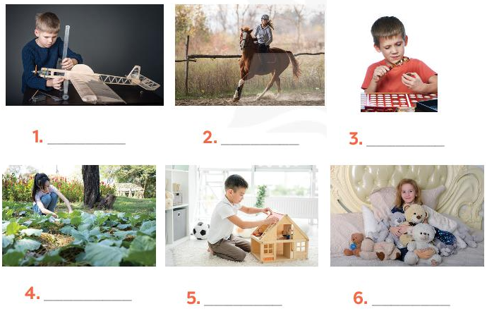
making models
riding a horse
collecting coins
collecting
teddy bears
gardening
building dollhouses

Slide 36
Task 4
Work in pairs. Write the hobbies from 3 in the suitable columns. (p.9)

Slide 37
What is the difference between
doing things and making things ?
Doing things | Making things | Collecting things

Slide 38
Doing things | Making things
Expresses daily activities or jobs (physical tasks). These are usually activities that produce no physical object. | Refers to a specific outcome or object created by that activity

Slide 39
Doing things | Making things | Collecting things
Riding a horse,
gardening,
Making models, building dollhouses,
Collecting coins, collecting teddy bears,
listening to music, reading books…
cooking, drawing,
baking..
collecting toys, collecting books..

Slide 40
Task 5
GAME: FIND SOMEONE WHO…(p.9)
Work in groups.
Ask as many classmates as you can about which hobbies they like. Use the question ‘Do you like…?’.
In the table, write your classmates’ names beside the activities they like.
Which hobby is the most popular?

Slide 41
HOBBIES | NAME
horse riding
building dollhouses
collecting teddy bears
collecting coins
gardening
making models

Slide 42
Yes, I do.
Do you like + Ving?
No, I don’t.
S + like(s) + Ving
In conclusion, in my team, …… is the most popular hobby

Slide 43
CONSOLIDATION

Slide 44
What have you learnt today?

Slide 45
VOCABULARY
unusual (adj) | /ʌnˈjuːʒuəl/ | Kì lạ, khác thường
creativity (n) | /ˌkriːeɪˈtɪvəti/ | Sự sáng tạo
cardborad (n) | /ˈkɑːrdbɔːrd/ | Bìa cứng
glue (n) | /ɡluː/ | Keo dán
dollhouse (n) | /ˈdɑːlhaʊs/ | Nhà búp bê
make models (v) | /meɪk ˈmɑːdlz/ | Chế tạo mô hình

Slide 46
STRUCTURES
Yes, I do.
Do you like + Ving?
No, I don’t.
S + like(s) + Ving

Slide 47
HOMEWORK
- Read again the conversation on page 6.
- Do more exercises in workbook.
- Name a list of cheap hobbies, expensive hobbies, easy and difficult hobbies.

Slide 48
THANKS for your attention!

