Slide 1
Welcome to my lessons!
Notes:
Ask ss some checking questions (Gọi 2 hs) – 2p
What is your hobby?
Do you like swimming?
Do you like watching movies?

Slide 2
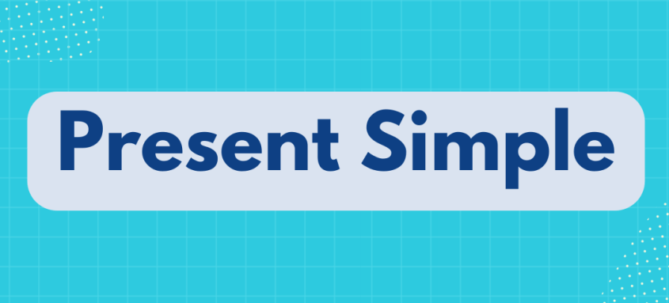
GAME: Magic pieces!
rarely
twice a week
often
every day
Notes:
Warm- up: show signal word → guess the targeted grammar
game: Magic pieces

Slide 3
Unit 1
HOBBIES
Lesson 3: Closer look 2
PRESENT SIMPLE

Slide 4
rarely, often, twice a week, every day, ….
I. Grammar: Present simple
Signal words:
adverbs of frequency (rarely, seldom, sometimes, often, usually, always), every day, three times a week, …
Notes:
HS bổ sung thêm signal words:

Slide 5
I. Grammar
Act 1: Match each example with the relevant usage
EXAMPLES | USAGE
The sun rises every morning.
She goes swimming three times a week. | Something that happens regularly in the present
The cooking lesson starts at 9 a.m. | Timetables or programmes
Something that is a general truth
Something that happens regularly in the present
Something that happens regularly in the present
Timetables or programmes
Something that is a general truth
Timetables or programmes
Notes:
1. Call ss go to the board and match examples vs relevant usage
Design a poster
hỏi hs xđ signal words xh trong câu
Gọi 2 HS về nghĩa tiếng việt của cách dùng
2. Invite ss to go to the board and write form ( viết sẵn cách trình bày các CT cho HS) / hoặc cho hs chuẩn bị poster vt công thức ( 2 đội vt CT vs ĐT to be- 2 đội vt CT verb) → chữa, show công thức

Slide 6
THE PRESENT SIMPLE
STRUCTURES
 | TO BE | VERB
(+) | S + am/are/is + … | S + V(_s/es)
(-) | S+ am/are/is + not + … ‘m not/aren’t/isn’t | S + do/does + not +V don’t/ doesn’t
(?) | Am/Are/Is + S + …? Yes, S + am/are/is. No, S+ ‘m not/ aren’t/isn’t | Do/Does + S + V+ …? Yes, S + do/does No, S + don’t/doesn’t
Notes:
THE PRESENT SIMPLE
SIGNAL WORDS
B. USAGE
C. STRUCTURES

Slide 7
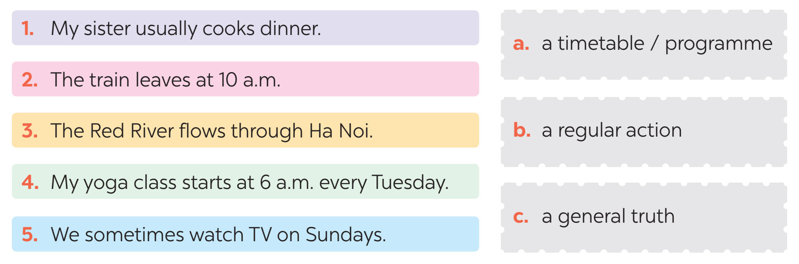
II. Practice
1
Work in groups. Match the sentences (1 – 5) to the correct
uses (a–c).( p11)
b
a
c
a
b
Notes:
KT xem hs đã nắm đc cách dùng của present perfect chưa
group work
Matching
Đội nhanh nhất dán poster lên, 3 đội còn lại đổi vs
Dụng cụ: nam châm, 1 poster

Slide 8











Complete the sentences. Use the present simple form of the verbs
II. Practice
2
1. My brother and I (make) ________ a new model every month. 2. What _________ Lan (do) ________ in her free time? 3. I (have) _________ a drawing lesson every Tuesday. 4. Mark (not like) ____________ doing judo. 5. _________ your English lesson (start) _________ at 6 p.m?
make
does
do
have
doesn’t like
Does
start
Notes:
PAIR –WORK
CHECK & EXPLAIN
T gives a sample of how to explain: find signal words → identify tense → xđ dạng đúng của verbs dựa theo chủ ngữ.
4. Mark (not like) ____________ doing judo. → Thì HTĐ còn dung để mô tả sơ thích

Slide 9










II. Practice
3
Work in pair. Fill in each blank with the correct form of the verb in brackets
My family members have different hobbies. My dad (1. enjoy) ________ gardening. He (2. spend) ________ two hours in our garden every day. My mum and sister (3. not like) __________ gardening, but they love cooking. They (4. go) _______ to a cooking class every Sunday. Their lesson (5. begin) ________ at 9 a.m. I (6. not enjoy) _____________ cooking, and I cannot cook very well.
enjoys
spends
don’t like
go
begins
don’t enjoy
Notes:
Swap answers to the ppl next to you
→ CHECK & EXPLAIN.
Các bạn hãy cho cô câu trả lời và giải thích tại sao các bạn chia động từ như vậy.
Câu 1
Câu 4
…

Slide 10
II. Practice
4
Write complete sentences, using the given words and phrases. You may have to change the words or add some.
1. sun / set / in / west / every evening. ______________________________________________________ 2. Trang and Minh / play / basketball / every day / after school? ______________________________________________________ 3. flight / from / Ho Chi Minh City / not arrive / 10:30. ______________________________________________________ 4. our science teacher / start / our lessons / 1 p.m. / on Fridays. ______________________________________________________ 5. you / make / model / at / weekend? ______________________________________________________
The sun sets in the west every evening.
Do Trang and Minh play basketball every day after school?
The flight from Ho Chi Minh City doesn’t arrive at 10:30.
Our science teacher starts our lessons at 1 p.m. on Fridays.
Do you make models at the weekend?
Notes:
INDIVIDUALLY in 2 minutes
2 ss go to the board and write answer
Chấm điếm; xog nhanh +0.5.

Slide 11

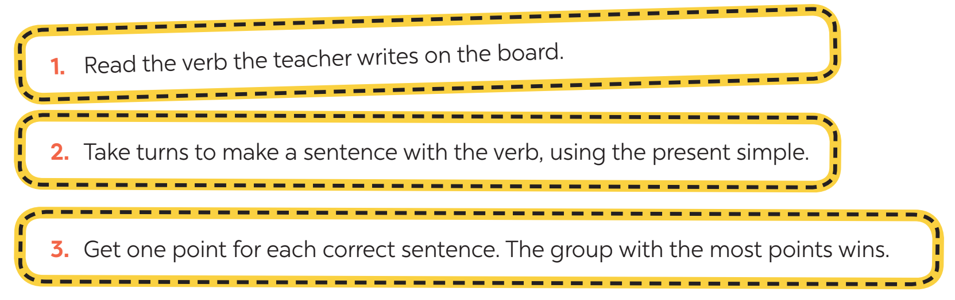
5
Game: Sentence Race
MAKE
DO
HAVE
ENJOY
Notes:
Games
2 nhóm lớn
Provide some verbs: HAVE, MAKE, DO, ENJOY
CÁC BẠN KO LÊN BẢNG VT THÌ PHẢI VT CÂU VÀO VỞ CÔ SẼ THU VỞ CỦA 1 VÀI BN ĐỂ KT

Slide 12

CONSOLIDATION
WRAP-UP
Usage
PRESENT SIMPLE TENSE
Form
Signal words

Slide 13

CONSOLIDATION
HOMEWORK
Design a mind map on Present Simple tense.
Complete exercises in the Workbook.

Slide 14
THANK YOU FOR YOUR ATTENTION!

