Slide 1





Teacher: Phạm Công Thành

Slide 3

Solve the crossword puzzle.
DOWN
1
2
1.
She likes to meet new people.
She’s .
4
3
2.
People cook meals in this room.
4.
5
You hear with them.
ACROSS
3.
He’s good at drawing.
He’s very .
5.
It’s a side of the face, below the eyes.

Slide 4

1
2
f
r
i
e
n
d
l
y
k
i
t
c
h
e
n
4
c e a t v
e
a
r
s
3
5
c h e k

Slide 5
REVIEW 1
UNIT 1,2,3
Period 23
Pronunciation
LANGUAGE
Vocabulary
Grammar

Slide 6
A. LANGUAGE
I. PRONUCIATION
1. Odd one out:
A. ears B. eyes C. arms D. lips
2.A. stove B. telephone C. mother D. bone
3.A. vases B. dishes C. tables D. fridges
4. A. notebooks B. rulers C. erasers D. pencils
5.A. brother B. nose C. stomach D. oven

Slide 7
*Pronunciation: The ways to pronounce _s/_es at the end of the word
Cách đọc | Âm cuối | Ví dụ
a, b, e, g, l, m, n, o, r, u, v, w
/ z /
enjoys, games, arrives, plays answers, tries
(nguyên tắc chung)
(các âm còn lại ngoài 2 nguyên tắc riêng dưới đây)
/ ɪz /
s, ch, x, sh, z, ge
buses, boxes, watches, brushes, quizzes, languages
(nguyên tắc riêng 1)
(Sáu chạy xe SH zin ghê)
/ s /
th, p, k, f,t
cats, taps, paths, looks, books, laughs, handcuffs
(nguyên tắc riêng 2)
(Thời phong kiến fương tây )

Slide 8
A. LANGUAGE
I. PRONUCIATION
1. Odd one out:
A. ears B. eyes C. arms D. lips
2.A. stove B. telephone C. mother D. bone
3.A. vases B. dishes C. tables D. fridges
4. A. notebooks B. rulers C. erasers D. pencils
5.A. brother B. nose C. stomach D. oven

Slide 9
2. Write the name of the school things and
furniture in the house which begin with /b/ and /p/
/b/ : book,
bag,
bed,
/p/ : pen,
picture,
pencil,
poster.

Slide 10
ii. vocabulary
3. Complete the words
1.E _ _ l _ _ _
3. l _ _ _ _ h
5. b_ _ m _ _ _ _ n
7. l _ _ _ o _
2. h _ _ _ w _ _ _
4. s _ _ r _ _
6. p _ _ s _ _ _
8. j _ _ _
English
homework
lunch
sports
badminton
physics
lessons
judo
Play :
Do:
3 Have:
4.Study:

Slide 11

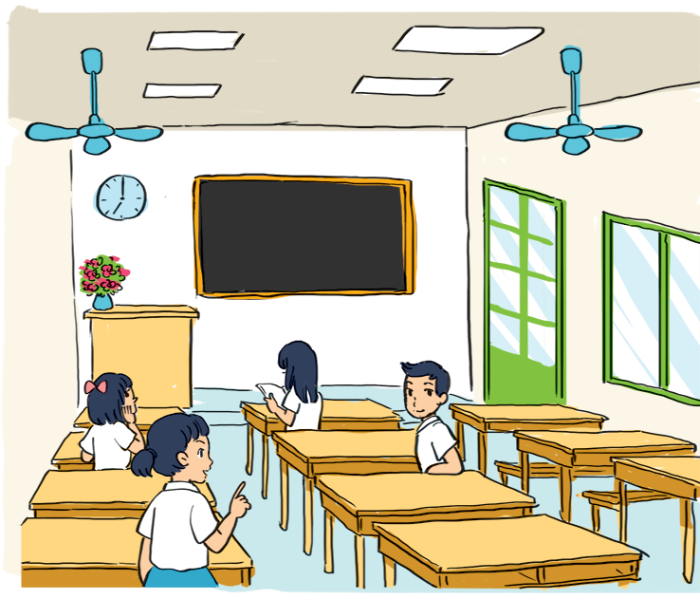
Look at the picture of a classroom. Choose the best answer A, B, or C.

Slide 12
1.
There is a blackboard and a clock the wall.
A.
in
B.
on
C.
behind

Slide 13
2.
A vase of flowers is on the desk.
A.
teacher’s
B.
teachers
C.
teacher’

Slide 14
4.
The window is the big door.
A.
behind
B.
next to
C.
under

Slide 15
4.
The window is the big door.
A.
behind
B.
next to
C.
under

Slide 16
5.
A girl her book now.
A.
reads
B.
reading
C.
is reading

Slide 17
iii. grammar
6. Complete the sentences with the present simple or present continuous form of the verbs in brackets
We can’t go out now. It ( rain) …………………
What time you (have) ….... breakfast every day?
3………
4. My dog (like) ………… my bed very much.
5.There (be) ………… a lamp, a computer, and some book on my bed
she (study) ……………… English now?

Slide 18
iii. grammar
6. Complete the sentences with the present simple or present continuous form of the verbs in brackets
is raining
We can’t go out now. It ( rain) …………………
What time you (have) ….... breakfast every day?
3.
4. My dog (like) ………… my bed very much.
5.There (be) ………… a lamp, a computer, and some book on my bed
do you have
Is
she (study) studying English now?
likes
are

Slide 19
B. SKILL
Reading
Speaking
Listening
Writing

Slide 20
I. READING
1. Choose A, B, C for each blank in the e-mail below
From: an@fastmail.com
To: nick@fastmail.com
Subject: My best friend
Hi Nick,
It’s great to hear you. I want to tell you about my best friend.
My grandma is my best friend. She is 68 years old. She (1) …………. Our family. She was a Math teacher (2)…………… a secondary school. She likes (3) …………….. up early and watering the flowers in our garden. She usually helps (4) ………………. With my homework. In the evening, she tells me interesting (5) ……………… She also listens (6)………… me when I’m sad . I love my grandma very much.
What about you? Who’s your best friend?
Please write to me soon.
Bye bye,
An.
lives
at
getting
………..
me
stories
to

Slide 21
2. Read the text and answer the questions
My school
My new school is a quiet place not far from the city center. It has three buildings and a large yard. This year there are 26 classes with more than 1,000 students in my school. Most students are hard working and serious. The school has about 40 teachers. They are all helpful and friendly. My school has different clubs: Dance, English, Arts, Football and Basketball. I like English, so I join the English club. I love my school because it is a good school.

Slide 22
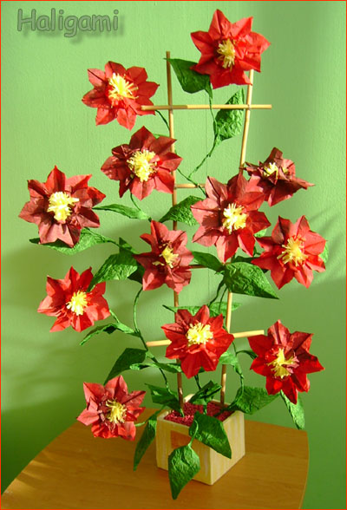
BEARS
DUCKS
4
3
2
8
7
5
1
6

Slide 23
1. Where is the writer’s new school?
It’s in a quiet place not far from the city center.

Slide 24
2. What are the students like?
They are hard – working and serious.

Slide 25
3. What are the teachers like?
They are helpful and friendly.

Slide 26
4. How many clubs are there in the school?
There are five clubs.

Slide 27
5. Why does the author love the school?
Because it’s a good school.

Slide 28

Congratulation !
You get 1 flower

Slide 29
Congratulation !
You get 1 flower

Slide 30
Sorry !
You lose 1 flower.

Slide 31
ii. speaking
3 . Interview two classmates. Ask them what they like and dislike about your school and the reason why. Write their answers in the table and report them to the class.
 | What he / she likes + reason | What he / she dislikes + reason
Classmate A
Classmate B

Slide 32

iii. listening
4. An and Mi are talking on the phone. Listen and circle the parts of the house you hear
Kitchen garden garage
bathroom bedroom living room

Slide 33

5. Listen again and answer the questions
What’s Mi’s Mum doing?
2. What’s Mi’s Dad doing?
3. Where is Mi’s younger brother?
4. What’s Mi’s cousin doing?
She is watering the plants in the garden
He’s listening to the radio
He’s in Mi’s bedroom
She’s watching TV

Slide 34
iv. writing
6. Write an email to your friend. Tell him / her about a family member. Include this information
Who the person is?
How old is he / she?
What is his / her job is / was?
What he / she likes doing?
What he / she does for you ?

Slide 35

V. Homework:
1. Do Language focus 1
2. Be ready for Test 1

Slide 36

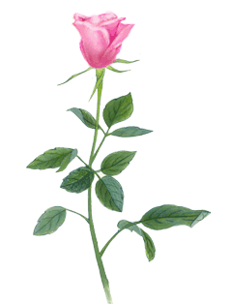
THANK YOU FOR ATTENTION!
the end
GOOD BYE!

