Slide 1

UNIT 1 : MY NEW SCHOOL
Lesson 1: Getting started
Teacher: Phạm Công Thành

Slide 2

book
ruler
Eraser
School things
chalk
paper
pen
notebook
School bag

Slide 3
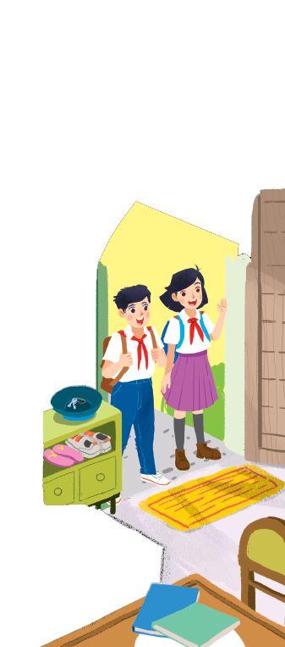
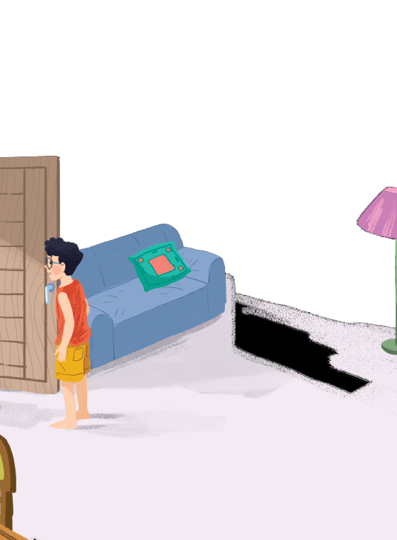



Listen and read.
A special day
Who are they? What are they talking about?

Slide 4
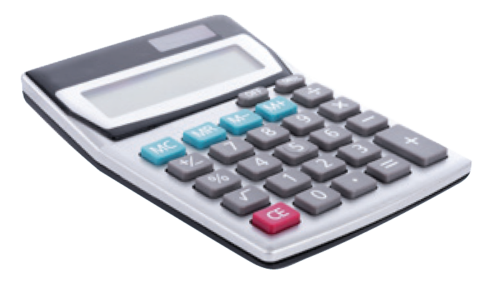
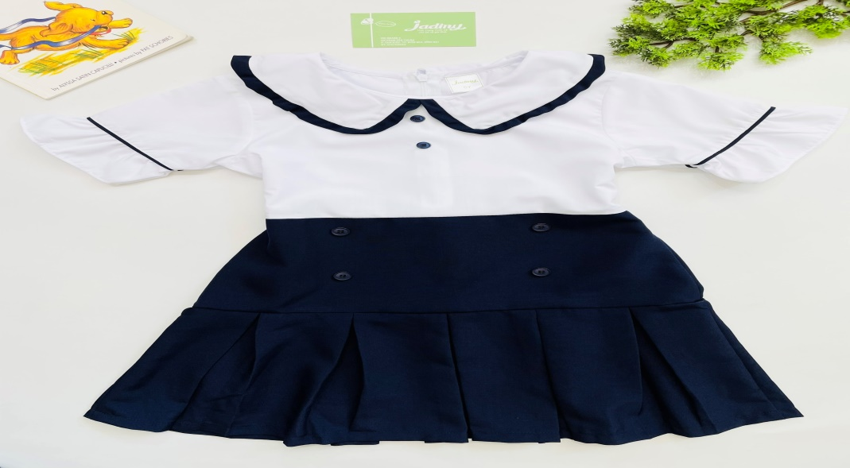
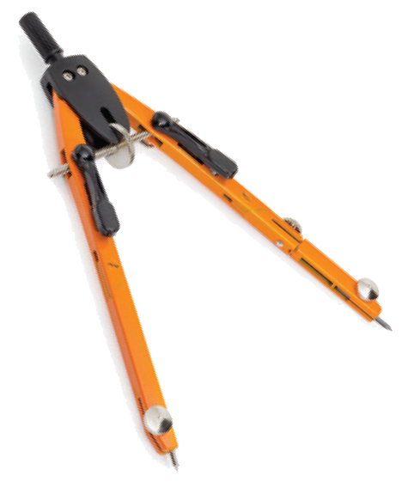
I.Vocabulary:
- excited (a):
hào hứng
- calculator (n):
máy tính
- uniform (n) :
đồng phục
- smart (a) :
thông minh
put on = wear ( v )
mặc
- compass (n)
compa

Slide 5
A special day
(Loud knock)
Phong: Hi, Vy.
Vy: Hi, Phong. Are you ready?
Phong: Just a minute.
Vy: Oh, this is Duy, my new friend.
Phong: Hi, Duy. Nice to meet you.
Duy: Hi, Phong. I live near here, and we go to the same school!
Phong: Good. Hmm, your school bag looks heavy.
Duy: Yes! I have new books, and we have new subjects to study.
Phong: And a new uniform, Duy! You look smart!
Duy: Thanks, Phong. We always look smart in our uniforms.
Phong: Let me put on my uniform. Then we can go.

Slide 6

Read the conversation again and tick () T (True) or F (False).
 |  | T | F
1. | Vy, Phong, and Duy go to the same school.
2. | Duy is Phong’s friend.
3. | Phong says Duy looks smart in his uniform.
4. | They have new subjects to study
5. | Phong is wearing a school uniform.
✓
✓
✓
✓
✓

Slide 7

Write ONE word from the box in each gap.
go
subjects
has
wear
uniforms
Students their uniforms on Monday.
1.
wear
has
2.
Vy a new friend, Duy.
- Do Phong,Vy, and Duy to the same school?
3.
go
- Yes, they do.
Students always look smart in their .
4.
uniforms
5.
subjects
- What do you like to study?
- I like to study English and history.

Slide 8

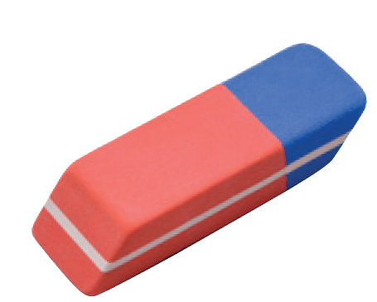
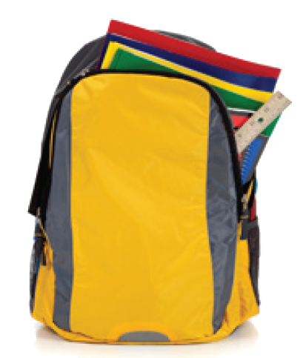
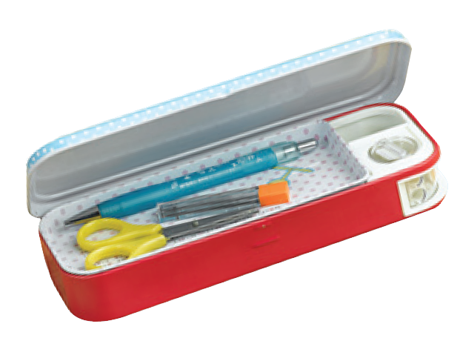
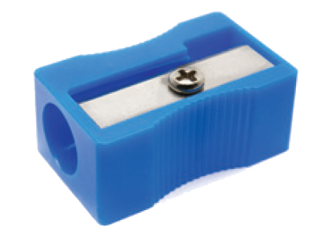
Match the word with the school things. Then listen and repeat.
4
rubber
school bag
1
pencil case
2
5
compass
pencil sharpener
calculator
3
6

Slide 9

Look around the class. Write the names of the things you see in your notebook.

Slide 10







