Slide 1

Warmly welcome to our class
English 6 A 4
Kien Thiet Secondary School

Slide 2



MY NEIGHBOURHOOD
Unit 4:
LESSON 6
LISTENING ANG WRITING

Slide 3
I. Listening
1. Do you remember Khang?
2. Where does he live?
(Da Nang).
➔Today we are going to meet Khang again.
He is talking with his friend Vy.
Let’s see what they are talking about.”

Slide 4


Listen to the conversation between Khang and Vy and tick () T (true) or F (False).
 |  | T | F
1. | Vy lives in the centre of Ho Chi Minh City.
2. | There is a big market near her house.
3. | The streets are narrow.
4. | The schools are faraway.
5. | There are some factories near her neighbourhood.





1. F Vy lives in the suburbs of HCMC
3. F (The streets are wide.)
Correct

Slide 5
AUDIO SCRIPT
Khang: Where do you live, Vy?
Vy: I live in the suburbs of Ho Chi Minh City.
Khang: What do you like about it?
Vy: There are many things I like about it. There’s a big
market near my house. There are also many shops,
restaurants and art galleries here. The streets are
wide. The people here are helpful and friendly.
Khang: What do you dislike about it?
Vy: The schools are too faraway. There are also some
factories near here, so the air isn’t very clean and the
streets are noisy and crowded.

Slide 6

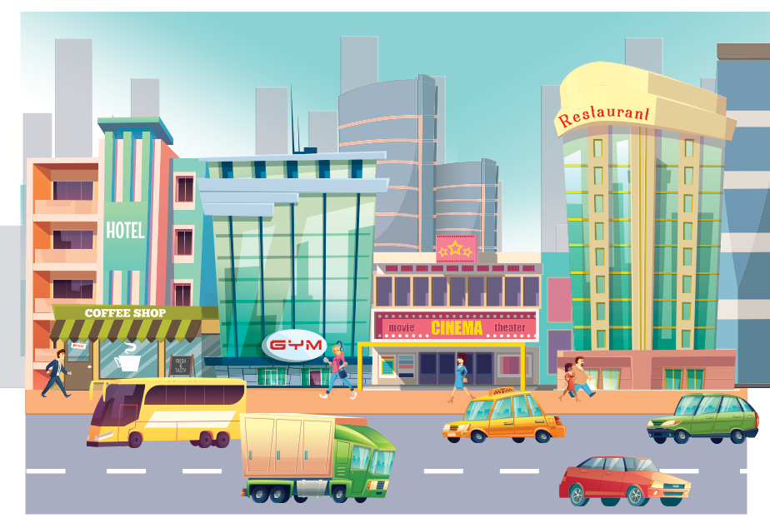
Listen to the conversation again and fill the blanks.
What Vy likes
What Vy dislikes
art galleries
- many shops, restaurants, and (1) in her neighbourhood
- too (4) school
faraway
- (2) streets
wide
- dirty air
- helpful and (3) people
friendly
crowded
- noisy and (5) streets
T

Slide 7
AUDIO SCRIPT
Khang: Where do you live, Vy?
Vy: I live in the suburbs of Ho Chi Minh City.
Khang: What do you like about it?
Vy: There are many things I like about it. There’s a big
market near my house. There are also many shops,
restaurants and art galleries here. The streets are
wide. The people here are helpful and friendly.
Khang: What do you dislike about it?
Vy: The schools are too faraway. There are also some
factories near here, so the air isn’t very clean and the
streets are noisy and crowded.

Slide 8

II. Writing
Tick () what you like or dislike about a neighbourhood.
 |  | Like | Dislike
1. | sandy beaches
2. | heavy traffic
3. | many modern buildings and offices
4. | peaceful streets
5. | good restaurants and cafés
6. | sunny weather
7. | helpful and friendly people
8. | many shops and markets

Slide 9

Write a paragraph of about 50 words about your neighbourhood saying what you like and dislike about it. Use Khang’s blog as a model.
I live in _______. There are many / some things I like about my neighbourhood.
However, there are some / many / one thing(s) I dislike about it.

Slide 10
* Make notes about your neighbourhood. Think about the things you like/ dislike about it.
LIKE
DISLIKE
- It’s great for outdoor activities.
-The weather is too wet in rainy season.
-The air is fresh.
- There’s almost everything here.
- The streets are slope down and old.
- People are kind and friendly.
The food is delicious
- There is a lot of rain
- Many kinds of good fruits such as : cane, orange. Durians, lemon string.

Slide 11
* Write a paragraph of about 50 words about your neighbourhood
MODEL WRITING
My neighbourhood is peaceful and the weather is sunny and fine.
People are friendly and kind. The food is fresh and delicous
Every house has a backyard and a frontyard.
However , there is one thong I dislike about it. The roads are narrow .But I still love my neighbourhood very much

Slide 12

HOMEWORK
Rewrite the paragraph in your notebook.
- Prepare lesson 7

