Slide 1

Dao Quang Tuyen

Slide 2


Slide 3



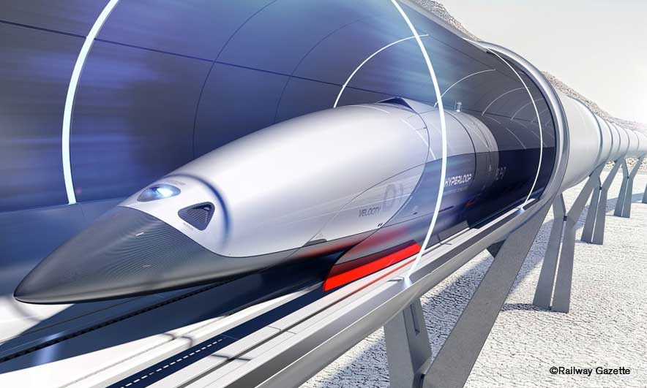
Unit
11
TRAVELLING IN THE FUTURE
LESSON 1: GETTING STARTED
I hope we will have a hyperloop soon!
Unit
HOBBIES

Slide 4

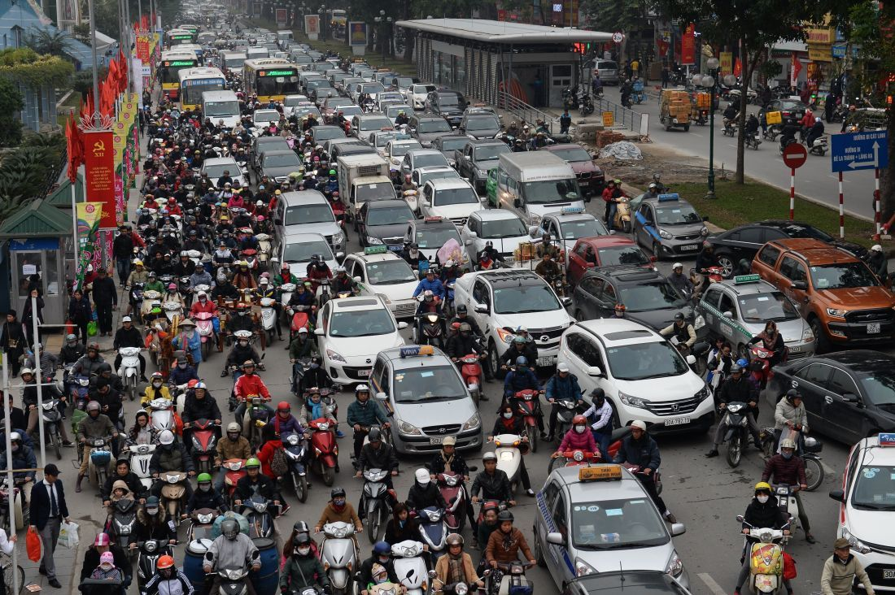
WARM-UP: CHATTING
+ How do you think people travel every day?
+ What do you think about the traffic in the picture?
+ How about traffic in the future?

Slide 5

LESSON 1: GETTING STARTED

Slide 6

PRESENTATION
eco-friendly (adj)
/ˈiːkəʊˌfrendli/
thân thiện với môi trường

Slide 7
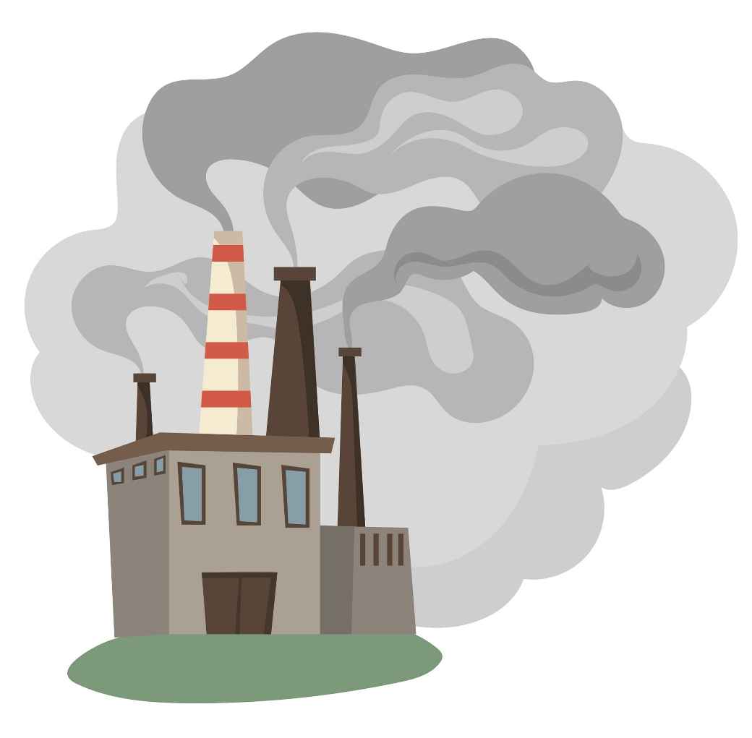
PRESENTATION
fume (n)
/fjuːm/
khói

Slide 8
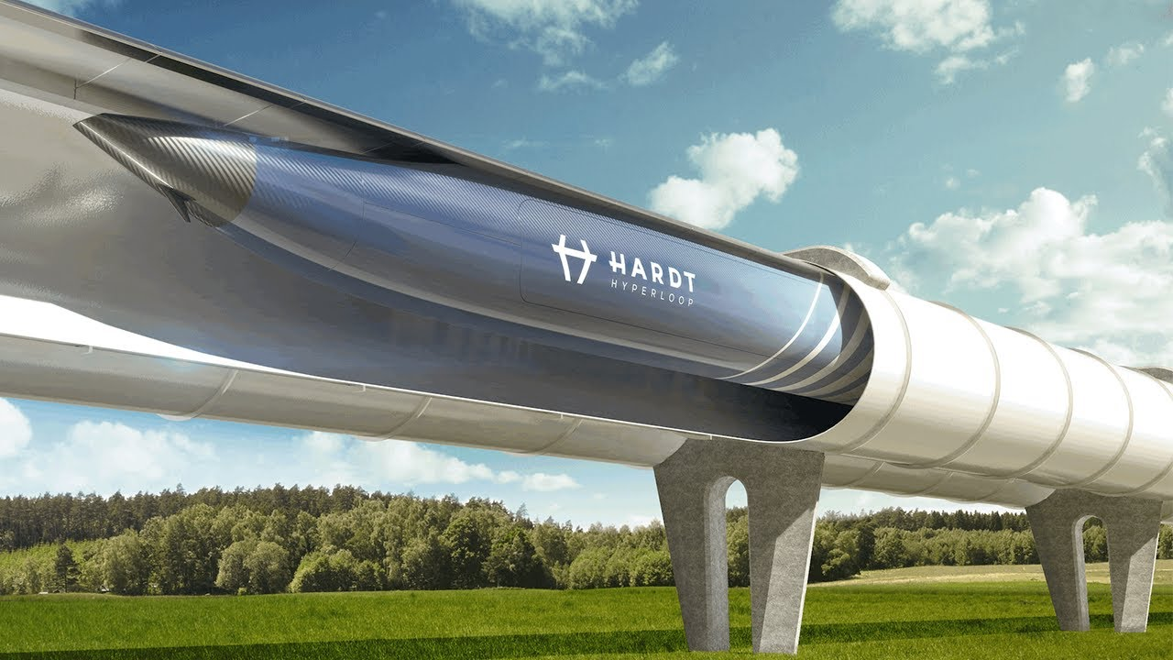
PRESENTATION
hyperloop (n)
/ˈhaɪpərluːp/
hệ thống giao thông
tốc độ cao

Slide 9
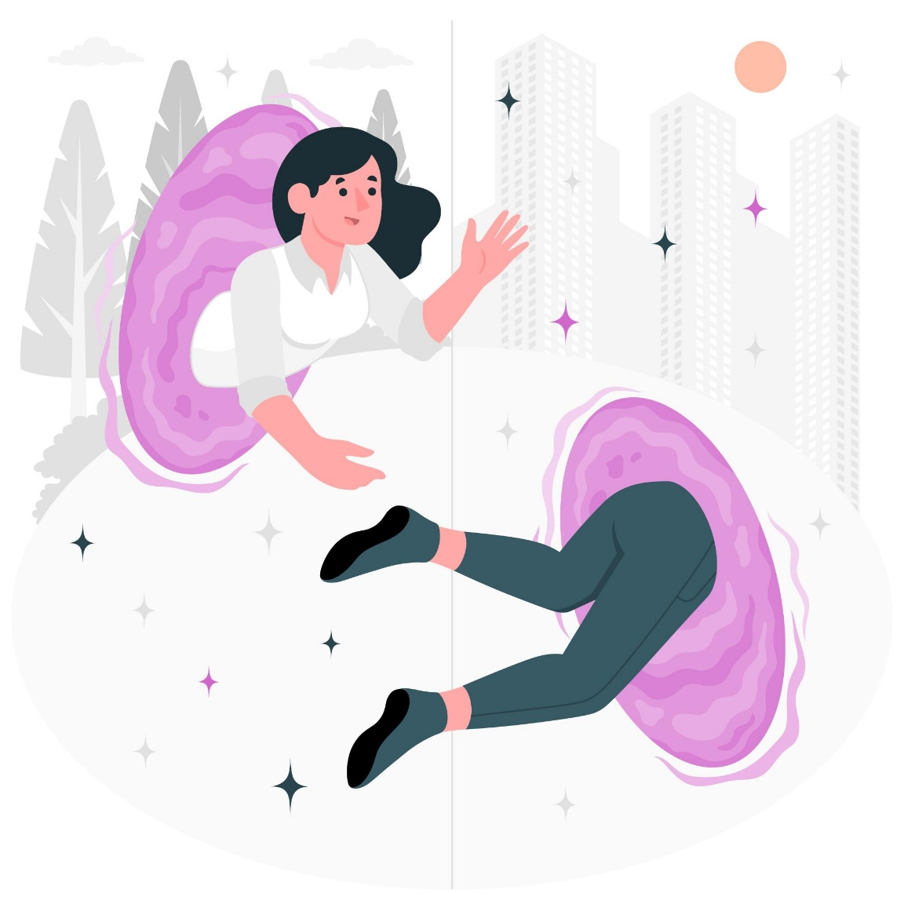
PRESENTATION
teleporter (n)
/ˈtelɪpɔːtər/
phương tiện di chuyển tức thời

Slide 10
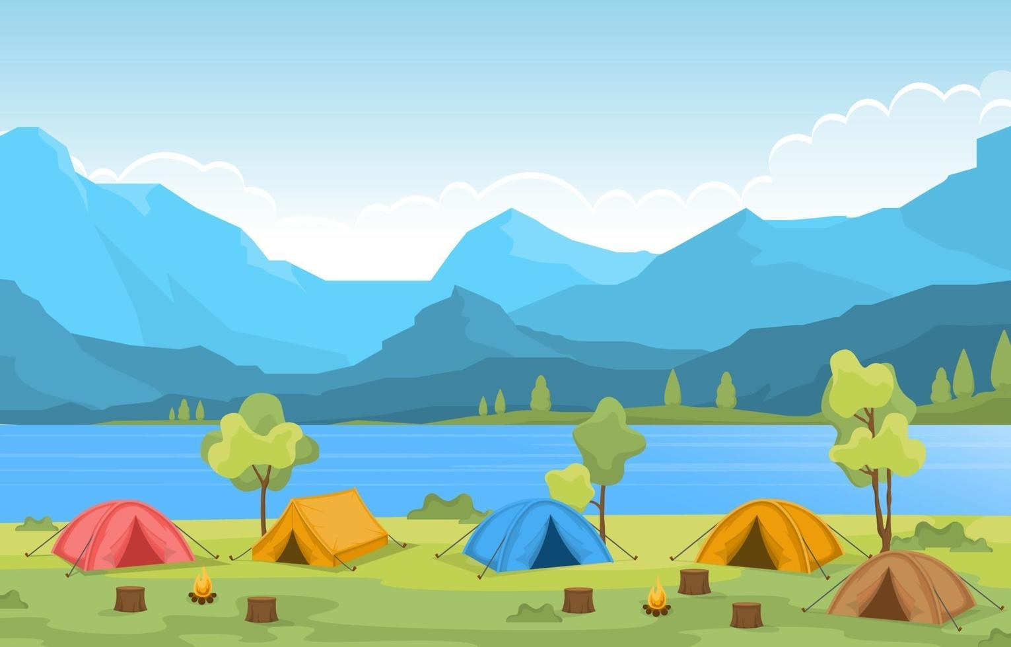
PRESENTATION
campsite (n)
/ˈkæmpsaɪt/
địa điểm cắm trại

Slide 11
PRESENTATION
New words | Pronunciation | Meaning
1. eco-friendly (adj) | /ˈiːkəʊˌfrendli/ | thân thiện với môi trường
2. fume (n) | /fjuːm/ | khói
3. hyperloop (n) | /ˈhaɪpərluːp/ | hệ thống giao thông tốc độ cao
4. teleporter (n) | /ˈtelɪpɔːtər/ | phương tiện di chuyển tức thời
5. campsite (n) | /ˈkæmpsaɪt/ | địa điểm cắm trại

Slide 12

PRACTICE
1
Listen and read. What are Ann and Minh talking about?
Minh: Oh, another traffic jam.
Ann: How will we get to the campsite on time now?
Minh: I don’t know. It’s a pity that we don’t have a hyperloop now!
Ann: What’s a hyperloop?
Minh: It’s a system of tubes. You can go from one place to another in just minutes.
Ann: Amazing! Even faster than a flying car!
Minh: Yes, and there are no traffic jams.
Ann: Will it pollute the environment?
Minh: No. There will be no fumes, and it’s totally safe.
Ann: Like a teleporter?
Minh: A teleporter is also fast, safe and eco-friendly. But it’s a different mode of travel.
Ann: So when we travel in hyperloops, we won’t have to worry about bad weather, right?
Minh: Right.
Ann: Sounds great! I hope we’ll have them soon.

Slide 13
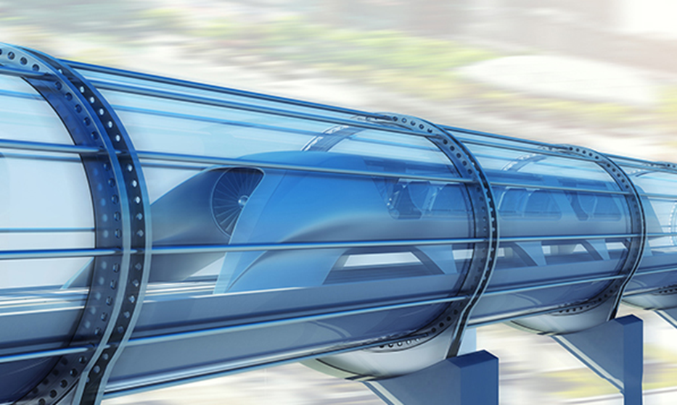
PRACTICE
1
Listen and read. What are Ann and Minh talking about?
A. Travelling by teleporter
B. Future modes of travel
C. Being in a traffic jam

Slide 14
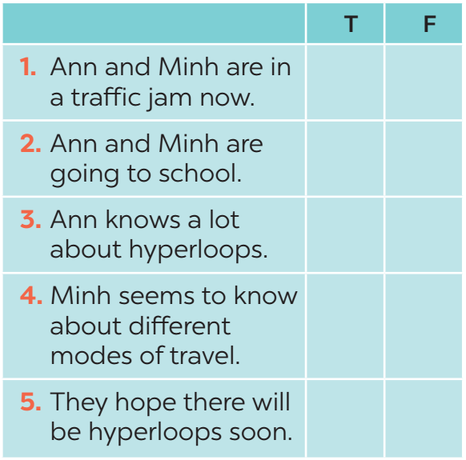

PRACTICE
2
Read the conversation again and tick T (True) or F (False).
→ Ann: How will we get to the campsite on time now?
→ Ann: What’s a hyperloop?

Slide 15
PRACTICE
3
Find the words and phrases that describe the means of transport in the conversation and write them in the correct columns.
Hyperloop | Teleporter
a system of tubes
fast
faster than a flying car
safe
no traffic jams
eco-friendly
no fumes
safe

Slide 16
PRACTICE
4
Quiz. What vehicle is this?
1. It has two wheels and you pedal it.
2. It has four wheels. It runs on petrol or electricity, and can carry up to eight passengers.
3. It carries many passengers and runs on tracks.
4. It sails on the sea. It needs wind to sail.
5. It travels in space. It can even carry people to the moon.
→ bicycle / bike
→ car
→ train
→ sailing boat
→ rocket / spaceship

Slide 17
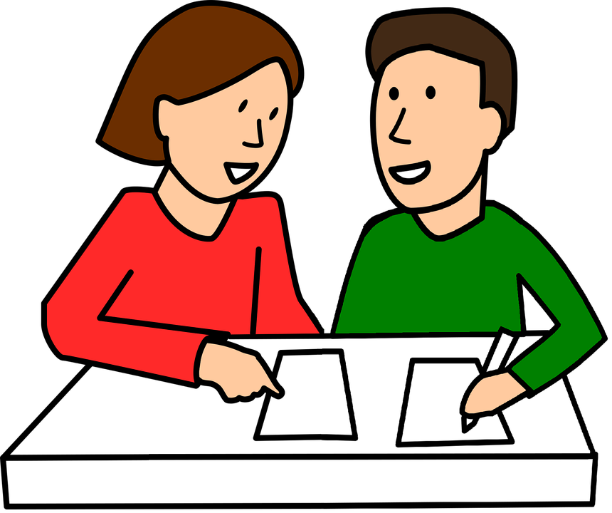
PRODUCTION
5
Discussion: What do you think these vehicles will be like in 50 years?

Slide 18
CONSOLIDATION
1
WRAP-UP
Topic of the unit
Vocabulary
Travelling in the future
Future means of transport

Slide 19
CONSOLIDATION
2
HOMEWORK
Prepare the vocabulary for the next lesson: A closer look 1.
Do the exercise in the Workbook.

