Slide 1


Slide 2
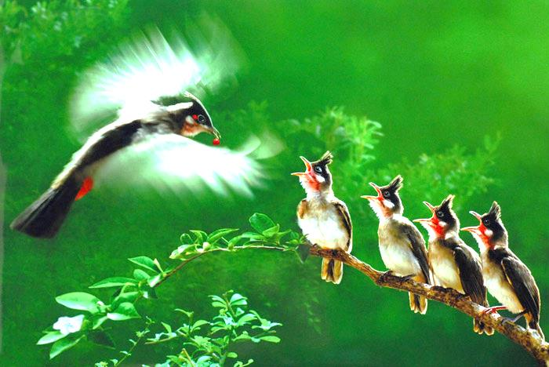

6D5
Nam Hai secondary school
Welcome to our lesson !

Slide 3
1
C | L | E | V | E | R
2
B | U | S | T | O | P
3
T | E | M | P | L | E
4
P | E | A | C | E | F | U | L
5
C | A | T | H | E | D | R | A | L
6
S | Q | U | A | R | E
7
N | O | I | S | Y
8
E | X | P | E | N | S | I | V | E
9
B | O | R | I | N | G
10
M | O | D | E | R | N

Slide 4
1. He always get good marks. He does exercises at school quickly. He is…………
CLEVER

Slide 5
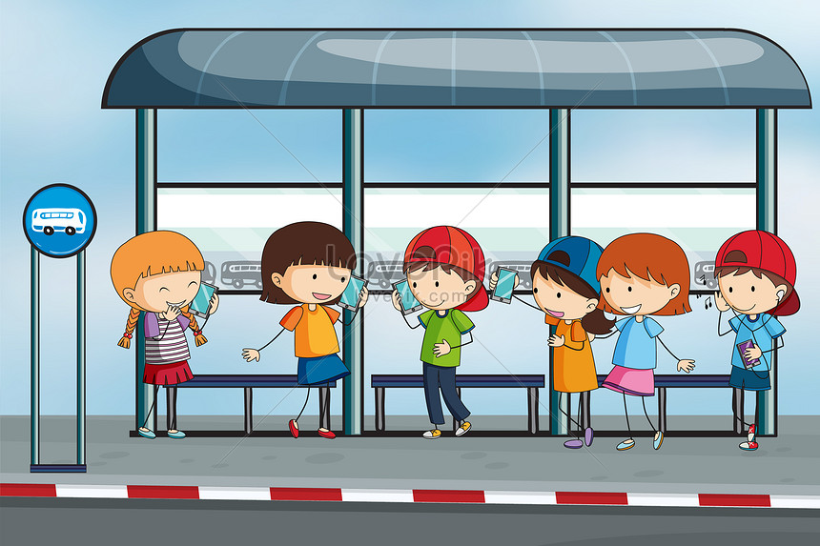
2. What is this?
Bus stop

Slide 6
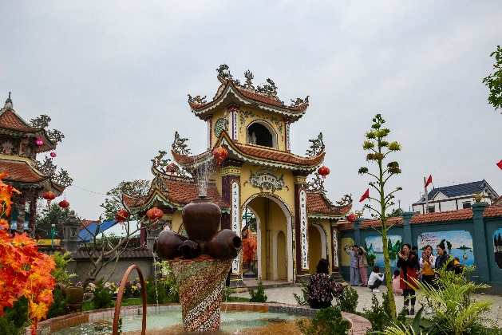
3. What is this?
a
TEMPLE

Slide 7
4. ……………# NOISY
PEACEFUL

Slide 8
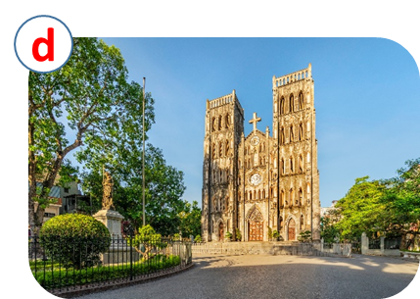
5. What is this?
CATHEDRAL

Slide 9
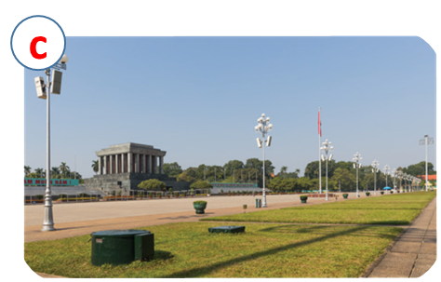
6. What is this?
SQUARE

Slide 10
7. The city is crowed. It is…………
NOISY

Slide 11
8. ……………# cheap
EXPENSIVE

Slide 12
9. I don’t like living in the coutryside because it is…………….
BORING

Slide 13
10…………………….# HISTORIC
MODERN

Slide 14


UNIT 4: MY NEIGHBOURHOOD
LESSON 3

Slide 15

*Grammar
Comparative adjectives
We can use comparative adjectives to compare two people or things.

Slide 16
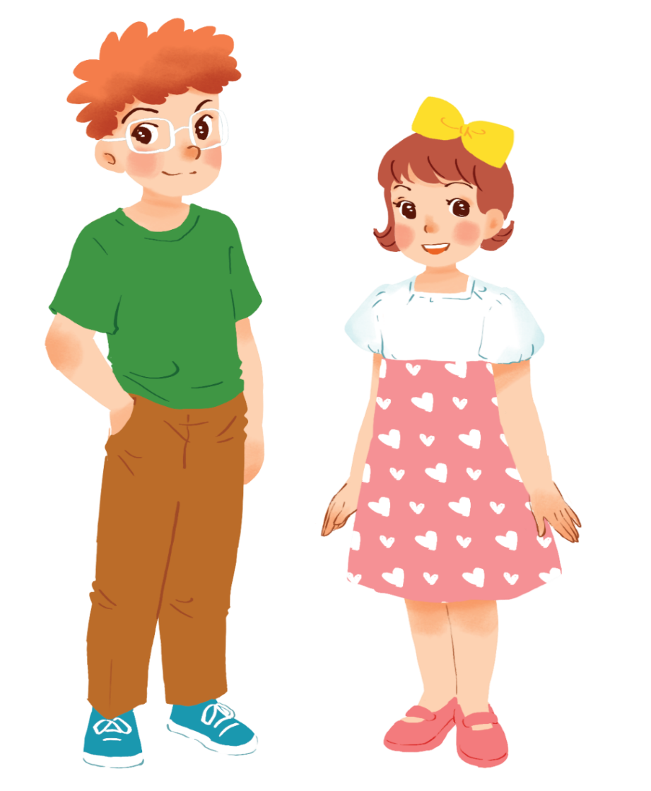
Example:
Tom is taller than Mary.

Slide 17
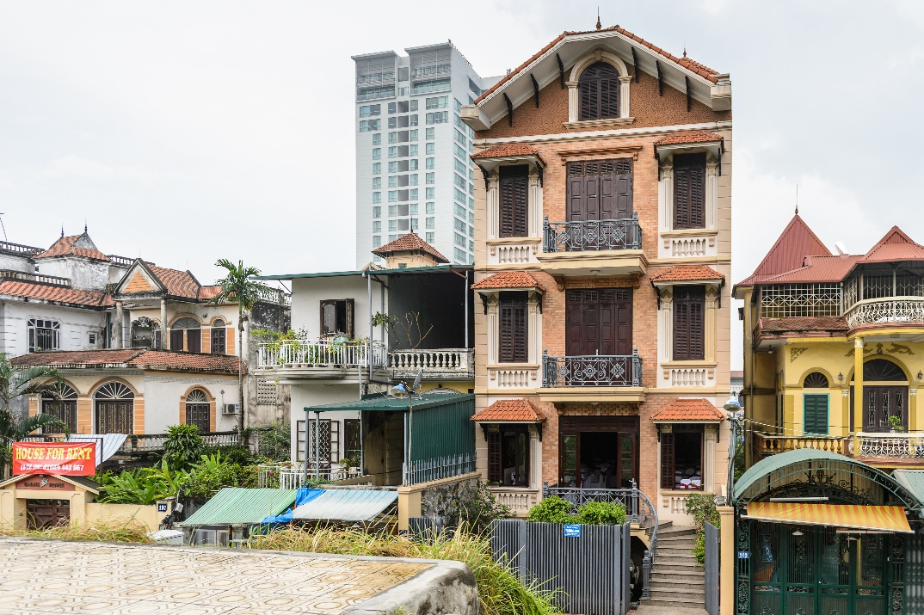
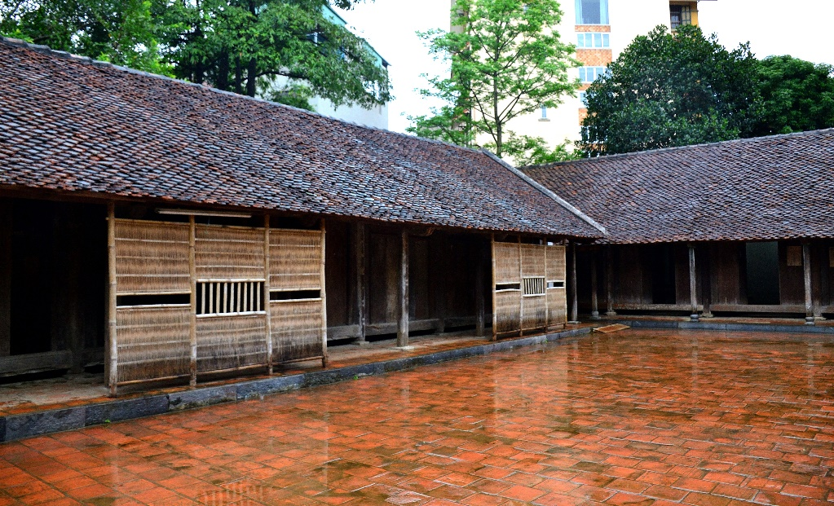
Example:
A house in a city is normally more expensive than a house in the countryside.

Slide 18
* Form:
Comparative adjectives: (Cấp so sánh hơn của tính từ).
+ Short Adj:
S + be + adj-ER + than + S’.
+ Long Adj:
S + be + MORE + adj + than + S’.

Slide 19
* Note:
syllable | Positive | Comparative | Rule
fast
faster
+ er
one
syllable
large
larger
+ r
big
bigger
+ ...er
two
syllables
noisy
noisier
y → ier

Slide 20

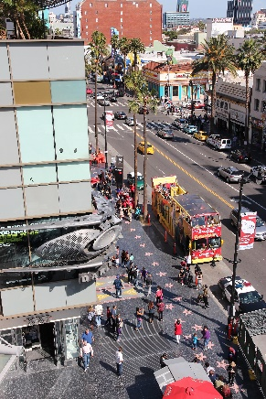
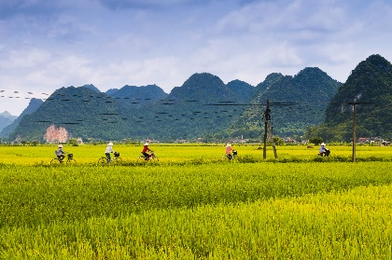
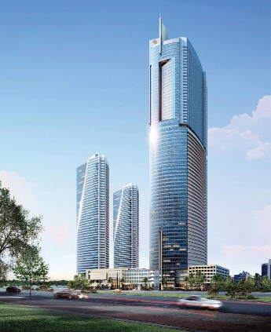
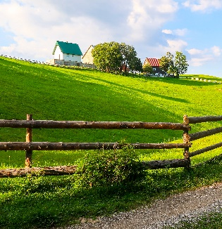
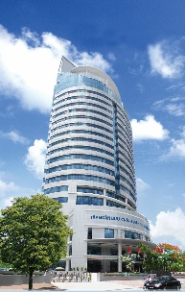
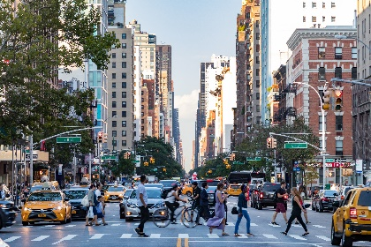
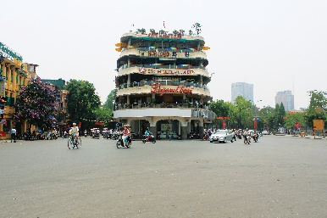
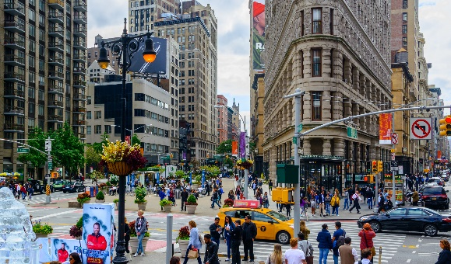
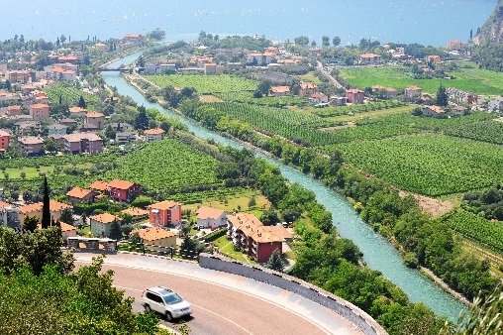
Complete the following sentences with the comparative form of the adjectives in brackets. Number 1 is an example.

Slide 21


Tom
Jerry
40
Lucky Numbers
10
20
30
60
70
80
50
70
10
40
20
30
60
50
1
2
3
4
5
6
7
8

Slide 22
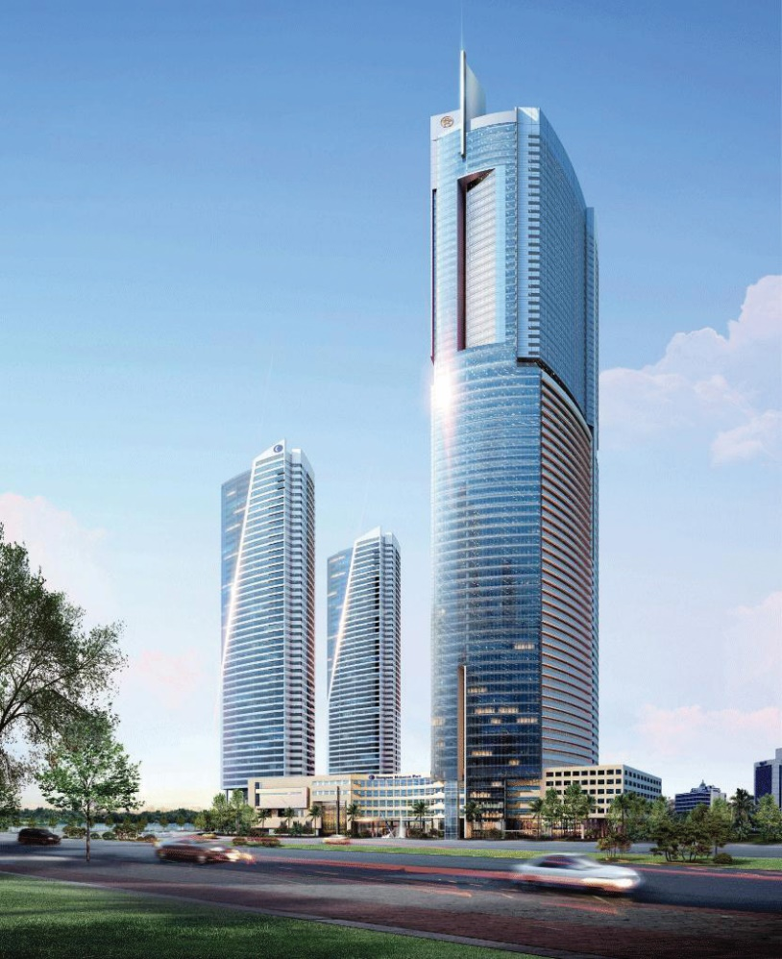

1.
taller
This building is…. ……….than that building. (tall)

Slide 23
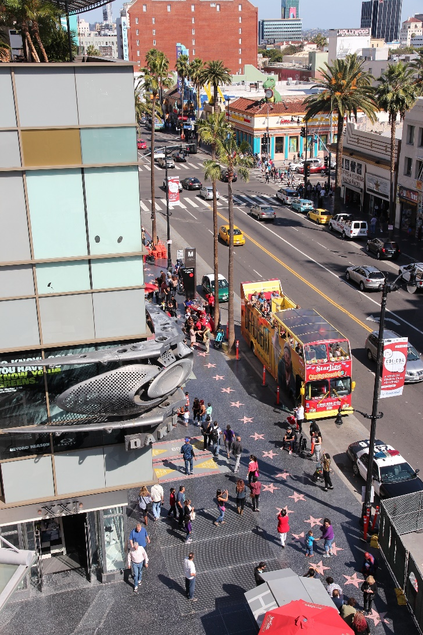

2.
My neighbourhood is than your neighbourhood. (noisy)
noisier

Slide 24

The square in Ha Noi is than the square in Hoi An. (big)
3.
bigger

Slide 25


4.
Living in the countryside is
in a city. (peaceful)
more peaceful
than living

Slide 26
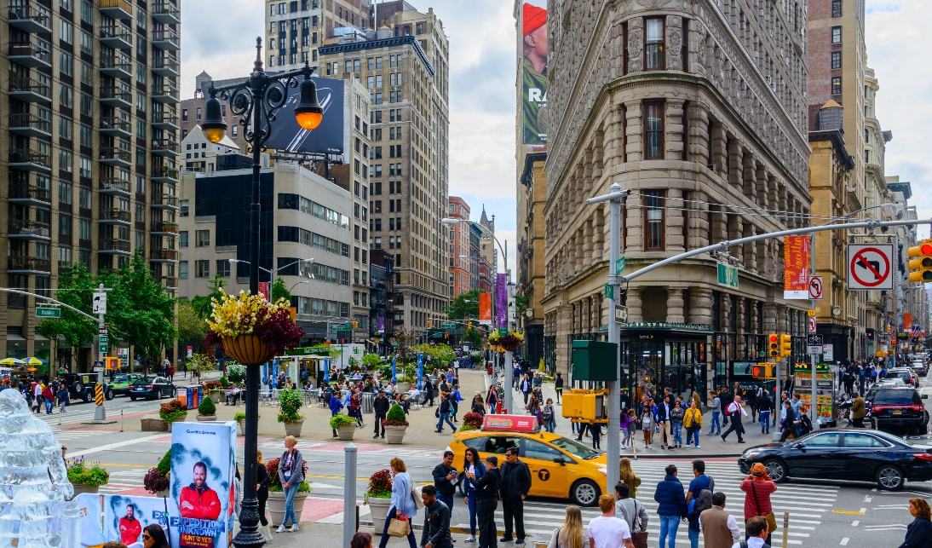

more exciting
than living
5.
Is living in a city
in the countryside? (exciting)

Slide 27
more expensive
Things in this shop is …………......……than things in the supermarket ( expensive).

Slide 28

LUCKY NUMBER!

Slide 29
LUCKY NUMBER!

Slide 30


Use the correct form of the words in brackets to complete the letter.
Dear Nick,
How are you?
Ha Noi is beautiful but it’s too busy for me. I’m having a great time at Cua Lo Beach now. The weather is (1. hot) ______ than that in Ha Noi. The houses and buildings are (2. small) _______ and (3. old) _______ than those in Ha Noi.
The streets are (4. wide) _______ with less traffic. the seafood here is (5. delicious) _______ and (6. cheap) _______ than the seafood in Ha Noi.
See you soon,
Vy

Slide 31
Use the correct form of the words in brackets to complete the letter.
Dear Nick,
How are you?
Ha Noi is beautiful but it’s too busy for me. I’m having a great time at Cua Lo Beach now. The weather is (1. hot) hotter than that in Ha Noi. The houses and buildings are (2. small) smaller and (3. old) older than those in Ha Noi.
The streets are (4. wide) wider with less traffic. the seafood here is (5. delicious) more delicious and (6. cheap) cheaper than the seafood in Ha Noi.
See you soon,
Vy

Slide 32

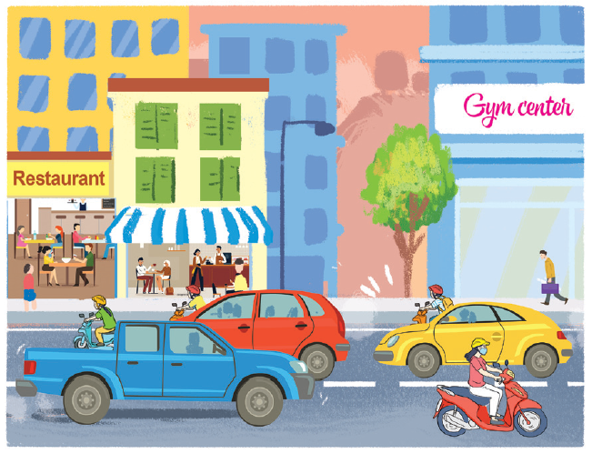
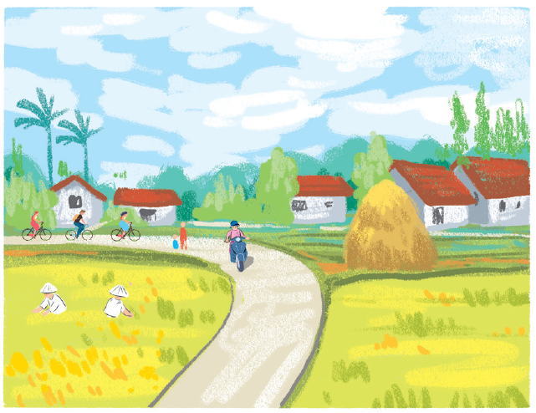
Look at the pictures of the two neighbourhoods: Binh Minh and Long Son. Compare two neighbourhoods. You can use the adjectives below.
noisy
quiet
modern
boring
crowded
peaceful
busy
Example:
Binh Minh is noisier than Long Son.
Binh Minh
Long Son

Slide 33

Work in pairs. Ask and answer questions about Binh Minh and Long Son neighborhoods using the pictures in 3.
1. Binh Minh / crowded / Long Son?
2. Long Son / modern / Binh Minh?
3. Binh Minh / noisy / Long Son?
4. Long Son / beautiful / Binh Minh?
5. Long Son / peaceful / Binh Minh?
Example:
A: Is Binh Minh noisier than Long Son?
B: Yes, it is.
A: Is Long Son more modern than Binh Minh?
B: No, it isn’t.

Slide 34

* Home ASSIGNMENT
- Do exercise in workbook.
Make five sentences using comparative adjective

Slide 35

Thank you very much.

