Slide 1

Warmly welcome to our class
English 6 D4
Nam Hai Secondary School
Nguyen Thi Hoang Huong

Slide 2


ENGLISH 6
Unit 4:
MY NEIGHBOURHOOD

Slide 3
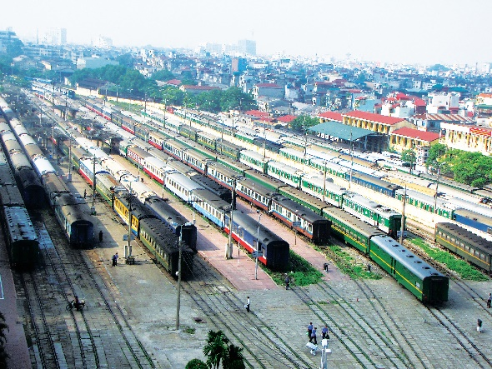
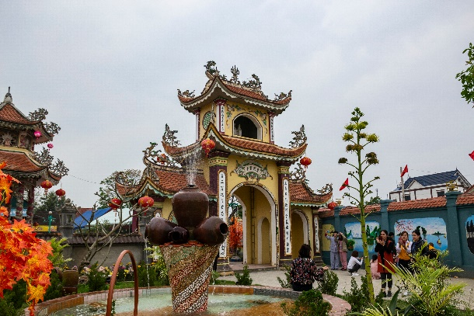
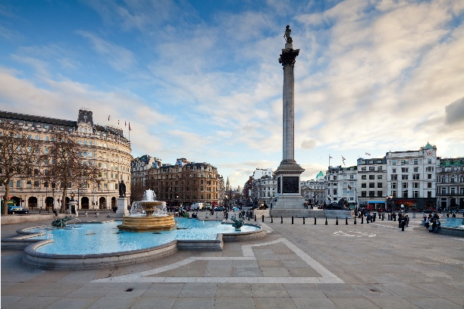
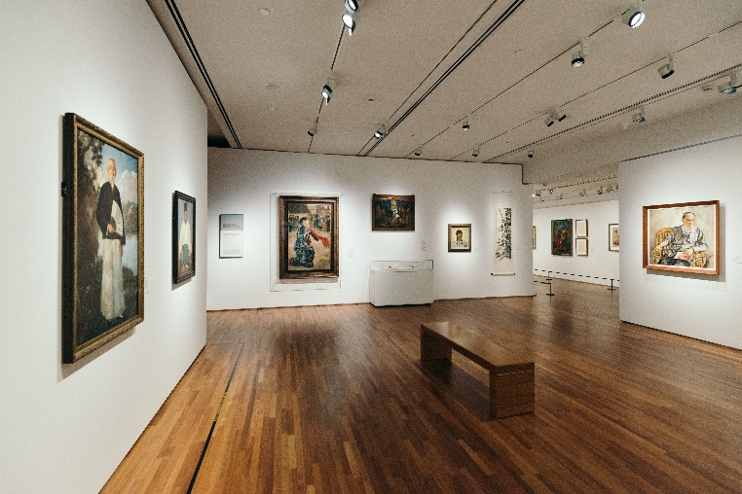
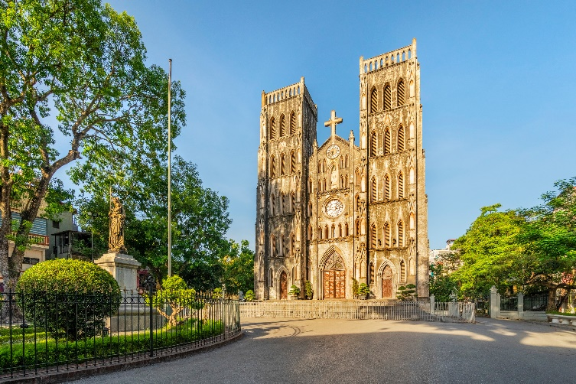
KIM’S GAME

Slide 4
KIM’S GAME
10
9
3
2
1
7
6
5
4
8

Slide 5
KIM’S GAME
1. temple
2. railway station
3. square
4. art gallery
5. cathedral

Slide 6


Unit 4:
MY NEIGHBOURHOOD
LESSON 7

Slide 7

Write the name for each picture.
1. temple
2. railway station
3. square
4. art gallery
5. cathedral

Slide 8
Grammar
Short adjective has one syllable or two syllables that end with y, ow, le, er, et.
(Tính từ ngắn là các tính từ có 1 âm tiết hoặc một số tính từ có 2 âm tiết được kết thúc bằng y, ow, le, er, et.)
So sánh hơn: S1 + be + adj + er + than + S2
Long adjective has two or more syllables
(Tính từ dài là các tính từ có 2 âm tiết trở lên)
So sánh hơn: S1 + be + more + adj + than + S2

Slide 9

Put the following adjectives in the correct column.
fast
hot
large
expensive
exciting
fast
hot
large
expensive
exciting
heavy
noisy
quiet
beautiful
heavy
noisy
quiet
beautiful
One syllable | Two syllables | Three or more syllables
fast
heavy
expensive
hot
noisy
exciting
large
quiet
beautiful

Slide 10

Now write their comparative forms in the table below.
Adjectives | Comparative form
fast | faster
beautiful
noisy
expensive
hot
exciting
quiet
heavy
large
more beautiful
noisier
more expensive
hotter
more exciting
quieter
heavier
larger

Slide 11

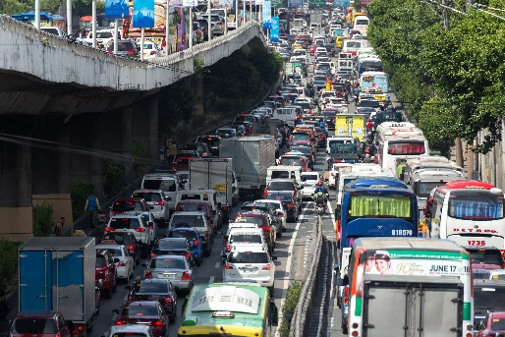
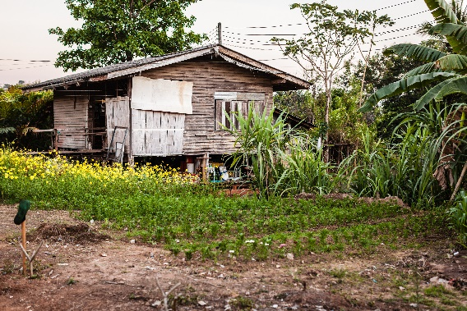
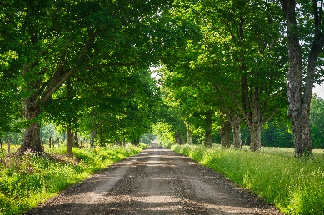
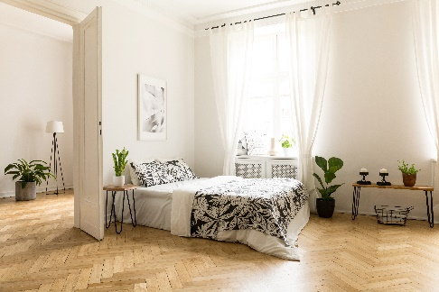
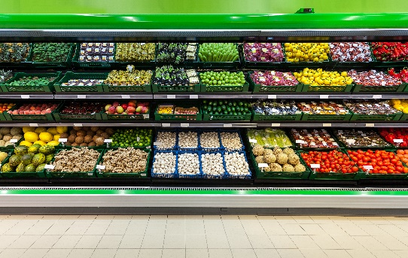
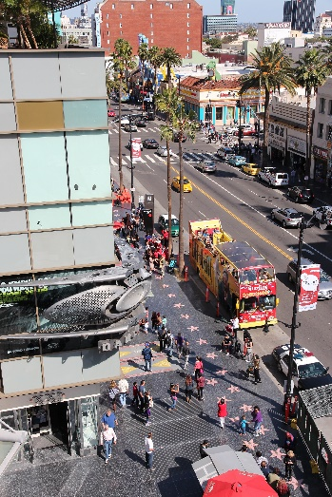
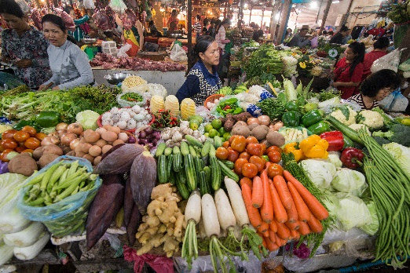
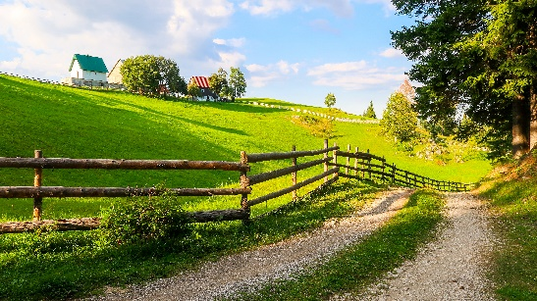
Complete the sentences comparing the pictures. Use the comparative forms of the adjectives below.
expensive
noisy
modern
peaceful

Slide 12



GAME:
LUCKY APPLE
5
3
3
6
1
4
2

Slide 13
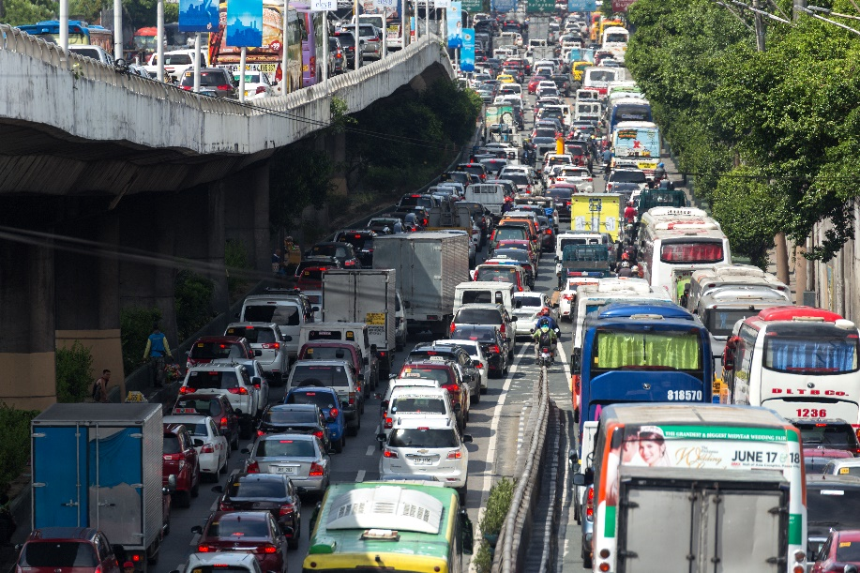

expensive
noisy
modern
peaceful
noisier
1. This street is ……………. than that one.

Slide 14


expensive
noisy
modern
peaceful
more modern
2. A city house is…. …………………..than a country house.

Slide 15
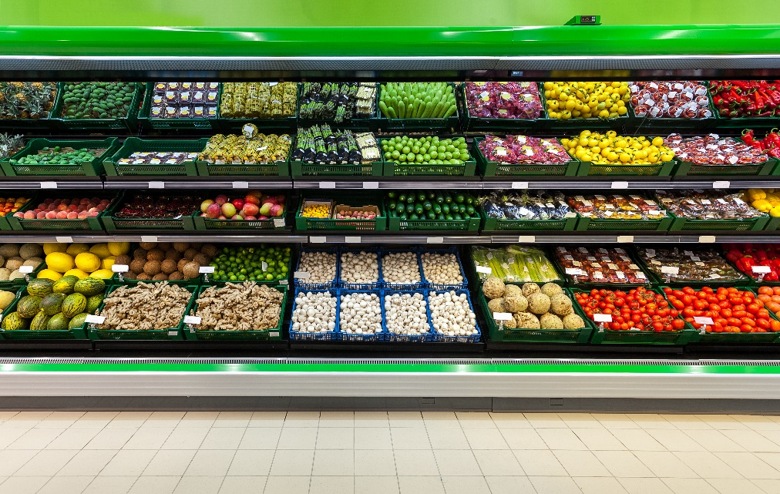

expensive
noisy
modern
peaceful
more expensive
3. Things at a corner shop are ……………………….than things
at a village market.

Slide 16


expensive
noisy
modern
peaceful
more peaceful
4. Life in the countryside is…. …………………than life
in the city.

Slide 17
LUCKY APPLE

Slide 18
LUCKY APPLE

Slide 19
PRODUCTION
* Rewrite the sentences using the words in brackets.
Quang is lazier than Ha. (HARD-WORKING)
2. A city is noisier than a village. (PEACEFUL)
3. There’s a post office on one side of my house and a café on the other. (BETWEEN)
4. Please tell me something about your neighbourhood. (CAN)
5. Oranges are cheaper than apples. (EXPENSIVE)
→ Ha is more hard-working than Quang.
→ A village is more peaceful than a city.
→ My house is between a post office and a café .
→ Can you tell me something about your neighbourhood?
→ Apples are more expensive than oranges.

Slide 20



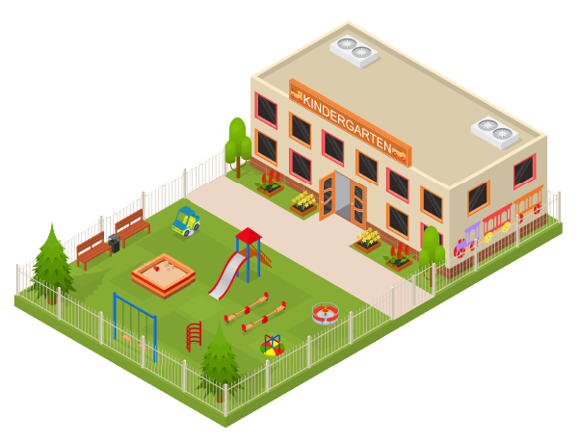
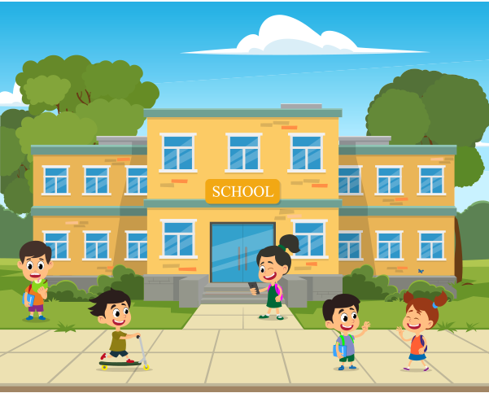
Draw a map of a neighbourhood. Write names of at least five places on your map.

Slide 21
Work in pairs. Take turns to ask for and give directions to the places on the map.

Slide 22


Home assignments:
Do section E in workbook.
Be ready for Unit 5 – Lesson 1

Slide 23


Thank you for your attention!

