Slide 1


Slide 2



Unit
2
HEALTHY LIVING
LESSON 2: A CLOSER LOOK 1

Slide 3

WARM-UP: FACE TO FACE
HEALTHY ACTIVITIES

Slide 4


VOCABULARY
dim light (n)
/dɪm lait/
ánh sáng lờ mờ

Slide 5
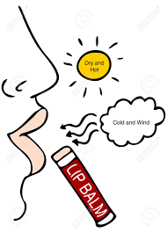
VOCABULARY
lip balm (n)
/ˈlɪp ˌbɑːm/
son dưỡng môi

Slide 6
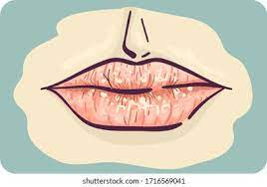
VOCABULARY
chapped lips (n)
/tʃæpt lɪps /
môi nứt nẻ

Slide 7
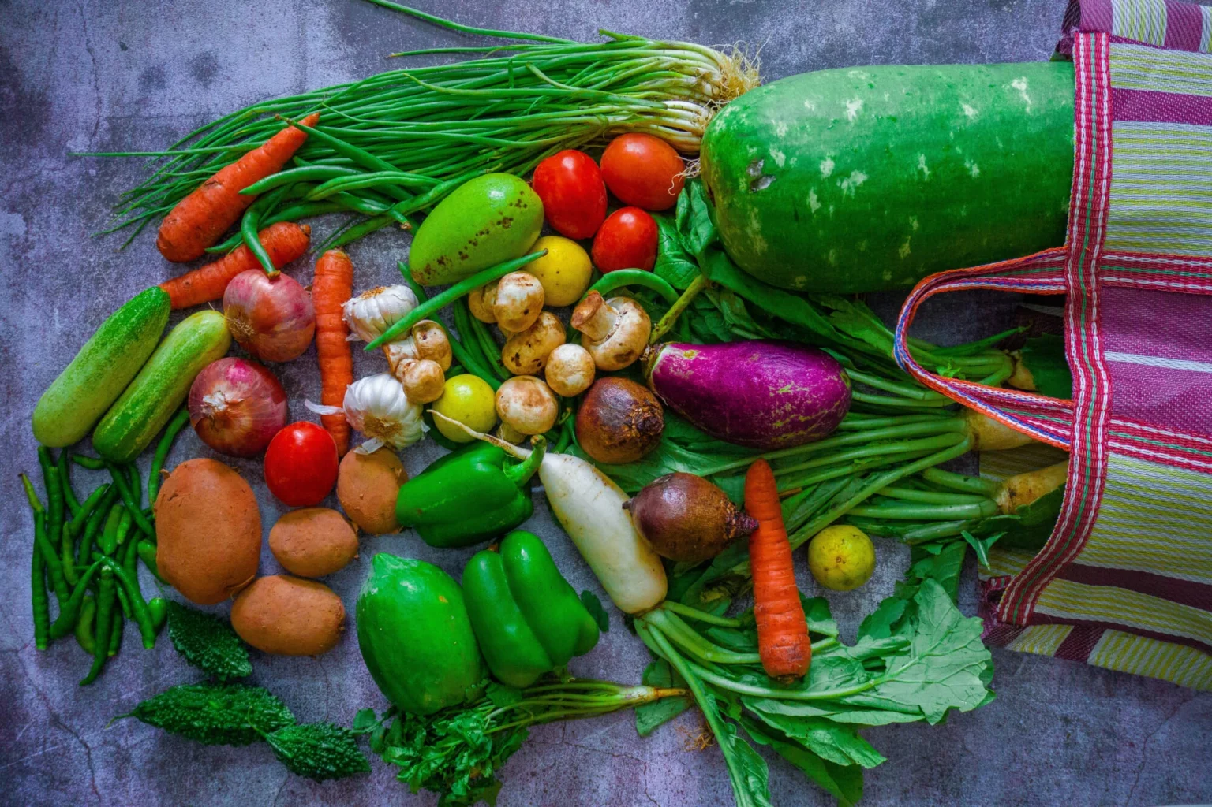
VOCABULARY
coloured vegetables (n)
/ ˈkʌləd ˈvedʒtəbəl/
rau có màu sắc

Slide 8
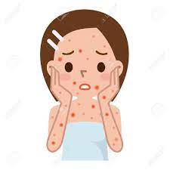
VOCABULARY
red spots (n)
/red spɒt/
đốm đỏ

Slide 9
VOCABULARY
New words | Pronunciation | Meaning
1. dim light (n) | /dɪm lait/ | ánh sáng lờ mờ
2. lip balm (n) | /ˈlɪp ˌbɑːm/ | son dưỡng môi
3. chapped lips (n) | /tʃæpt lɪps / | môi nứt nẻ
4. coloured vegetables (n) | / ˈkʌləd ˈvedʒtəbəl/ | rau có màu sắc
5. red spots (n) | /red spɒt/ | đốm đỏ

Slide 10
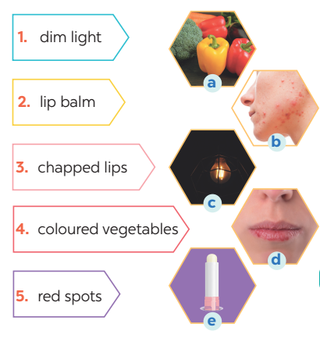
VOCABULARY
1
Match the phrase on the left with the correct pictures on the right.
1. c
2. e
3. d
4. a
5. b

Slide 11
VOCABULARY
2
Complete the sentences with the correct words and phrases.
skin condition soft drinks coloured vegetables sunburn fit
coloured vegetables
1. - Please name some ________________________.
- Carrots and tomatoes.
2. ___________ are not good for your health. 3. My parents go cycling every Sunday. It keeps them _______. 4. The weather may affect our ________________. 5. - How do we get _________?
- When we spend a long time in the sun without a hat or suncream.
Soft drinks
fit
skin condition
sunburn

Slide 12

VOCABULARY
3
Discuss and tick each activity in the table as H (Healthy) or U (Unhealthy).
 | H | U
1. washing your hands often
2. reading in dim light
3. eating tofu and coloured vegetables
4. brushing your teeth twice a day
5. touching your face with dirty hands

Slide 13
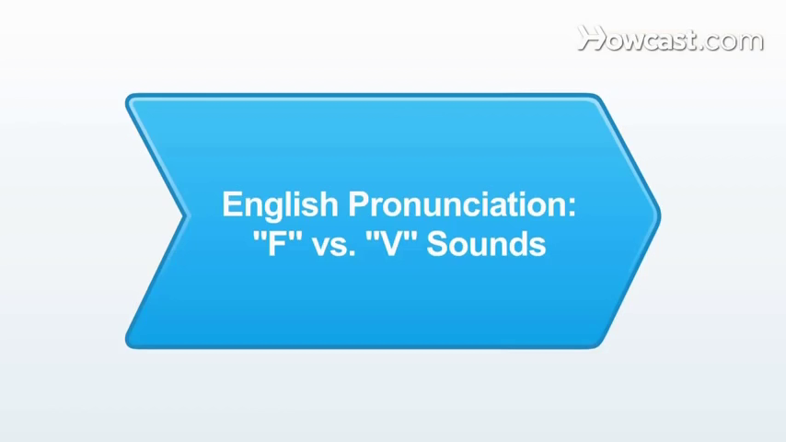
PRONUNCIATION
/f/ and /v/

Slide 14
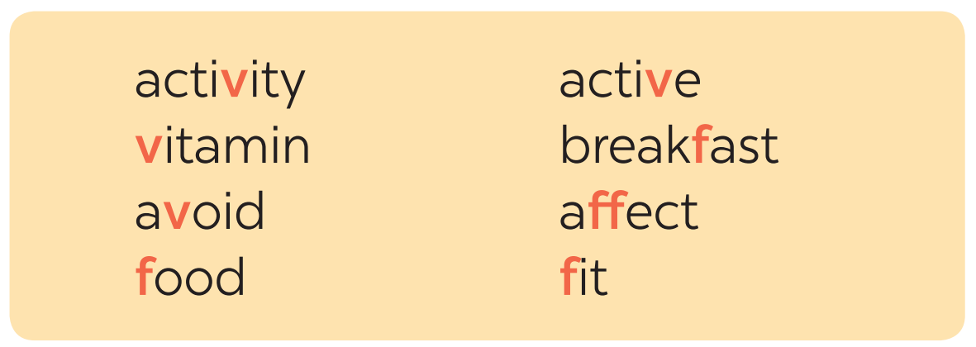
PRONUNCIATION
4
Listen and repeat the words. Pay attention to the sounds /f/ and /v/.

Slide 15

PRONUNCIATION
5
Listen and repeat, paying attention to the underlined words.
1. Coloured vegetables are good food. 2. My favorite outdoor activity is cycling. 3. We need vitamin A for our eyes. 4. Being active helps keep you fit. 5. Jack never eats fish.
/f/ and /v/

Slide 16
FOOD GAME

Slide 17
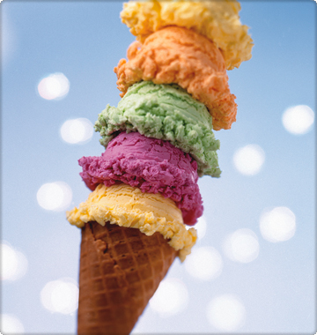
What is this?
an ice cream
Well done !
a sweet
crisps

Slide 18
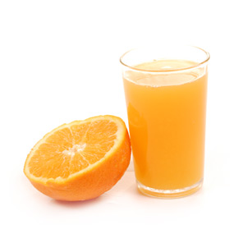
What is this?
some tea
Well done !
some juice
some coke

Slide 19
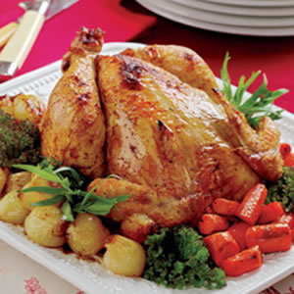
What is this?
beef
Well done !
lamb
chicken

Slide 20
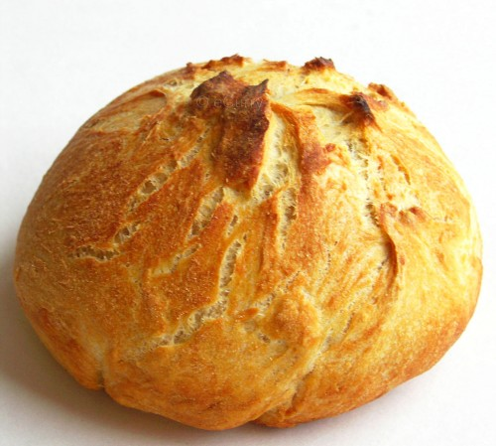
What is this?
pasta
Well done !
bread
lentil

Slide 21
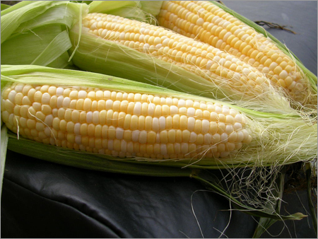
What is this?
cauliflower
Well done !
aubergine
corn

Slide 22
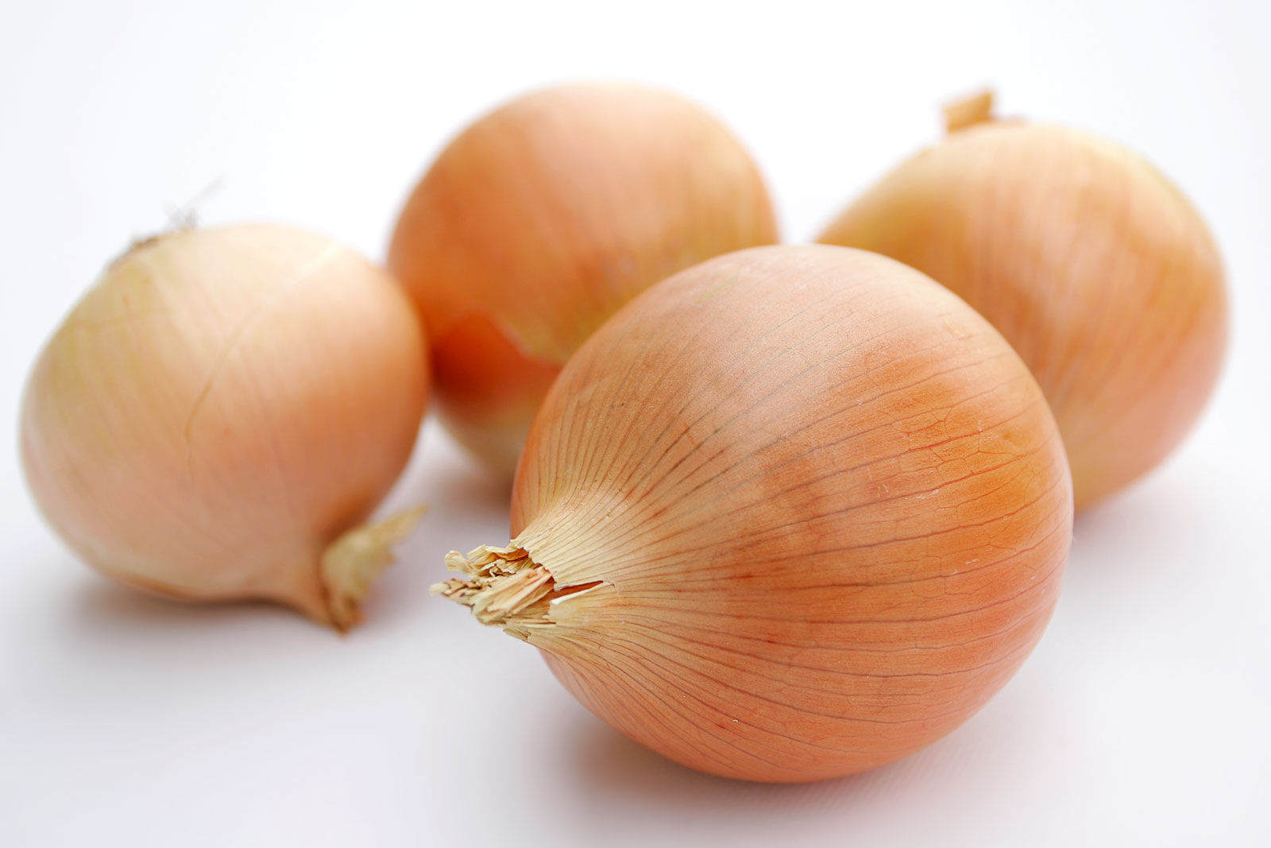
What is this?
garlic
Well done !
onion
rice

Slide 23
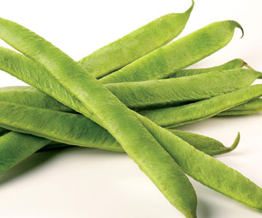
What is this?
courgette
Well done !
pasta
green beans

Slide 24
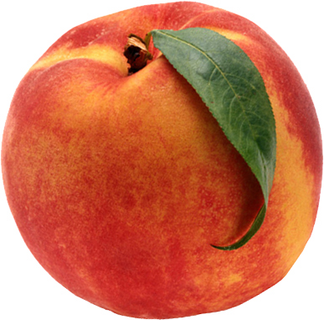
What is this?
peach
Well done !
strawberry
orange

Slide 25
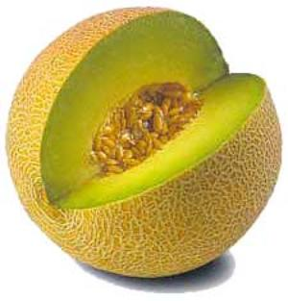
What is this?
watermelon
Well done !
melon
tea

Slide 26
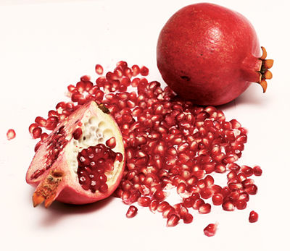
What is this?
pepper
Well done !
lamb
pomegranate

Slide 27
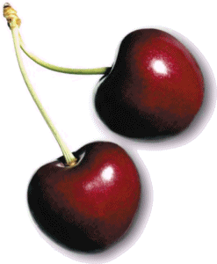
What is this?
cherries
Well done !
apricot
bread

Slide 28
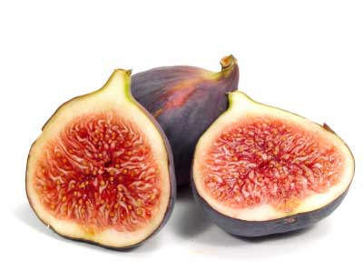
What is this?
green beans
Well done !
corn
fig

Slide 29
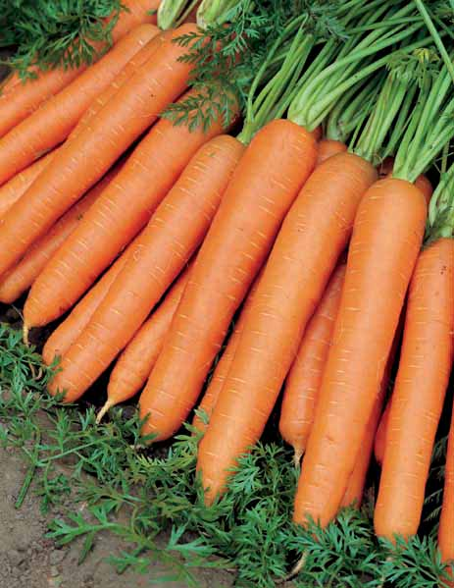
What is this?
potato
Well done !
carrot
peas

Slide 30
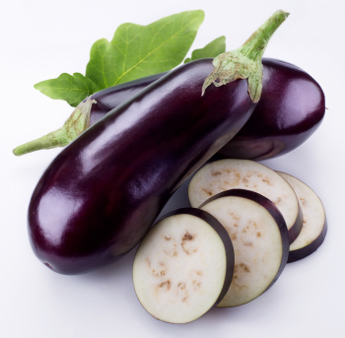
What is this?
aubergine
Well done !
cauliflower
pomegranate

Slide 31
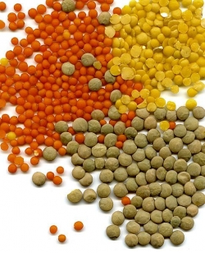
What is this?
bread
Well done !
milk
lentil

Slide 32
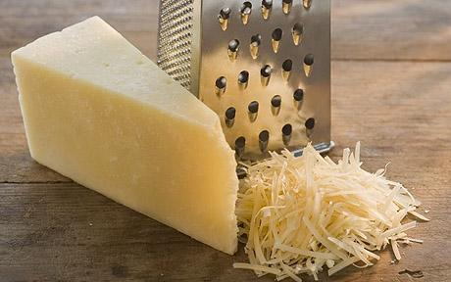
What is this?
milk
Well done !
cheese
garlic

Slide 33
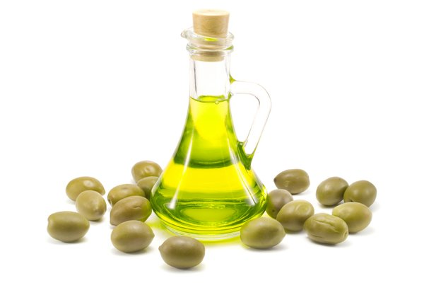
What is this?
butter
Well done !
oil
rice

Slide 34
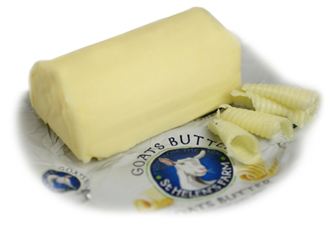
What is this?
peach
Well done !
lamb
butter

Slide 35
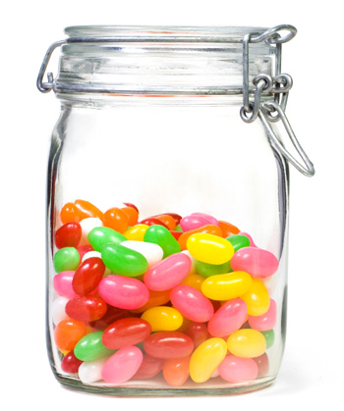
What is this?
sweets
Well done !
peas
cherries

Slide 36


Slide 37


Slide 38
Do more exercises in workbook.
Find 5 more words with the sound /f/ and 5 more words with the sound /v/. Write them down and practice pronouncing the words.

Slide 39


