Slide 1
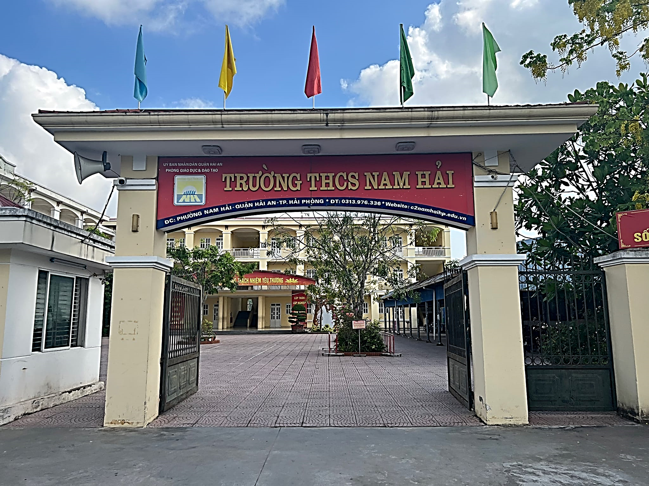
UNIT 1: MY NEW SCHOOL

Slide 2

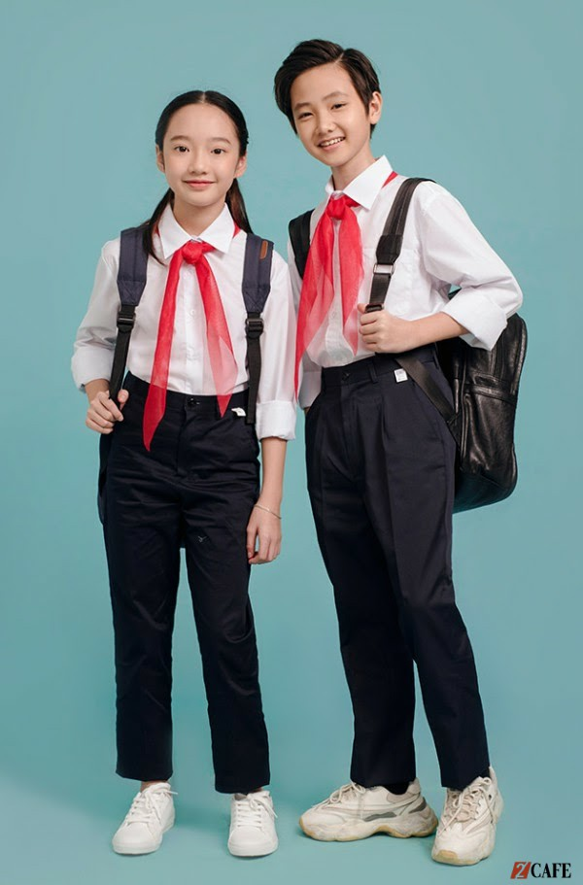
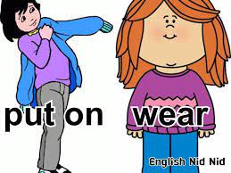
UNIT 1: MY NEW SCHOOL
LESSON 1: Getting started
A special day
* Vocabulary:
- uniform (n):
đồng phục
- heavy ( adj):
nặng
- smart (a):
thanh nhã, lịch sự
put on (phr.v):
mặc (chuẩn bị mặc vào)

Slide 3
* Checking words:
UNIT 1: MY NEW SCHOOL
Matching
uniform
put on
heavy
smart

Slide 4
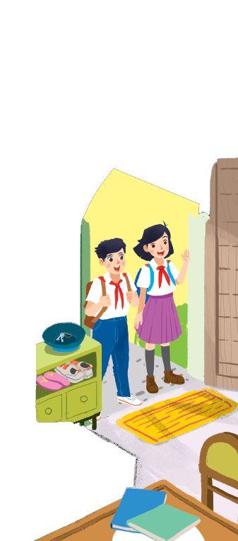
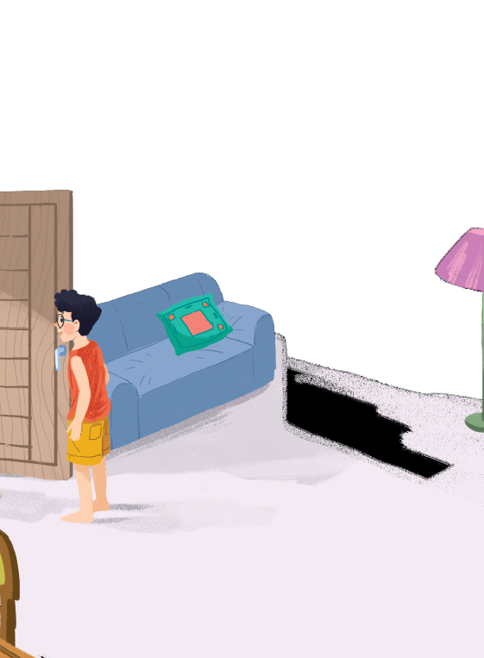



Listen and read.
A special day
Vy
Duy
Phong

Slide 5
Listen and read.
A special day
(Loud knock)
Phong: Hi, Vy.
Vy: Hi, Phong. Are you ready?
Phong: Just a minute.
Vy: Oh, this is Duy, my new friend.
Phong: Hi, Duy. Nice to meet you.
Duy: Hi, Phong. I live near here, and we go to the same school!
Phong: Good. Hmm, your school bag looks heavy.
Duy: Yes! I have new books, and we have new subjects to study.
Phong: And a new uniform, Duy! You look smart!
Duy: Thanks, Phong. We always look smart in our uniforms.
Phong: Let me put on my uniform. Then we can go.

Slide 6

Read the conversation again and tick () T (True) or F (False).
 |  | T | F
1. | Vy, Phong, and Duy go to the same school.
2. | Duy is Phong’s friend.
3. | Phong says Duy looks smart in his uniform.
4. | They have new subjects to study
5. | Phong is wearing a school uniform.
✓
Vy: oh, this is Duy, my new friend.
✓
✓
✓
Phong: Let me put on my uniform. …
✓

Slide 7

Write ONE word from the box in each gap.
go
wear
uniforms
subjects
has
Students their uniforms on Monday.
1.
wear
Vy a new friend, Duy.
2.
has
go
3.
- Do Phong, Vy, and Duy to the same school?
- Yes, they do.
Students always look smart in their .
4.
uniforms
5.
subjects
What do you like to study?
- I like to study English and history.

Slide 8

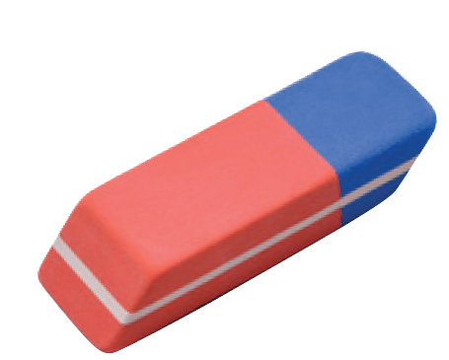
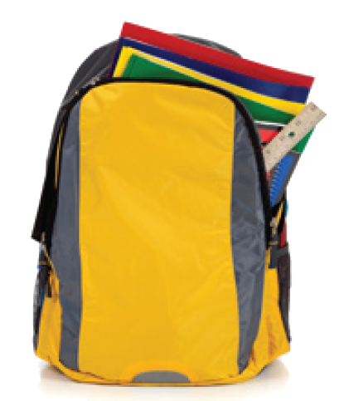
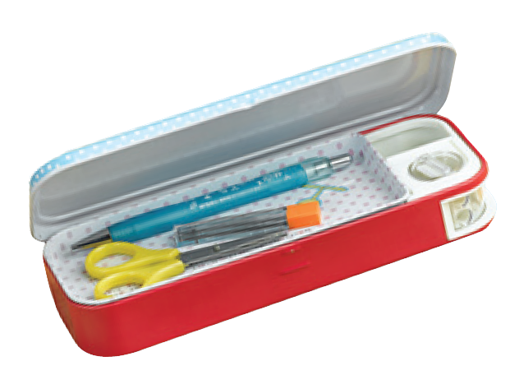
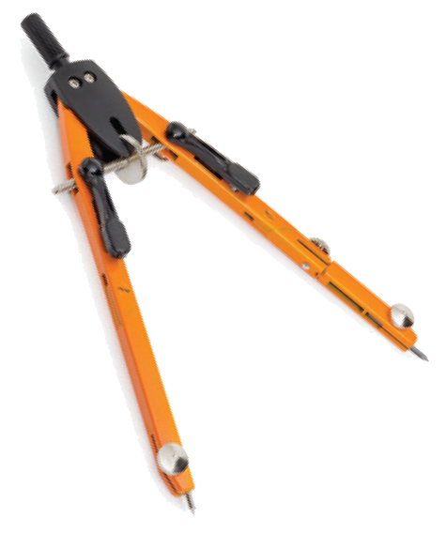
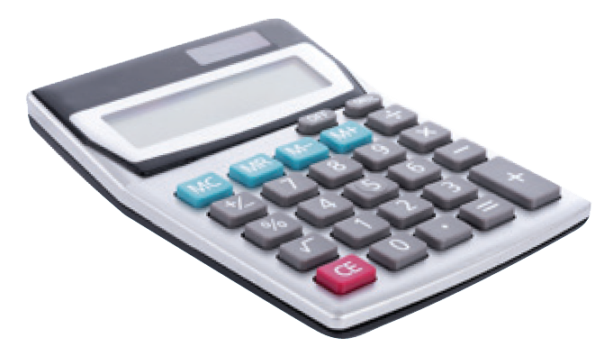
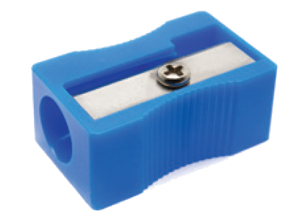
Match the word with the school things. Then listen and repeat.
pencil sharpener
4
compass
1
school bag
2
calculator
5
rubber
3
pencil case
6

Slide 9

Look around the class. Write the names of the things you see in your notebook.
Chairs, tables, desk, book, notebook, picture, clock, school bags, backpack, board, books, pen, flower pot, pencil, rubber, pencil sharpener, pencil case, calculator, compass, …

Slide 10
5. Homework - Learn by heart all the new words. - Prepare Lesson 2 ( A closer look 1/p8).

