Slide 1



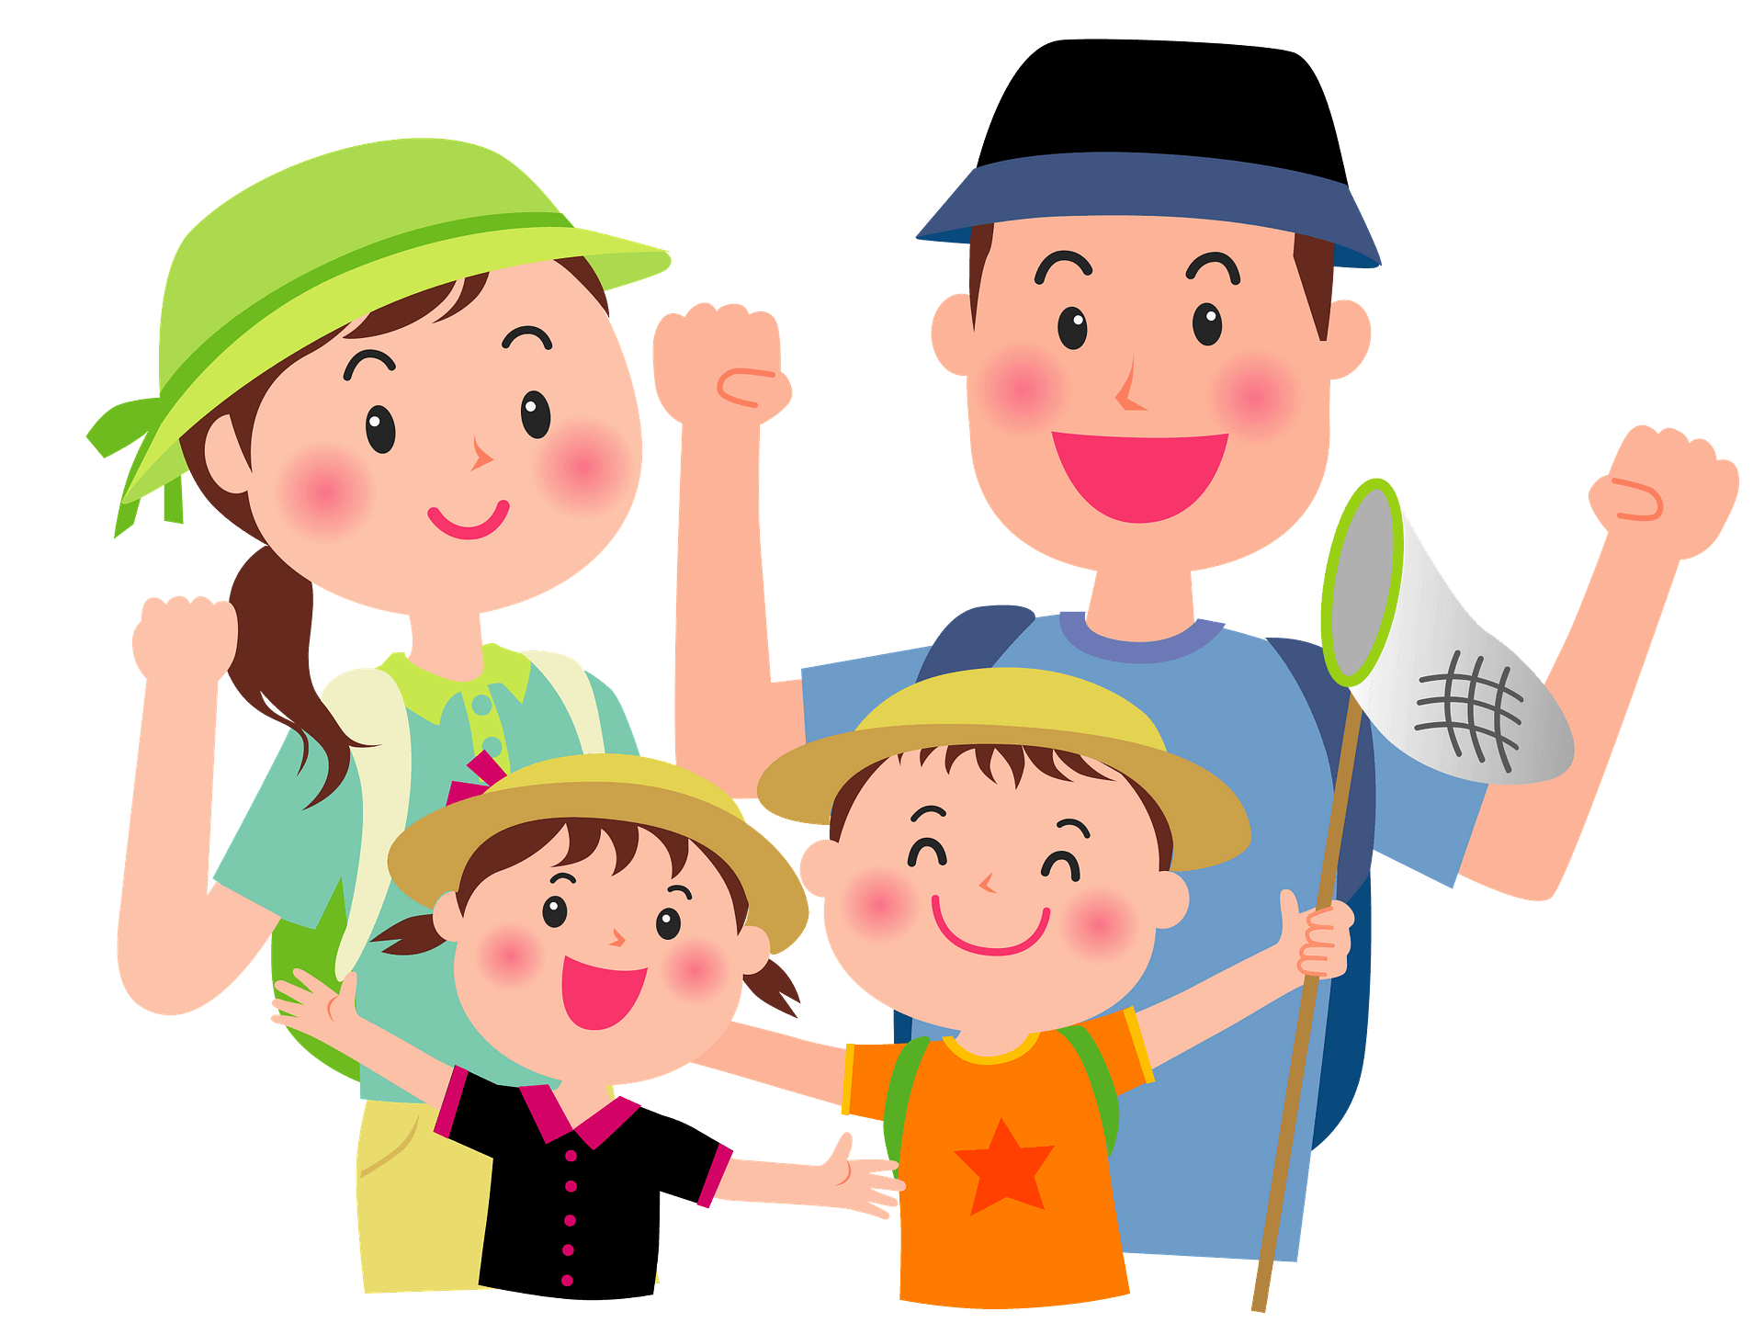
Unit
2
HEALTHY LIVING
LESSON 1: GETTING STARTED
Lets go out!
HOBBIES

Slide 2
WARM-UP: BRAINSTORMING
HEALTHY EATING

Slide 3

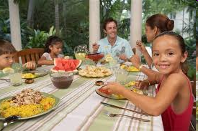
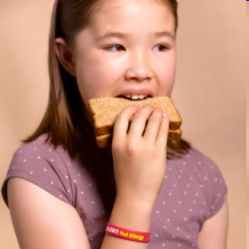
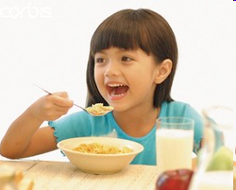
Come along and I will show you what should we eat in every meal.
breakfast
lunch
dinner

Slide 4
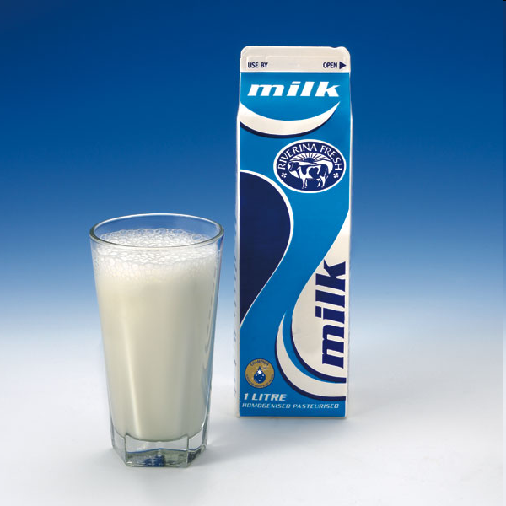
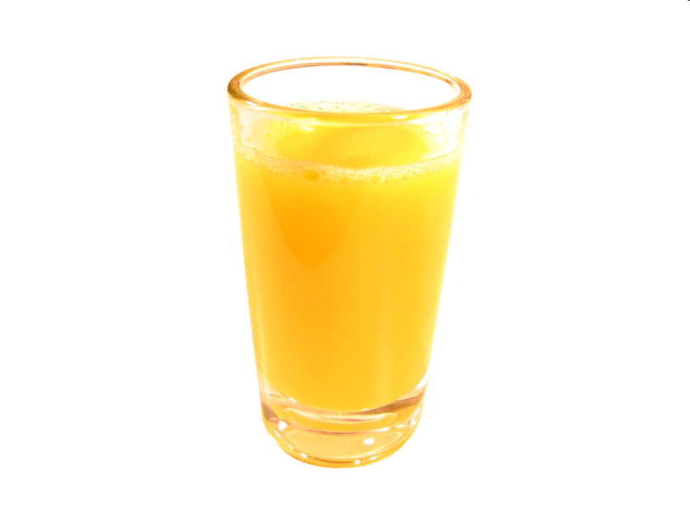
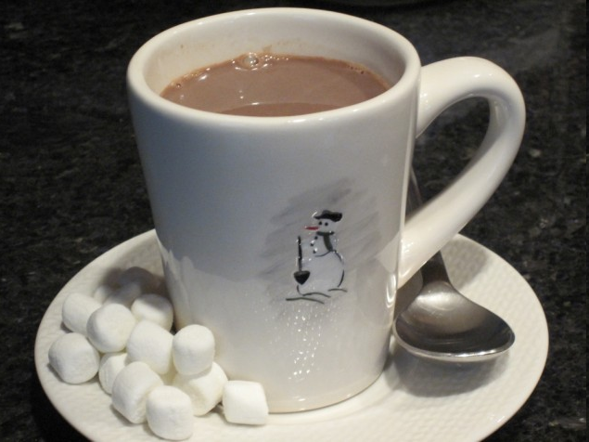
breakfast
We drink...
milk
juice
cocoa

Slide 5
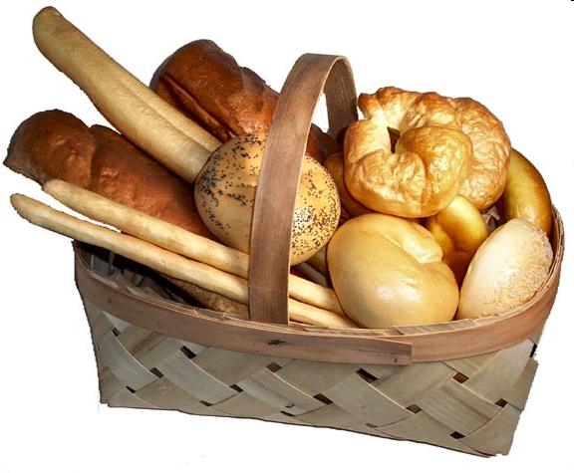
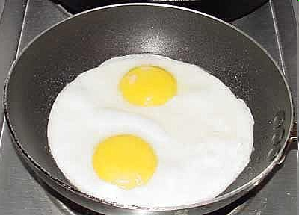
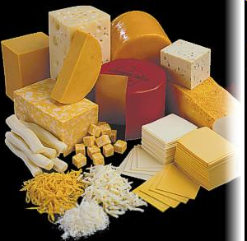
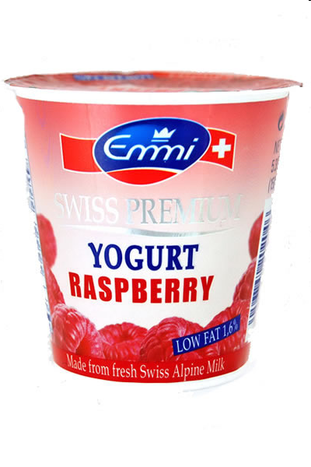
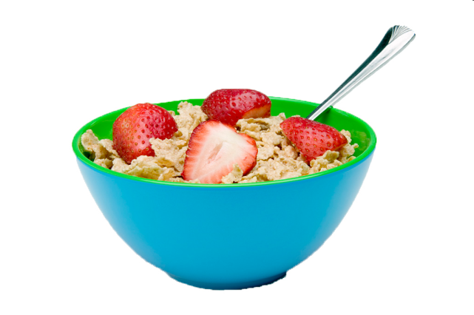
We eat...
eggs
bread
yogurt
cereal
cheese

Slide 6
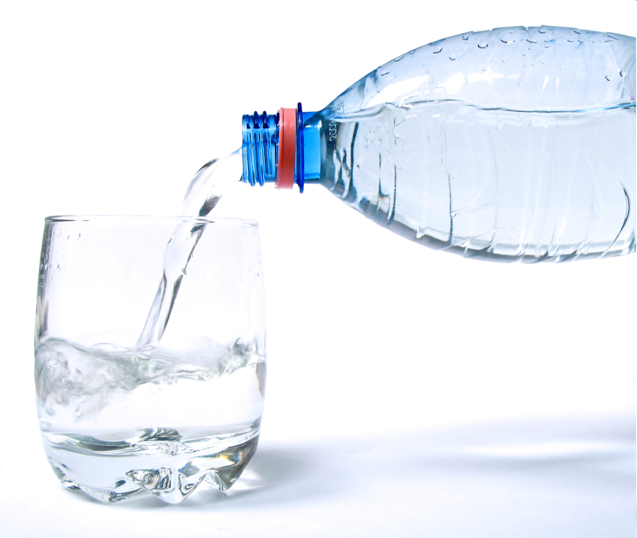
LUNCH
We drink...
juice
water

Slide 7
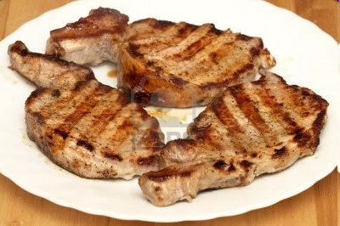
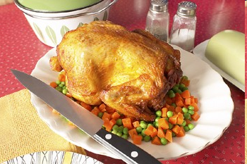
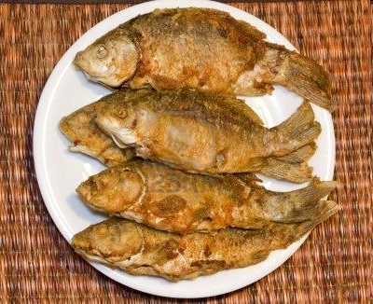
We eat...
meat
chicken
fish

Slide 8
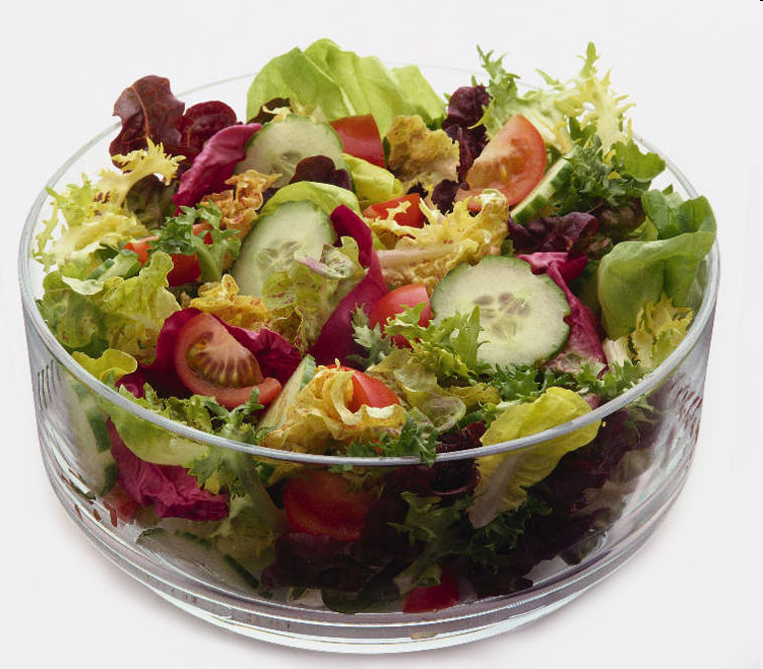
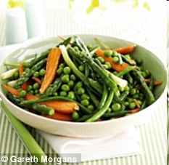
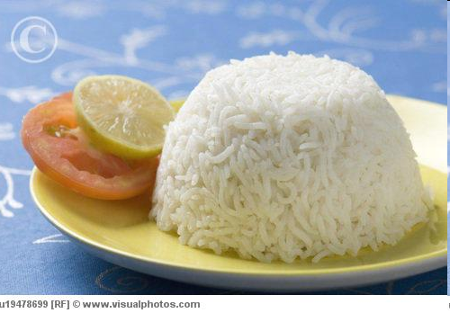
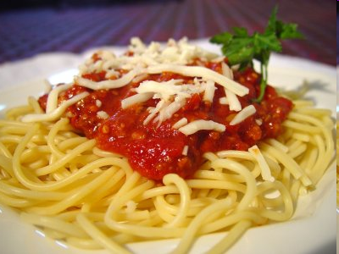
salad
vegetables
rice
pasta

Slide 9

DINNER
We drink...
milk
juice
water

Slide 10
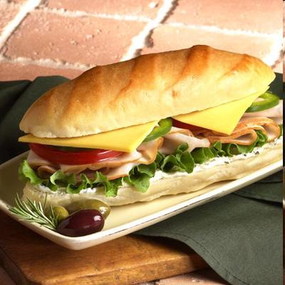
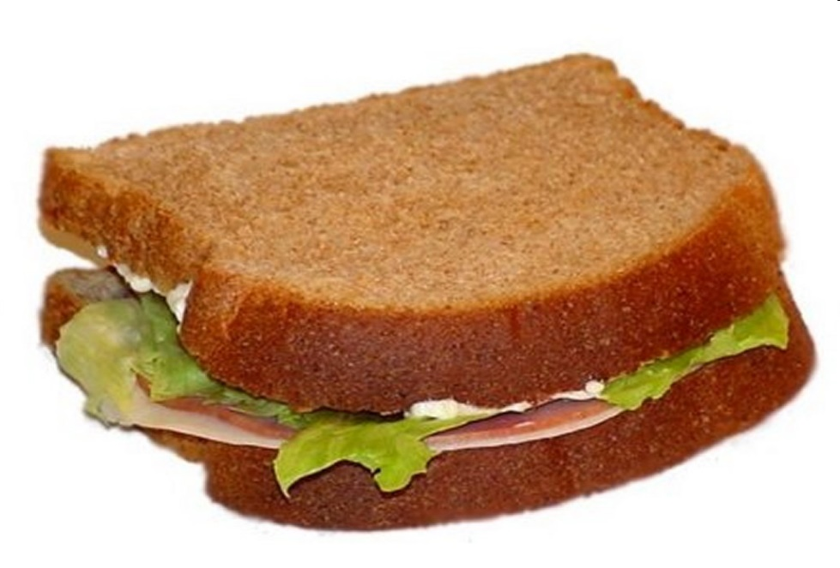
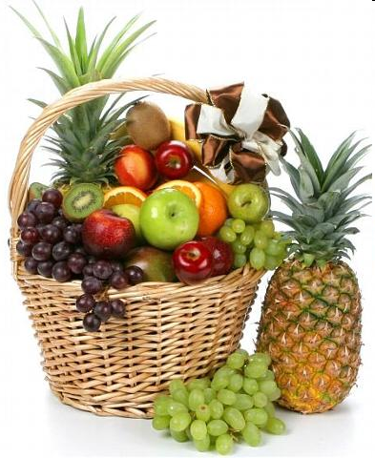
We eat...
sandwich
fruits
toast

Slide 11

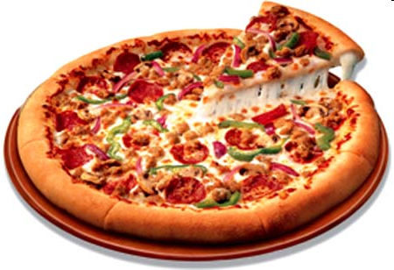
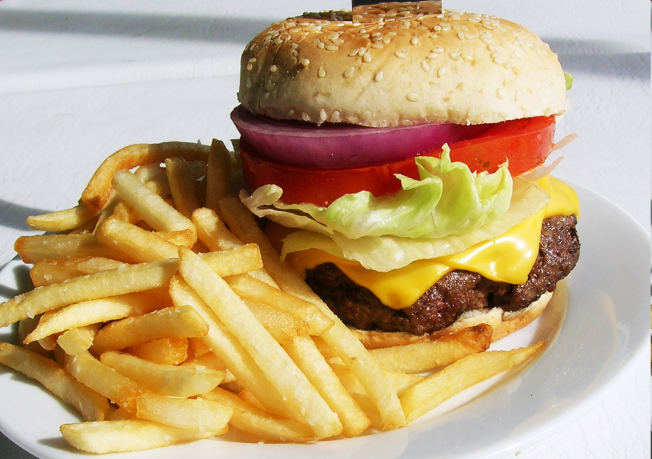

WE ARE WHAT WE EAT, SO EAT HEALTHILY TO LIVE HEALTHILY!
pizza
burger & fries
pop corn

Slide 12


PRESENTATION
popular (a)
/ˈpɒpjələ(r)/
phổ biến, nổi tiếng

Slide 13
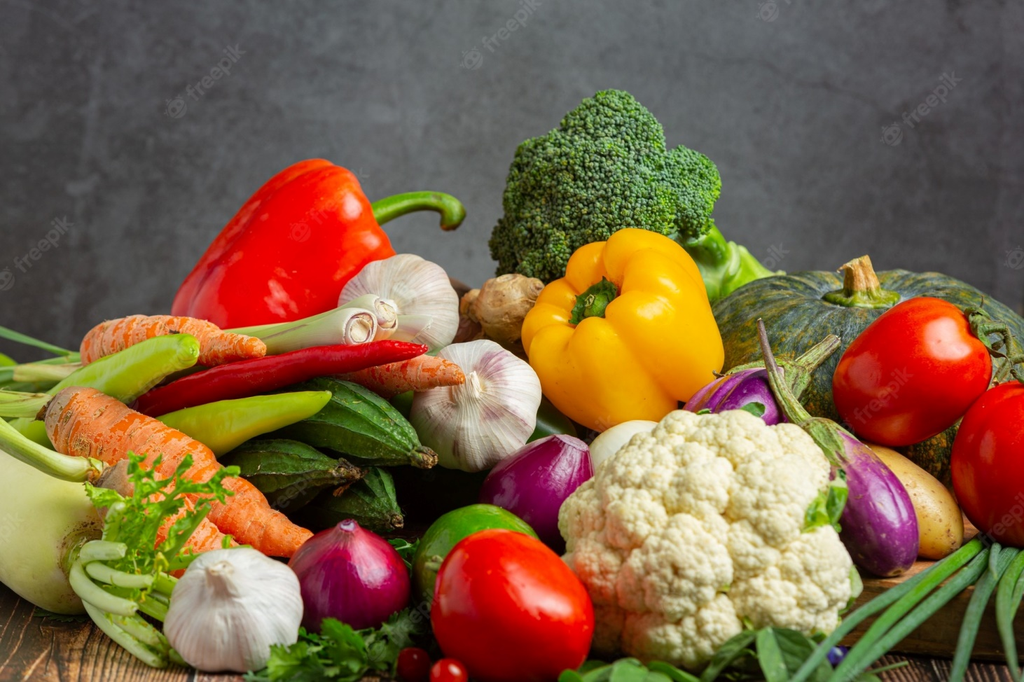
PRESENTATION
fresh (a)
/freʃ/
tươi, mới

Slide 14
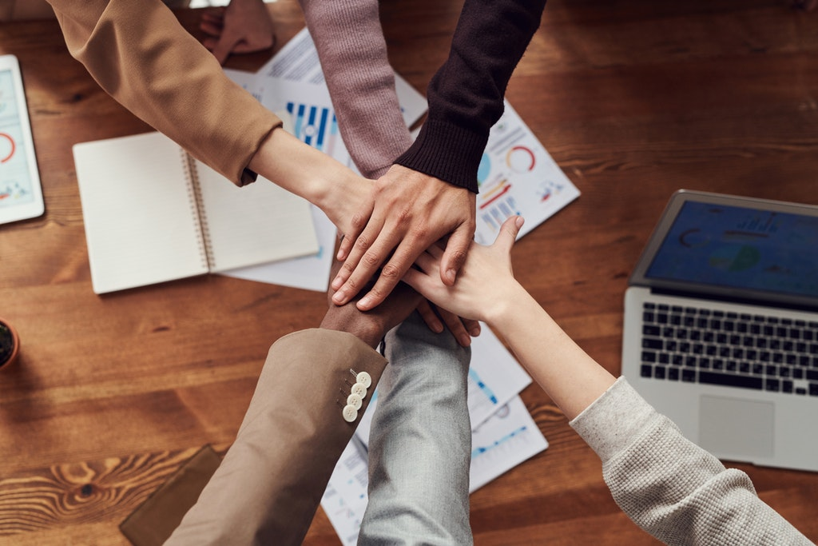
PRESENTATION
join (v)
/dʒɔɪn/
tham gia

Slide 15
PRESENTATION
New words | Pronunciation | Meaning
popular (a) | /ˈpɒpjələr/ | phổ biến, nổi tiếng
fresh (a) | /freʃ/ | tươi, mới
join (v) | /dʒɔɪn/ | tham gia

Slide 16
LISTEN AND READ.
Mi: This is a nice picture, Mark.
Mark: That’s my dad and I boating at Yen So Park.
Mi: It also see a lot of people exercise there.
Mark: Yes, it’s a popular place for people in my neighbourhood.
Mi: Outdoor activities are good for our health. My family often goes cycling in the countryside. It’s quiet and there’s a lot of fresh air.
Mark: It sounds interesting.
Mi: Yes, it’s lots of fun. We also bring fruit, water, and a lunch box with us.
Mark: I’d love to join you next time.
Mi: Sure. Bring along a hat and suncream.
Mark: Why suncream?
Mi: It’s really hot and sunny at noon so you might get sunburn.
Mark: I see.

Slide 17
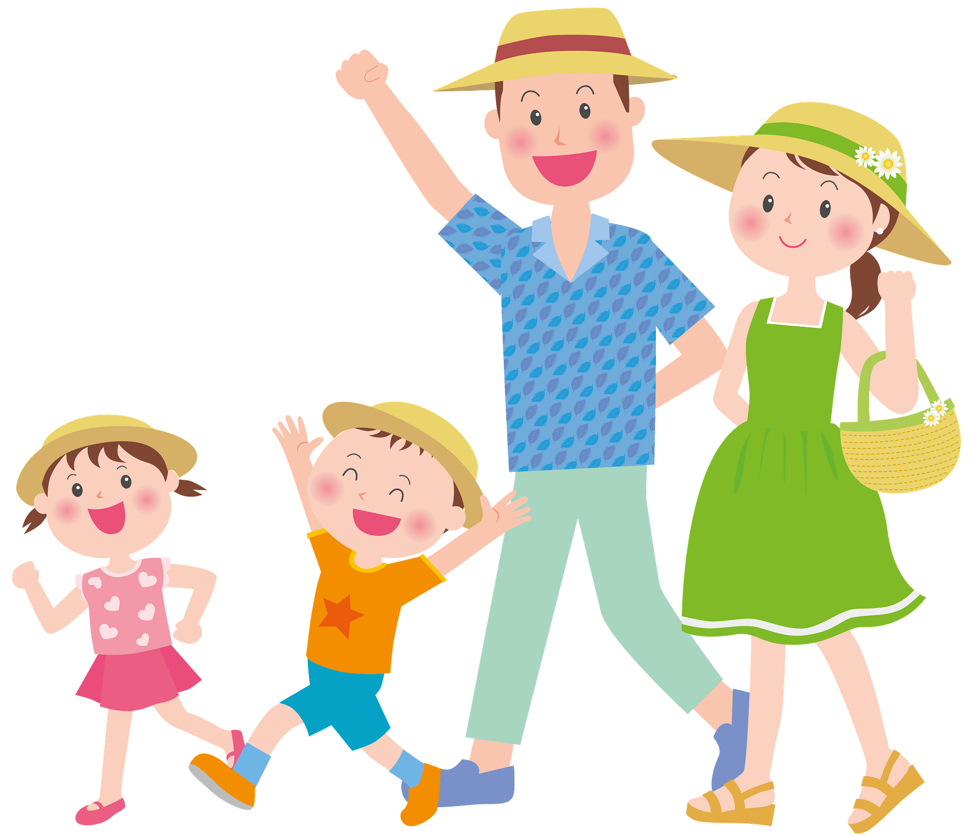
PRACTICE
1
Circle the correct answer.
1. What are Mark and Mi talking about?
A. Health problems
B. Healthy activities
C. Sports and games
Mi: I also see a lot of people exercising there.
Mark: Yes, it’s a popular place for people in my neighbourhood.

Slide 18
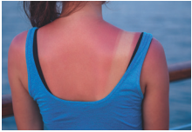

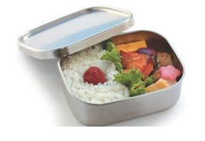
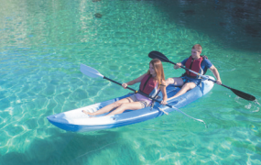
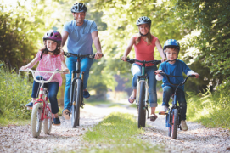
2
Write a word or phrase from the box under its picture.
boating suncream lunch box sunburn cycling
1.
sunburn
2.
suncream
3.
lunch box
4.
boating
5.
cycling

Slide 19
3
Complete each sentence with a word from the conversation.
1. In the picture, Mark and his father are __________.
boating
Mi: This is a nice picture, Mark.
Mark: That’s my dad and I boating at Yen So Park.
2. The people in Mark’s neighbourhood love to go to the _________ .
park
Mi: It also see a lot of people exercise there.
Mark: Yes, it’s a popular place for people in my neighbourhood.

Slide 20
3
Complete each sentence with a word from the conversation.
3. Mi’s family often goes cycling in the ___________.
countryside
Mi: Outdoor activities are good for our health. My family often goes cycling in the countryside. It’s quiet and there’s a lot of fresh air.
4. - I don’t want to get sunburn.
- Wear a hat and use __________.
suncream
Mi: Sure. Bring along a hat and suncream.
Mark: Why suncream?
Mi: It’s really hot and sunny at noon so you might get sunburn.

Slide 21
3
Complete each sentence with a word from the conversation.
5. Fruit and water are good for our _________ .
health
Mi: Yes, it’s lots of fun. We also bring fruit, water, and a lunch box with us.

Slide 22
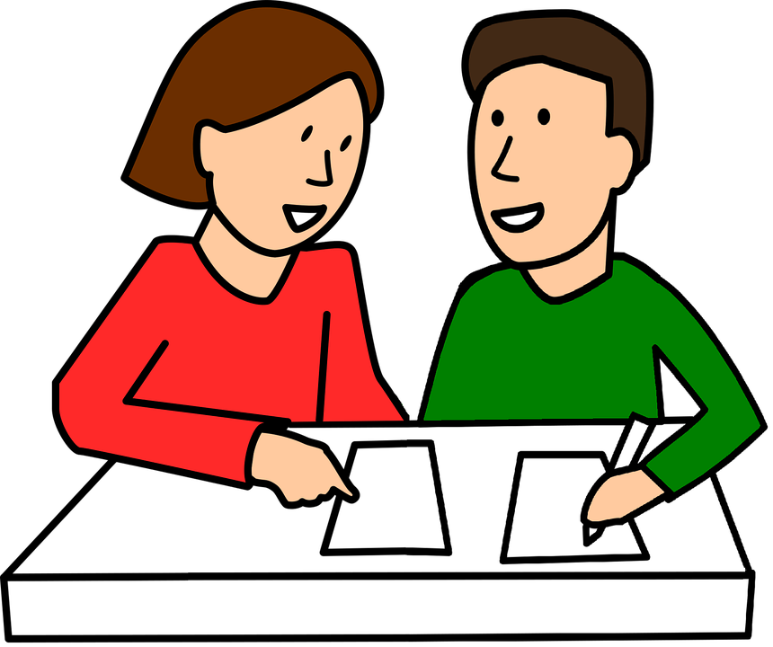
PRODUCTION
4
Survey: Good or bad for health.
Example:
A: I walk to school.
B: I think it’s good for your health.
A: I rarely eat breakfast.
B: It’s not good. Breakfast is very important. It gives us energy for the day.

Slide 23
PRODUCTION
4
Survey: Good or bad for health.
Daily activities | How often | Good | Bad
Walking to school | Every day | √
Eating junk food
√
√
Play football
Play computer games
√

Slide 24
CONSOLIDATION
1
WRAP-UP
HEALTHY LIVING
Things to go out
Healthy activities
Topic of the unit
Vocabulary

Slide 25
CONSOLIDATION
2
HOMEWORK
- Read again the conversation
- Do more exercises in workbook.
- Name a list of bad habits and think about tips to change those.

