Slide 1


Slide 2

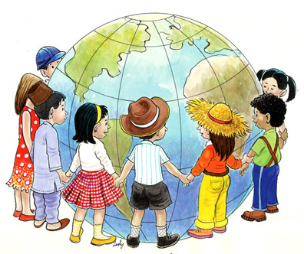
Unit
6
LIFESTYLES
LESSON 1: GETTING STARTED
Lifestyle differences
1

Slide 3
LESSON 1: GETTING STARTED
WARM-UP
Asking questions
PRESENTATION
Vocabulary
Task 1: Listen and read.
Task 2: Read the conversation again and complete the table.
Task 3: Complete each sentence with a word or phrase from the box.
Task 4: Label each picture with a word or phrase from the box.
PRACTICE
FURTHER PRACTICE
Task 5: QUIZZ: Greetings around the world.
CONSOLIDATION
Wrap-up
Homework

Slide 4

WARM-UP
Answer the questions:
1. What is the video about?
2. In Viet Nam, how to two men greet when they meet?
3. Do people in Thailand shake hands when meeting?
LIFESTYLE DIFFERENCES

Slide 5

PRESENTATION
greet (v)
﻿/ɡriːt/
chào hỏi

Slide 6
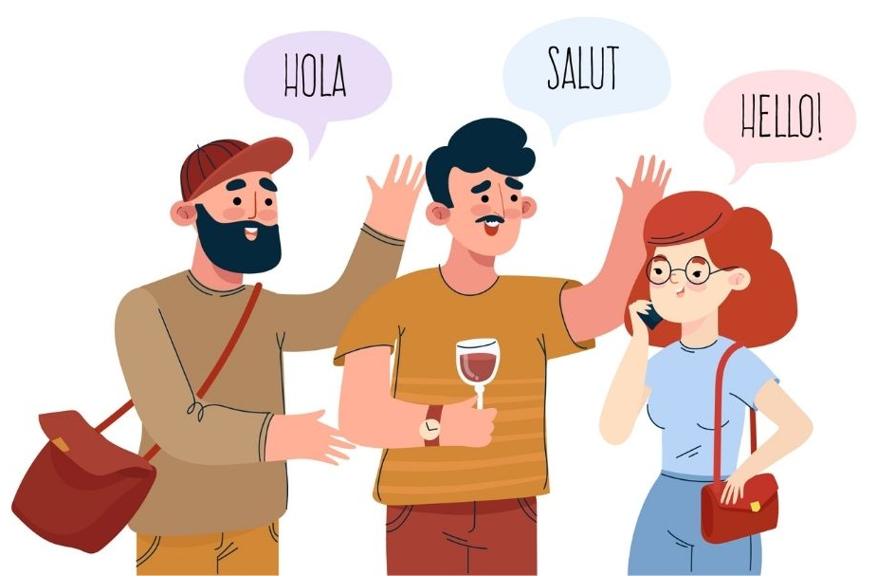
PRESENTATION
greeting (n)
﻿/ˈɡriːtɪŋ/
lời chào

Slide 7
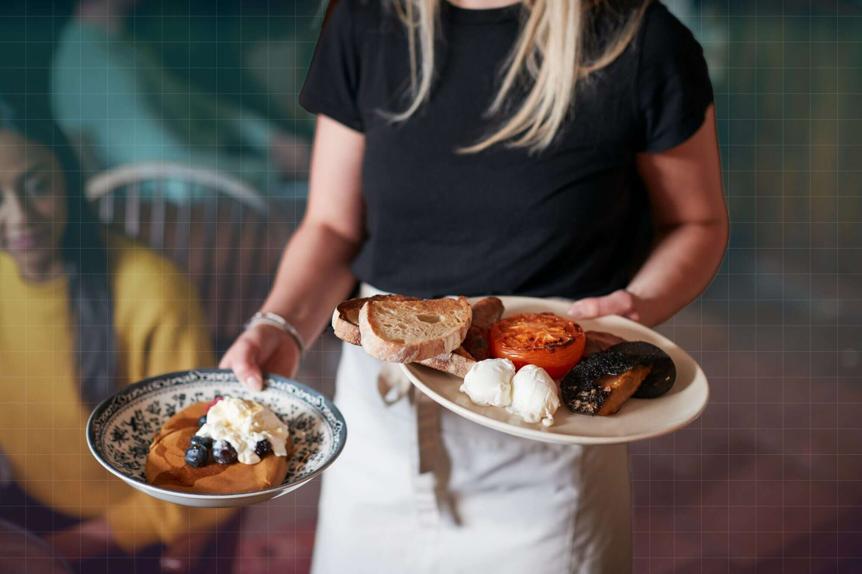
PRESENTATION
serve (v)
/sɜːv/
phục vụ

Slide 8

PRESENTATION
common practice (n)
﻿/ˈkɒmən ˈpræktɪs/
thông lệ

Slide 9
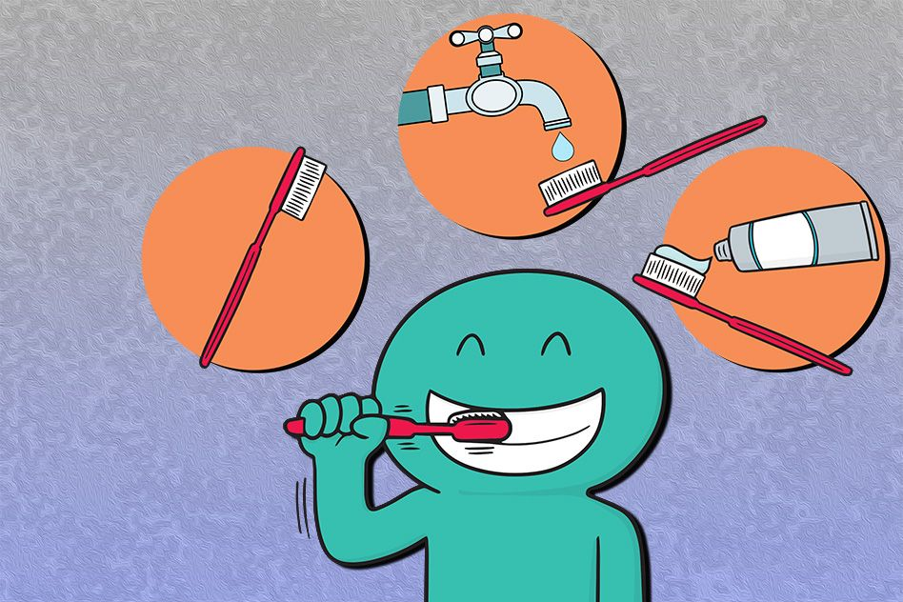
PRESENTATION
in the habit of
﻿/ɪn ðə ˈhæbɪt əv/
có thói quen làm gì

Slide 10
PRESENTATION
New words | Pronunciation | Meaning
1. greet (v) | ﻿/ɡriːt/ | chào, chào hỏi
2. greeting (n) | ﻿/ˈɡriːtɪŋ/ | lời chào
3. serve (v) | ﻿/sɜːv/ | phục vụ
4. common practice (n) | /ˈkɒmən ˈpræktɪs/ | thông lệ
5. in the habit of | ﻿/ɪn ðə ˈhæbɪt əv/ | có thói quen làm gì

Slide 11

PRACTICE
1
Listen and read.
﻿Nam: Hello, Tom. How’re things?
Tom: Oh good. I like it here. The lifestyle is interesting and different from that in my country.
Nam: Really?
Tom: Sure. Students here call their teachers by their title “teacher”, not by their names.
Nam: Right. How do you greet your teachers?
Tom: We usually say “Hello” or “Good morning” then Mr, Mrs, or Miss and their surnames, for example “Good morning, Mr Smith.”
Nam: Are there other differences?
Tom: People buy and sell a lot of street food here. In my country people usually buy food in a store or a restaurant.
Nam: Yeah. Buying street food is a common practice in my city.
﻿Tom: And I’ve noticed that many people have breakfast on the street too! In my country, we typically have a light breakfast at home.
Nam: I see. But here many adults are in the habit of having breakfast outside of their homes. If they’re not in a hurry, they’ll even have a leisurely coffee there.
Tom: That’s fascinating!

Slide 12
PRACTICE
2
﻿Read the conversation again and complete the table.
﻿In Nam’s country | ﻿In Tom’s country
﻿– Students greet teachers by their title. – People eat breakfast (2) ______________. – People buy and sell food on the roadside. | ﻿– Students refer to their teachers as Mr, Mrs, or Miss and their teachers’ (1) ___________. – People eat breakfast at home. – People often buy food in a (3) __________________.
on the street
surnames
store / restaurant

Slide 13
PRACTICE
3
Complete the sentences with the words and phrases from the box.
greet
practice
lifestyle
serve
in the habit of
﻿1. A balanced diet and exercise are important for a healthy ___________.
2. Handshaking, bowing, and hugging are some of the ways in which people _________ one another.
3. Waiters and waitresses ________ food in restaurants.
4. Going out for breakfast has become a common _________ in this city.
5. My mum is _______________ keeping everything in the kitchen bright and clean.

Slide 14
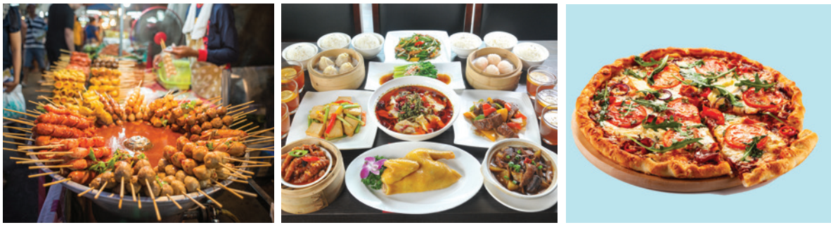



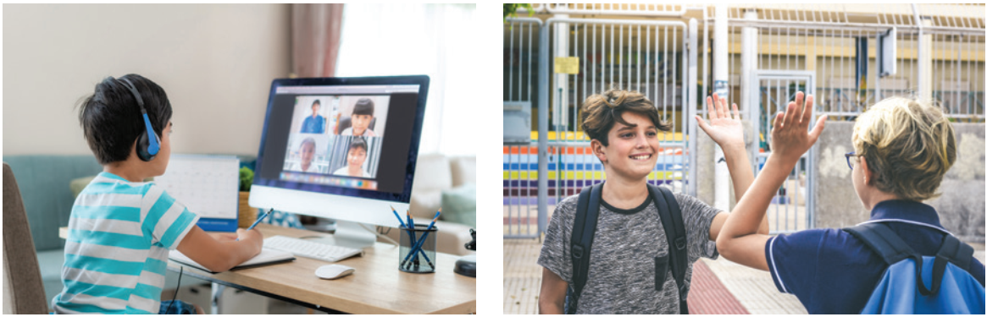


PRACTICE
4
﻿Label each picture with a word or phrase from the box.
greeting
online learning
pizza
street food
food in restaurant

Slide 15

FURTHER PRACTICE
5
Work in pairs. Ask and answer questions in the quiz.
1. Which is probably the most common way
of greeting around the world?
A. Shaking hands.
B. Sticking out one’s tongue.
2. In the USA, people greet each other by ______.
A. shaking heads
B. saying “hello”

Slide 16
FURTHER PRACTICE
5
Work in pairs. Ask and answer questions in the quiz.
3. Thais greet their elders by saying “sawadee” and ______.
A. saying their surname
B. slightly bowing to them
4. The Maori of New Zealand greet each other by ______.
A. kissing each other’s cheek
B. pressing their noses together

Slide 17
FURTHER PRACTICE
5
Work in pairs. Ask and answer questions in the quiz.
5. How do people in Japan normally greet each other?
A. They bow to each other.
B. They hug each other.

Slide 18

CONSOLIDATION
1
Wrap-up
What have we learnt in this lesson?
identify the topic of the unit
use lexical items related to lifestyles
identify the language features that are covered in the unit

Slide 19

CONSOLIDATION
2
Homework
- Name a list of 10 ways of greetings from different countries.
- Do exercises in the workbook.
- Start preparing for the Project of the unit

Slide 20

Website: hoclieu.vn
Fanpage: facebook.com/www.tienganhglobalsuccess.vn/

