Slide 1


Unit
02
I always get up early.
How about you?
Lesson 1

Slide 2
Warm-up

Slide 3
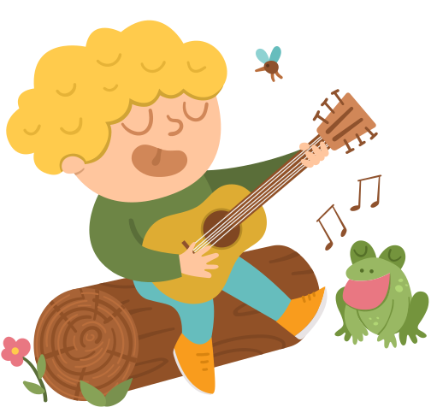

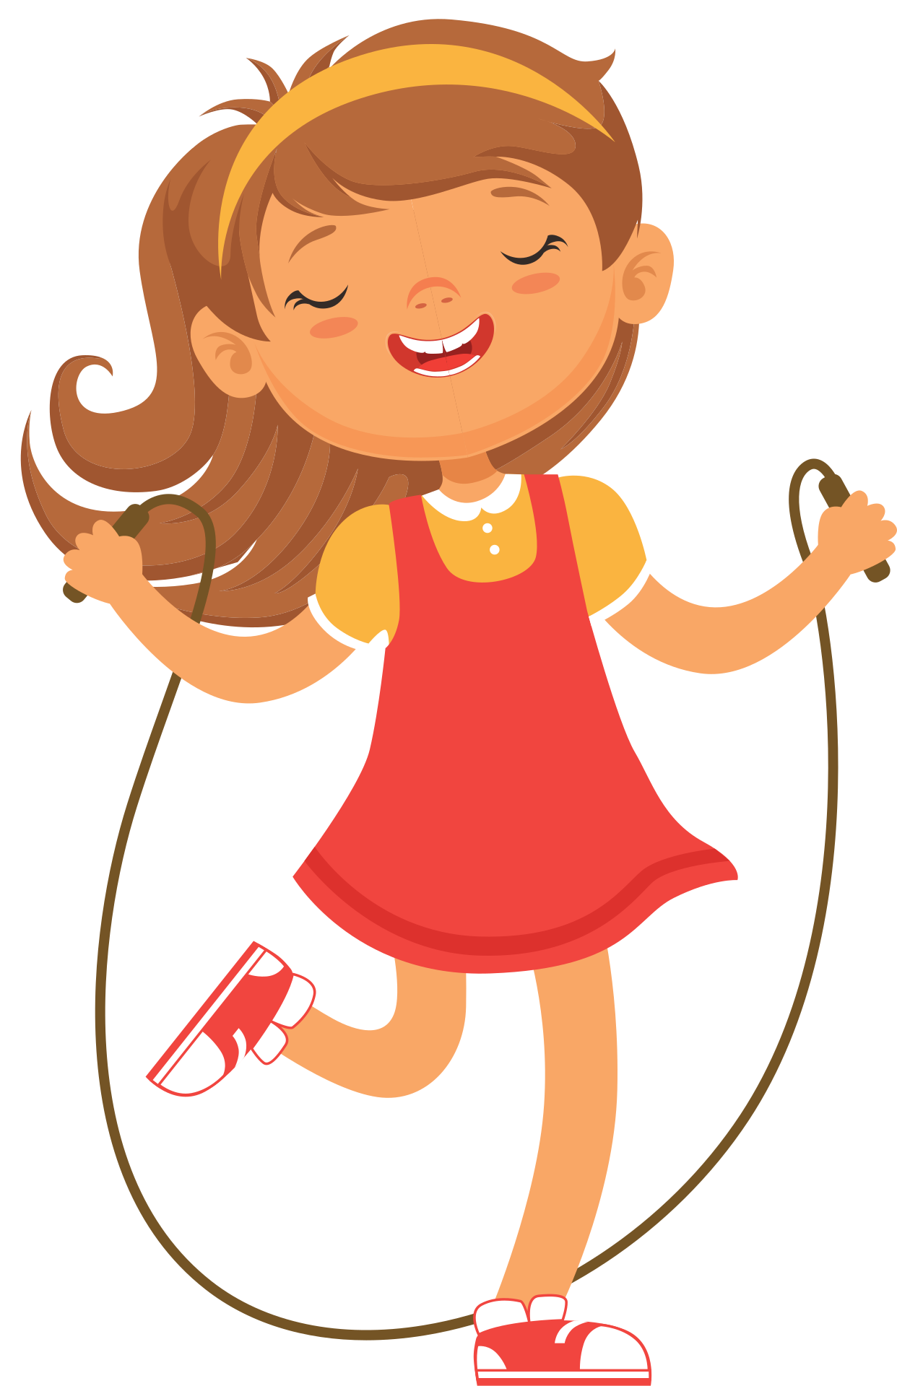
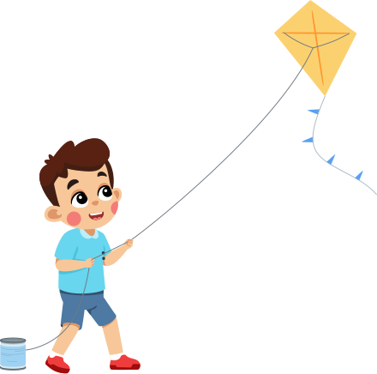

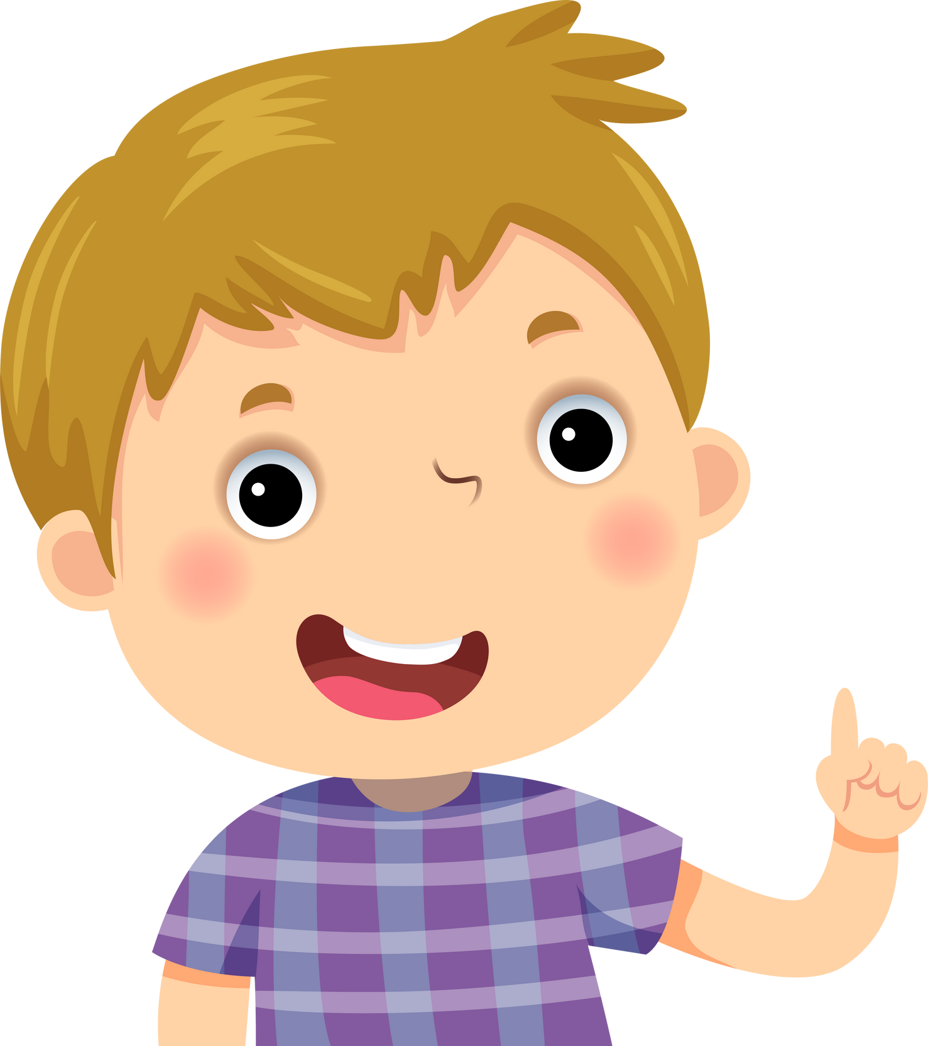
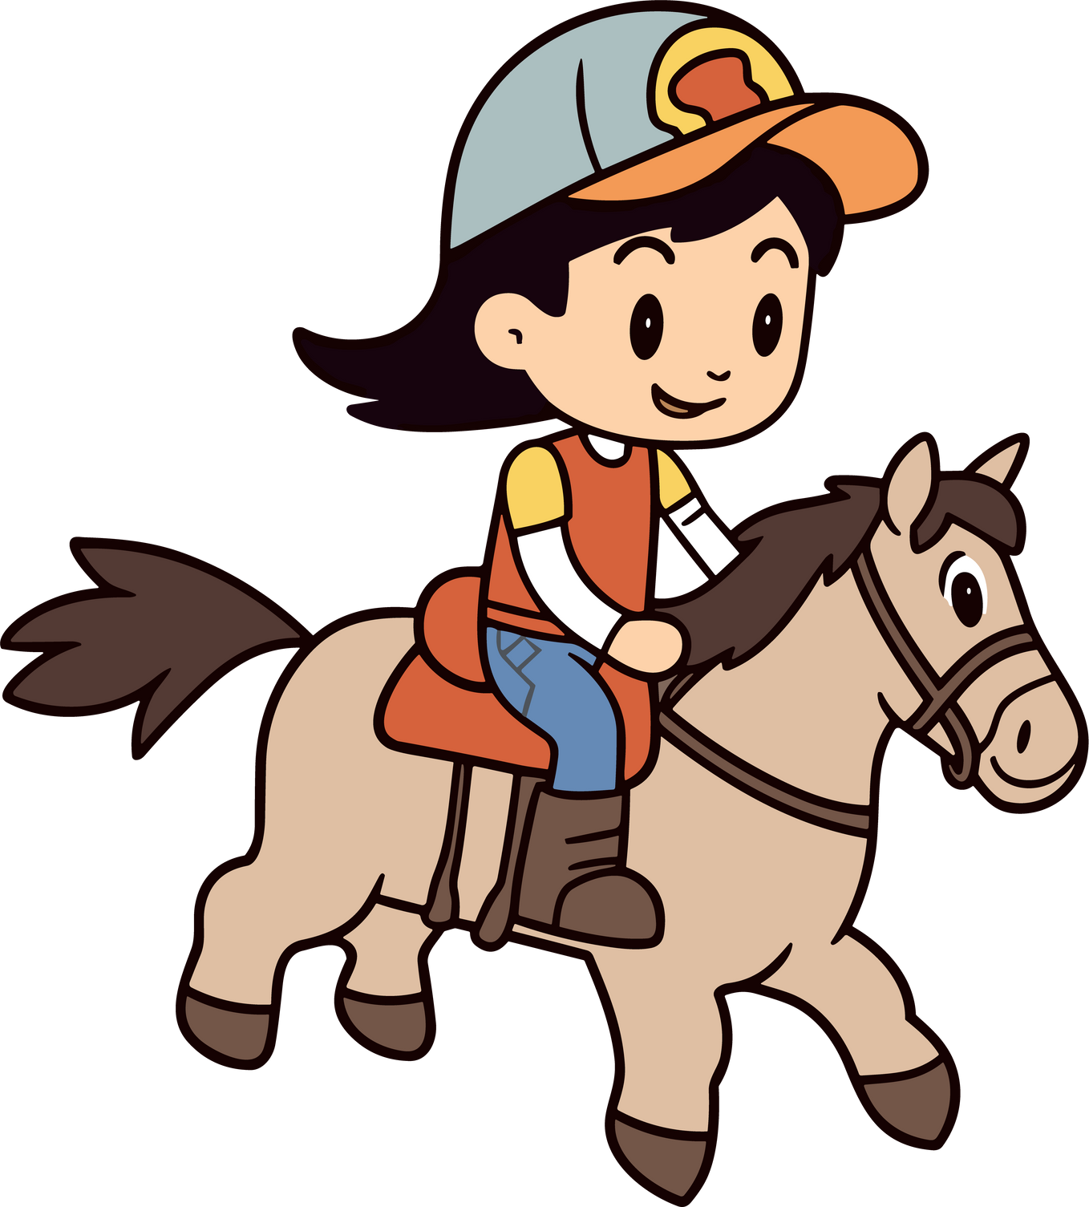
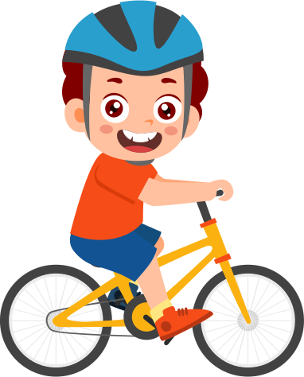
Game
“Act out”

Slide 4











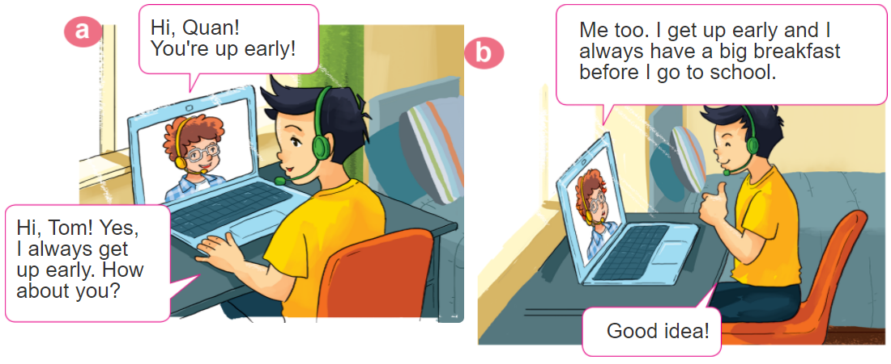
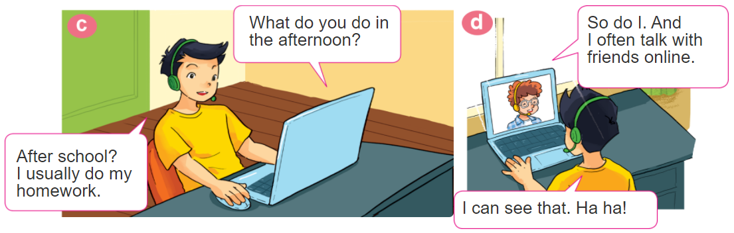
1. Look, listen and repeat

Slide 5
Vocabulary

Slide 6


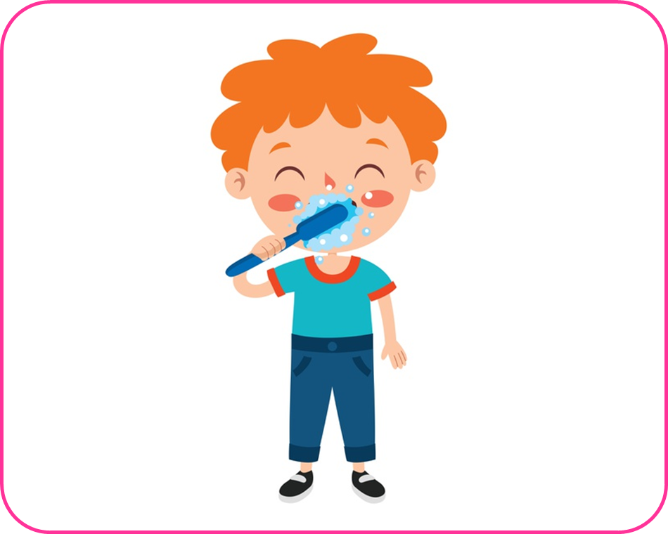
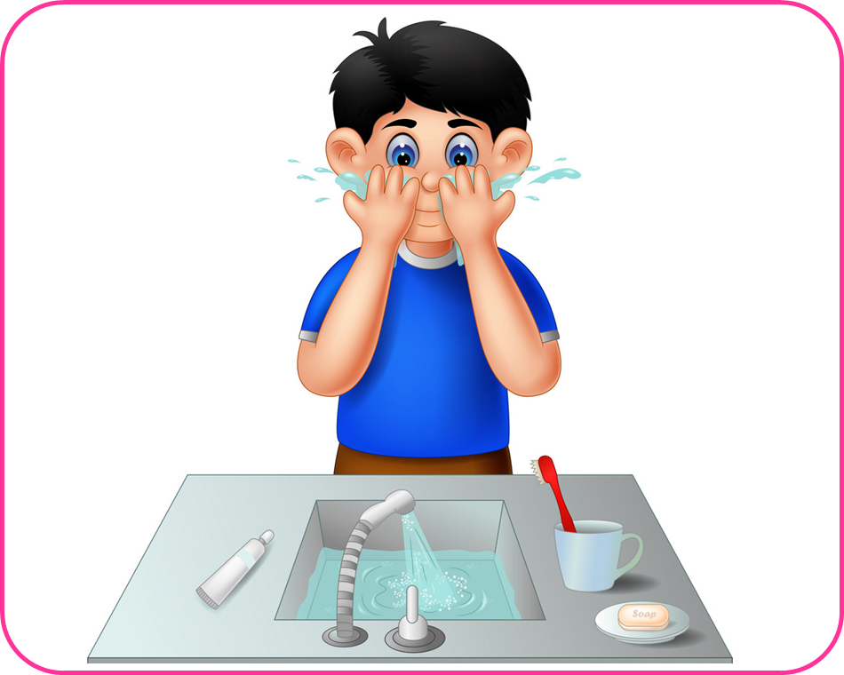
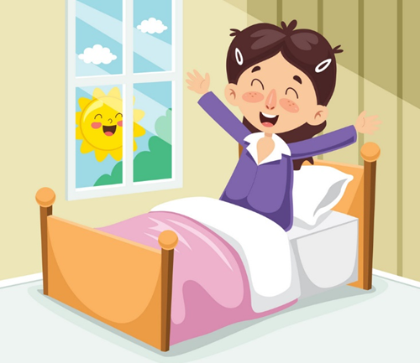
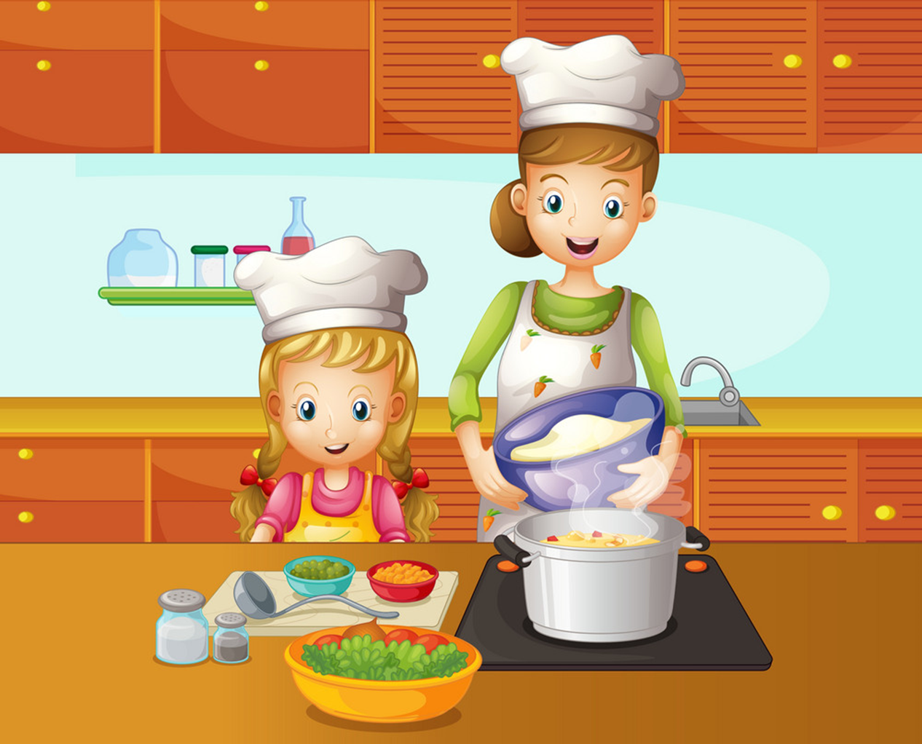
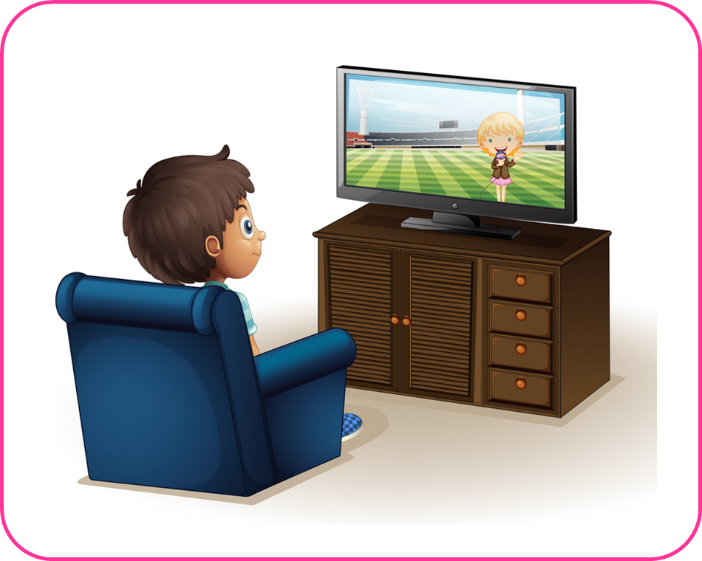
1
2
3
Have breakfast
Do morning exercise
Brush my teeth
4
5
6
7
Wash my face
Get up
Cook dinner
Watch TV

Slide 7
Get up

Slide 8
Do morning exercise

Slide 9
Brush my teeth

Slide 10
Wash my face

Slide 11
Have breakfast

Slide 12
Watch TV

Slide 13
Cook dinner

Slide 14
CORRECT PICTURE

Slide 15
1
2
3
✔
Cook dinner

Slide 16
1
2
3
✔
Brush my teeth

Slide 17
1
2
3
✔
Get up

Slide 18
1
2
3
✔
Wash my face

Slide 19
1
2
3
✔
Watch TV

Slide 20
1
2
3
✔
Do morning exercise

Slide 21
1
2
3
✔
Have breakfast

Slide 22
2. Point and say
What do you do in the _________?
I usually _____________________.
morning
do morning exsercise

Slide 23
2. Point and say
What do you do in the _________?
I often ____________.
afternoon
cook dinner

Slide 24
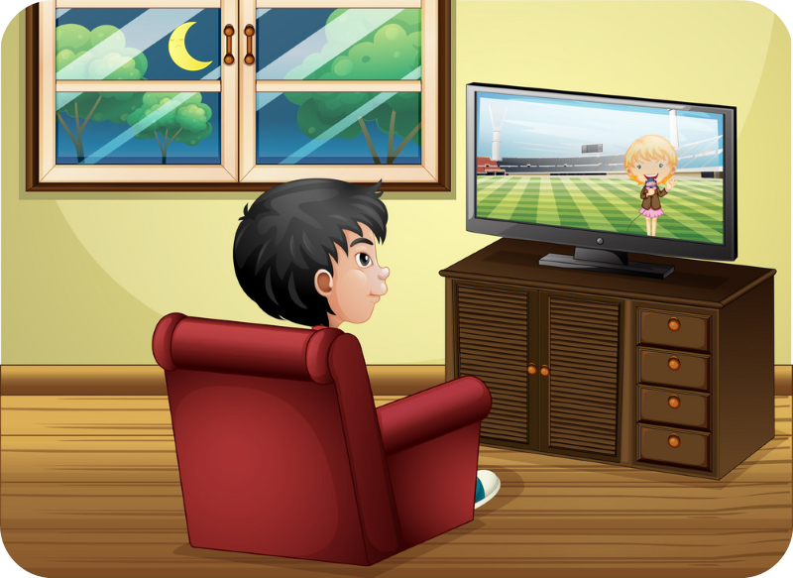
2. Point and say
What do you do in the _________?
I sometimes ____________.
evening
watch TV

Slide 25
2. Point and say
What do you do in the _________?
I usually _____________________.
morning
do morning exsercise

Slide 26
2. Point and say
What do you do in the _________?
I often ____________.
afternoon
cook dinner

Slide 27
2. Point and say
What do you do in the _________?
I sometimes ____________.
evening
watch TV

Slide 28
Sentences:
What do you do in the morning?
I always brush my teeth.
What do you do in the afternoon?
I sometimes get up early.
What do you do in the evening?
I usually wash my face.

Slide 29
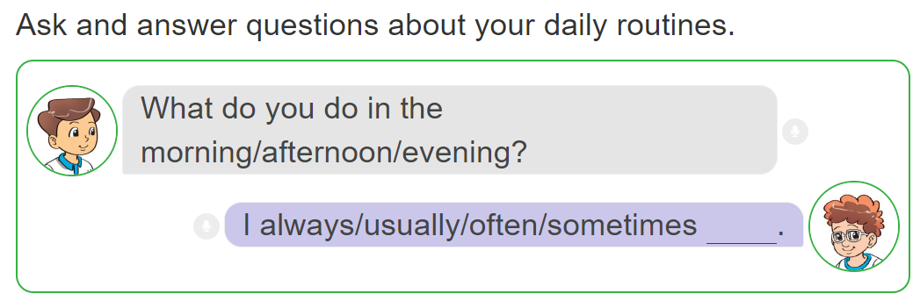
3. Let’s talk.

Slide 30
Extra sentences:
What does she do in the morning?
She always gets up.
What does he do in the evening?
He usually washes his face.

Slide 31




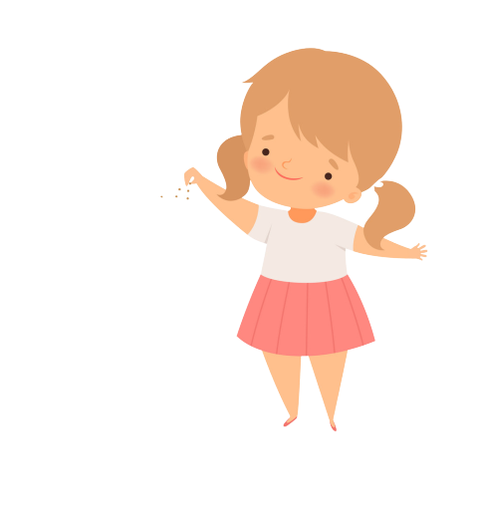

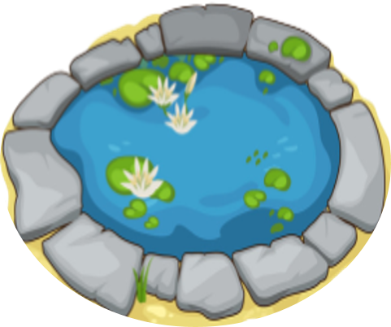
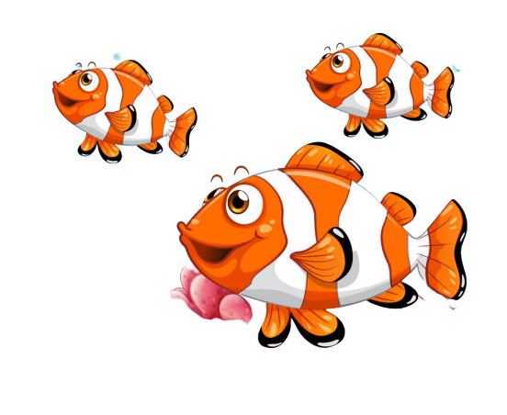
FEEDING FISH
START

Slide 32

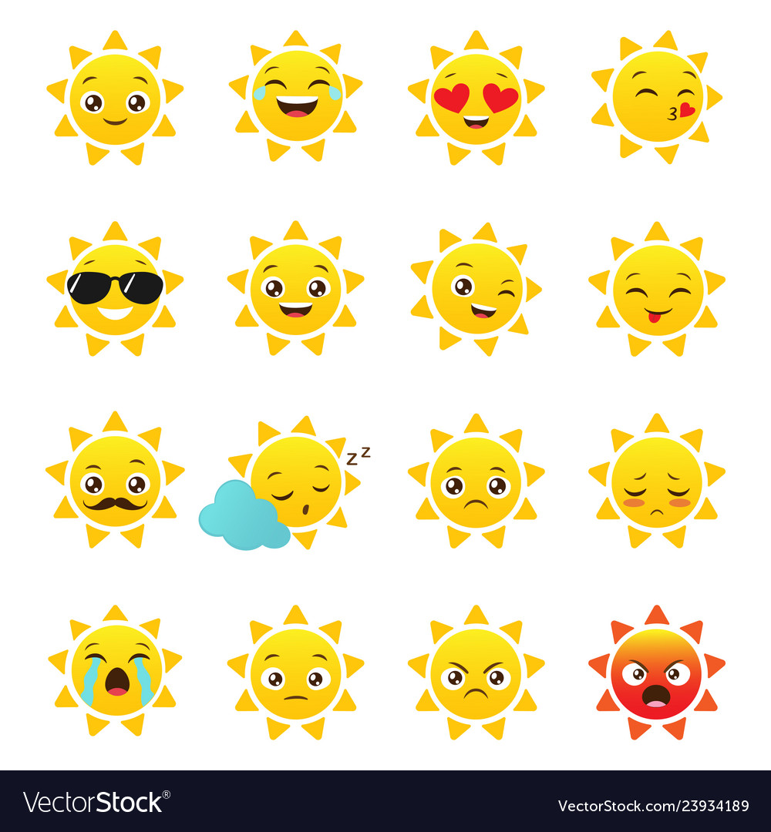
Next
__________in the morning?
I usually do morning exercise.
What does you do
What do you do
What do she do
Notes:
YOUTUBE: MsPham.
Facebook: Dạy và học cùng công nghệ.

Slide 33
Next
__________in the morning?
He often gets up early.
What do you do
What does she do
What does he do
Notes:
YOUTUBE: MsPham.
Facebook: Dạy và học cùng công nghệ.

Slide 34
Next
__________in the evening?
She always wash her face.
What does she do
What does he do
What do you do
Notes:
YOUTUBE: MsPham.
Facebook: Dạy và học cùng công nghệ.

Slide 35
What ____ your father do in the afternoon?
Next
do
does
Notes:
YOUTUBE: MsPham.
Facebook: Dạy và học cùng công nghệ.

Slide 36
What ____ your sister do in the afternoon?
Next
do
does
Notes:
YOUTUBE: MsPham.
Facebook: Dạy và học cùng công nghệ.

Slide 37
Next
What ____do you do in the free time?
I often play football.
is
do
does
Notes:
YOUTUBE: MsPham.
Facebook: Dạy và học cùng công nghệ.

Slide 38
Next
What ____ your friend do at school?
She often plays hide-and-seek.
is
do
does
Notes:
YOUTUBE: MsPham.
Facebook: Dạy và học cùng công nghệ.

Slide 39
Next
What ___ in the evening?
She always wash her face.
What does she do
What does he do
What do you do
Notes:
YOUTUBE: MsPham.
Facebook: Dạy và học cùng công nghệ.

Slide 40
THANK YOU!
Next
Notes:
YOUTUBE: MsPham.
Facebook: Dạy và học cùng công nghệ.

