Slide 1


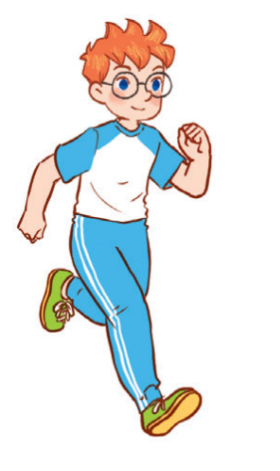
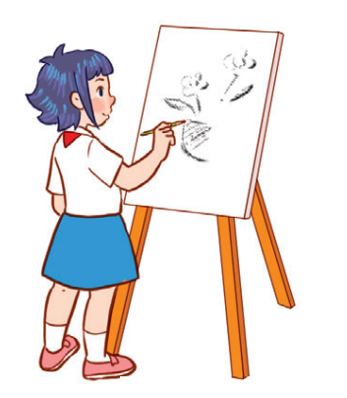

Unit 8
P1,2,3

Slide 2
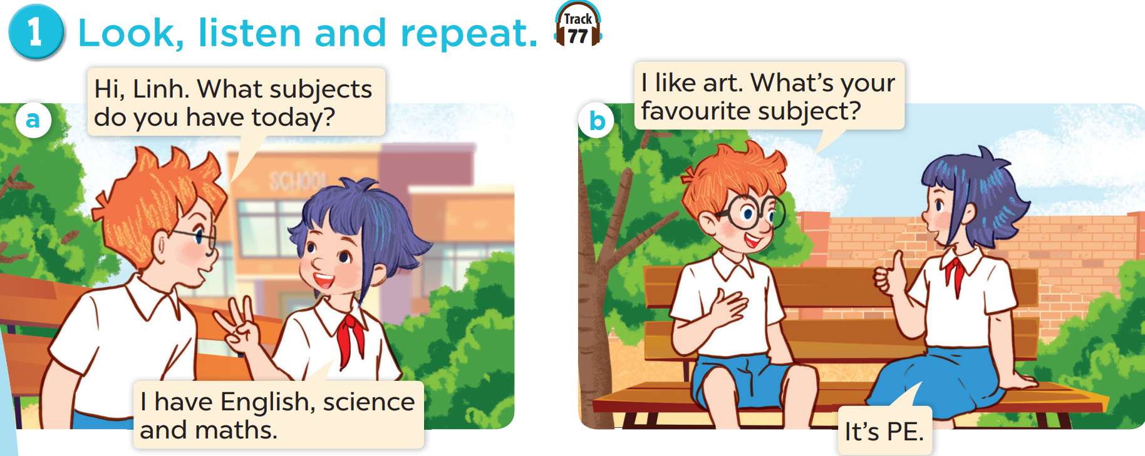


Slide 3





Art
IT
PE
Music

Slide 4
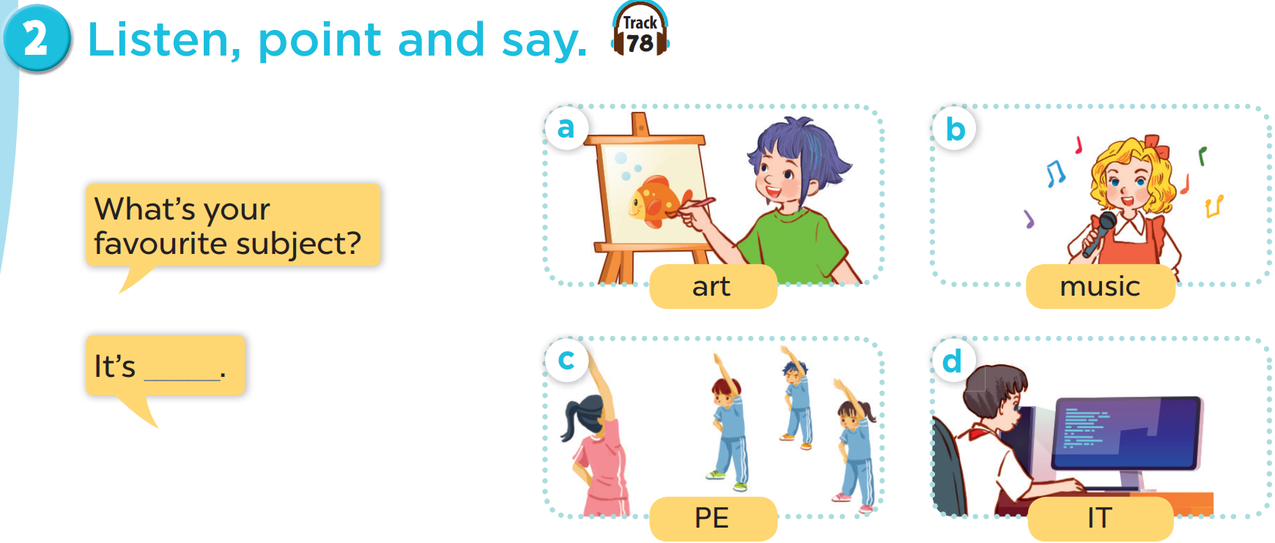

Slide 5
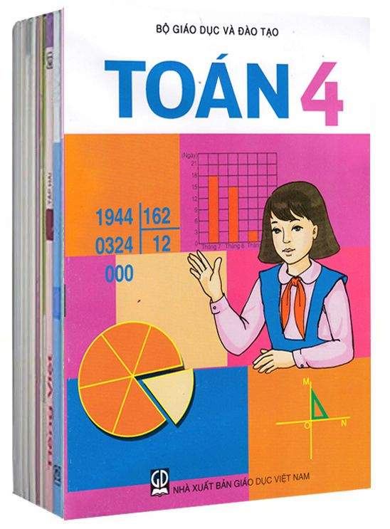
Game: Matching
A: What’s your favourite subject ?
B: My favourite subject is ,,,,,,,,,,,,,
Maths
English
Music
PE
Art
IT

Slide 6
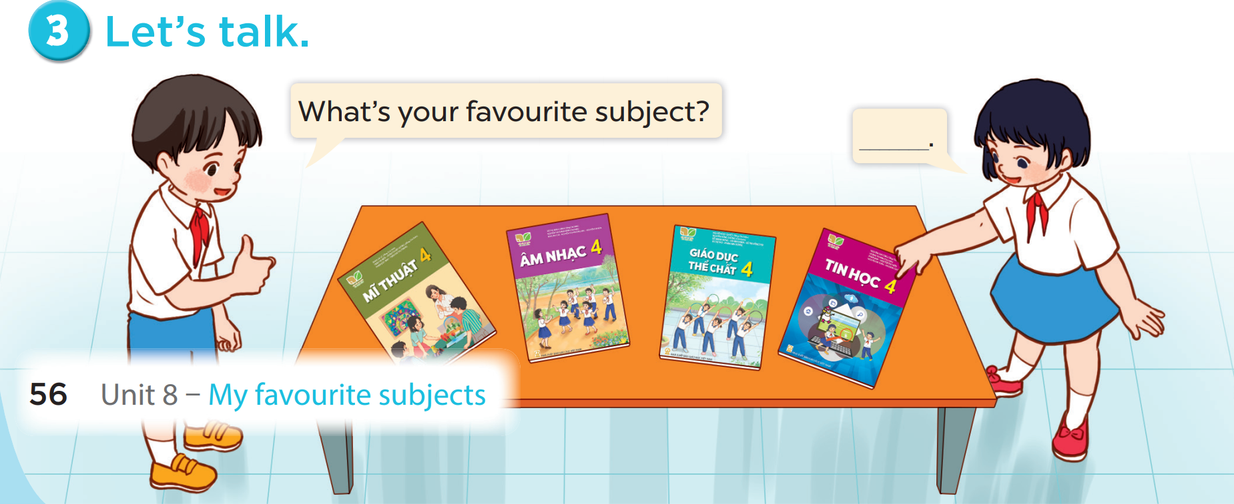
It
My favourite subject is ( môn học )

Slide 7
Art
Maths
IT
PE
English
Music
A: What’s your favourite subject ?
B: My favourite subject is ,,,,,,,,,,,,,

Slide 8
5
Fun corner and wrap-up
5
Game: Matching game

Slide 9





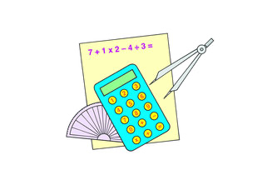
1
2
3
MATHS
4
5
6
PE
SCIENCE
7
8
9
ART
IT
MUSIC
10
11
12
Notes:
Click on the blue part to show pictures/words, if pupils get the correct pairs, leave the square open.
If pupils answer incorrectly, click on the red circle to cover the square again.
Repeat until pupils match all the words with the corresponding pictures.

