Slide 1



Slide 2



Starter
LESSON 1

Slide 3




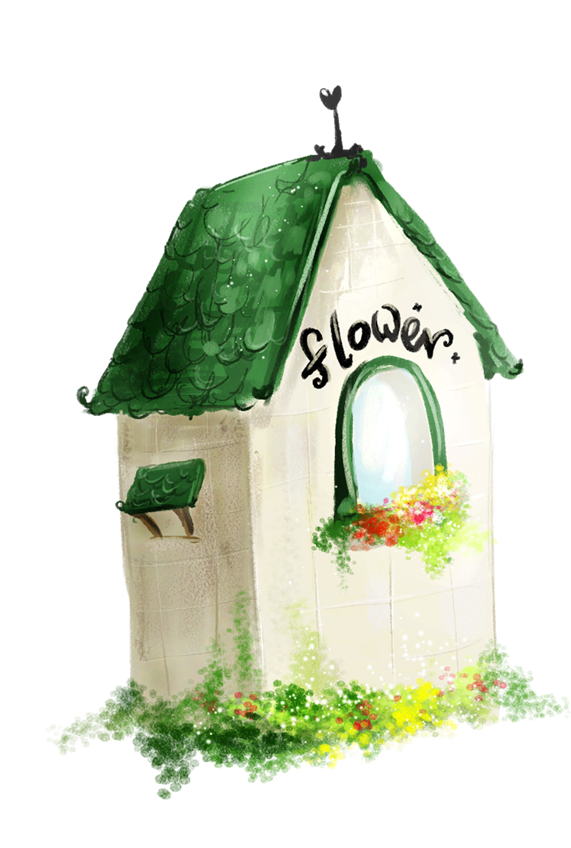
1. Warm-up
2. Listen, point and repeat.
3. Listen and tick.
4. Read and match.
5. Fun corner and wrap up.
Contents

Slide 4

1. Warm-up

Slide 5





Slide 7
2. Listen, point and repeat.

Slide 8
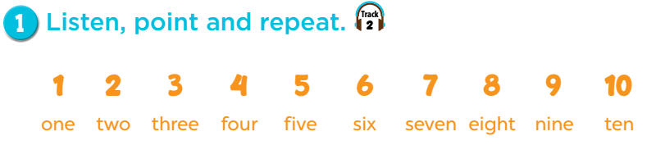



Notes:
Step 1: Draw pupils’ attention to the numbers. Tell them to listen, point at the numbers and repeat. Play the recording for pupils to listen to the numbers, and familiarise themselves with their stress and intonation.
Step 2: Play the recording again for pupils to listen and repeat. Remind them to point at the numbers while listening. Do this several times until they feel confident. Correct their pronunciation where necessary.
Step 3: Put pupils into pairs to practise listening, pointing at and repeating the numbers 1 − 10. Go around the classroom to offer support.

Slide 9
3. Listen and tick.

Slide 10
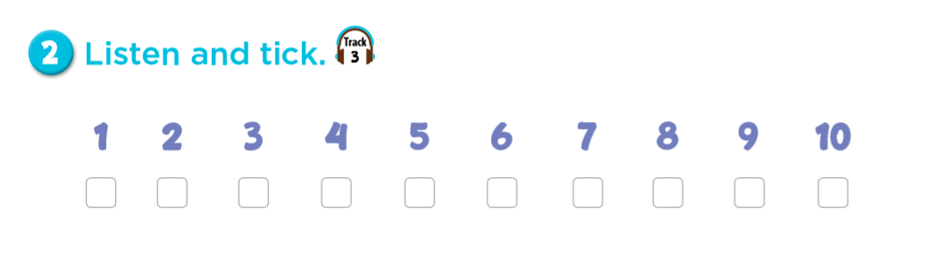
✓
✓
✓
✓

Slide 11
4. Read and match.

Slide 12
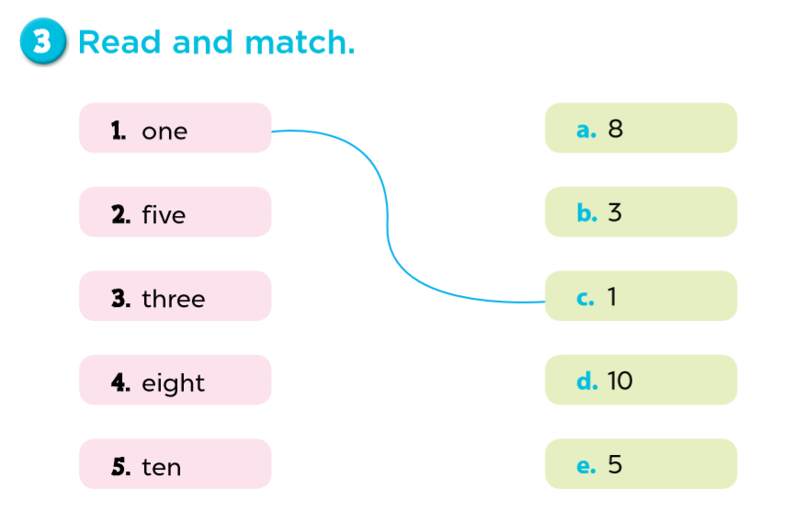
Notes:
Step 1: Draw two columns on the board like the input. Tell pupils to read the words for numbers and draw lines to match with the target numbers. Use number one as an example: Have pupils read the word in chorus and draw a line to match with Number one.
Step 2: Give pupils time to do the task individually or in pairs. Go around the classroom to offer support where necessary.
Step 3: Check the answers as a class. Then invite a pupil to come to the front and draw a line on the board to match the words with the relevant numbers.

Slide 13
5. Fun corner and wrap-up
Game: Let’s look and say the numbers.

Slide 14
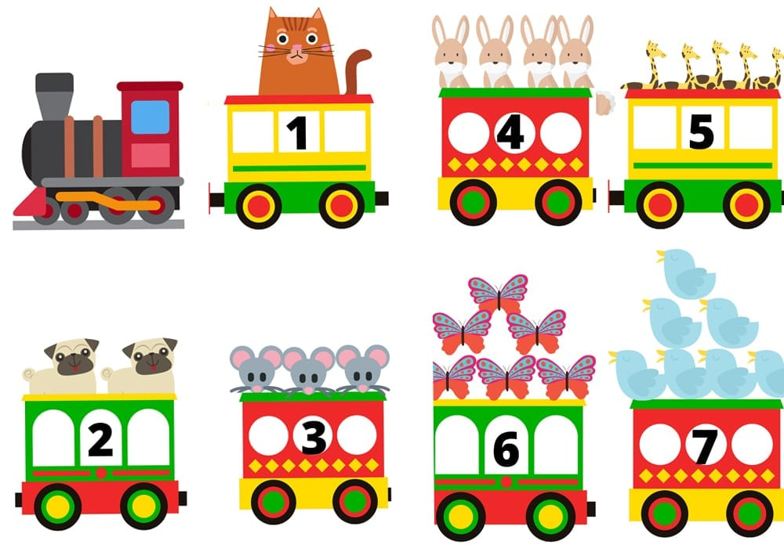
one
five
four
Notes:
Goal: Match the words with the numbers.
Step 1: Let the pupils say the numbers and the words.
Step 2: Click to each cloud of word to let it go below the numbers.
Step 3: Ask pupils to say the numbers and words again.

Slide 15
six
two
three
seven
Notes:
Goal: Match the words with the numbers.
Step 1: Let the pupils say the numbers and the words.
Step 2: Click to each cloud of word to let it go below the numbers.
Step 3: Ask pupils to say the numbers and words again.

Slide 16


Well done!

Slide 17

Website: sachmem.vn
Fanpage: www.facebook.com/sachmem.vn

