Slide 1



Slide 2


Our names
2
9
LESSON 2 – PERIOD 3

Slide 3
TABLE OF CONTENTS
01
02
03
04
05
WARM-UP
MODEL
SENTENCES
PRACTICE
LET’S TALK!
FUN TIME

Slide 4
WARM-UP
01

Slide 5
WHO’S FASTER?

Slide 6


Slide 7


Slide 8


Slide 9


Slide 10


Slide 11


Slide 12


Slide 13


Slide 14



Slide 15


Slide 16









Let’s count together!

Slide 17
MODEL SENTENCES
02

Slide 18
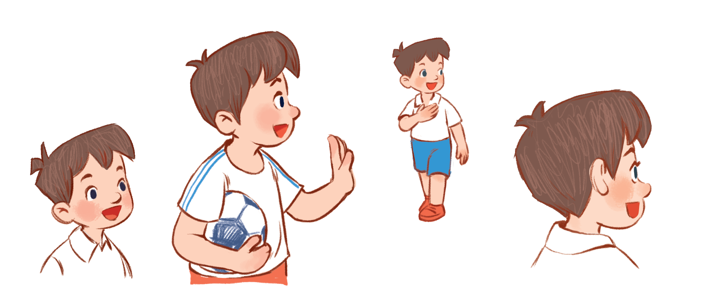

I’m Minh.
What’s your name?
Hello!
My name’s Mary.
Hi!

Slide 19
How old are you?
I’m …… years old.
eight
8

Slide 20

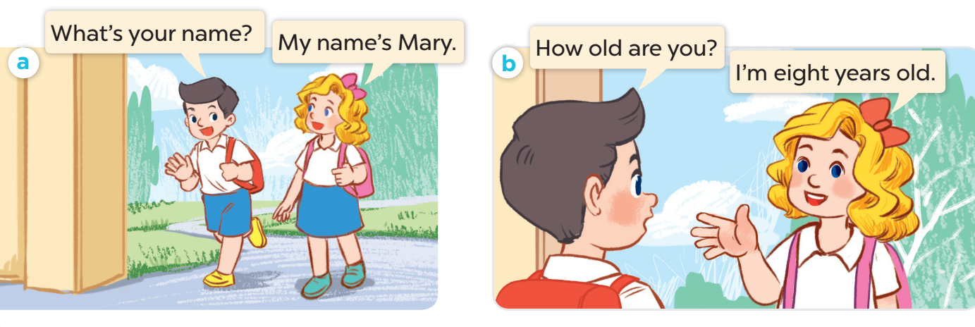

Slide 21
PRACTICE
03

Slide 22
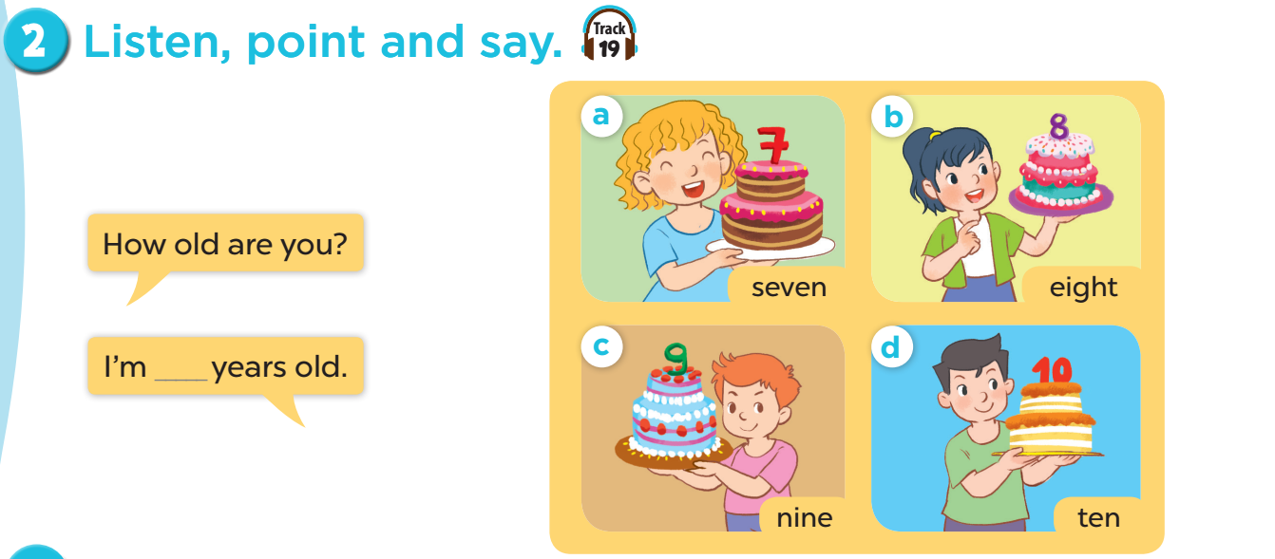

Slide 23


Slide 24


1. Work in teams (girls & boys)
2. Choose and answer.

Slide 25

Notes:
CLICK THE CLOUD – GO TO PART 4

Slide 26



How old are you?
I’m __ years old.
7
Notes:
CLICK PINK AMONG US – GO TO THE POINTS

Slide 27

How old are you?
I’m __ years old.
5
Notes:
CLICK PINK AMONG US – GO TO THE POINTS

Slide 28

How old are you?
I’m __ years old.
9
Notes:
CLICK PINK AMONG US – GO TO THE POINTS

Slide 29

How old are you?
I’m __ years old.
8
Notes:
CLICK PINK AMONG US – GO TO THE POINTS

Slide 30

How old are you?
I’m ___ years old.
10
Notes:
CLICK PINK AMONG US – GO TO THE POINTS

Slide 31

What’s your name?
My name’s ____.
Bill
Notes:
CLICK PINK AMONG US – GO TO THE POINTS

Slide 32
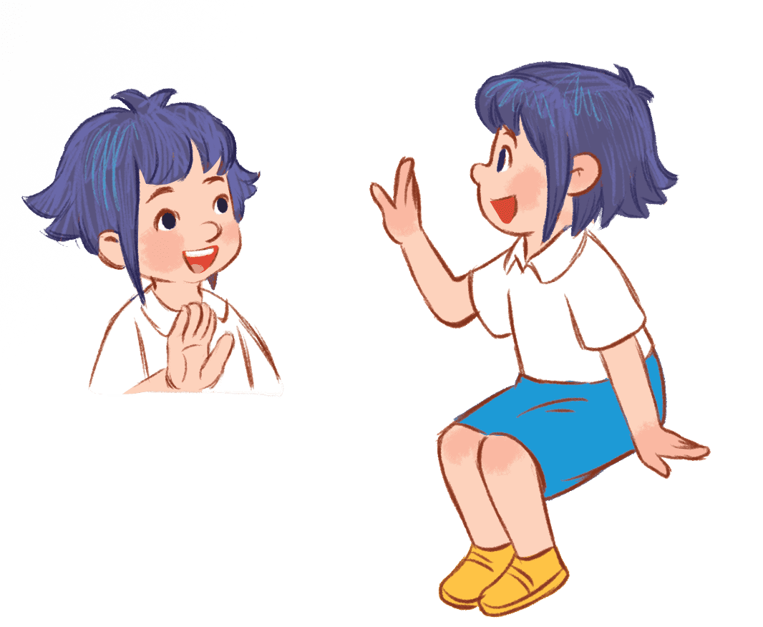
What’s your name?
My name’s ____.
Linh
Notes:
CLICK PINK AMONG US – GO TO THE POINTS

Slide 33

What’s your name?
My name’s ____.
Lucy
Notes:
CLICK PINK AMONG US – GO TO THE POINTS

Slide 34





Slide 35



Slide 36


Slide 37


Slide 38


Slide 39


Slide 40


Slide 41


Slide 42
LET’S TALK!
04

Slide 43
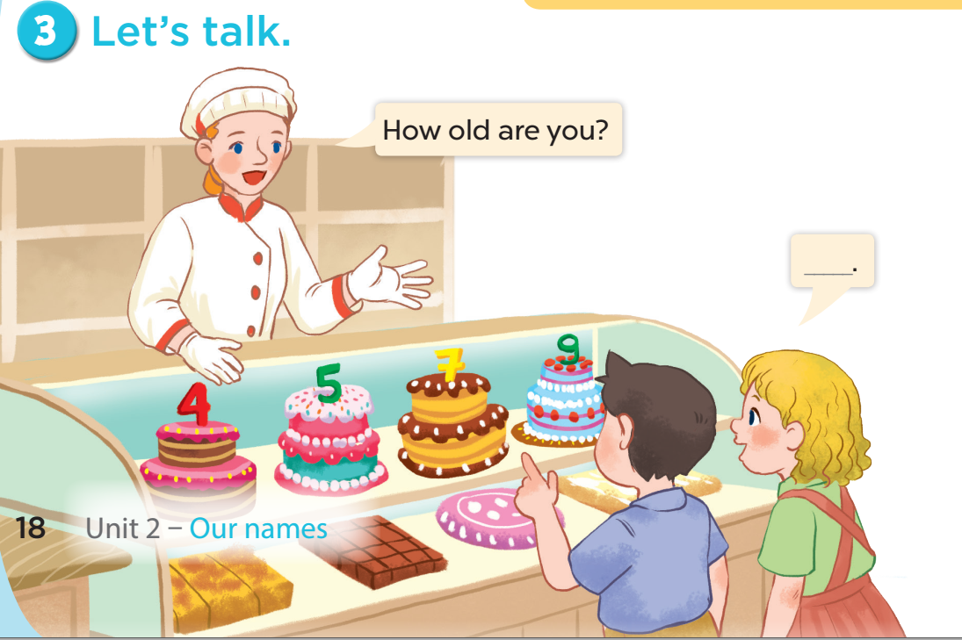

Slide 44
FUN TIME
05

Slide 45


5
10
1
7
8
SPIN
-5
3
9
-3
4
6
2
tekhnologic

Slide 46

Website: sachmem.vn
Fanpage: www.facebook.com/sachmem.vn
Youtube: Sách Mềm

