Slide 1


Our sports day
9
Lesson 1 – P1,2,3

Slide 2

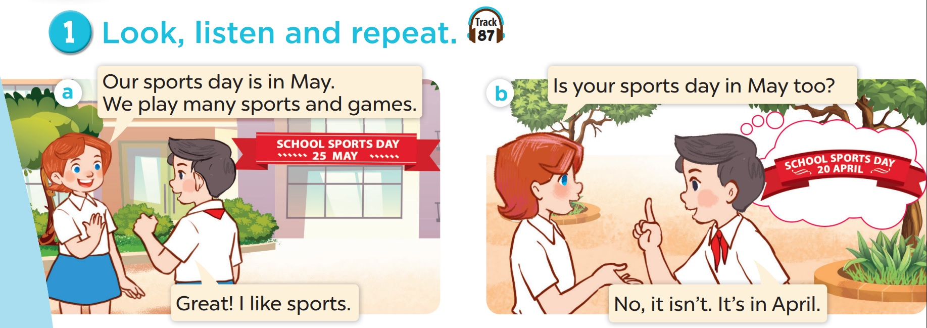
1.Look, listen and repeat.

Slide 3
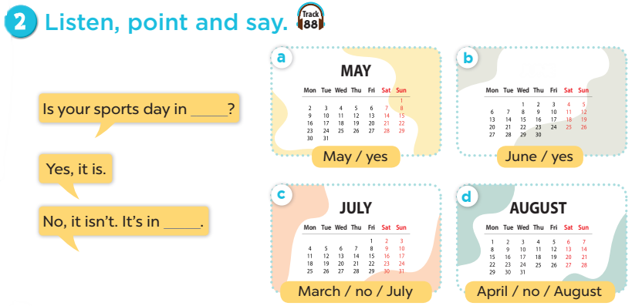
Tháng 5
Tháng 6
June
A: Is your sports day in …………………?
B: Yes, it is No, it isn’t. it’s in……
Tháng 7
Tháng 8
Notes:
Click on the Speaker Icon to play the audio.

Slide 4
June
A: Is your sports day in …………………?
B: Yes, it is
Notes:
Click on the Speaker Icon to play the audio.

Slide 5
A: Is your sports day in …………………?
B: No, it isn’t. It’s in ……..
Notes:
Click on the Speaker Icon to play the audio.

Slide 6
A: Is your sports day in …………………?
B: Yes, it is.
No, it isn’t. It’s in ……..
Notes:
Click on the Speaker Icon to play the audio.

Slide 7

Is your sports day in ___?
Yes, it is.
No, it isn't. It's in ____.

Slide 8

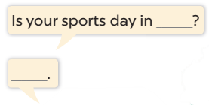
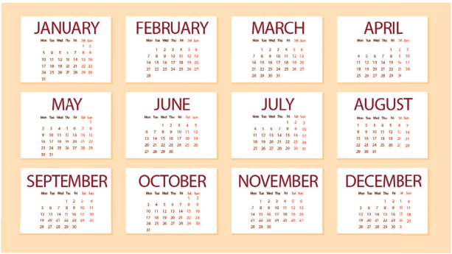
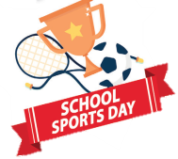

Slide 9
06
Game

Slide 10
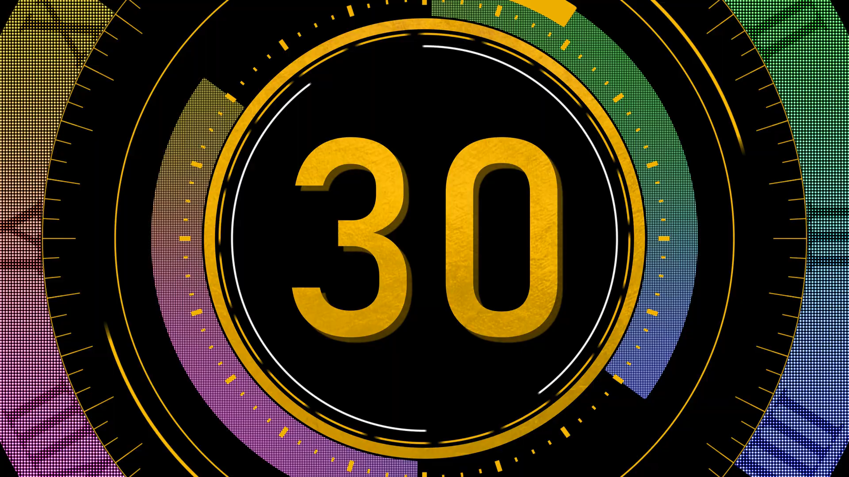

Our sports day is …… June.
in
From
on
A
B
C

Slide 11
…….. your sports day in March ?
Are
Do
Is
A
B
C

Slide 12
Our / in / is/ sports/ July.
Our sports day in is July.
A
Our sports day is in July.
B
Our day sports is in July.
C

Slide 13
January,February,March,……….,May, June,
July
August
April
A
B
C

Slide 14
It’s in QUANG NINH.
CHUA HUONG
PHU QUOC
HA LONG
A
B
C

Slide 15
It’s in VIET NAM.
Sydney
CAN THO
Bangkok
A
B
C

Slide 16
0
0
0
O
O
O
X
X
X
1
2
3
X
X
X
0
0
0
O
O
O
X
X
X
4
5
6
X
X
X
0
0
0
O
O
O
X
X
X
7
8
9
X
X
X
Notes:
- Divide Ss into 2 teams: one team is X, one team is O.
- Students select a number on the grid, then 2 students from that team ask and answer based on the cue. If they answer correctly, teacher clicks on the home button to go back to the first slide, then click on X or O (depending on which team is answering).
- The first team to get three Xs or three Os in a row wins!

Slide 17
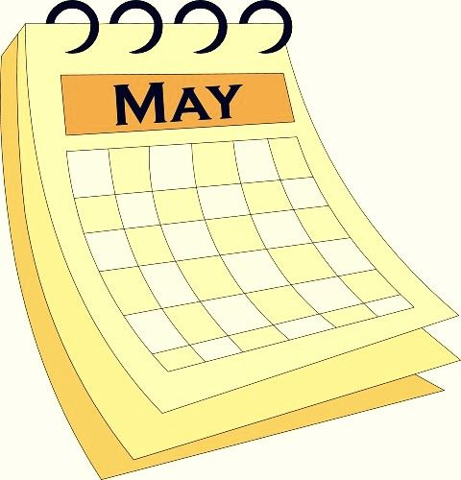
your sports day / May?
Is your sports day in May?
Yes, it is.

Slide 18
your sports day / June?
Is your sports day in June?
No, it isn't.
It's in May.

Slide 19


your sports day / July?
Is your sports day in July?
Yes, it is.

Slide 20

your sports day / July?
Is your sports day in July?
No, it isn't. It's in June.

Slide 21
your sports day / February?
Is your sports day in February?
No, it isn't. It's in June.

Slide 22
What's the 4th month of the year?
It's April.

Slide 23
What's the 5th month of the year?
It's May.

Slide 24
What's the 6th month of the year?
It's June.

Slide 25
What's the 7th month of the year?
It's July.

