Slide 1
English 11
Unit
4
Asean and Viet Nam
Unit
FAMILY LIFE
LESSON 2
LANGUAGE

Slide 2
WARM-UP
MATCHING
Work in 4 groups.
Match the pronunciation to the real word.

Slide 3
WARM-UP
MATCHING
/pˈteɪtoʊ/
/tˈnaɪt/
police
/ˈevri/
tonight
/pˈliːs/
history
every
potato
/ˈhɪstri/

Slide 4


WARM-UP
ELISION OF VOWELS
‘his- to- ry’
history
/ˈhɪstri/
‘e-ve-ry’
every
/ˈevri/
Notes:
Link video phát âm về nuốt âm: https://www.youtube.com/watch?v=vCnLuB_xclo

Slide 5

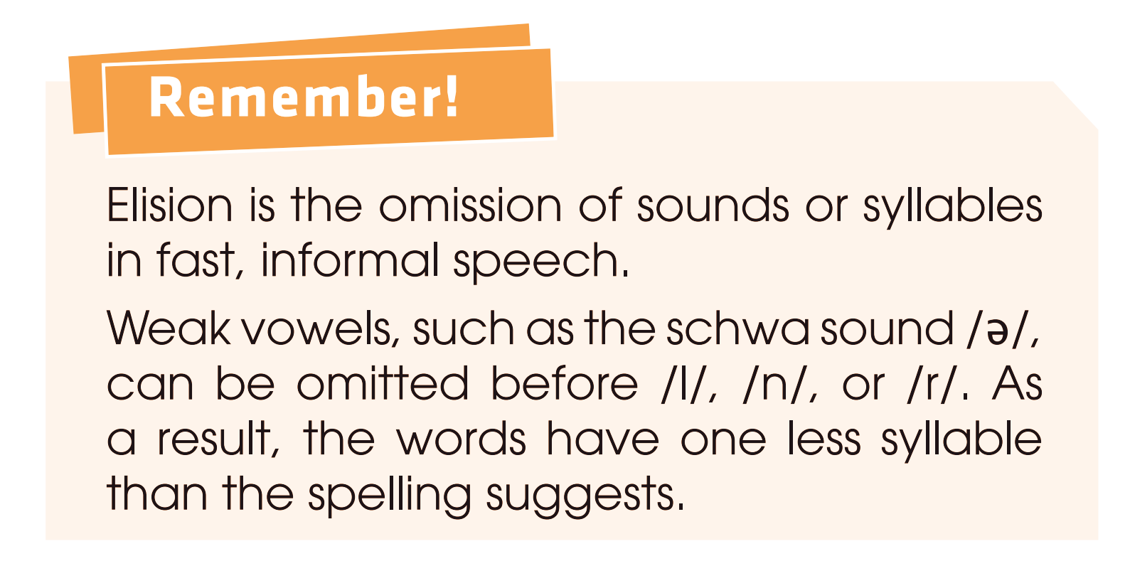
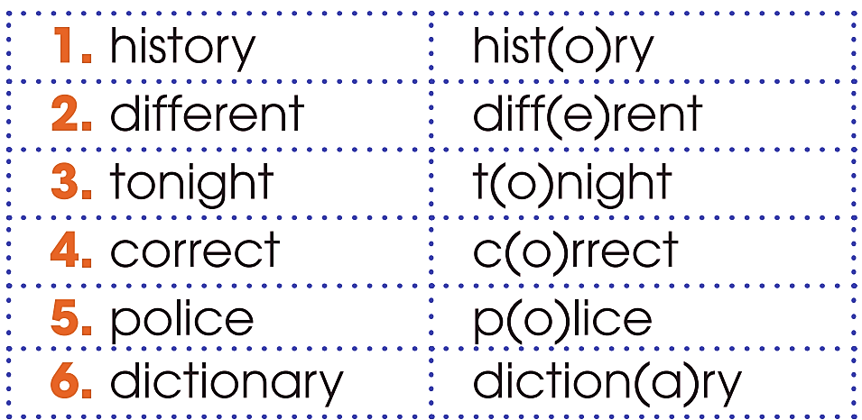
PRONUNCIATION
1
Listen and repeat.

Slide 6


PRONUNCIATION
2
Listen and repeat.
1. Let’s find the correct answer! 2. We also provide mobile library services in rural areas. 3. My family will move to a different country. 4. Please bring your dictionary to the history class.
c(o)rrect
libr(a)ry
fam(i)ly - diff(e)rent
diction(a)ry - hist(o)ry

Slide 7
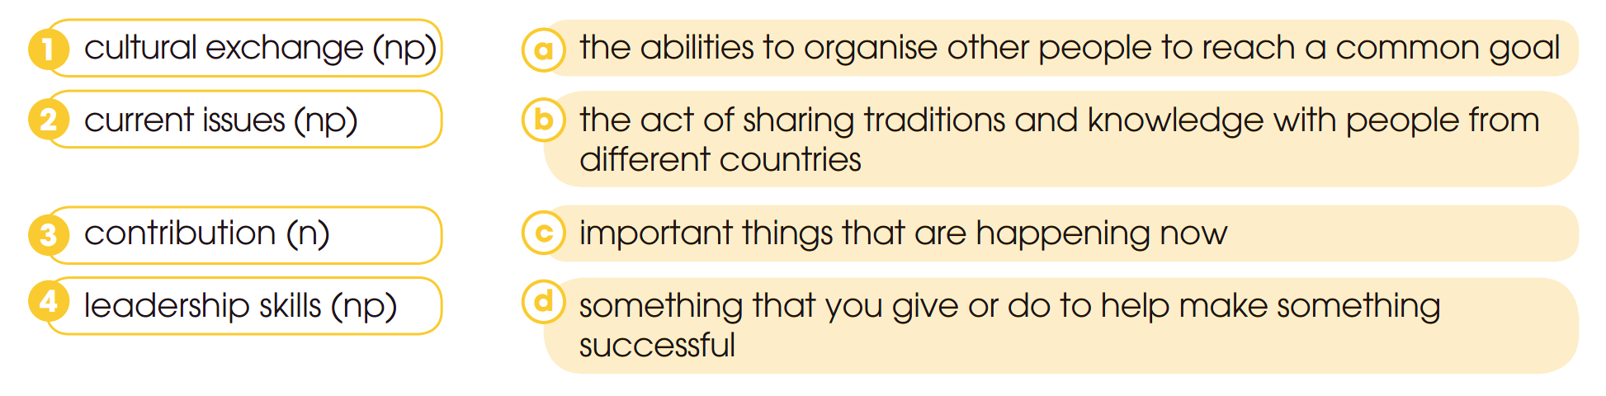

VOCABULARY
1
Match the word and phrases with their meanings.

Slide 8
VOCABULARY
2
Complete the sentences using the word and phrases in Task 1.
1. Communicating with people and managing teamwork well are important _______________.
2. ASEAN has made a major ____________ to peace in the region.
3. A _______________ is the best way for young people to understand other countries’ values and ideas.
4. The aim of this meeting is to discuss ____________ such as climate change and pollution.
leadership skills
contribution
cultural exchange
current issues

Slide 9

GRAMMAR

Slide 10
Gerund
* Form:
V – ing
1. Là chủ ngữ của câu:
Ex: dancing bored him.
2. Bổ ngữ trong các trường hợp sau:
* Use:

Slide 11
TH1: Sau một số động từ
admit (thừa nhận), avoid (tránh), anticipate (lường trước), appreciate (tán thành), complete (hoàn thành), consider (xem xét), deny (chối), detest (ghét), discuss (thảo luận), defend (bảo vệ), delay (trì hoãn), despise (khinh thường), enjoy (thích thú), escape (thoát khỏi), excuse (thứ lỗi), fancy (mê thích), forgive (tha thứ), imagine (tưởng tượng), involve (liên quan), loathe (kinh tởm), mind (phiền), miss (hụt; lỡ), mention (đề cập), prevent (ngăn chặn), postpone (trì hoãn), practice (thực hành), .............
Eg:

Slide 12
TH 2: Sau giới từ hoặc cụm giới từ
on, in, into, at, onto, out, out of, under, with, of, down, up, within.....,apologize for (xin lỗi vì...), accuse of (tố cáo), insist on (khăng khăng), feel like (cảm thấy thích), congratulate on (chúc mừng về việc), suspect of (nghi ngờ về), look forward to (trông mong việc gì), dream of (mơ về), succeed in (thành công), object to (phản đối), approve/disapprove of (tán thành/phản đối)...
Eg:

Slide 13
TH 3: Sau một số cụm từ
- It's no use / It's no good/ There's no point (in)... = vô ích
- can’t help = can’t resist = không nhịn được
- can’t bear = can’t stand = không chụi đựng được
- Have difficult (in) / have a hard time... = gặp khó khăn
- It's a waste of time / money... = lãng phí th.gian/tiền
- Spend / waste time / money... = chi xài/lãng phí...
- Be / get used to/ accustomed to... = quen với..
- Do / Would you mind... ? = có phiền...
- What about... ? How about...? = thế thì...?
Go + V-ing (go shopping, go swimming... )
............
Eg:

Slide 14
TH 4: Sau động từ tobe
Eg: : Her hobby is collecting dolls.
Note: Khi sử dụng trong câu phủ định : Phủ định của Gerund được hình thành bằng cách thêm not trước V-ing.
Eg: My grandparents have retired and enjoy not working.

Slide 15
GRAMMAR
1
Rewrite the following sentences using gerunds.
1. It is more convenient for students to apply for ASEAN scholarships online. → ______________________________________ is more convenient for students.
Applying for ASEAN scholarships online

Slide 16
GRAMMAR
1
Rewrite the following sentences using gerunds.
2. My sister usually listens to music in her free time. → My sister’s hobby is _______________ in her free time.
listening to music

Slide 17
GRAMMAR
1
Rewrite the following sentences using gerunds.
3. Could you help me translate the documents for the workshop? → Do you mind ______________________________ for the workshop?
helping me translate the documents

Slide 18
GRAMMAR
1
Rewrite the following sentences using gerunds.
4. They managed to start a youth programme in Southeast Asia.
→ They succeeded in ________________________ in Southeast Asia.
starting a youth programme

Slide 19
GRAMMAR
1
Rewrite the following sentences using gerunds.
4. Maria can’t forget the conference she participated last year.
→ __________________________________ was an unforgettable experience for Maria.
Participating in the conference last year

Slide 20


GRAMMAR
2
Work in pairs. Take turns to make sentences about your partner, using gerunds. He or she should tell you if they are true.

Slide 21
CONSOLIDATION
1
Wrap-up
Choose the best answer for each sentence.
Question 1: All ASEAN member states have agreed (take) part in the conference.
A. take B. to take C. taking D. took
Question 2: My father’s work involves (travel) to the member states of ASEAN.
A. travel B. travelled C. to travel D. travelling
Question 3: Lan can’t wait (go) to the airport to meet her pen pal from Malaysia.
A. to go B. going C. go D. went
Question 4: Students from Viet Nam who want (apply) for the ASEAN Scholarships must be approved by the Ministry of Education and Training.
A. apply B. applied C. applying D. to apply
Question 5: Would you mind (prepare) the quiz questions on ASEAN and the ASEAN Charter?
A. prepare B. preparing C. to prepare D. prepared
Question 6: I really enjoy (participate) in the activities organised by the ASEAN Youth Volunteer Programme.
A. participate B. to participate C. participating D. participated

Slide 22

CONSOLIDATION
2
Homework
Do exercises in the workbook.

Slide 23

Website: hoclieu.vn
Fanpage: facebook.com/www.tienganhglobalsuccess.vn

