Slide 1



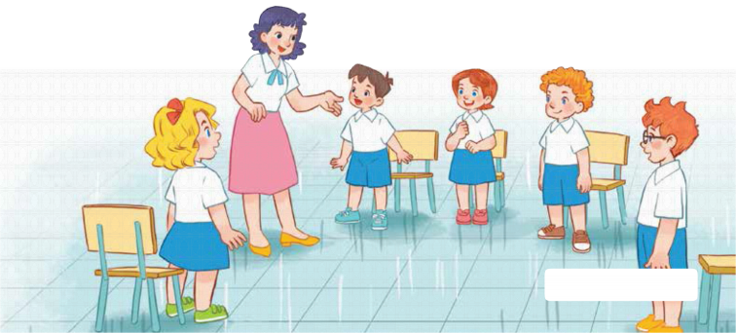
7
Classroom instructions
LESSON 1 – PERIOD 2

Slide 2
CONTENTS
Let’s play.
Listen and tick.
Look, complete and read.
Fun corner and wrap up
Warm-up and review

Slide 3
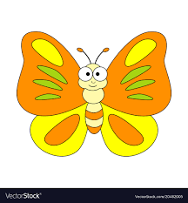



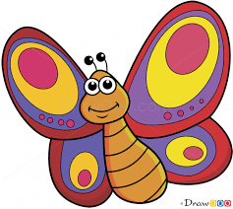
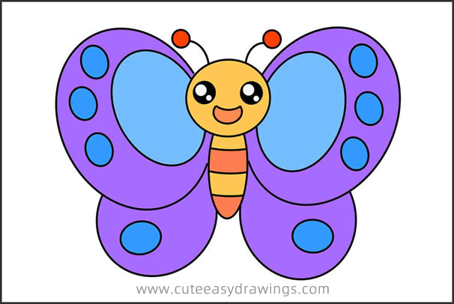
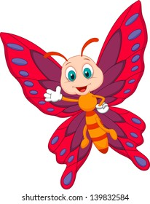


Warm-up and review
Notes:
- Divide the class into 2 teams.
- Each team chooses one butterfly to go to the question.
- Have pupils look, read and choose the right option.
- Back to the menu for another question.
- Pupils take turns to play until they catch all the butterflies.
- The team who gets the most butterflies is the winner.

Slide 4



A. Close your book, please!
B. Stand up, please!
C. Open your book, please!
Notes:
Click each answer to check.
Click the flower to go back to the game.

Slide 5

A. Close your book, please!
B. Sit down, please!
C. Open your book, please!
Notes:
Click on each answer to check.
Click on the flower to go back to the game.

Slide 6
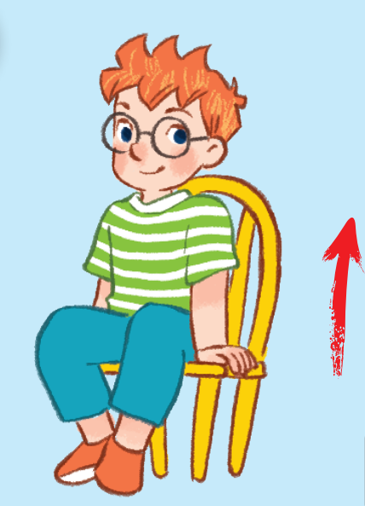
A. Sit down, please!
B. Stand up, please!
C. Close your book, please!
Notes:
Click on each answer to check.
Click on the flower to go back to the game.

Slide 7
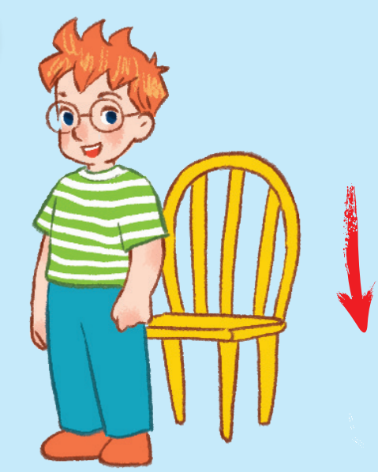
A. Stand up, please!
B. Open your book, please!
C. Sit down, please!
Notes:
Click on each answer to check.
Click on the flower to go back to the game.

Slide 8
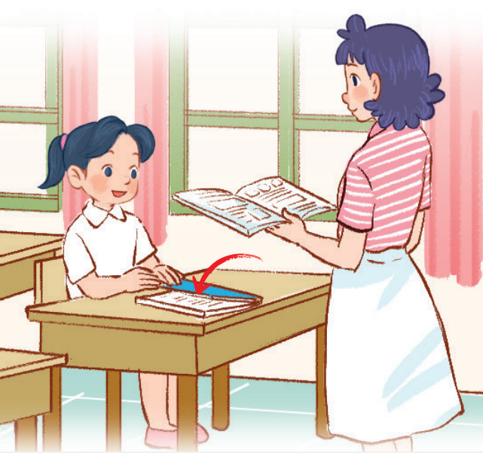
A. Close your books, please!
B. Sit down, please!
C. Open your books, please!
Notes:
Click on each answer to check.
Click on the flower to go back to the game.

Slide 9
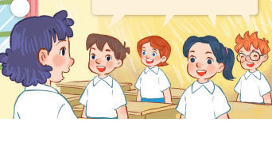
A. Hello, Ms. Hoa.
B. Good morning, Ms. Hoa.
C. Hi, Ms. Hoa.
Notes:
Click on each answer to check.
Click on the flower to go back to the game.

Slide 10
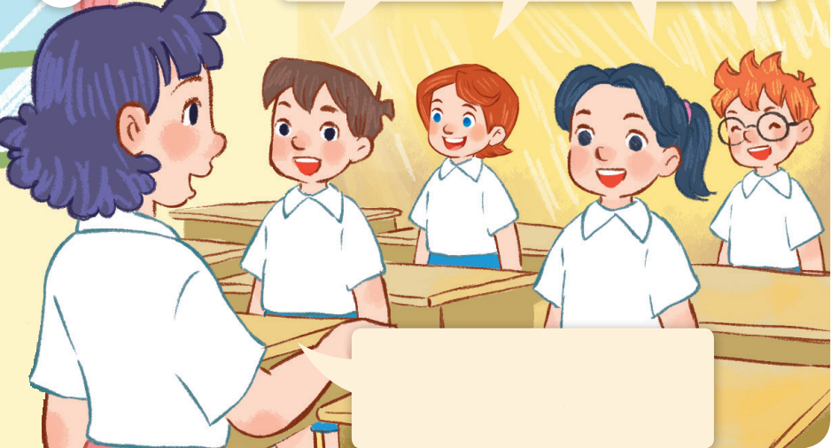

A. Hello, class.
Sit down, please!
B. Good bye, class.
Sit down, please!
C. Hello, class.
Stand up, please!
Notes:
Click on each answer to check.
Click on the flower to go back to the game.

Slide 11
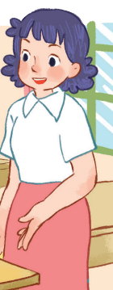
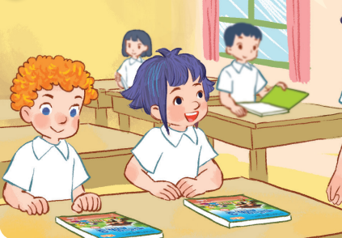
A. Close your books, please!
B. Open your books, please!
C. Stand up, please!
Notes:
Click on each answer to check.
Click on the flower to go back to the game.

Slide 12

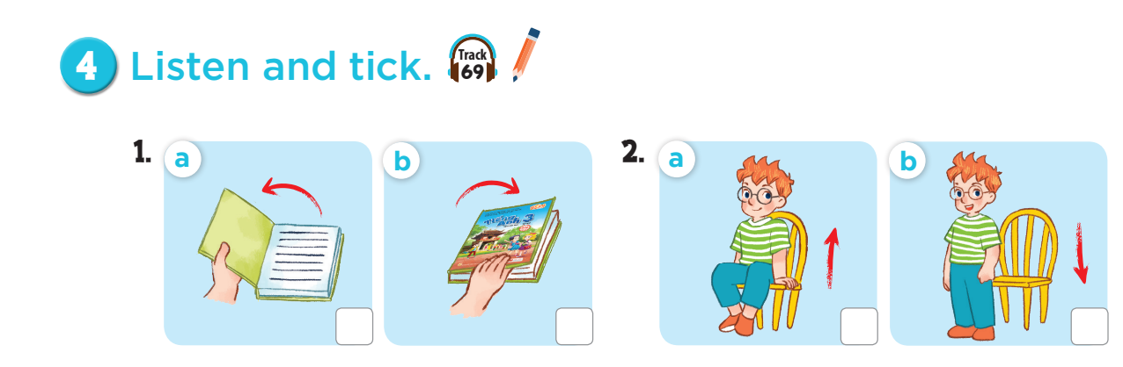



Slide 13
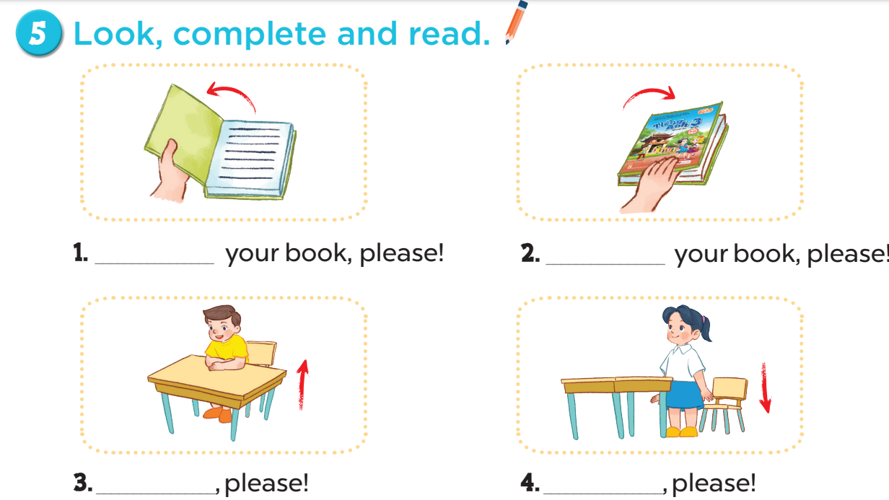
Open
Close
Stand up
Sit down

Slide 14
