Slide 1
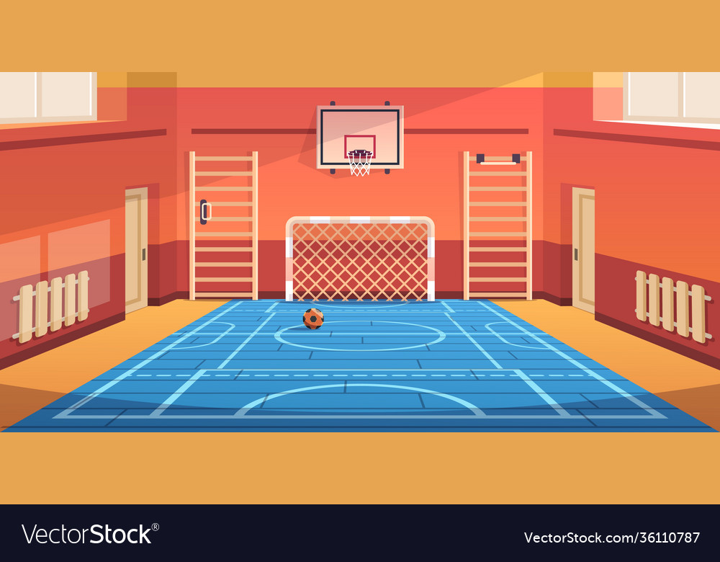



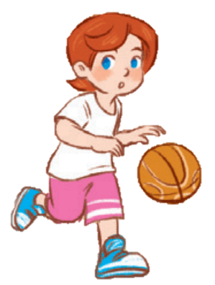
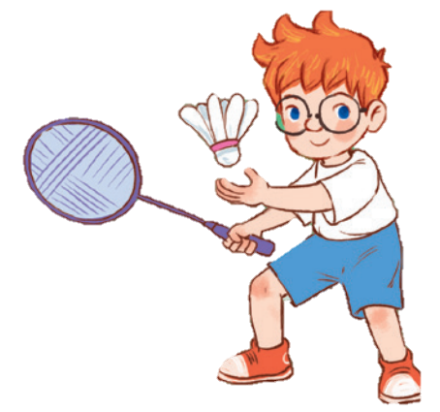
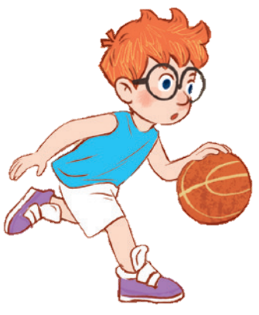
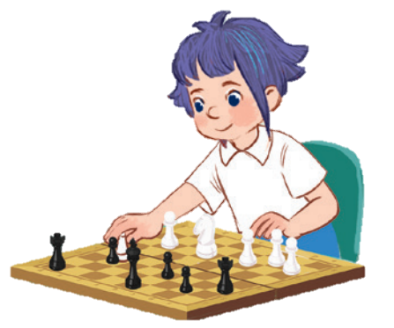
10

Slide 2
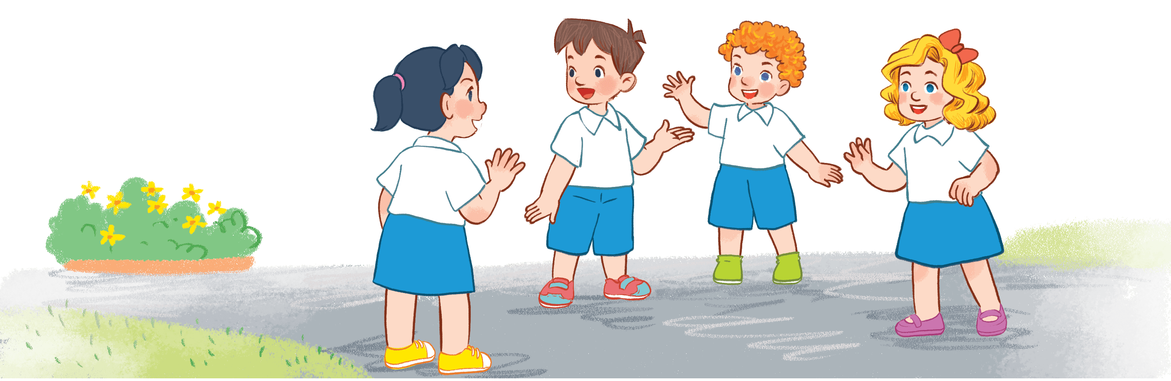
Warm-up AND REVIEW
Notes:
Game: Look and Guess
- Teacher shows 4 pictures numbered 1 to 4 on the board.
- Teacher lets the pupils choose 1 square on the screen and open it.
- Teacher lets the pupils guess the corresponding number of the picture.

Slide 3
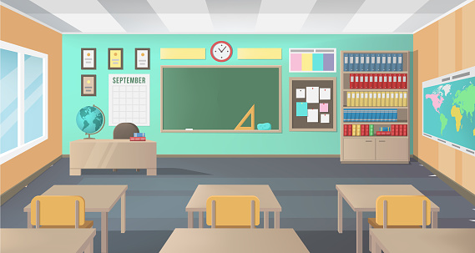
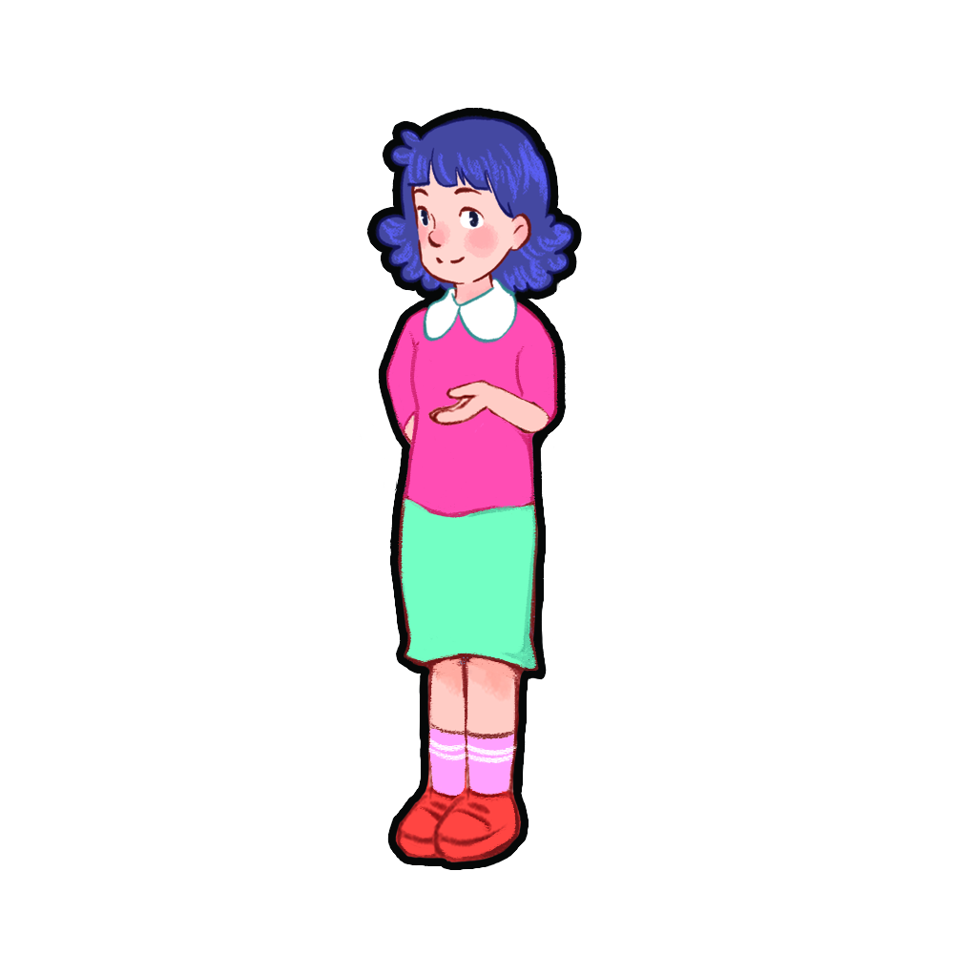
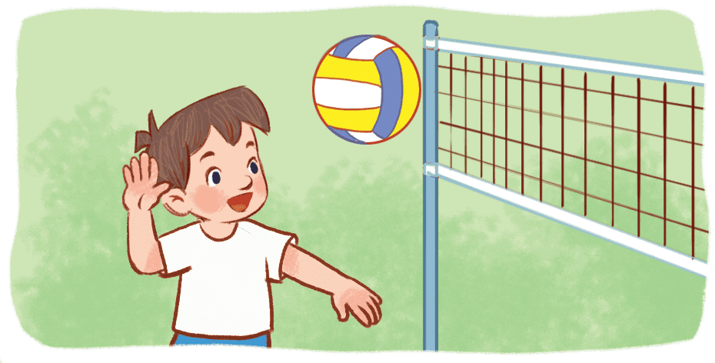
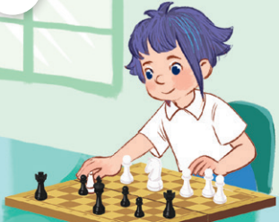
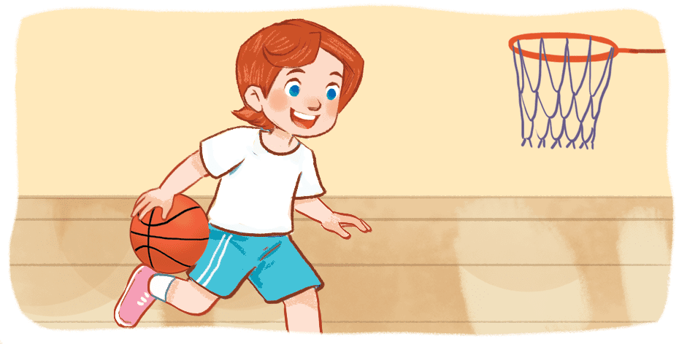
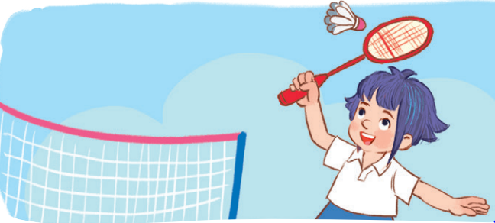
(1)
(3)
(2)
(4)
Notes:
Game: Look and Guess
- Teacher shows 4 pictures on the board with numbers.
- Teacher lets the pupils choose 1 square on the screen and open it.
- Teacher lets the pupils guess the number of the pictures.

Slide 4
Notes:
Picture 1

Slide 5
Notes:
Picture 2

Slide 6
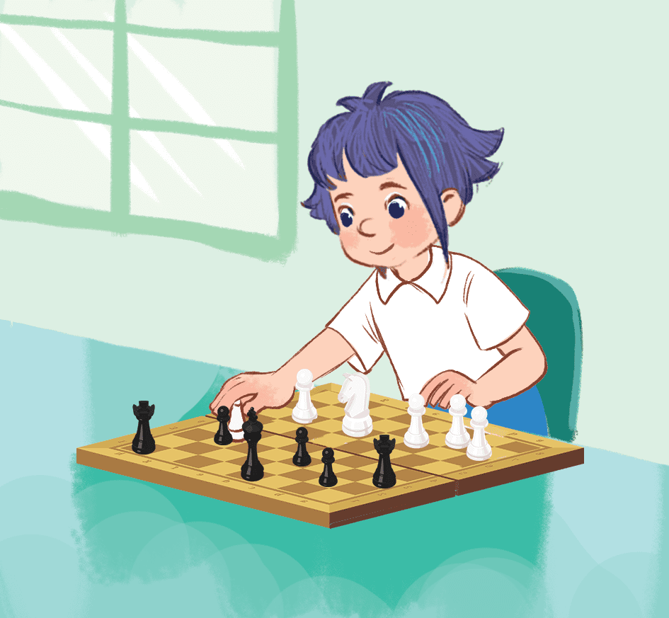
Notes:
Picture 3

Slide 7
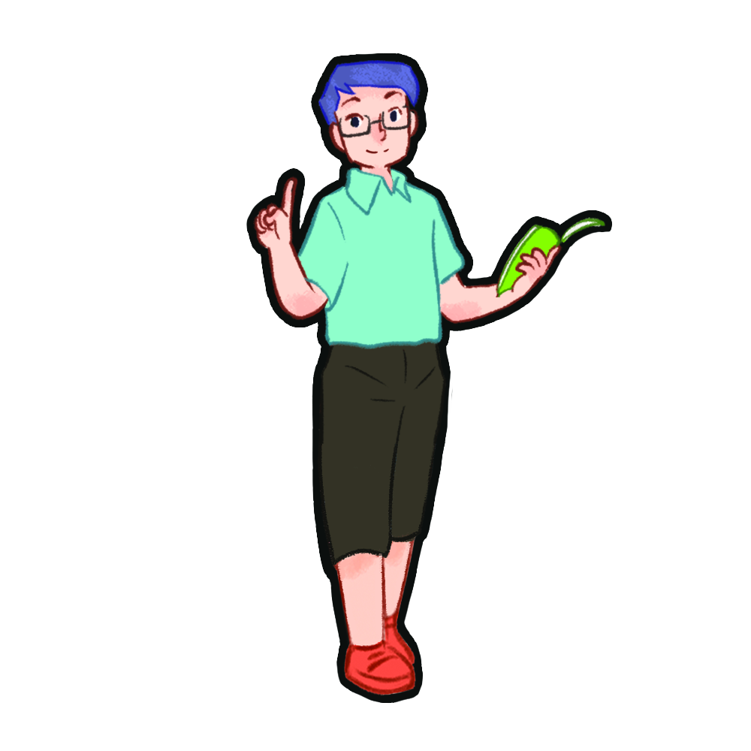
Look, listen and repeat.

Slide 8

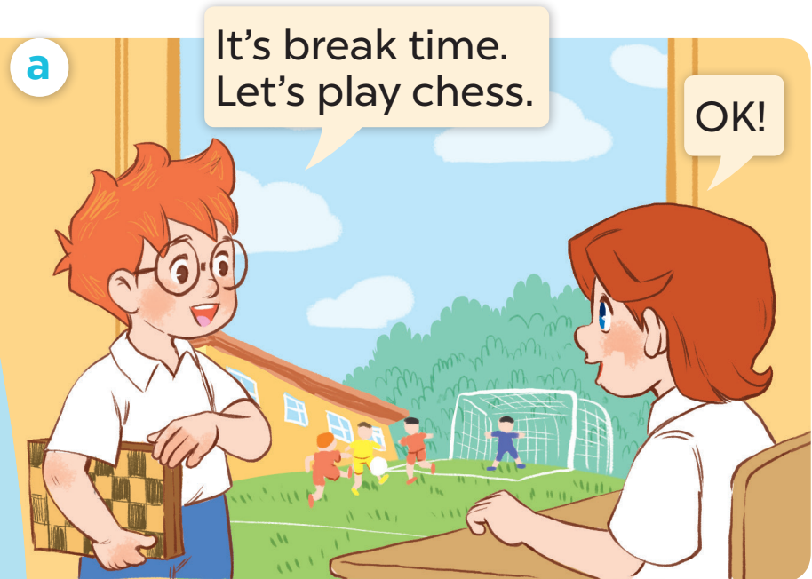
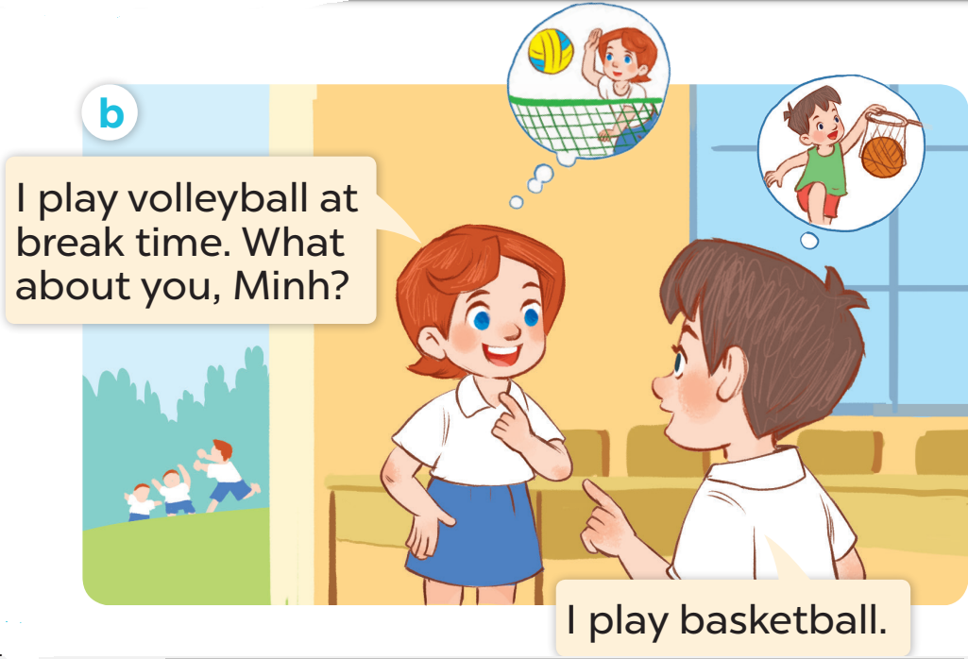

Slide 9
Listen, point and say.

Slide 10

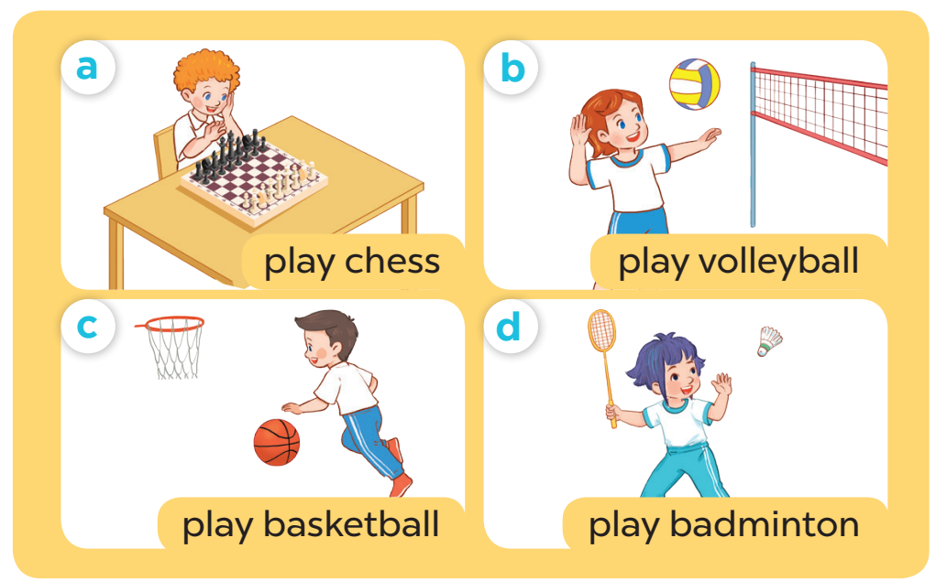

Slide 11
Game time
Notes:
Game: Whisper
- Teacher divides the class into groups of 4.
- Teachers asks 2 groups to get in 2 lines and stand back to the board.
- Teacher asks the first pupil of each line to look at one picture and whisper to the next pupil.
- The last one of each line comes to the board and choose the picture and stick it on the board.
- Change the position of the first pupil and repeat the activities.

Slide 12
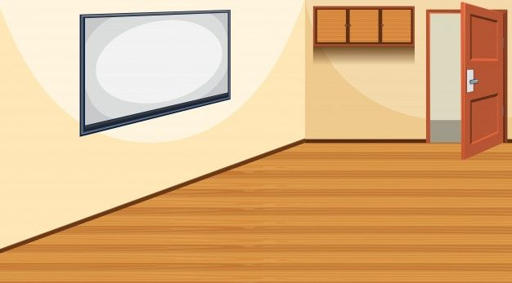




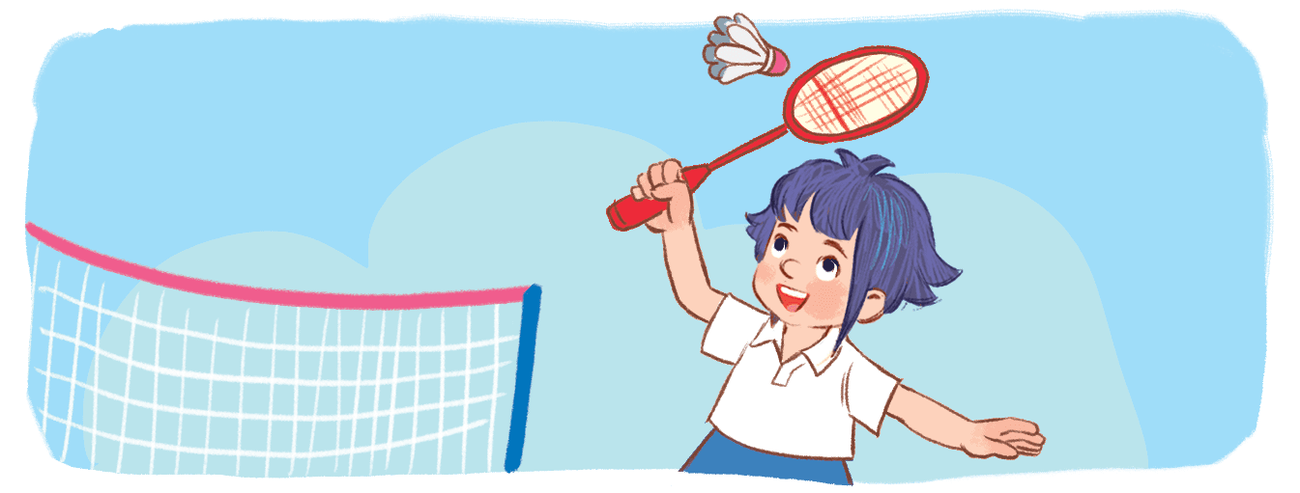
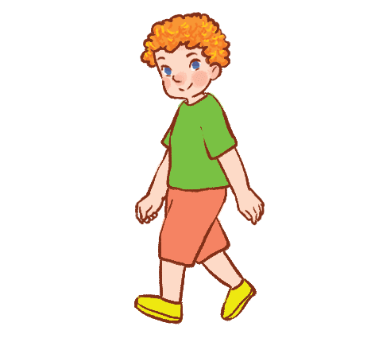



TEAM B
TEAM A

Slide 13



TEAM B
TEAM A

Slide 14
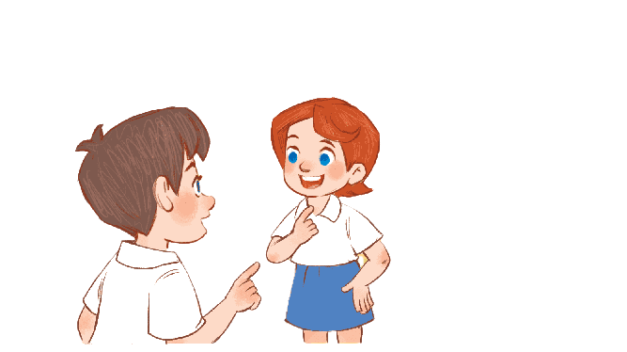
Let’s talk.

Slide 15
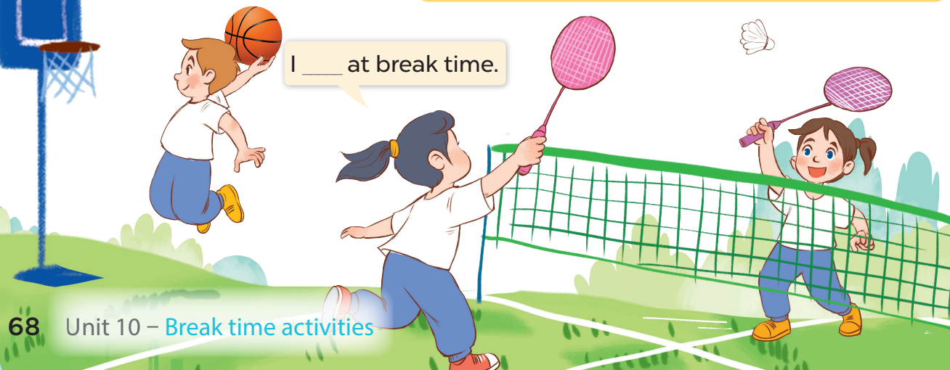

Slide 16

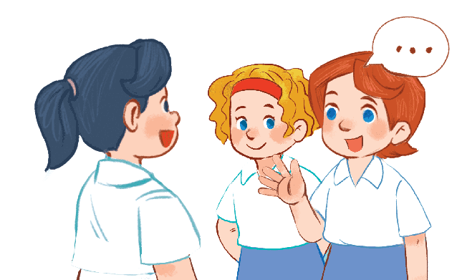
I ……….. at break time
Notes:
-T asks pupils to practise in pairs asking and answering.
-T asks some pairs to present in front of the class.

Slide 17
Fun corner and Wrap-up
Notes:
Game: Act and guess
- Teacher asks 4 pupils to come to the board and act to describe 4 break time activities (play volleyball, play basketball, play chess, play badminton).
- Teacher asks the others to look at the pictures on the board and guess which pupils go with which pictures.

Slide 18



(1)
(2)
(3)
(4)
Notes:
Game: Act and guess
- Teacher asks 4 pupils to come to the board and act to describe 4 break time activities (play volleyball, play basketball, play chess, play badminton).
- Teacher asks the others to look at the pictures on the board and guess which pupils go with which pictures.

Slide 19

play
basketball
play
chess
play
volleyball
play
badminton
I ………. at break time.
Notes:
Teacher shows 4 pictures of break time activities on the board and asks pupils to practice using the model structure to make sentences.

