Slide 1


Slide 2
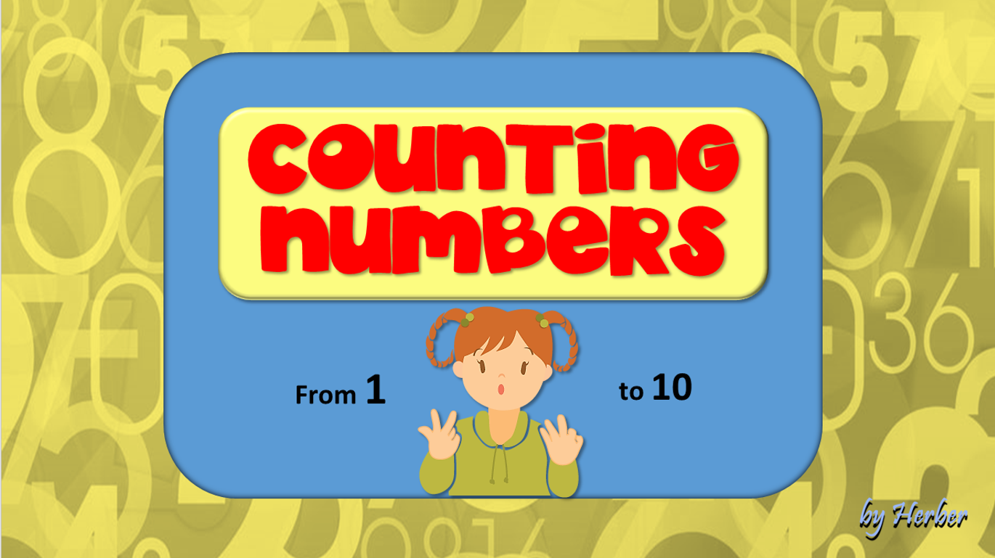
Let’s Review 1
Let’s Review 2
Game 1
Game 2

Slide 3

I can count my numbers
Will you count them with me?

Slide 4
1 2 3 4 5
6 7 8 9 10

Slide 5
one two three four five
six seven eight nine ten

Slide 6
I can count my numbers
Will you count them with me?

Slide 7
1 2 3 4 5
6 7 8 9 10

Slide 8

one two three four five
six seven eight nine ten

Slide 9

next

Slide 10




two
2
6
9
1

Slide 11
four
1
4
8
7

Slide 12
nine
6
9
7
3

Slide 13
three
6
8
9
3

Slide 14
six
10
8
6
1

Slide 15
ten
10
3
6
4

Slide 16













Slide 17





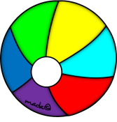




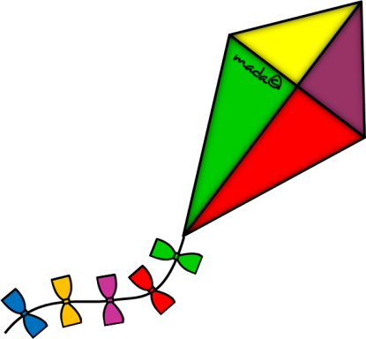

Slide 18




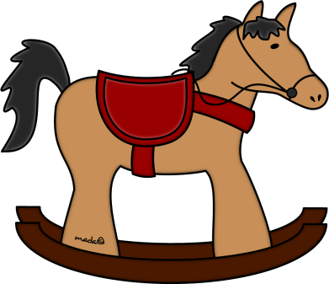





Slide 19





Slide 20
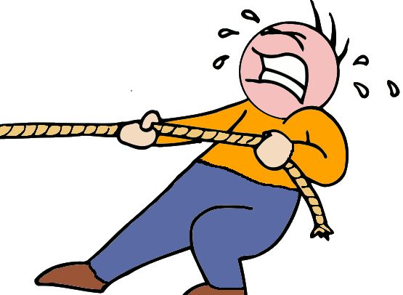


GOODBYE!
Notes:
20

