Slide 1

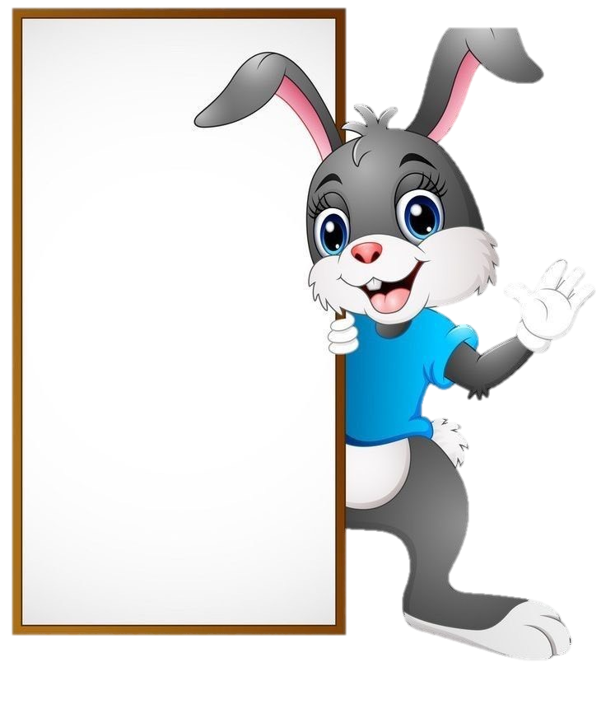

1
2
Ô CỬA
BÍ
MẬT
3
4

Slide 2


Home

Slide 3

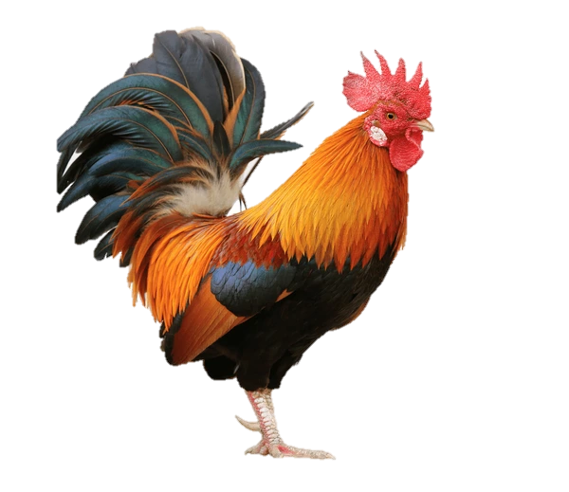
Home

Slide 4

Home

Slide 5
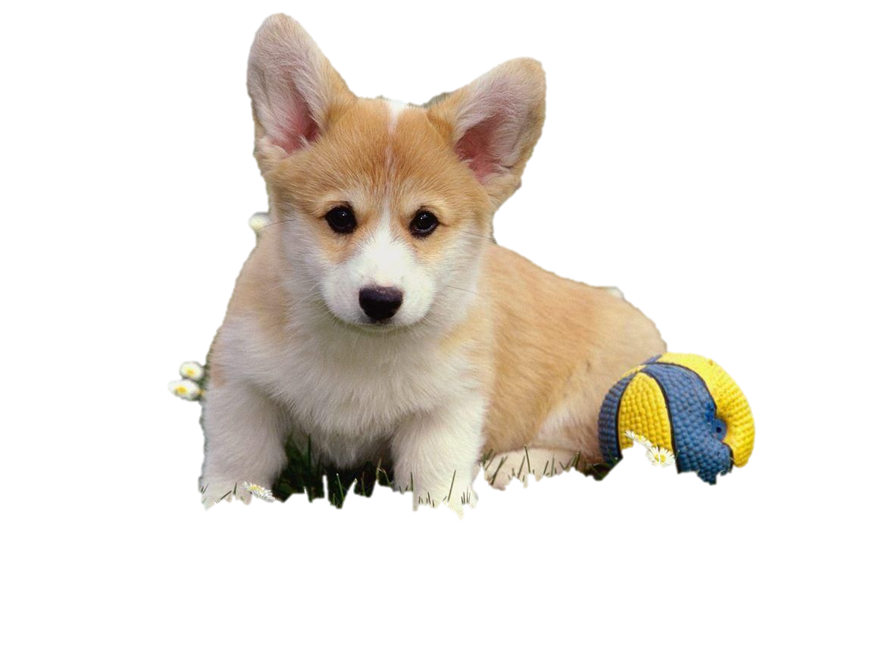
Home

