Slide 1







Slide 2


FAMILY
PLAY

Slide 3






Who is this?
HẾT GIỜ
HẾT GIỜ
1
Dad
2
Mom
3
Grandmother
4
Grandfather

Slide 4


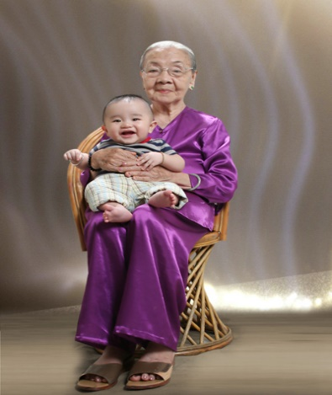
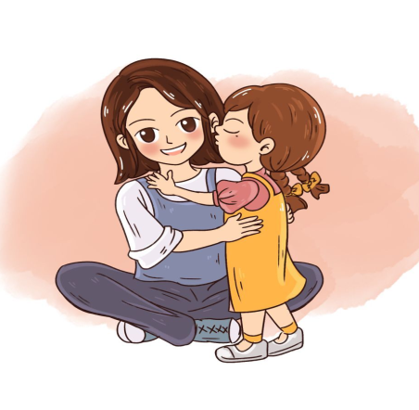
Where is the Mother in the picture?
HẾT GIỜ
1
2
4
3

Slide 5
Find the missing letter in the world “ Grand...arther”
HẾT GIỜ
1
S
2
F
3
D
4
A

Slide 6
How many letter are there in the world “ Son”
HẾT GIỜ
1
6
2
4
3
3
4
5

Slide 7


How many pepole are there
in your family picture?
HẾT GIỜ
1
5
2
6
3
3
4
4

Slide 8




