Slide 1












Unit 12
MsPham
0936082789
Jobs
Lesson 1 – Period 1

Slide 2

Warm up

Slide 3


Notes:
Look , listen and action.

Slide 4

Vocabulary
MsPham
0936082789

Slide 5

a farmer
/ əˈfɑːmə/
MsPham
0936082789
Nông dân

Slide 6
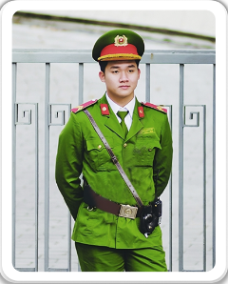
a policeman
/ə pəˈliːsmən/
MsPham
0936082789
Cảnh sát (nam)

Slide 7

a teacher
/əˈtiːtʃər/
MsPham
0936082789
Giáo viên

Slide 8

an office worker
/ ən ˈɒfɪs wɜːkə/
MsPham
0936082789
Nhân viên văn phòng

Slide 9
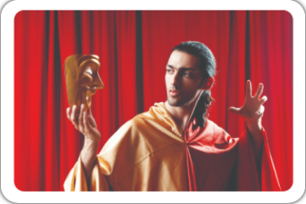
an actor
/ ən ˈæktə/
MsPham
0936082789
Diễn viên (nam)

Slide 10
Vocabulary
a policeman
: Cảnh sát
a teacher
: Giáo viên
MsPham
0936082789
a farmer
: Nông dân
an office worker
: Nhân viên văn phòng
an actor
: Diễn viên nam

Slide 11
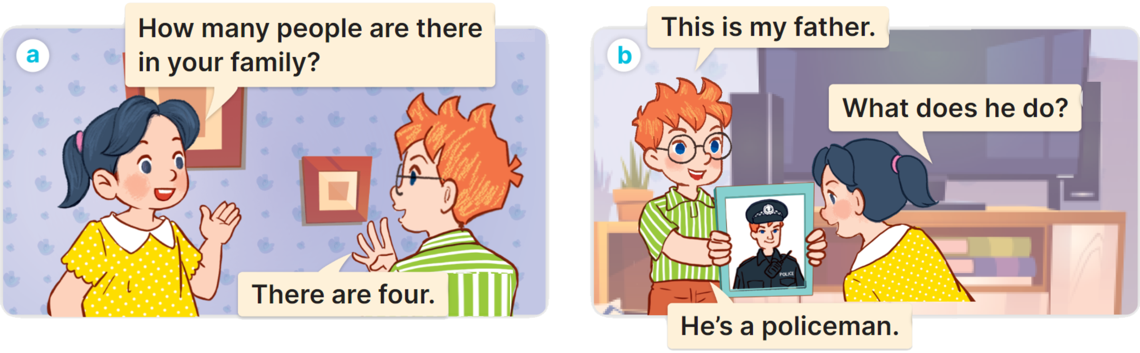

1
Look, listen and read.
MsPham
0936082789

Slide 12
Structure
MsPham
0936082789

Slide 13
1
Cách hỏi một người nào đó làm nghề gì:
What does he/she/name do?
(Anh ấy/cô ấy làm nghề gì?)
He’s/She’s a/an + job.
(Anh ấy / cô ấy là một ______)
Ex:

Slide 14

2
Listen, point and say.
What does he/she do?
He’s/She’s _____.
MsPham
0936082789
a farmer
a policeman
an office worker
an actor

Slide 15


2
Listen, point and say.
MsPham
0936082789
What does she do?
She’s a farmer.

Slide 16


2
Listen, point and say.
MsPham
0936082789
What does he do?
He’s a policeman.

Slide 17
2
Listen, point and say.
MsPham
0936082789
What does she do?
She’s an office worker.

Slide 18
2
Listen, point and say.
MsPham
0936082789
What does he do?
He’s an actor.

Slide 19
2
Listen, point and say.
What does he/she do?
He’s/She’s _____.
MsPham
0936082789
a farmer
a policeman
an office worker
an actor

Slide 20







Notes:
Ms Huyền Phạm - 0936.082.789 – YOUTUBE: MsPham. Facebook: Dạy và học cùng công nghệ.

Slide 21




+5
she
What does ____ do?
She is a farmer.
-1
he
-1
you
Notes:
Ms Huyền Phạm - 0936.082.789 – YOUTUBE: MsPham. Facebook: Dạy và học cùng công nghệ.

Slide 22
-1
she
What does ____ do?
He is a policeman.
+5
he
-1
you
Notes:
Ms Huyền Phạm - 0936.082.789 – YOUTUBE: MsPham. Facebook: Dạy và học cùng công nghệ.

Slide 23
+5
she
What does ____ do?
She is a teacher.
-1
you
-1
he
Notes:
Ms Huyền Phạm - 0936.082.789 – YOUTUBE: MsPham. Facebook: Dạy và học cùng công nghệ.

Slide 24
+5
he
What does ____ do?
He is an actor.
-1
she
-1
you
Notes:
Ms Huyền Phạm - 0936.082.789 – YOUTUBE: MsPham. Facebook: Dạy và học cùng công nghệ.

Slide 25
-1
an actor
What does he do?
He is ________.
+5
an office worker
-1
an nurse
Notes:
Ms Huyền Phạm - 0936.082.789 – YOUTUBE: MsPham. Facebook: Dạy và học cùng công nghệ.

Slide 26
-1
a teacher
What does she do?
She is ________.
-1
a teacher
+5
a farmer
Notes:
Ms Huyền Phạm - 0936.082.789 – YOUTUBE: MsPham. Facebook: Dạy và học cùng công nghệ.

Slide 27
+5
an actor
What does he do?
He is ________.
-1
a policeman
-1
a teacher
Notes:
Ms Huyền Phạm - 0936.082.789 – YOUTUBE: MsPham. Facebook: Dạy và học cùng công nghệ.

Slide 28
+5
a policeman
What does he do?
He is ________.
-1
a farmer
-1
an office worker
Notes:
Ms Huyền Phạm - 0936.082.789 – YOUTUBE: MsPham. Facebook: Dạy và học cùng công nghệ.

Slide 29
-1
an actor
What does he do?
He is ________.
-1
a policeman
+5
a teacher
Notes:
Ms Huyền Phạm - 0936.082.789 – YOUTUBE: MsPham. Facebook: Dạy và học cùng công nghệ.

Slide 30


Great job!
Exit
Notes:
Ms Huyền Phạm - 0936.082.789 – YOUTUBE: MsPham. Facebook: Dạy và học cùng công nghệ.

Slide 31

3
Let’s talk.
What does he/she/name do?
He’s/She’s _____.

Slide 32

3
Let’s talk.
What does he do?
He’s a policeman.

Slide 33
3
Let’s talk.
What does she do?
She’s a farmer.

Slide 34
3
Let’s talk.
What does he do?
He’s an office worker.

Slide 35
3
Let’s talk.
What does she do?
She’s a teacher.

Slide 36
3
Let’s talk.
What does he do?
He’s an actor.

Slide 37
3
Let’s talk.
What does he/she do?
He’s/She’s _____.

Slide 38
Review
MsPham
0936082789

Slide 39

What does he/she do?
MsPham
0936082789
He’s/She’s _____.
an actor
an office worker
a policeman
a farmer
a teacher

Slide 40
Thank you!
MsPham
0936082789

