Slide 1












Unit 12
MsPham
0936082789
Jobs
Lesson 2 – Period 1

Slide 2

Warm up

Slide 3


Click các dấu chấm trên video để hát từng câu
Click vào video để dừng hoặc hát tiếp
Notes:
Click các dấu chấm trên video để hát từng câu
Click vào video để dừng hoặc hát tiếp

Slide 4

Review
MsPham
0936082789

Slide 5


What does he/she do?
MsPham
0936082789
He’s/She’s _____.
an actor
an office worker
a policeman
a farmer
a teacher

Slide 6
Vocabulary
MsPham
0936082789

Slide 7

at a nursing home
/æt ə ˈnɜːsɪŋ həʊm/
MsPham
0936082789
Ở viện dưỡng lão

Slide 8

at a factory
/æt ə ˈfæktəri/
MsPham
0936082789
Ở nhà máy

Slide 9

at a school
/æt ə skuːl/
MsPham
0936082789
Ở trường học

Slide 10

on a farm
/ɒn əˈfɑːmər/
MsPham
0936082789
Ở trang trại/
Ở cánh đồng

Slide 11
Vocabulary
at a nursing home
: Ở viện dưỡng lão
MsPham
0936082789
at a farm
: trang trại
at a factory
: nhà máy
at a school
: Trường học

Slide 12
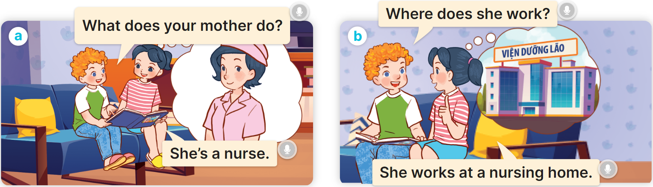
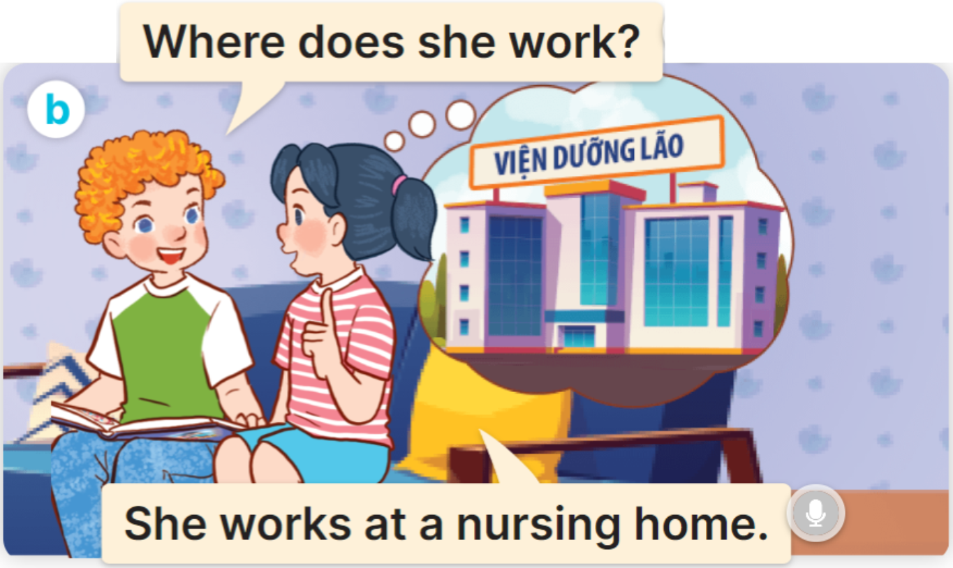
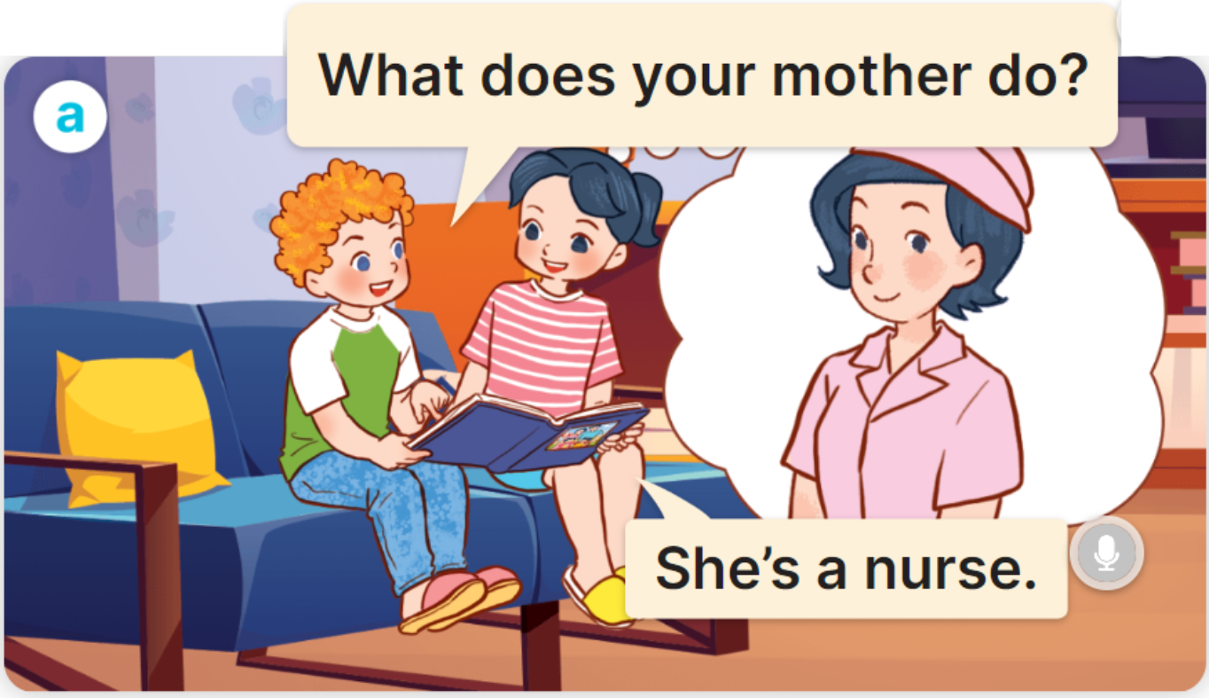

1
Look, listen and read.
MsPham
0936082789

Slide 13
Structure
MsPham
0936082789

Slide 14
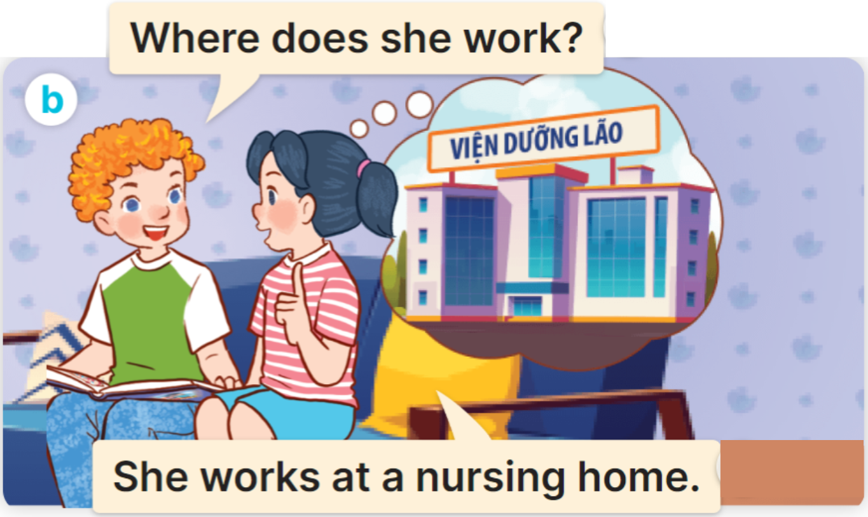
2
Cách hỏi một người nào đó làm việc ở đâu:
Where does he/she/name work?
(Anh ấy/cô ấy làm việc ở đâu?)
He/She works ________.
(Anh ấy / cô ấy làm ở ______)
Ex:

Slide 15
Practice
MsPham
0936082789

Slide 16

2
Listen, point and say.
Where does he/she work?
He/She works ___________.
MsPham
0936082789

Slide 17


2
Listen, point and say.
MsPham
0936082789
Where does she work?
She works a nursing home.

Slide 18
2
Listen, point and say.
MsPham
0936082789
Where does he work?
He works at a factory.

Slide 19


2
Listen, point and say.
MsPham
0936082789
Where does she work?
She works at a school.

Slide 20
2
Listen, point and say.
MsPham
0936082789
Where does he work?
He works on a farm.

Slide 21






BALLOONS
START
Notes:
Click quả bóng để chọn câu trả lời đúng, sai quả bóng sẽ nổ. Đúng dc cộng điểm

Slide 22

at a factory
at a
nursing home
at a school
Where does he work?
He works _________.
face

Slide 23
at a school
on a farm
at a factory
Where does she work?
She works _________.
ears

Slide 24
at a factory
at a
nursing home
on a farm
Where does he work?
He works _________.
blond hair.

Slide 25
at a school
on a farm
at a
nursing home
Where does he work?
He works _________.
nose

Slide 26

I go home at seven o’clock.
Where do you work?
Where does
she work?
She works at a factory.
brown eyes

Slide 27

Where does he work?
Where does
she work?
Where do you work?
He works at a school.
ears

Slide 28

Where does
he work?
Where does
she work?
Where do you work?
I work at a nursing home.
mouth

Slide 29
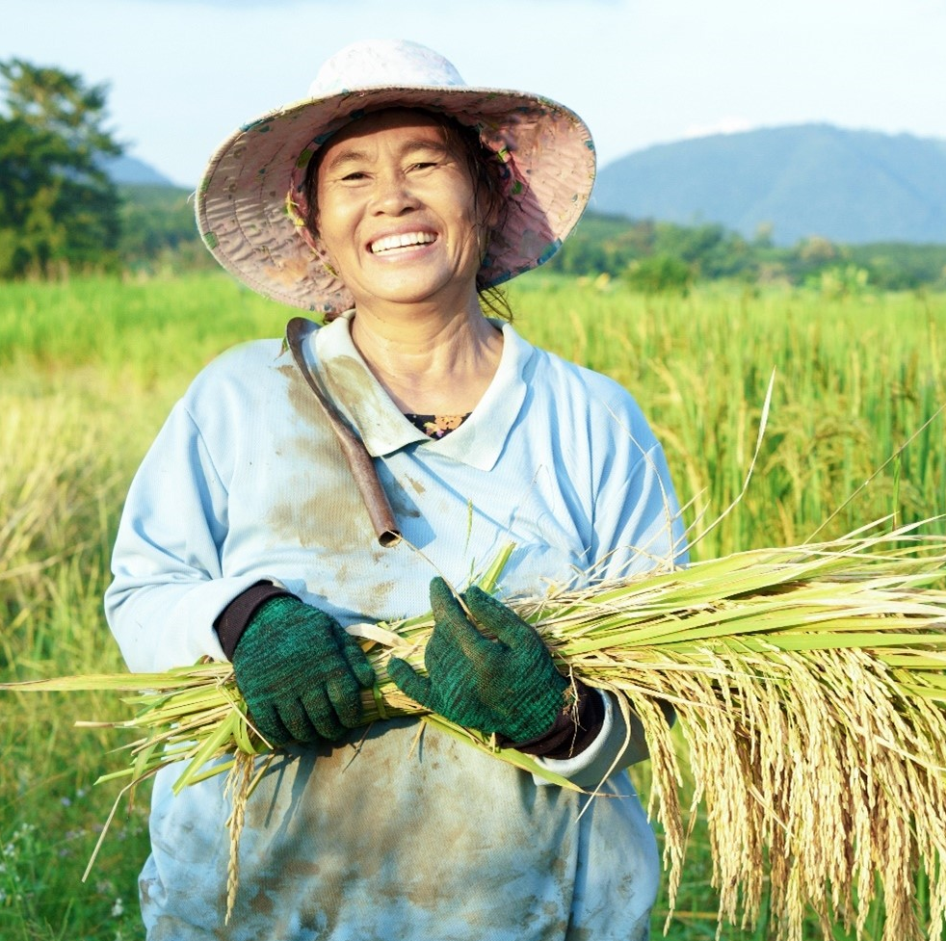
Where does
he work?
Where does she work?
Where do you work?
She works on a farm.
nose

Slide 30

Well done!
END

Slide 31

3
Let’s talk.
Where does he/she work?
He/She works ___________.

Slide 32
3
Let’s talk.
Where does she work?
She works at a nursing home.

Slide 33
3
Let’s talk.
Where does he work?
He works at a school.

Slide 34
3
Let’s talk.
Where does she work?
She works at a factory.

Slide 35
3
Let’s talk.
Where does he work?
He works on the farm.

Slide 36
Review
MsPham
0936082789

Slide 37
What does he/she do?
MsPham
0936082789
He’s/She’s _____.
at a
nursing home
at a school
at a factory
on a farm

Slide 38
Thank you!
MsPham
0936082789

