Slide 1












Unit 12
MsPham
0936082789
Jobs
Lesson 3 – Period 2

Slide 2

Warm up

Slide 3

MsPham
0936082789

Slide 4



Lucky wheel
20
10
30
1
2
3
x2
50
4
5
6
100
7
8
Notes:
Click vào mũi tên để quay nhận điểm
Chọn các số 1-8 để trả lời câu hỏi. Trả lời đúng dc nhận số điểm vừa quay được.

Slide 5
My / actor. / brother / an / is /
My brother is an actor.
Back
Check

Slide 6
does / mother / works. / Where / your /?
Where does your mother works?
Back
Check

Slide 7
worker. / My / is / an / father / office
My father is an office worker.
Back
Check

Slide 8
is / My / famer. / grandmother / a /
My grandmother is a farmer.
Back
Check

Slide 9
your / What / do? / does / grandfather /
What does your grandfather do?
Back
Check

Slide 10
works / My / a / factory. / friend / at /
My friend works at a factory.
Back

Slide 11
She / a / works / home. / at / nursing /
She works at a nursing home.
Back
Check

Slide 12
a / is / policeman. / He /
He is a policeman.
Back
Check

Slide 13
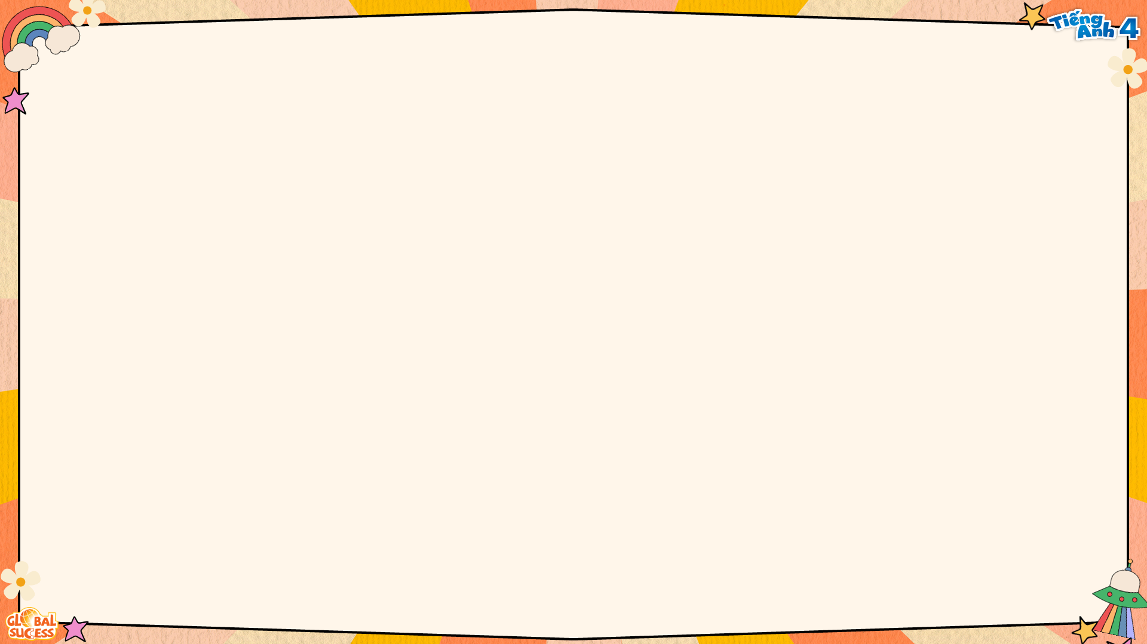
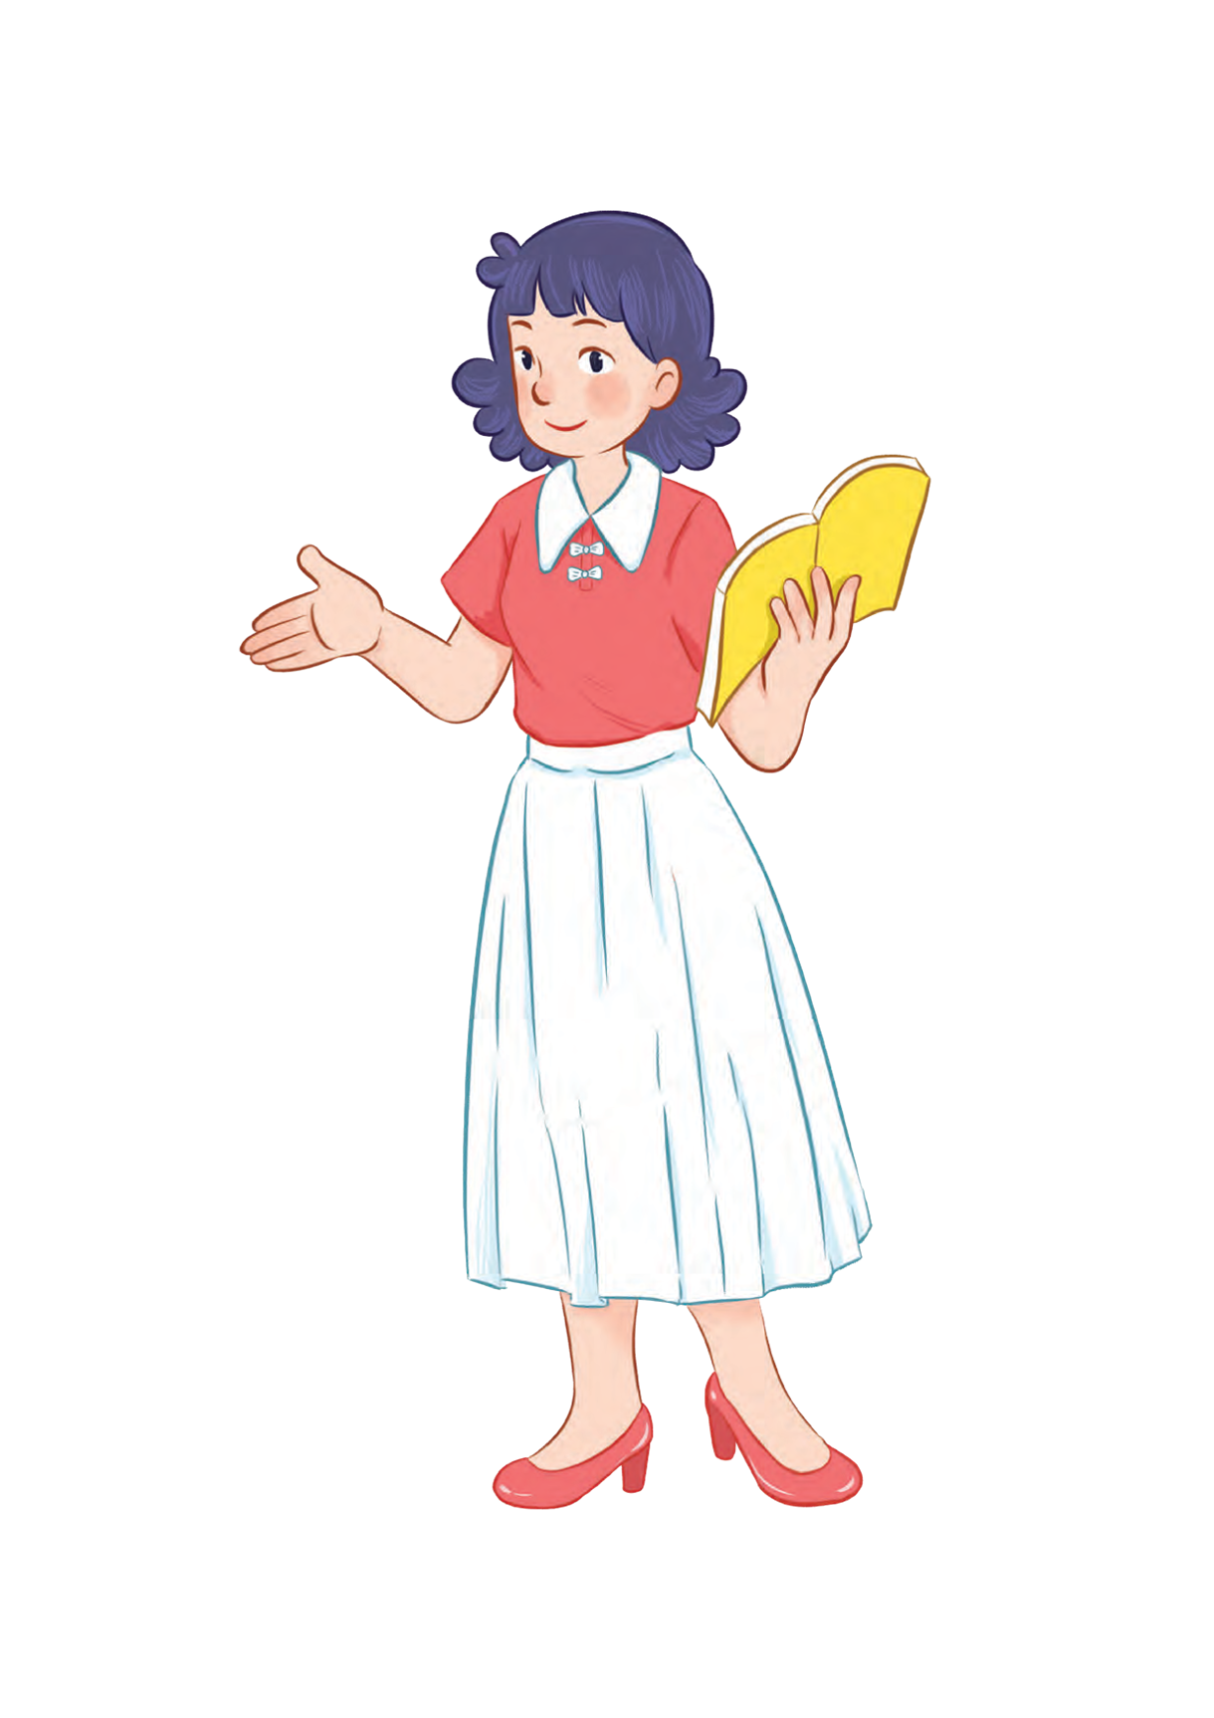
Review
MsPham
0936082789

Slide 14

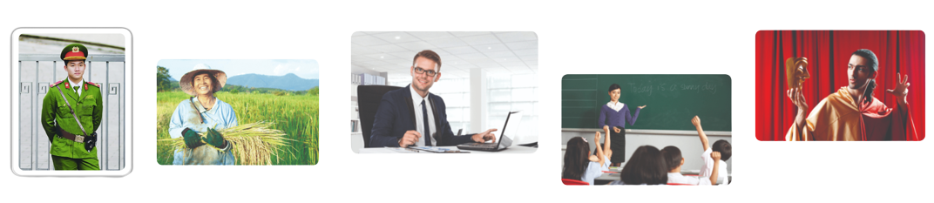
What does he/she do?
MsPham
0936082789
He’s/She’s _____.
MsPham
0936082789
an actor
an office worker
a policeman
a farmer
a teacher

Slide 15




What does he/she do?
MsPham
0936082789
He’s/She’s _____.
MsPham
0936082789
at a
nursing home
at a school
at a factory
on a farm

Slide 16
Practice
MsPham
0936082789

Slide 17
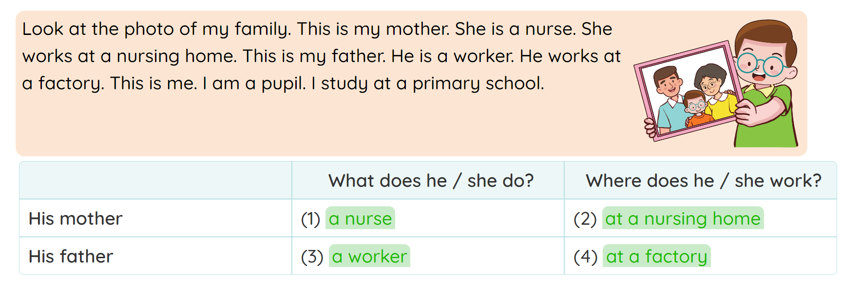
4
Read and match.

Slide 18
5
Let’s write.
There are _________ people in my family. My _________ is a(n) _________. She works ________. My is a(n) __________. He works ____________. My brother / sister and I are pupils. We study at school.

Slide 19
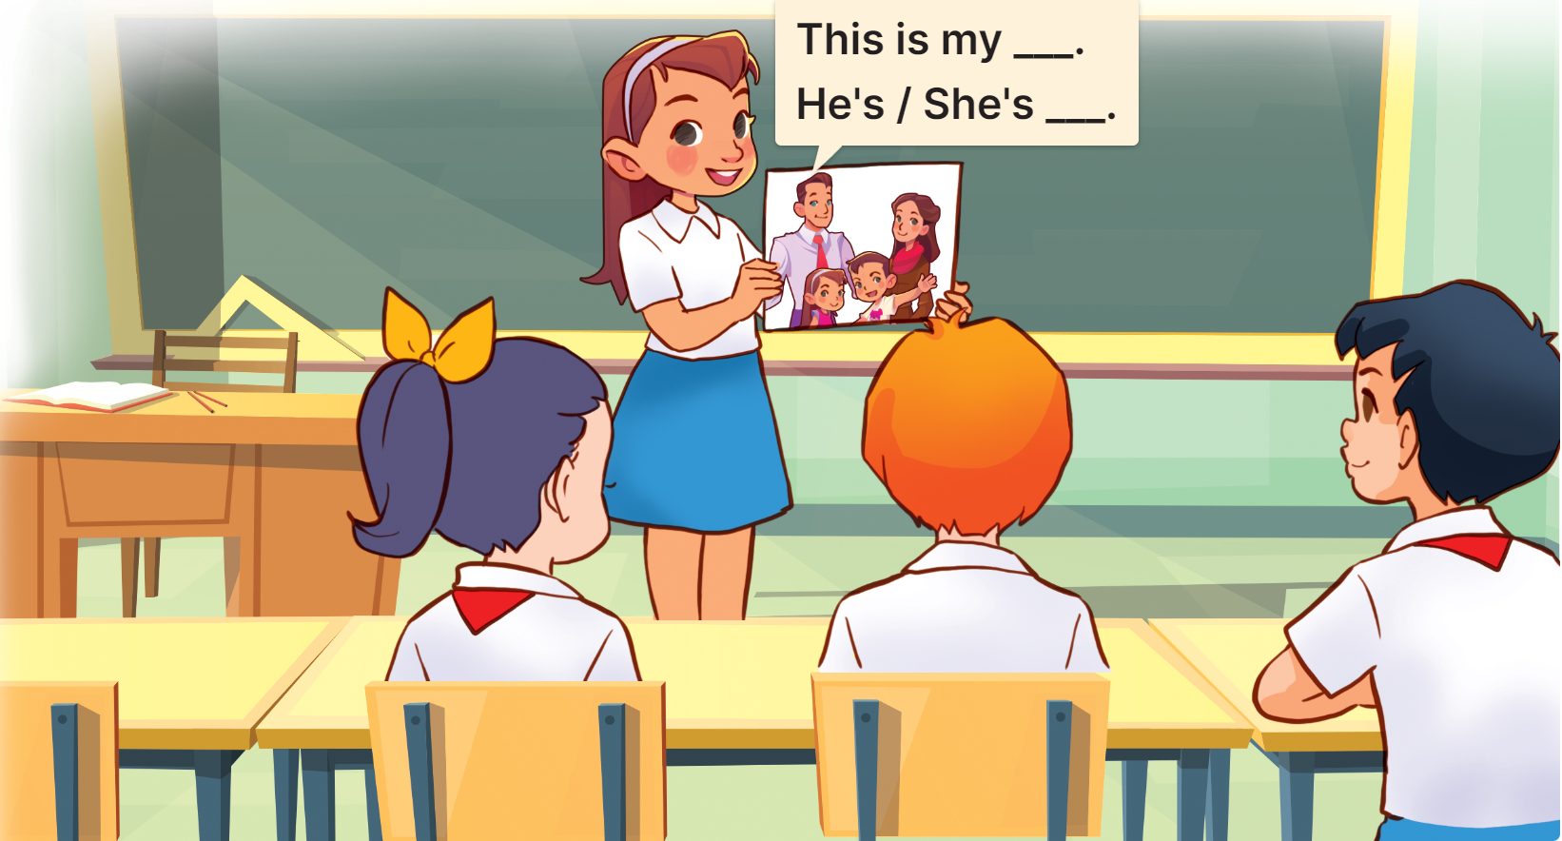
6
Project
Members of my family and their jobs

Slide 20
Thank you!
MsPham
0936082789

