Slide 1




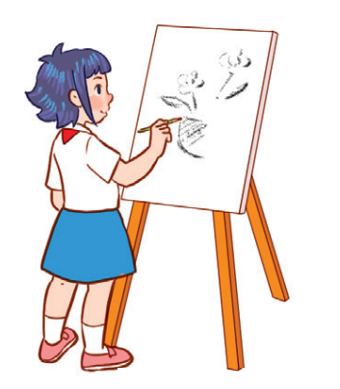

Unit 8
Period 3

Slide 2
Contents
2
1
3
Look, listen and repeat.
Listen, point and say.
Warm-up and review
5
4
Let’s talk.
Fun corner and wrap-up

Slide 3
Warm-up and review
1
1
Game: Who’s faster?

Slide 4

I LIKE…

Slide 5
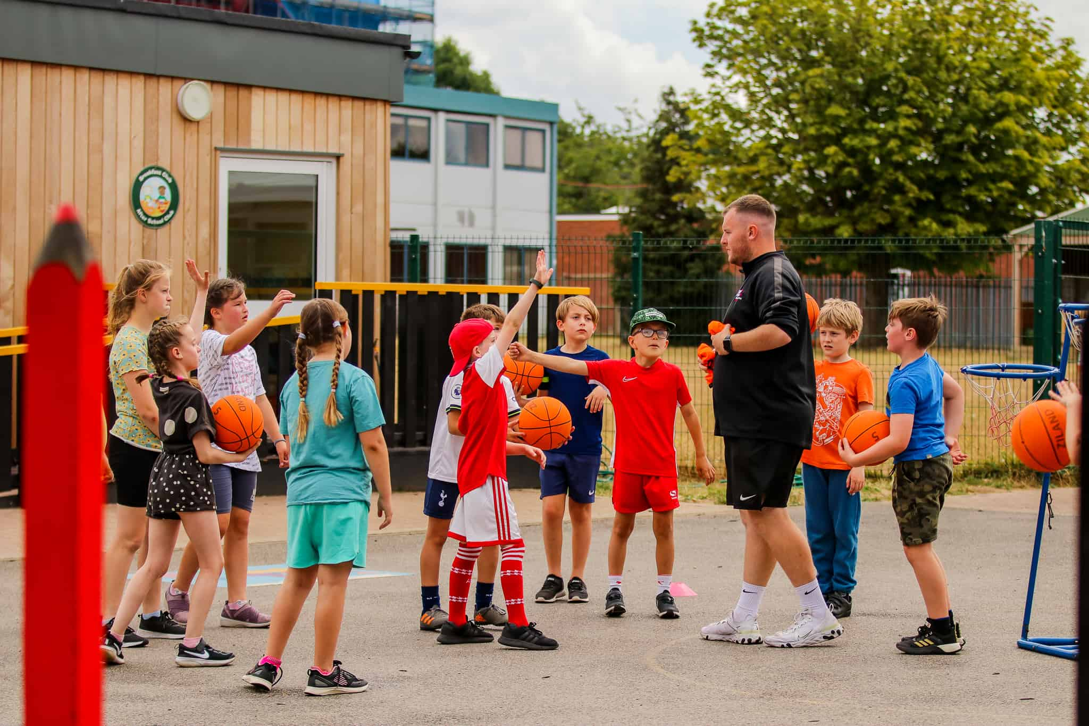
MY FAVOURITE SUBJECT IS...

Slide 6


Slide 7


Slide 8
Look, listen and repeat.
2
2

Slide 9

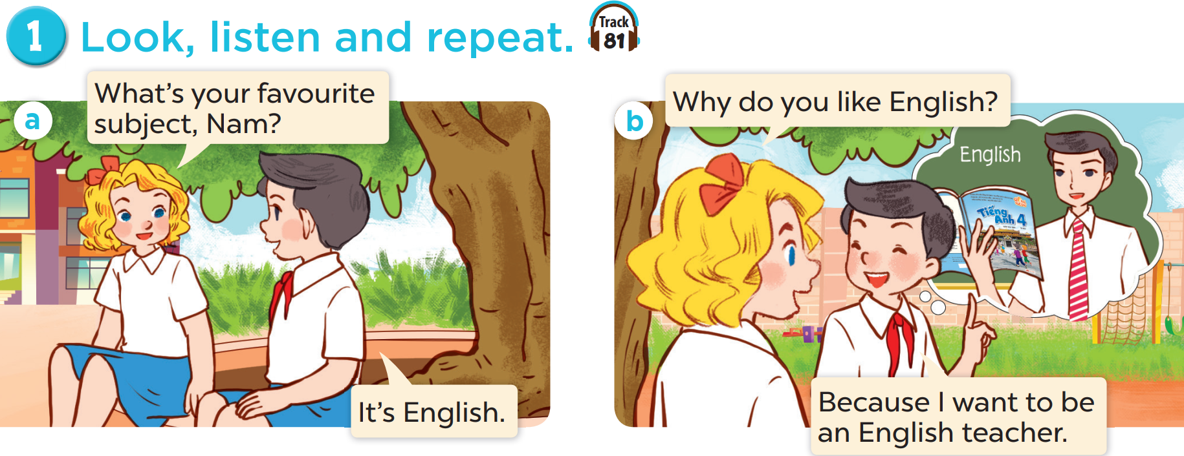

Slide 11
Listen, point and say.
3
3

Slide 12
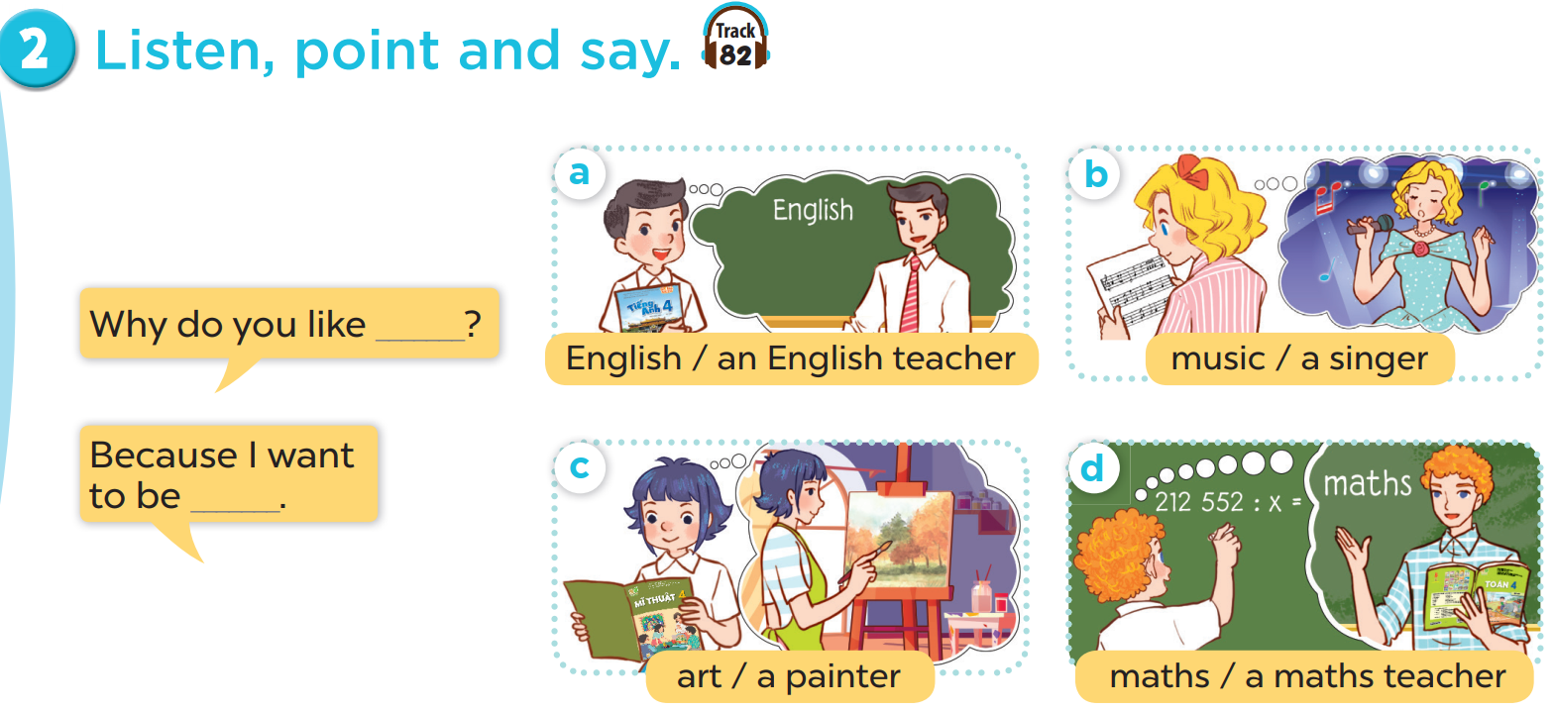

Slide 13


Slide 14

Let’s talk.
4
4

Slide 15
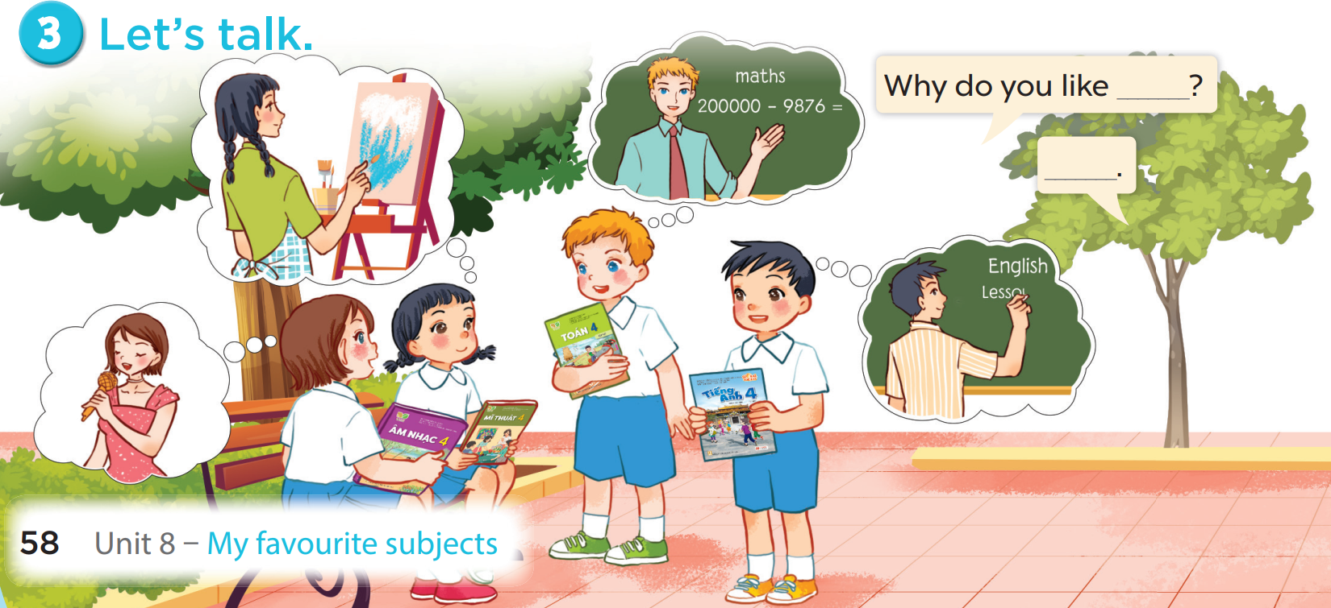

Slide 16
Fun corner and wrap-up
5
5
Game: Guessing game

Slide 17

SHOW

Slide 18

SHOW

Slide 19
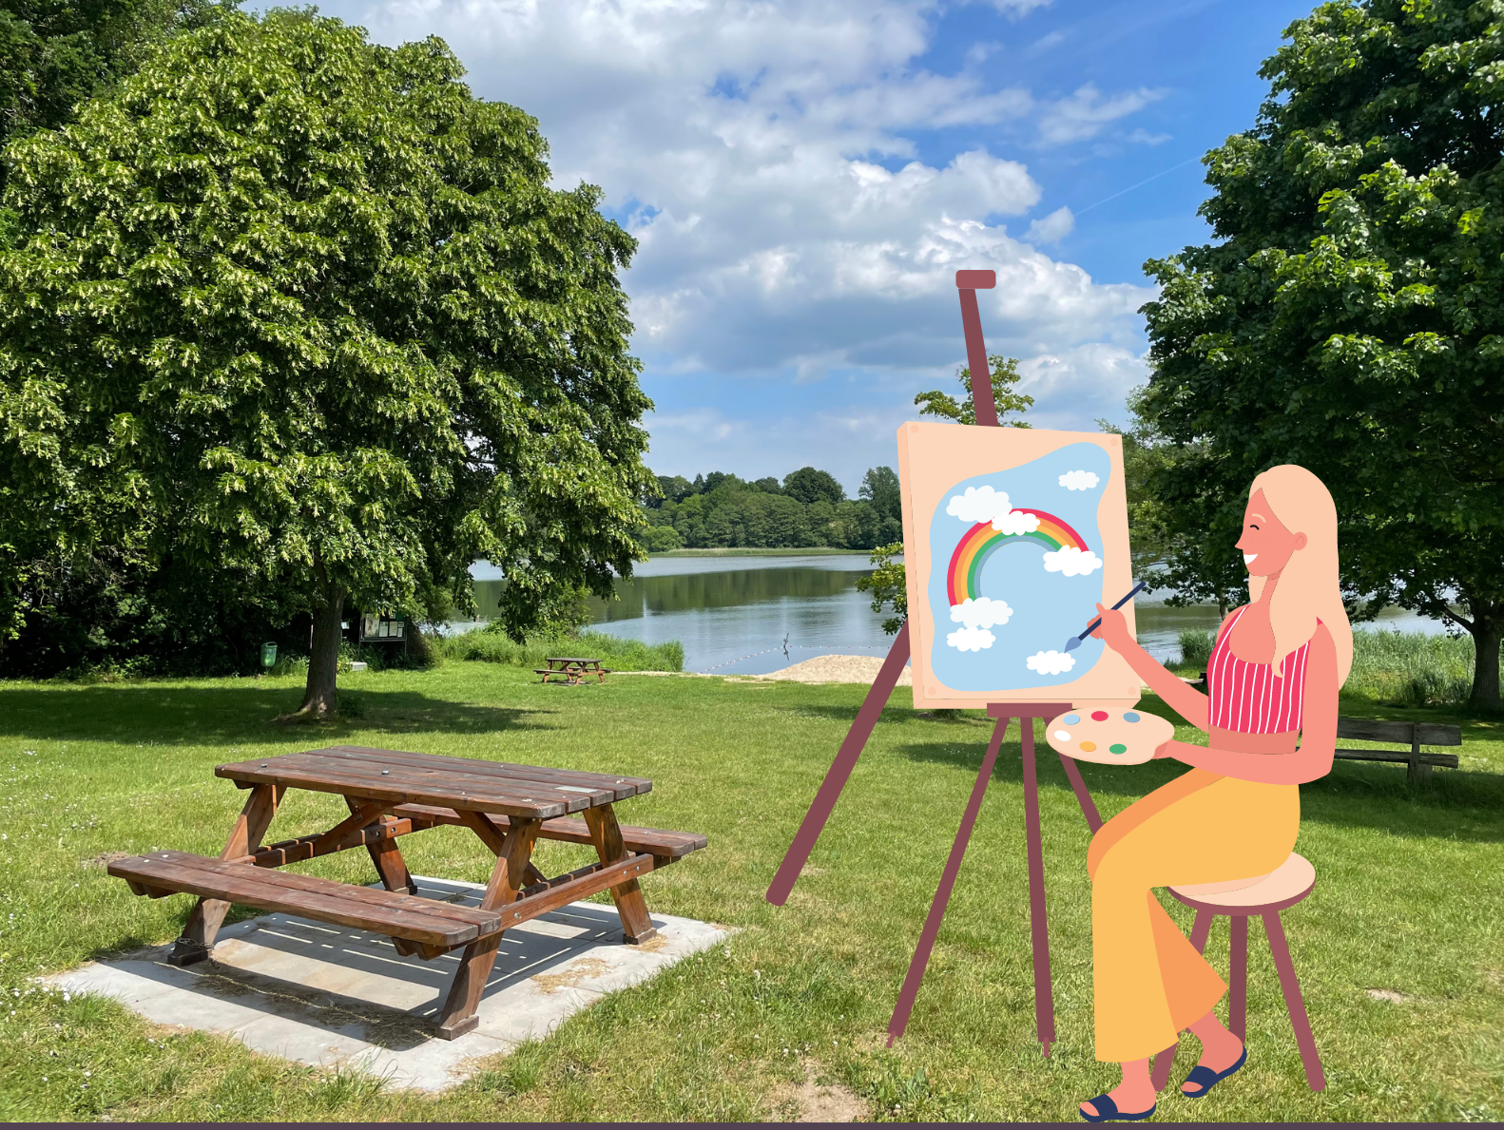
SHOW

