Slide 1
UNIT 9: OUR OUTDOOR ACTIVITIES
LESSON 2 ( 4, 5, 6)
Notes:
MADE BY FACEBOOK :TRAN THI THANH TAM

Slide 2
Warm - up
Notes:
MADE BY FACEBOOK :TRAN THI THANH TAM

Slide 3
WHAT’S MISSING?
Notes:
MADE BY FACEBOOK :TRAN THI THANH TAM

Slide 4


?
FARM
Notes:
MADE BY FACEBOOK :TRAN THI THANH TAM

Slide 5
WALKED
?
Notes:
MADE BY FACEBOOK :TRAN THI THANH TAM

Slide 6
?
THEATER
Notes:
MADE BY FACEBOOK :TRAN THI THANH TAM

Slide 7
VISITED
?
Notes:
MADE BY FACEBOOK :TRAN THI THANH TAM

Slide 8

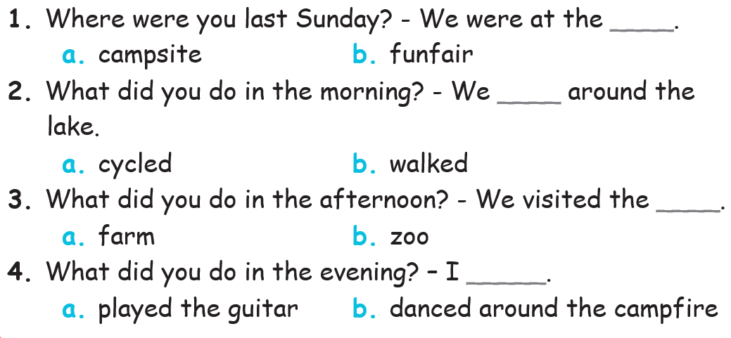
4.Listen and circle
Notes:
MADE BY FACEBOOK :TRAN THI THANH TAM

Slide 9
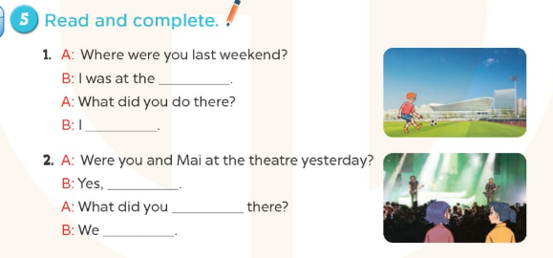
sports centre
played football
we were
do
listened to music
Notes:
MADE BY FACEBOOK :TRAN THI THANH TAM

Slide 10
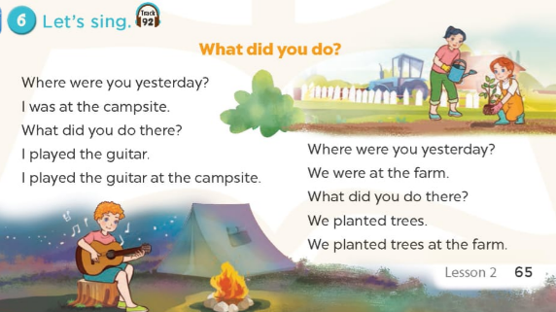
Notes:
MADE BY FACEBOOK :TRAN THI THANH TAM

Slide 11




PLAY GAME
WHISPER GAME
Notes:
Step 2: Have groups put the posters on the desk and practice the presentation. Encourage all members in the group to present. Go around the classroom and offer help where necessary.

Slide 12






Where were you last month?
Notes:
Step 5: Invite a few pairs to point at the pictures and say the questions and answers in front of the class.

Slide 13
We were at the campsite.
Notes:
Step 5: Invite a few pairs to point at the pictures and say the questions and answers in front of the class.

Slide 14
What did you do in the afternoon?
Notes:
Step 5: Invite a few pairs to point at the pictures and say the questions and answers in front of the class.

Slide 15
We played the guitar with our friends.
Notes:
Step 5: Invite a few pairs to point at the pictures and say the questions and answers in front of the class.

Slide 16


GOOD JOB!

Slide 17

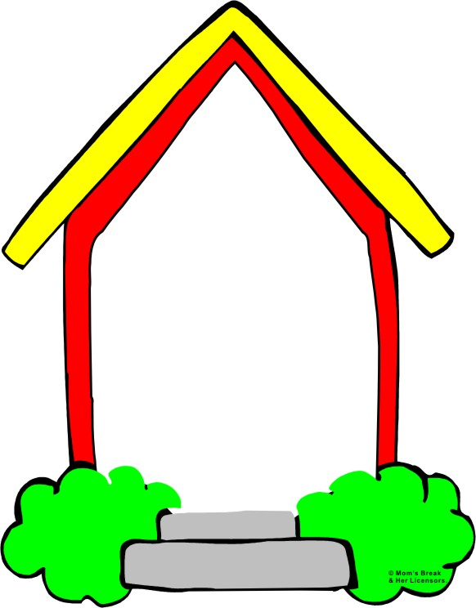
Homework:
- Practice more at home
- Prepare Unit 9- Lesson 3 ( 1, 2, 3)
Notes:
MADE BY FACEBOOK :TRAN THI THANH TAM

