Slide 1

UNIT 10:OUR SCHOOL TRIP
LESSON 1 ( 1, 2, 3)
Notes:
MADE BY FACEBOOK :TRAN THI THANH TAM

Slide 2
Warm - up
Made by Nguyen Thi Thu Phuong
Notes:
MADE BY FACEBOOK :TRAN THI THANH TAM

Slide 3



Travelling

Slide 4
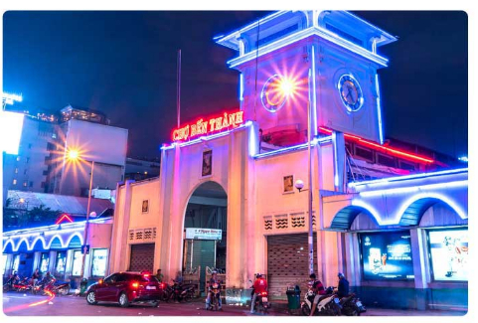
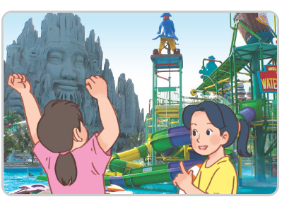

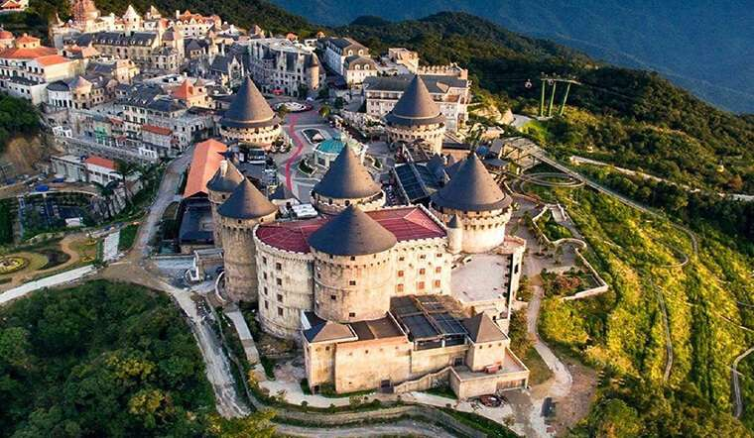
Places

Slide 5

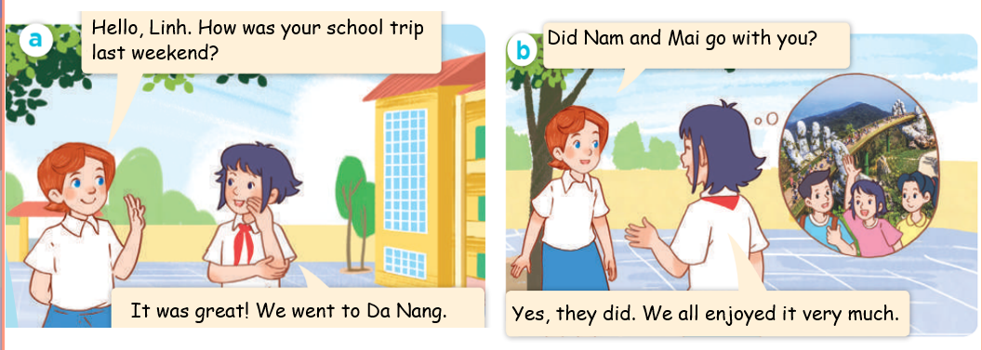
1.Look, listen and repeat
Notes:
MADE BY FACEBOOK :TRAN THI THANH TAM

Slide 6
Ba Na Hills/ˈba na hɪls/:
Khu du lịch Bà Nà Hills
Notes:
MADE BY FACEBOOK :TRAN THI THANH TAM

Slide 7

Hoan Kiem Lake/ˈhɒɑːn kɪem leɪk/
:Hồ Hoàn Kiếm
Notes:
MADE BY FACEBOOK :TRAN THI THANH TAM

Slide 8
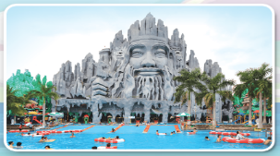
Suoi Tien Theme Park/sʊɒɪ tɪen θiːm pɑːk/
Công viên văn hóa Suối Tiên
Notes:
MADE BY FACEBOOK :TRAN THI THANH TAM

Slide 9
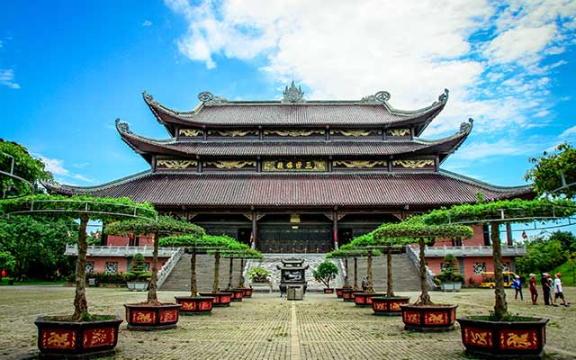
Bai Dinh Pagoda/ pəˈɡəʊdə/
:Chùa Bái Đính
Notes:
MADE BY FACEBOOK :TRAN THI THANH TAM

Slide 10
Let's play
Check vocabulary
Matching game
Notes:
Made by Facebook: TRAN THI THANH TAM

Slide 11
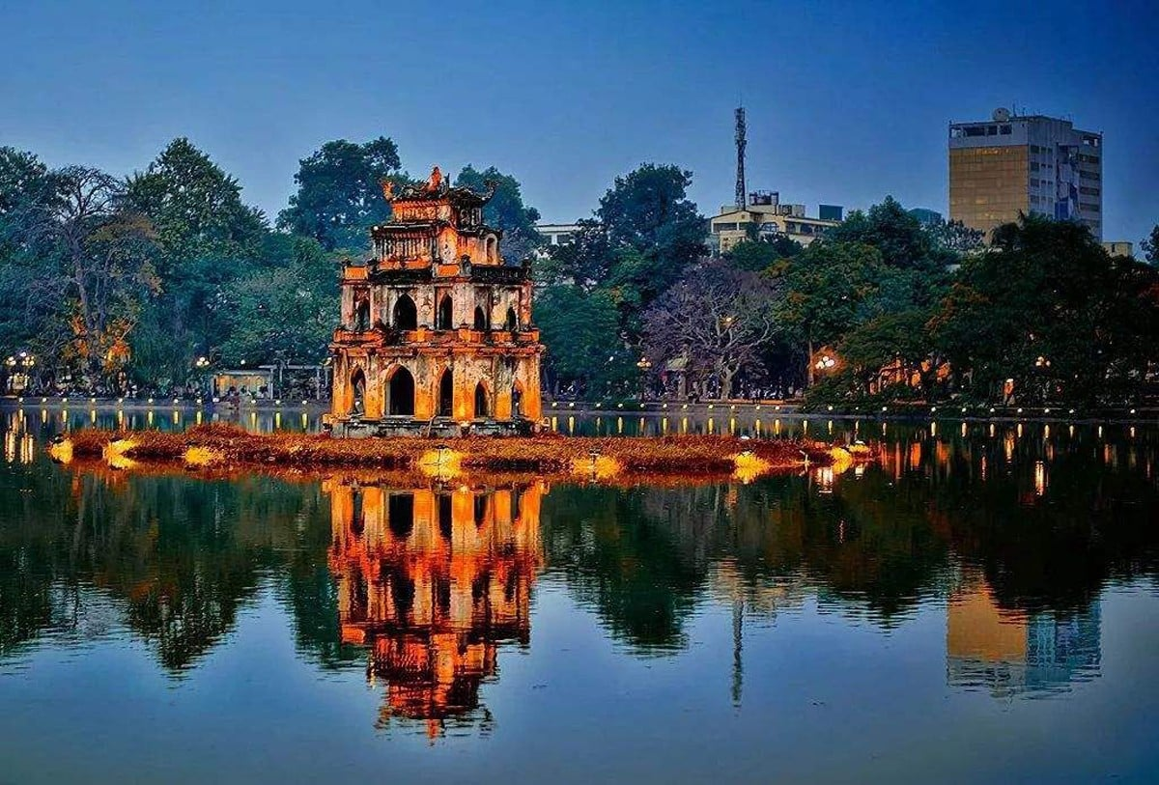
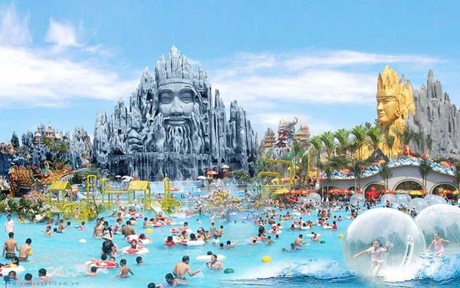
Matching
1
2
3
4
a
b
c
d
Hoan Kiem Lake
Ba Na Hills
Bai Dinh Pagoda
Suoi Tien Theme Park

Slide 12
Did they go to Ba Na Hills?
( Họ đã đến khu du lịch Bà Nà phải không?)
Yes, they did.
No, they didn’t.

Slide 13
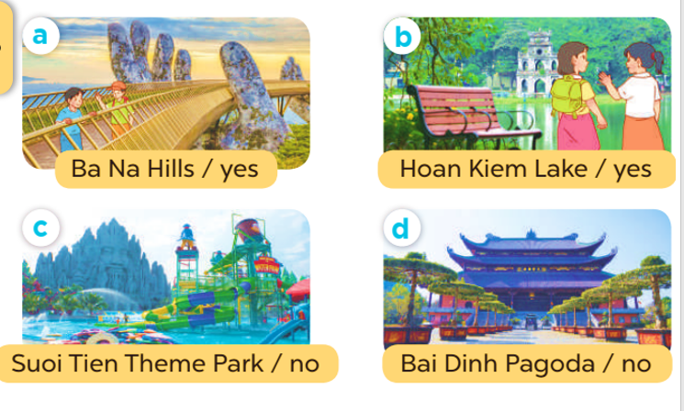
2.Listen, point and say
Ba Na Hills
Did they go to.............................?
Yes, they did.
No, they didn’t.
Notes:
MADE BY FACEBOOK :TRAN THI THANH TAM

Slide 14

Ba Na Hills
Did they go to.............................?
Yes, they did.
Notes:
MADE BY FACEBOOK :TRAN THI THANH TAM

Slide 15

Hoan Kiem Lake
Did they go to..................................?
Yes, they did.
Notes:
MADE BY FACEBOOK :TRAN THI THANH TAM

Slide 16
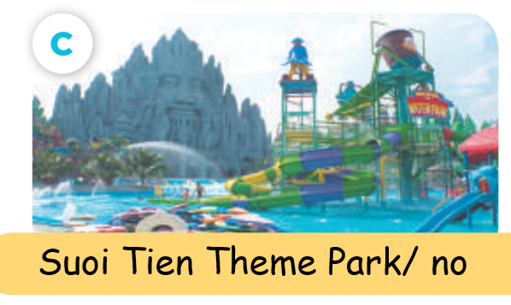
Suoi Tien Theme Park
Did they go to....................................?
No, they didn’t.
Notes:
MADE BY FACEBOOK :TRAN THI THANH TAM

Slide 17
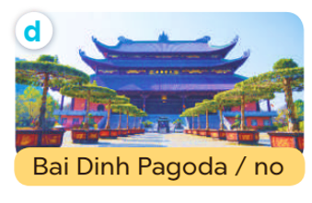
Bai Dinh Pagoda
Did they go to.................................?
No, they didn’t.
Notes:
MADE BY FACEBOOK :TRAN THI THANH TAM

Slide 18
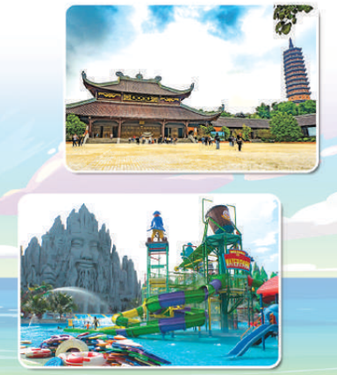
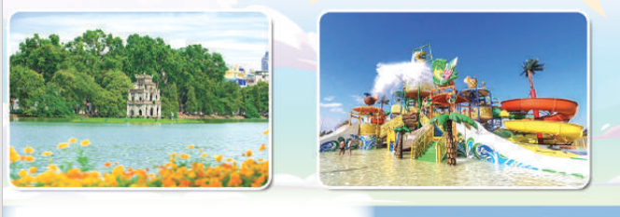
3. Let’s talk
Hoan Kiem Lake
Did they go to................................?
Yes, they did.
No, they didn’t.
Notes:
MADE BY FACEBOOK :TRAN THI THANH TAM

Slide 19
Let's play
LUCKY GAMES
Notes:
MADE BY FACEBOOK :TRAN THI THANH TAM

Slide 20


Ba Na Hills
Did they go to.............................?
No, they didn’t.

Slide 21
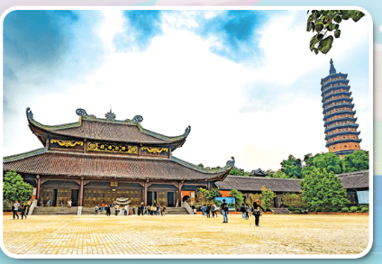

Bai Dinh Pagoda
Did they go to.................................?
Yes, they did.

Slide 22
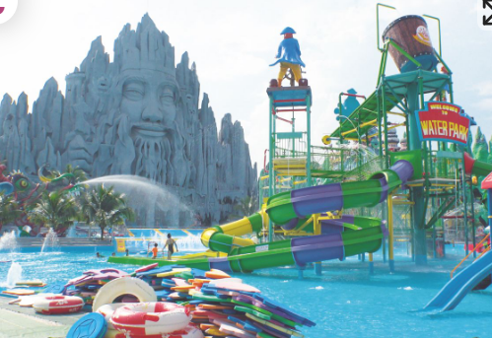
Suoi Tien Theme Park
Did they go to......................................?
Yes, they did.

Slide 23

Hoan Kiem Lake
Did they go to..................................?
No, they didn’t.

Slide 24

SUMMARY
1.Vocabulary:
Ba Na Hills:khu du lich Bà Nà
Hoan Kiem Lake: Hồ Hoàn Kiếm
Suoi Tien Theme Park: công viên văn hóa Suối Tiên
Bai Dinh Pagoda: chùa Bái Đính
2. Sentence pattern:
-Did they go to Ba Na Hills?
(Họ đã đến khu du lịch Bà Nà phải không?)
Yes, they did.
No, they didn’t.

Slide 25
Homework:
- Learn by heart vocabulary and sentence pattern
- Prepare Unit 10- lesson 1 ( 4, 5, 6)

