Slide 1

UNIT 10: OUR SCHOOL TRIP
LESSON 1 (4, 5, 6)
Notes:
MADE BY FACEBOOK :TRAN THI THANH TAM

Slide 2
Let's play
Guessing game
Notes:
Made by Facebook: TRAN THI THANH TAM

Slide 3
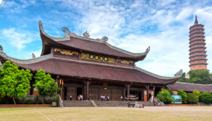
Guessing
Guessing?
Bai Dinh Pagoda
Notes:
MADE BY FACEBOOK :TRAN THI THANH TAM

Slide 4

Guessing
Guessing?
Ho Hoan Kiem Lake
Notes:
MADE BY FACEBOOK :TRAN THI THANH TAM

Slide 5
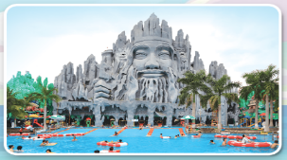
Guessing
Guessing?
Suoi Tien Theme Park
Notes:
MADE BY FACEBOOK :TRAN THI THANH TAM

Slide 6

Guessing
Guessing?
Ba Na Hills
Notes:
MADE BY FACEBOOK :TRAN THI THANH TAM

Slide 7

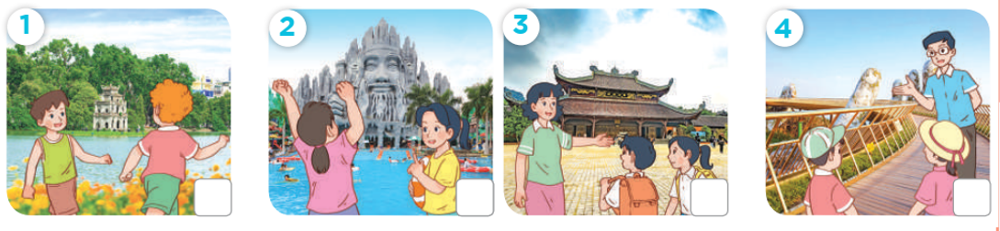
4. Listen and tick or cross
✓
✗
✓
✗
Notes:
MADE BY FACEBOOK :TRAN THI THANH TAM

Slide 8
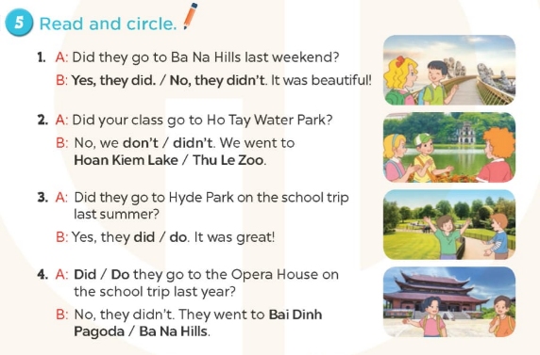
Notes:
MADE BY FACEBOOK :TRAN THI THANH TAM

Slide 9
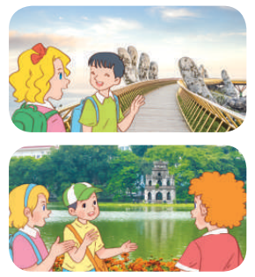
5.Read and complete.
1. A: Did they go to Ba Na Hills last weekend?
B: Yes, they did. / No, they didn’t. It was beautiful!

Slide 10
2. A: Did your class go to Ho Tay Water Park?
B: No, we don’t / didn’t. We went to Hoan Kiem Lake / Thu Le Zoo.

Slide 11
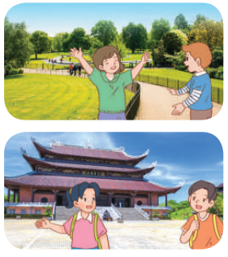
3. A: Did they go to Hyde Park on the school trip last summer?
B: Yes, they did / do. It was great!

Slide 12
4. A: Did / Do they go to the Opera House on the school trip last year?
B: No, they didn’t. They went to Bai Dinh Pagoda / Ba Na Hills.

Slide 13
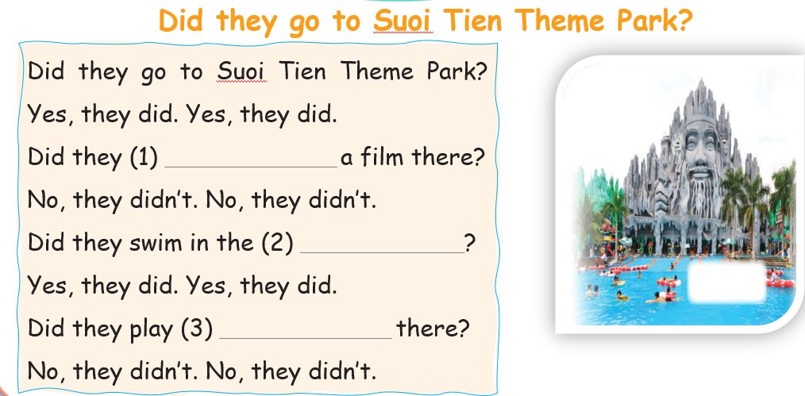
6. Listen, complete and sing
watch
swimming pool ?
badminton
Notes:
MADE BY FACEBOOK :TRAN THI THANH TAM

Slide 14
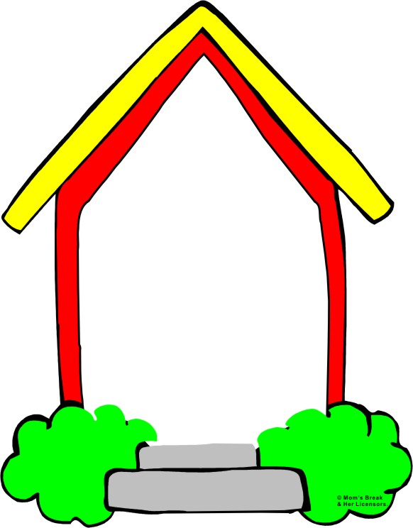

Homework:
- Practice more at home
- Prepare Unit 10- Lesson 2 ( 1, 2, 3)
Notes:
MADE BY FACEBOOK :TRAN THI THANH TAM

