Slide 1

UNIT 10:OUR SCHOOL TRIP
LESSON 2 ( 1, 2, 3)
Notes:
MADE BY FACEBOOK :TRAN THI THANH TAM

Slide 2
WARM-UP
Kim’s game

Slide 3


LET’S PLAY: KIM’S GAME
Let’s tell about places that you have seen in the pictures

Slide 4
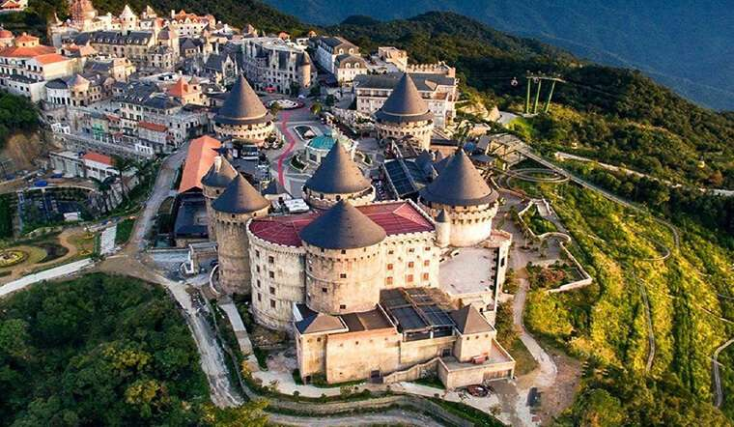

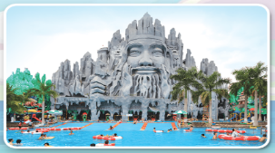
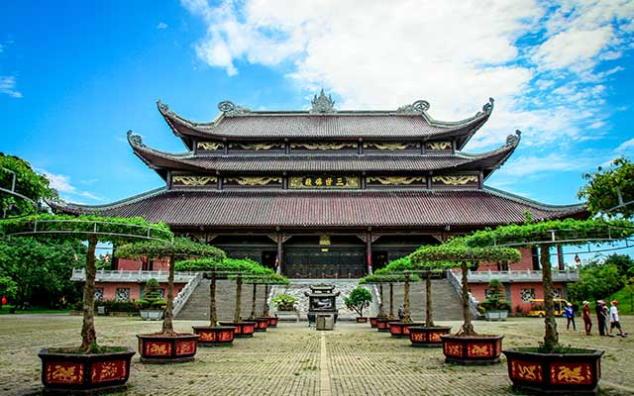
Check and read
Ba Na Hills
Hoan Kiem Lake
Suoi Tien Theme Park
Bai Dinh Pagoda

Slide 5

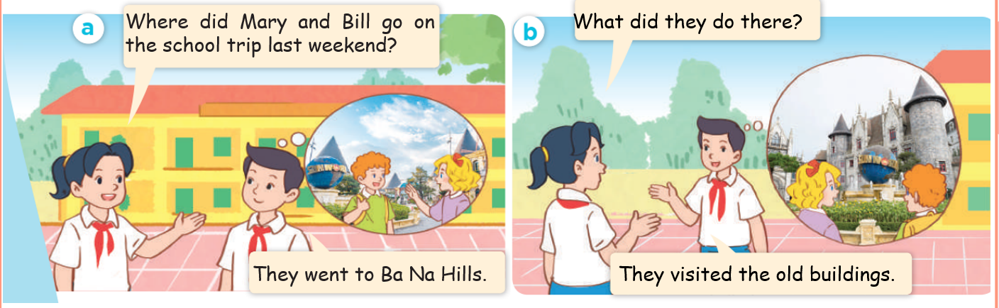
1.Look, listen and repeat
Notes:
MADE BY FACEBOOK :TRAN THI THANH TAM

Slide 6
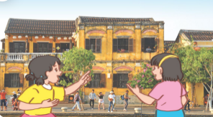
visit the old buildings/ˈvɪzɪt ðɪ ˈoʊɫdˈbɪldɪŋs/
thăm những tòa nhà cổ
Notes:
MADE BY FACEBOOK :TRAN THI THANH TAM

Slide 7
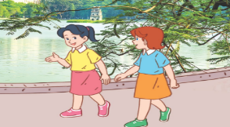
walk around the lake /wɔːk əˈraʊnd ðə leɪk /
đi bộ vòng quanh hồ
Notes:
MADE BY FACEBOOK :TRAN THI THANH TAM

Slide 8
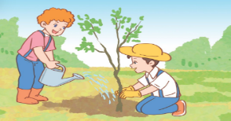
plant trees /plɑːnt triːs/:trồng cây
Notes:
MADE BY FACEBOOK :TRAN THI THANH TAM

Slide 9
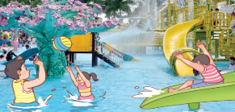
play games/pleɪ ˈɡeɪmz/ chơi trò chơi
Notes:
MADE BY FACEBOOK :TRAN THI THANH TAM

Slide 10

VOCABULARY
Visit the old buildings:thăm các tòa nhà cổ
Walk around the lake: đi bộ vòng quanh hồ
Play games: chơi trò chơi
Plant trees: trồng cây

Slide 11
Let's play
MATCHING
Notes:
Made by Facebook: TRAN THI THANH TAM

Slide 12
1.Walk around the lake
A
2.Play games
B
3.Plant trees
C
4. Visit the old buildings
D
Notes:
MADE BY FACEBOOK :TRAN THI THANH TAM

Slide 13

What did they do there?
( Họ đã làm gì ở đó vậy? )
They visited the old buildings.
(Họ thăm các tòa nhà cổ.)
Notes:
MADE BY FACEBOOK :TRAN THI THANH TAM

Slide 14
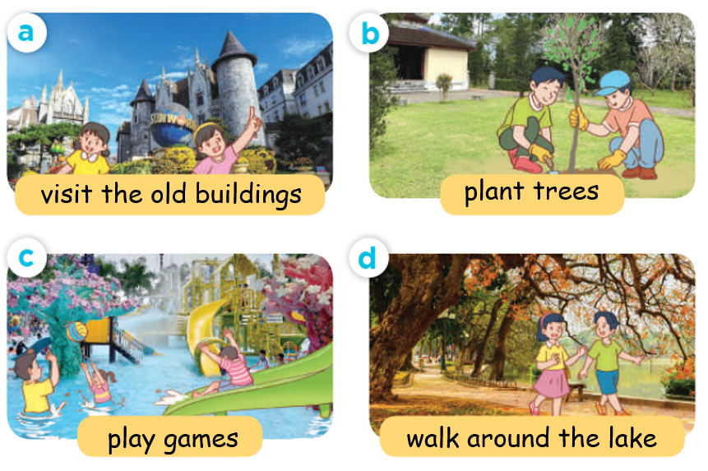
2.Listen, point and say
What did they do there?
visited the old buildings
They………...….........................
Notes:
MADE BY FACEBOOK :TRAN THI THANH TAM

Slide 15
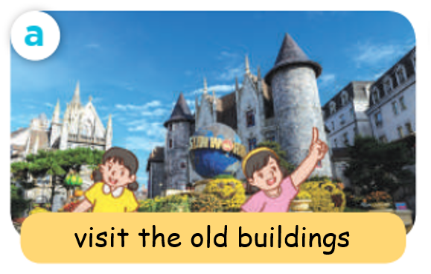
What did they do there?
visited the old buildings
They………...….........................
Notes:
MADE BY FACEBOOK :TRAN THI THANH TAM

Slide 16
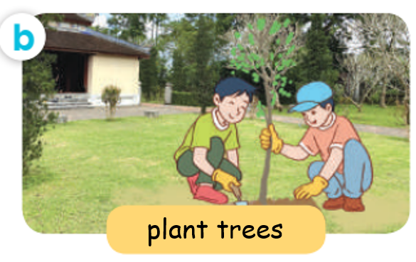
What did they do there?
planted trees
They………...….........................
Notes:
MADE BY FACEBOOK :TRAN THI THANH TAM

Slide 17
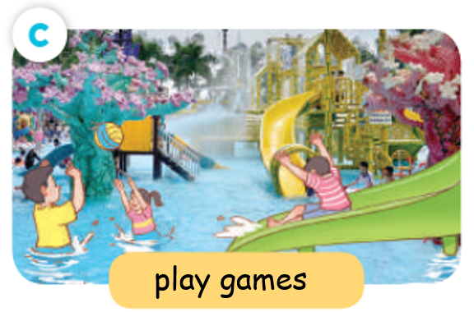
What did they do there?
played games
They………...….........................
Notes:
MADE BY FACEBOOK :TRAN THI THANH TAM

Slide 18
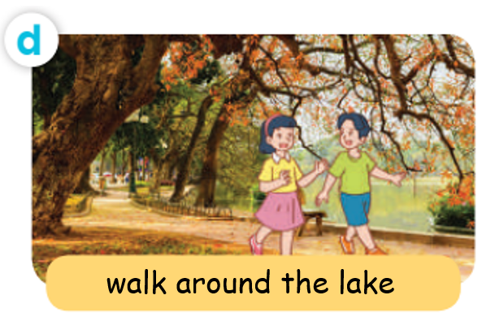
What did they do there?
walked around the lake
They.....………...….........................
Notes:
MADE BY FACEBOOK :TRAN THI THANH TAM

Slide 19
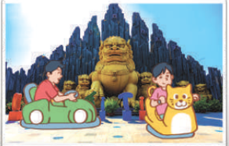
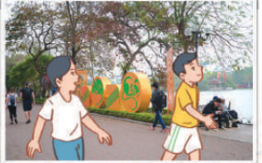
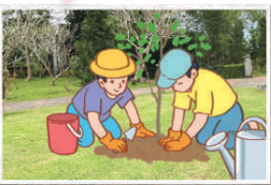
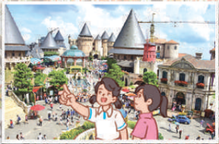
3. Let’s talk
Where did they go last weekend?
What did they do there?
Notes:
MADE BY FACEBOOK :TRAN THI THANH TAM

Slide 20


Let's play
Notes:
Made by Facebook: TRAN THI THANH TAM

Slide 21
SUMMARY
1.Vocabulary:
Visit the old buildings:thăm các tòa nhà cổ
Walk around the lake: đi bộ vòng quanh hồ
Play games: chơi trò chơi
Plant trees: trồng cây
2. Sentence pattern:
-What did they do there?
(Họ đã làm gì ở đó vậy?)
-> They visited the old buildings.
(Họ đã thăm các tòa nhà cổ.)

Slide 22
Homework:
- Learn by heart vocabulary and sentence pattern
- Prepare Unit 10- lesson 2 ( 4, 5, 6)
Notes:
MADE BY FACEBOOK :TRAN THI THANH TAM

