Slide 1

EXTENSION
ACTIVITIES
Notes:
MADE BY FACEBOOK :TRAN THI THANH TAM

Slide 2
Warm - up
Notes:
MADE BY FACEBOOK :TRAN THI THANH TAM

Slide 3
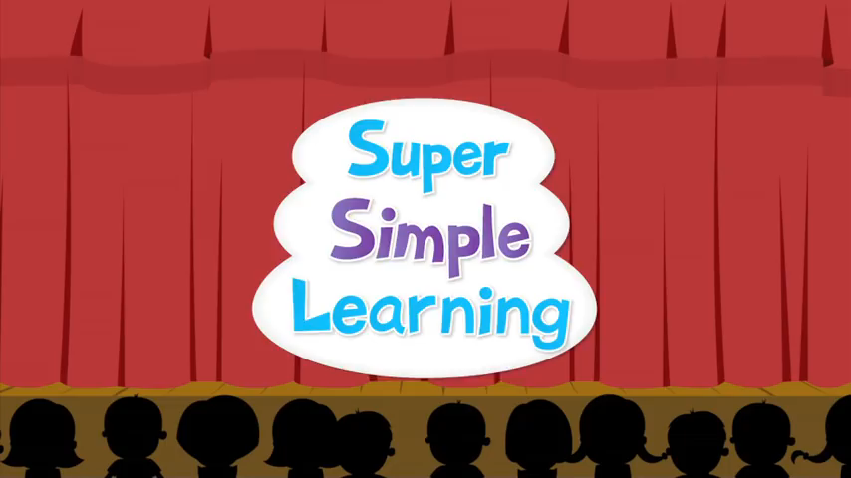
SING THE SONG: HEAD, SHOULDERS, KNEES AND TOES
Notes:
Made by FACEBOOK: TRAN THI THANH TAM

Slide 4
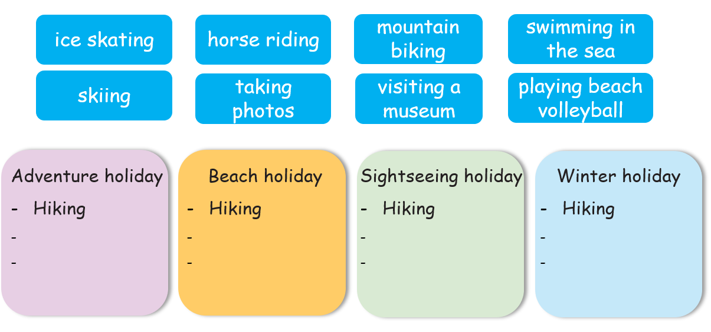
1.Write the activities in the correct places
Notes:
MADE BY FACEBOOK :TRAN THI THANH TAM

Slide 5
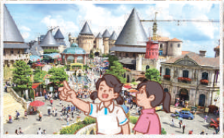
2.Answer the questions about your last holiday.
1. Where did you go?
___________________________________________________
2. What kind of holiday was it?
___________________________________________________
3. Who did you go with?
___________________________________________________
4. What did you do?
___________________________________________________
5. Did you enjoy the holiday? Why (not)?
______________________________________________________________________
Notes:
Giáo viên cho HS đọc câu hỏi. Đưa hình ảnh để HS thể hỏi và trả lời về hình ảnh đó.

Slide 6
Answer the questions
1.Where did you go?
I went to Ba Na Hills.
Notes:
MADE BY FACEBOOK :TRAN THI THANH TAM

Slide 7
Answer the questions
2.What kind of holiday was it?
It was summer holiday.
Notes:
MADE BY FACEBOOK :TRAN THI THANH TAM

Slide 8
Answer the questions
3.Who did you go with?
I went there with my family.
Notes:
MADE BY FACEBOOK :TRAN THI THANH TAM

Slide 9
Answer the questions
4. What did you do?
We visited the old buildings.
Notes:
MADE BY FACEBOOK :TRAN THI THANH TAM

Slide 10
Answer the questions
5.Did you enjoy the holiday? Why (not)?
Yes. Because it was a lot of fun.
Notes:
MADE BY FACEBOOK :TRAN THI THANH TAM

Slide 11
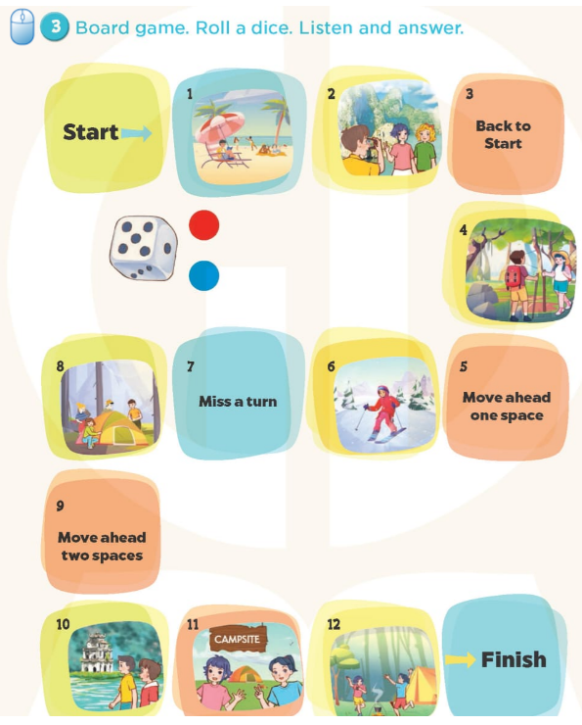
Notes:
MADE BY FACEBOOK :TRAN THI THANH TAM

Slide 12
PLAY GAME
Choose the best answer
Notes:
MADE BY FACEBOOK :TRAN THI THANH TAM

Slide 13
Where did you go last Sunday?
a. I watched T.V.
b. I went to Hoan Kiem lake.
c. It was fun.
Notes:
MADE BY FACEBOOK :TRAN THI THANH TAM

Slide 14
What did you do there in the morning?
a. I walked around the lake.
b. I walk around the lake.
c. I’m walking around the lake.
Notes:
MADE BY FACEBOOK :TRAN THI THANH TAM

Slide 15
What did you do in the afternoon?
a. They played games.
b. I drew a picture.
c. I draw a picture.
Notes:
MADE BY FACEBOOK :TRAN THI THANH TAM

Slide 16
How was your trips?
a. We went home late.
b. We was in a restaurant.
c. It was a lot of fun.
Notes:
MADE BY FACEBOOK :TRAN THI THANH TAM

Slide 17

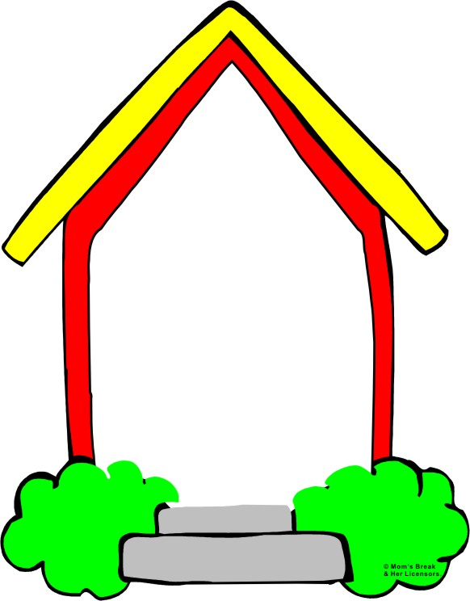
Homework:
- Practice more at home
- Prepare for the first semester
Notes:
MADE BY FACEBOOK :TRAN THI THANH TAM

