Slide 1

REVIEW 2
Notes:
MADE BY FACEBOOK :TRAN THI THANH TAM

Slide 2
Warm - up
Notes:
MADE BY FACEBOOK :TRAN THI THANH TAM

Slide 3
PLAY GAME
Unscramble the letters
Notes:
MADE BY FACEBOOK :TRAN THI THANH TAM

Slide 4


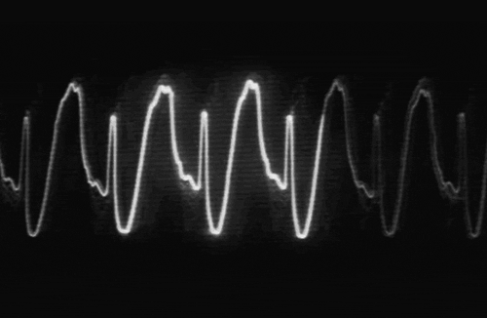


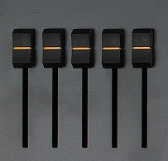




DENKEWE
WEEKEND
Notes:
Click on the red button to reveal the answer.

Slide 5
SUMIC
MUSIC
Notes:
Click on the red button to reveal the answer.

Slide 6
SONRACY
CRAYONS
Notes:
Click on the red button to reveal the answer.

Slide 7
TESBOKONO
NOTEBOOKS
Notes:
Click on the red button to reveal the answer.

Slide 8
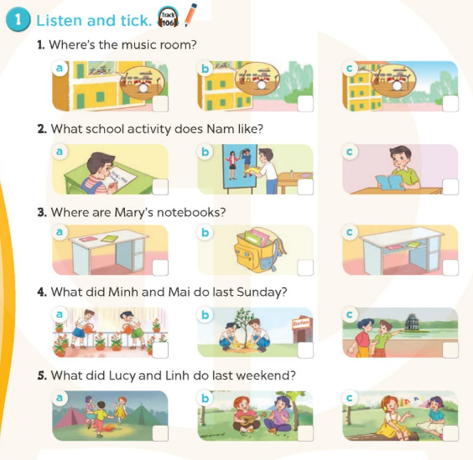

Notes:
MADE BY FACEBOOK :TRAN THI THANH TAM

Slide 9
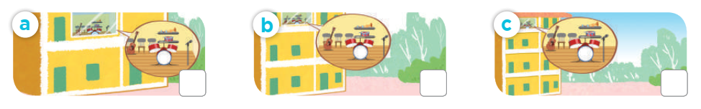
1.Listen and tick
1. Where’s the music room?

Slide 10
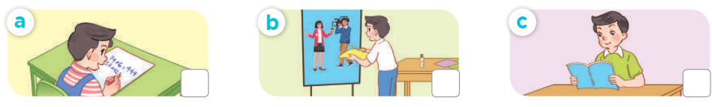
1.Listen and tick
2. What school activity does Nam like?

Slide 11
1.Listen and tick
2. What school activity does Nam like?

Slide 12
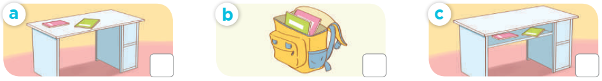
1.Listen and tick
3. Where are Mary’s notebooks?

Slide 13
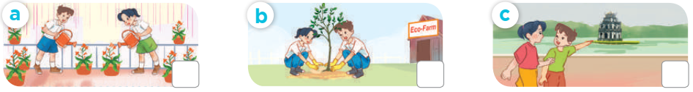
1.Listen and tick
4. What did Minh and Mai do last Sunday?

Slide 14
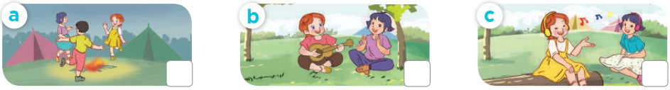
1.Listen and tick
5. What did Lucy and Linh do last weekend?

Slide 15
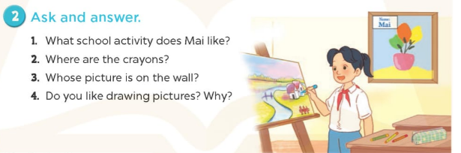
Notes:
MADE BY FACEBOOK :TRAN THI THANH TAM

Slide 16
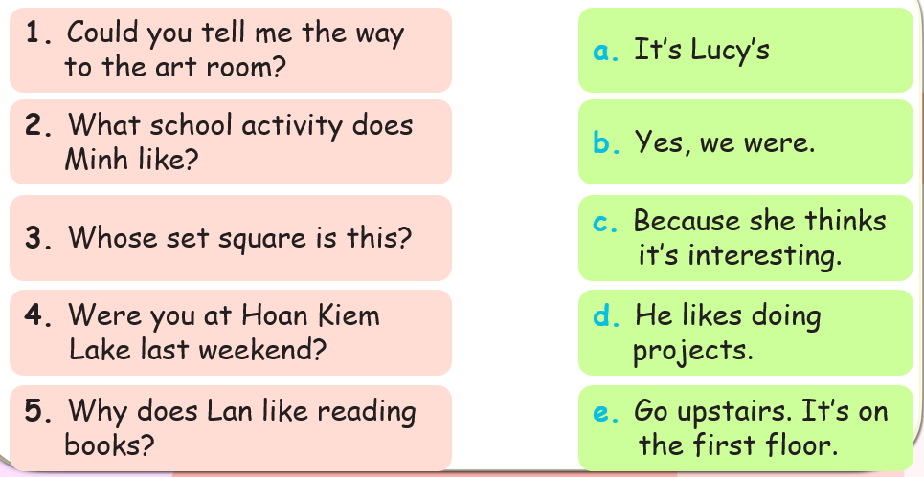
3. Read and match
Notes:
MADE BY FACEBOOK :TRAN THI THANH TAM

Slide 17

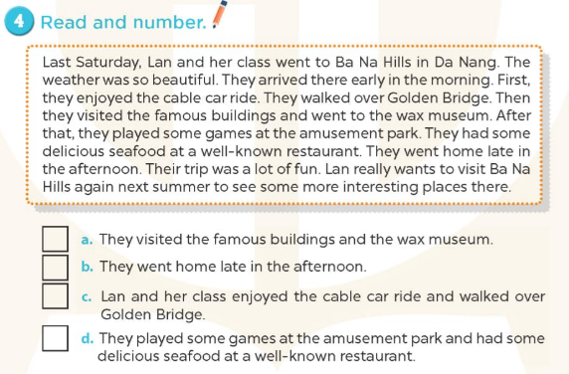
2
4
3
1
Notes:
MADE BY FACEBOOK :TRAN THI THANH TAM

Slide 18
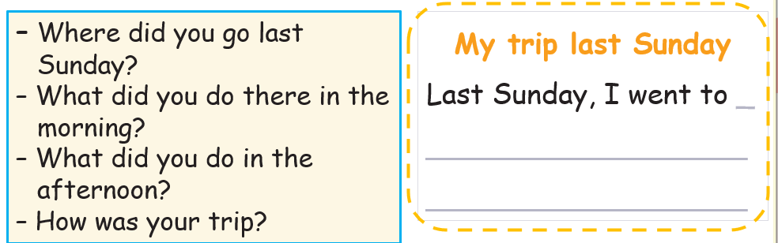
5. Let’s write
Write about your trip last Sunday (about 30 words)
Notes:
MADE BY FACEBOOK :TRAN THI THANH TAM

Slide 19
5. Let’s write
Write about your trip last Sunday (about 30 words)
Suggestion
My trip last Sunday
Last Sunday, I went to Hoan Kiem Lake with my friends. In the morning, we walked around the lake. We visited Ngoc Son Temple. In the afternoon, we went to see the water puppet show at the waterpuppet theatre by the lake. Our trip was a lot of fun!

Slide 20

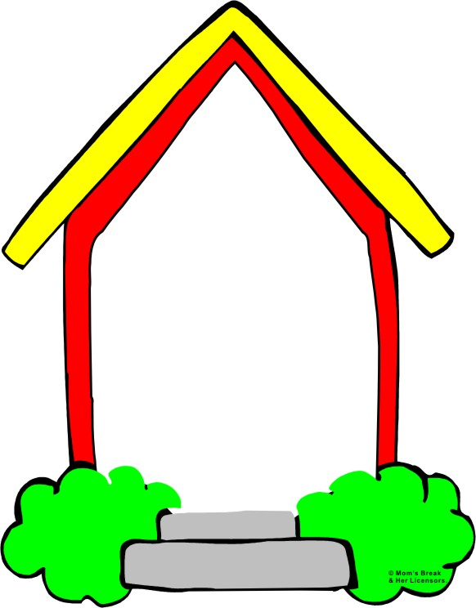
Homework:
- Practice more at home
- Prepare :Extension activities
Notes:
MADE BY FACEBOOK :TRAN THI THANH TAM

