Slide 1

UNIT 10:OUR SCHOOL TRIP
LESSON 3 (1, 2, 3)
Notes:
MADE BY FACEBOOK :TRAN THI THANH TAM

Slide 2
Warm - up
Notes:
MADE BY FACEBOOK :TRAN THI THANH TAM

Slide 3
Game: LUCKY WHEEL
Notes:
MADE BY FACEBOOK :TRAN THI THANH TAM

Slide 4

SPIN AND SAY
December
banana
November
october
yesterday
Click the needle to start and then again to stop the wheel. Then READ ALOUD.
badminton

Slide 5

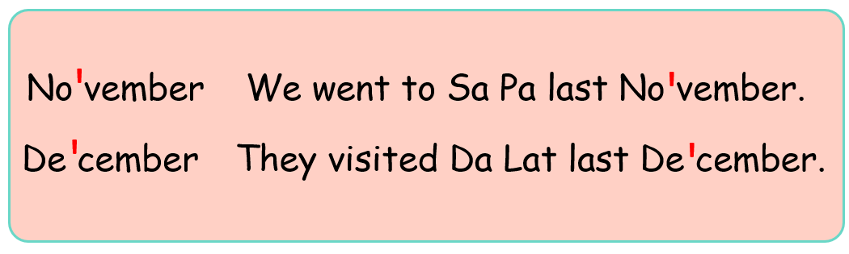
1. Listen and repeat
Notes:
MADE BY FACEBOOK :TRAN THI THANH TAM

Slide 6
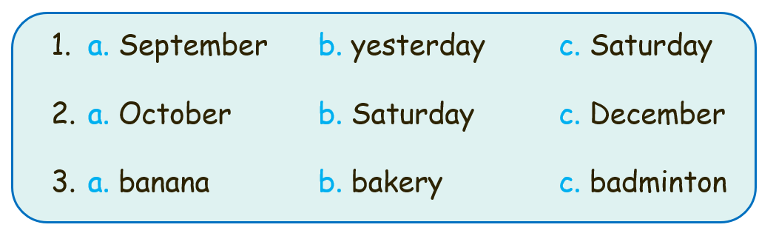
2. Circle, listen and check
Notes:
MADE BY FACEBOOK :TRAN THI THANH TAM

Slide 7
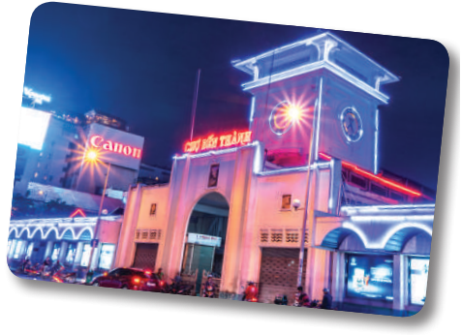
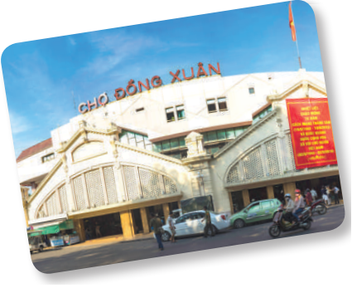
3. Let’s chant
November, December.
November, December.
Where did you go last November?
We went to Ben Thanh Market last November.
November, December.
November, December.
Where did they go last December?
They went to Dong Xuan Market last December.

Slide 8
LET’S PLAY

Slide 9

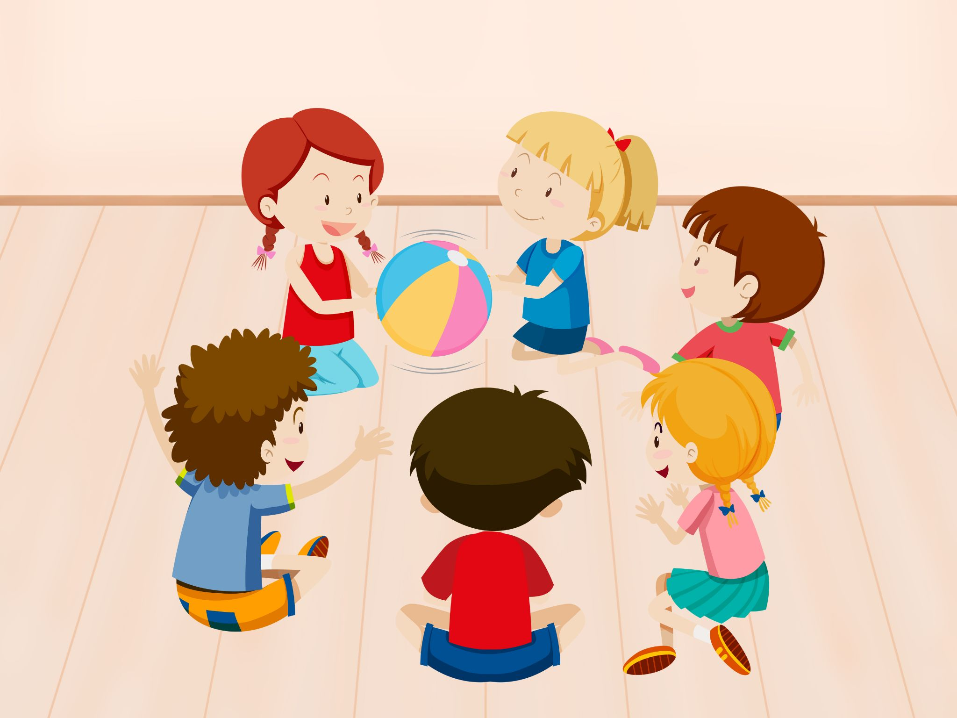
PASS THE BALL
Notes:
Giáo viên nháy choột để bật nhạc và dừng nhạc. Dừng nhạc bạn nào cầm bóng thì trả lời câu hỏi.

Slide 10
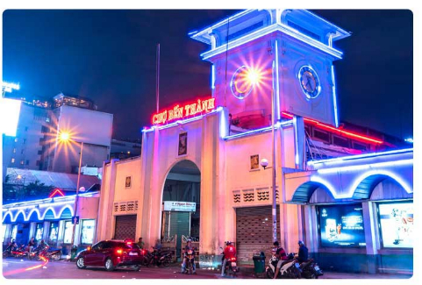
They went to___________last December.
Ben Thanh Market

Slide 11
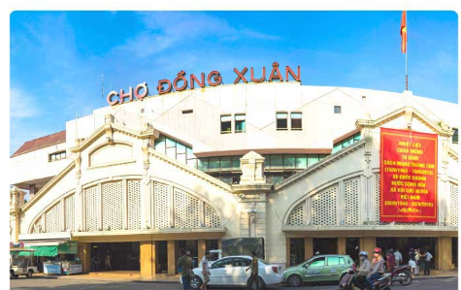
We went to___________last October.
Dong Xuan Market

Slide 12
We went to___________last October.
Dong Xuan Market

Slide 13
We went to___________last October.
Dong Xuan Market

Slide 14




The bye bye song
Bye, bye.
See you tomorrow.
Bye, bye.
See you tomorrow.
Bye, bye.
See you tomorrow.
Bye, bye. Bye, bye.
The bye bye song
Notes:
MADE BY FACEBOOK :TRAN THI THANH TAM

