Slide 1


UNIT 10: OUR SCHOOL TRIP
LESSON 3 ( 4, 5, 6)

Slide 2
Warm - up
Notes:
MADE BY FACEBOOK :TRAN THI THANH TAM

Slide 3
LET’S PLAY
GAME: MATCHING

Slide 4
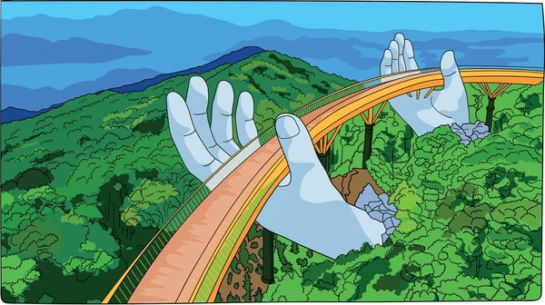
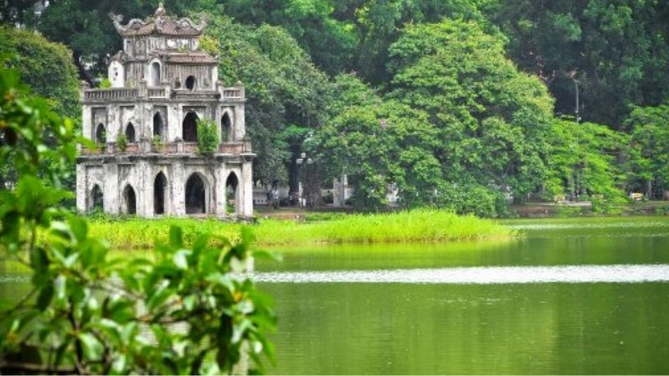
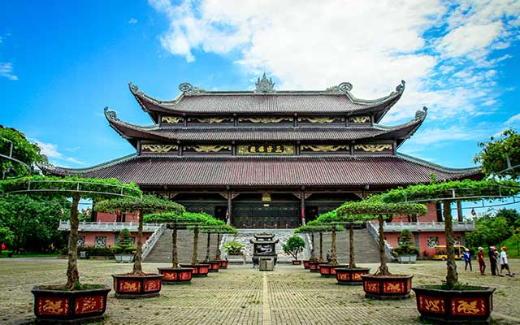
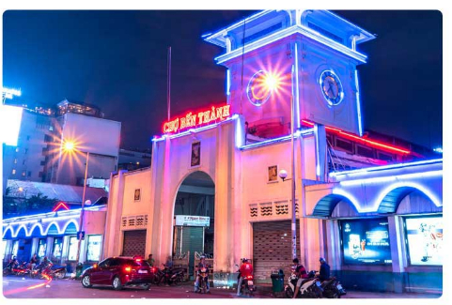
PLAY GAME:MATCHING
Bai Dinh Pagoda
Ben Thanh Market
Ba Na Hills
Hoan KiemLake

Slide 5
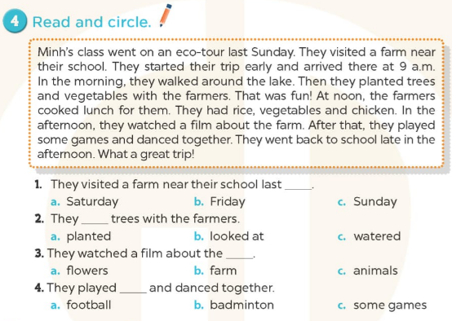
Notes:
MADE BY FACEBOOK :TRAN THI THANH TAM

Slide 6
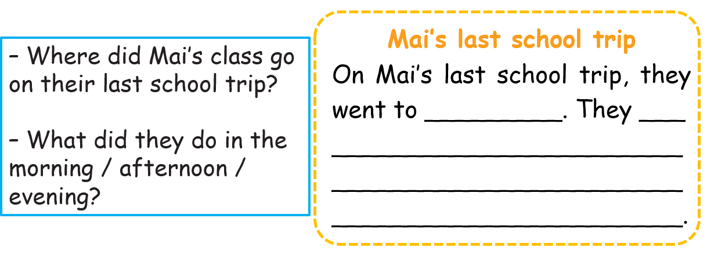
5. Let’s write
Write about Mai’s last school trip. (about 30 words)
Notes:
MADE BY FACEBOOK :TRAN THI THANH TAM

Slide 7
5. Let’s write
Write about Mai’s last school trip. (abput 30 words)
Suggestion
Mai’s last school trip
On Mai’s last school trip, they went to Ba Na Hills. In the morning, they visited the old buildings. In the afternoon, they walked along the Golden Bridge and took photos of the flowers. In the evening, they listened to music and watched the dances. They had a lot of fun.

Slide 8
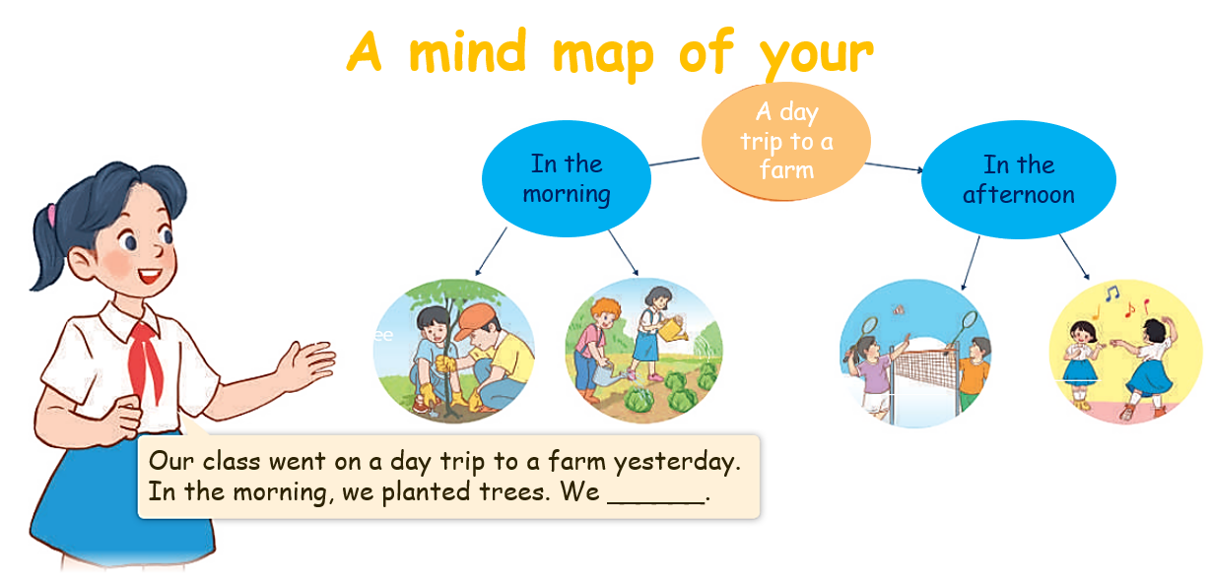
6. Project
Notes:
MADE BY FACEBOOK :TRAN THI THANH TAM

Slide 9




PLAY GAME
Sentence puzzle
Notes:
Step 2: Have groups put the posters on the desk and practice the presentation. Encourage all members in the group to present. Go around the classroom and offer help where necessary.

Slide 10
Sentence puzzle
1. visited / We / old / buildings. / the
2. trees. / My family/ planted
3. walked / Lake. / around / They/ Hoan Kiem
4. games. / played / Nam and Hoa
Notes:
MADE BY FACEBOOK :TRAN THI THANH TAM

Slide 11
Sentence puzzle
2. trees. / My family/ planted
-> My family planted trees.
Notes:
MADE BY FACEBOOK :TRAN THI THANH TAM

Slide 12
Sentence puzzle
3. walked / Lake. / around / They/ Hoan Kiem
They walked around Hoan Kiem ake.
Notes:
MADE BY FACEBOOK :TRAN THI THANH TAM

Slide 13
Sentence puzzle
4. games. / played / Nam and Hoa
-> Nam and Hoa played games.
Notes:
MADE BY FACEBOOK :TRAN THI THANH TAM

Slide 14
Homework:
- Practice more at home
- Prepare REVIEW 2

