Slide 1
UNIT 10:
Our summer holiday
LESSON 1 ( P1)
Made by: Nguyen thi thu phuong

Slide 2
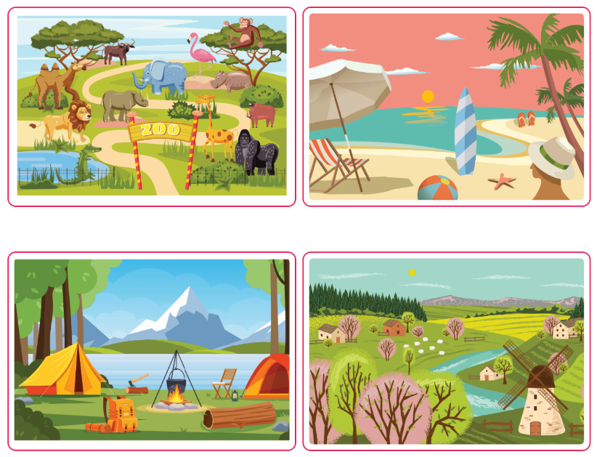
at the zoo
/æt ðə zuː/
Ở sở thú

Slide 3
on the beach
/ɒn ðə biːtʃ/
Ở bãi biển

Slide 4
at the campsite
/æt ðə ˈkæmpsaɪt/
Ở khu cắm trại

Slide 5
in the countryside
/ ɪn ðə ˈkʌntrisaɪd/
Ở đồng quê, ở nông thôn

Slide 6

Vocabulary
at the zoo
: Ở sở thú
MsPham
0936082789
on the beach
: Ở bãi biển
at the campsite
: Ở khu cắm trại
in the countryside
: Ở nông thôn
last weekend
: Cuối tuần
summer holiday
: Kì nghỉ hè

Slide 7
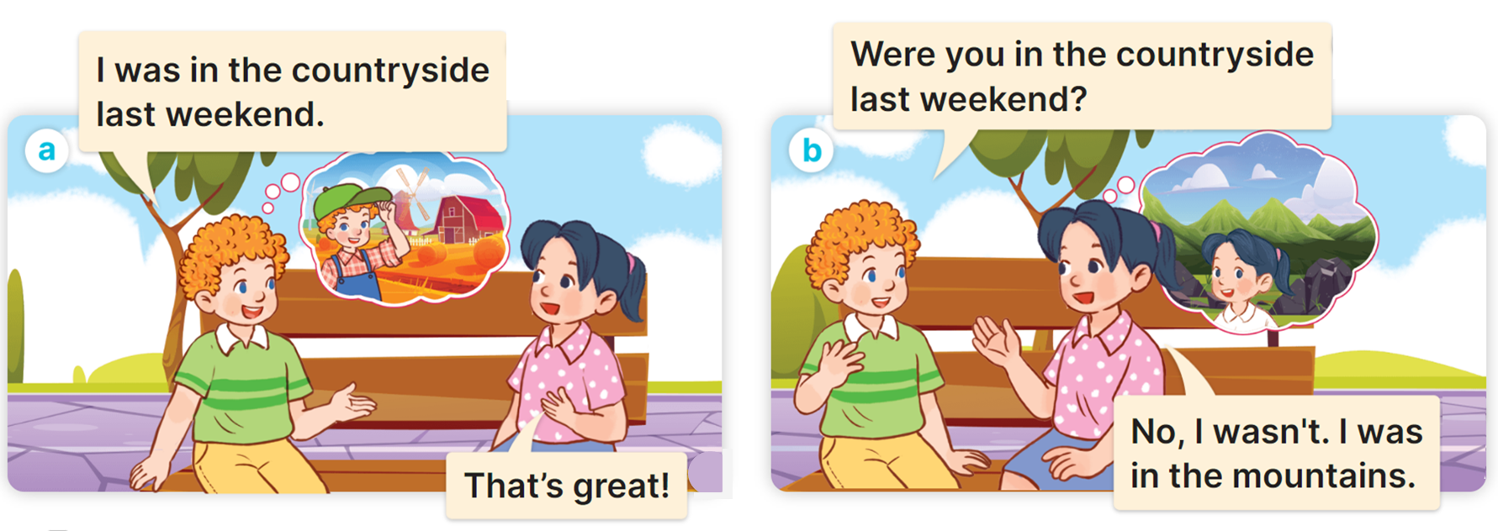

1
Look, listen and read.

Slide 8


I was at/on/in the + (địa điểm).
(Tôi đã ở __________)
Ex:
I was in the countryside.
I was in the mountains.

Slide 9


Yes, I was.
Were you at/on/in the + (địa điểm).
No, I wasn’t.
(Bạn đã ở _________ có phải không?)
Ex:
Were you in the countryside?
MsPham
0936082789
Yes, I was.
Were you at the zoo?
No, I wasn’t.

Slide 10
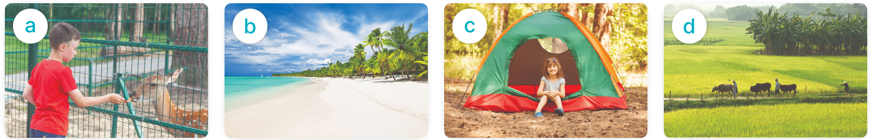
2
Listen, point and say.
Were you _____?
Yes, I was.
No, I wasn’t.
at the zoo
on the beach
at the campsite
in the countryside

Slide 11
2
Listen, point and say.
at the zoo / yes
Were you at the zoo last weekend?
Yes, I was.

Slide 12
2
Listen, point and say.
on the beach / no
Were you on the beach last weekend?
No, I wasn’t.

Slide 13
2
Listen, point and say.
at the campsite / yes
Were you at the campsite last weekend?
Yes, I was.

Slide 14
2
Listen, point and say.
in the countryside / no
Were you in the countryside last weekend?
No, I wasn’t.

Slide 15
2
Listen, point and say.
Were you _____?
Yes, I was.
No, I wasn’t.
at the zoo
on the beach
at the campsite
in the countryside

Slide 16
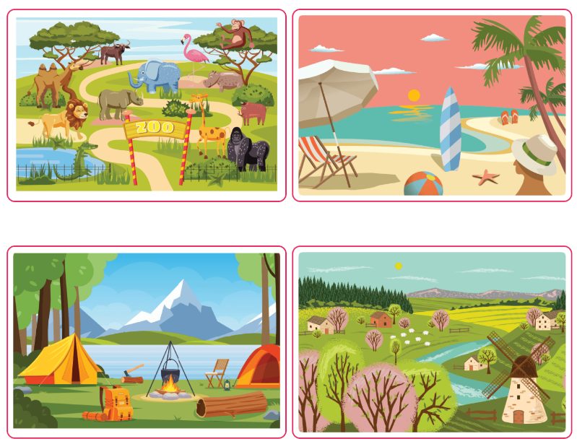
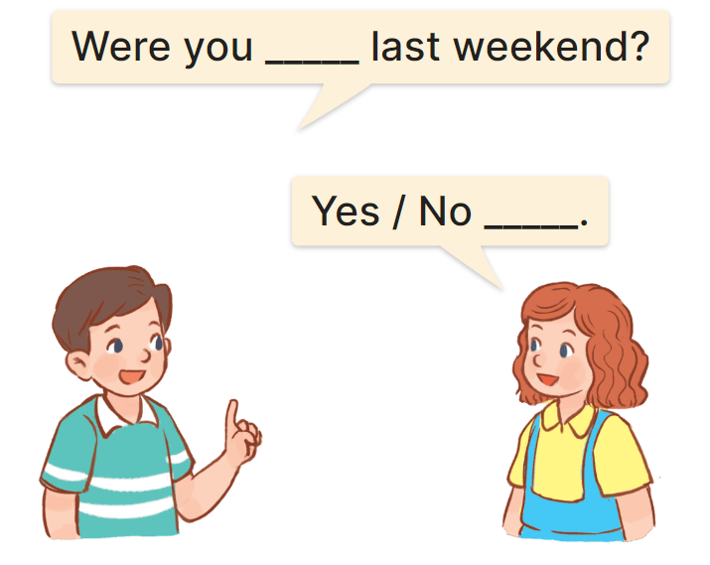
3
Let’s talk.

Slide 17
Yes, I was.
MsPham
0936082789
Were you ____ last weekend?
No, I wasn’t.
at the zoo
on the beach
at the campsite
in the countryside

Slide 18
GOOD BYE

