Slide 1
UNIT 10:
Our summer holiday
LESSON 1 ( P2)
Made by: Nguyen thi thu phuong

Slide 2


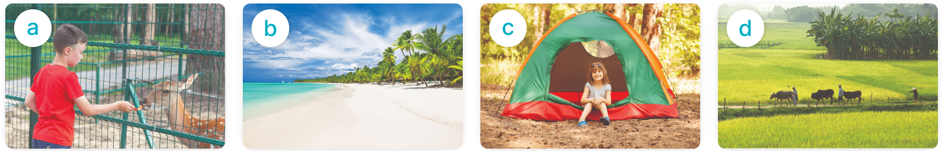
Yes, I was.
MsPham
0936082789
Were you ____ last weekend?
No, I wasn’t.
at the zoo
on the beach
at the campsite
in the countryside

Slide 3

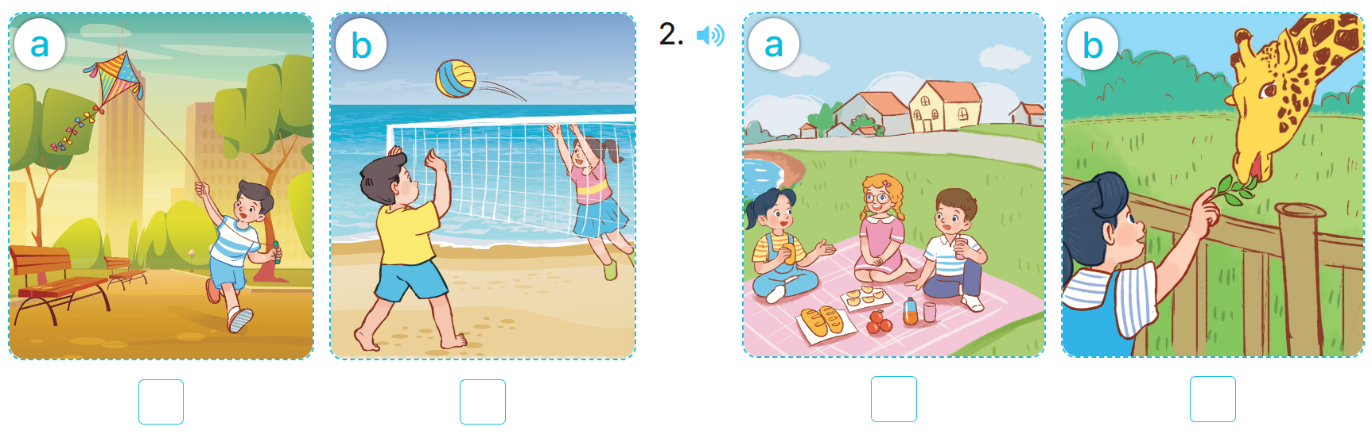
4
Listen and tick.
1
2
✓
✓

Slide 4
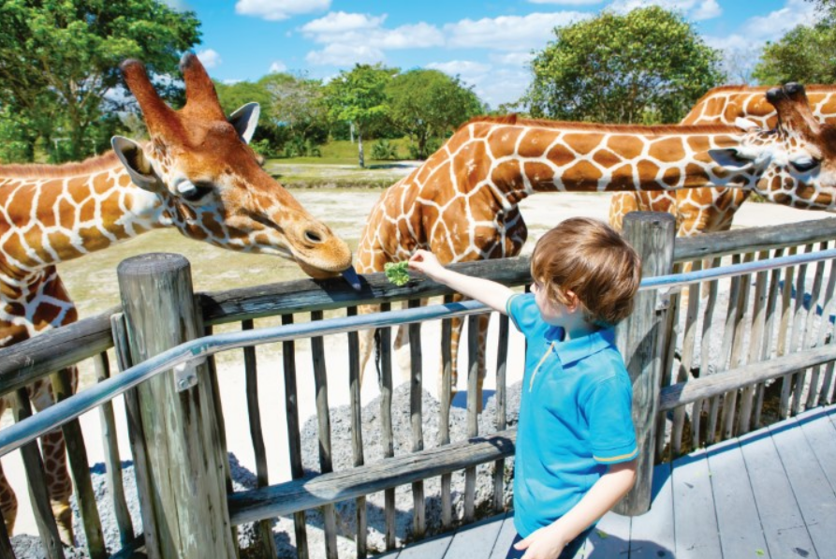
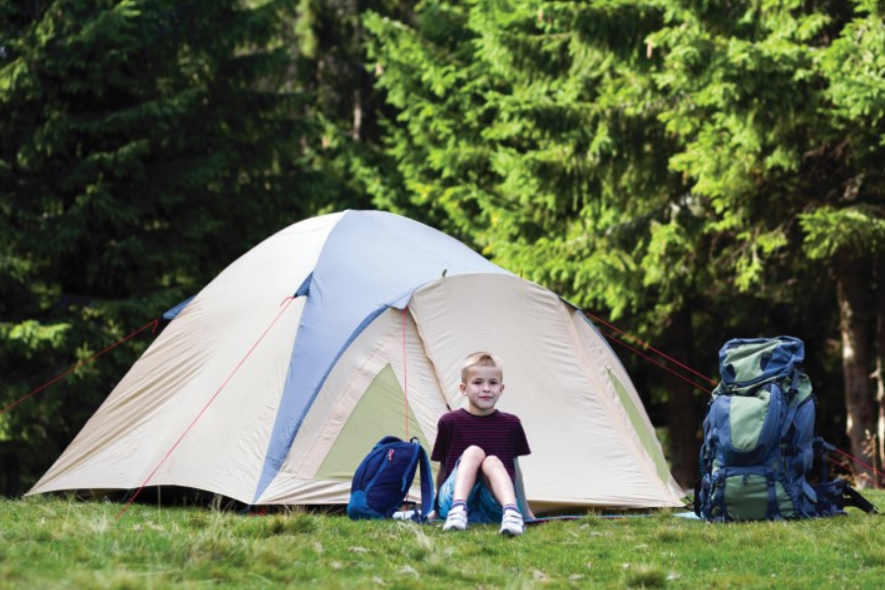
5
Look, complete and read.
1
2
the campsite
at the zoo
I was at ______________ yesterday.
I was at ______________ last weekend.

Slide 5
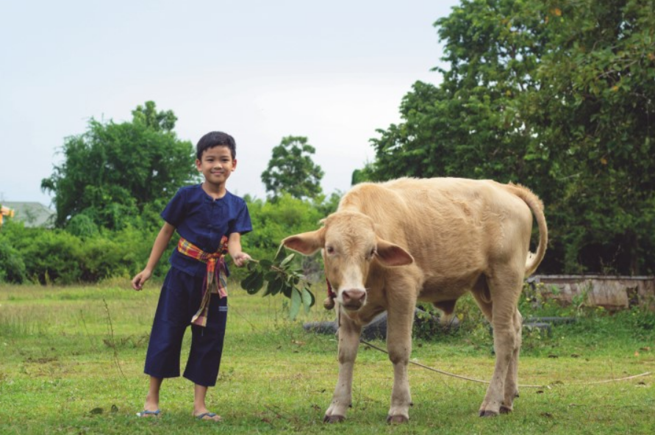
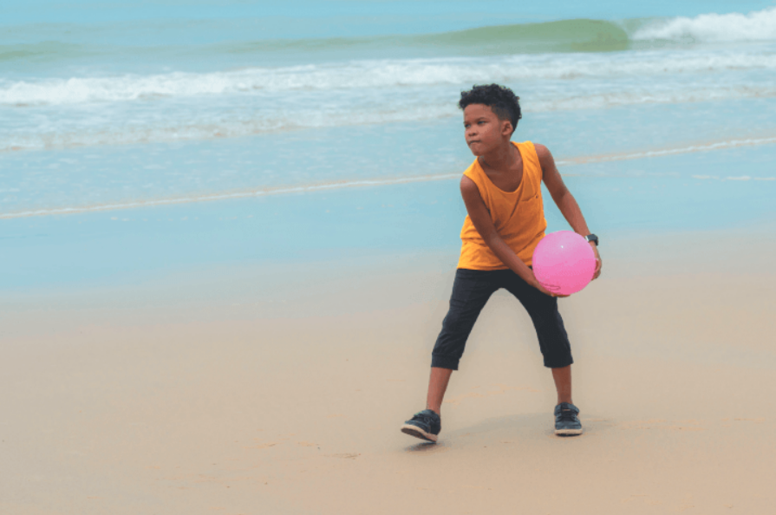
5
Look, complete and read.
3
4
A: Were you in the mountains last weekend?
B: No, I wasn’t. I was in ________
____________________________.
Were
A: ______ you in the mountains last weekend?
B: __________, I was.
Yes
the
countryside

Slide 6


6
Let’s sing.
Were you, were you,
Were you on the beach?
Were you on the beach yesterday?
Yes, I was. Yes, I was.
I was on the beach yesterday.
Were you, were you,
Were you on the beach?
Were you on the beach yesterday?
No, I wasn't. No, I wasn't.
I was in the countryside yesterday.

