Slide 1
UNIT 10:
Our summer holiday
LESSON 2 ( P1)
Made by: Nguyen thi thu phuong

Slide 2
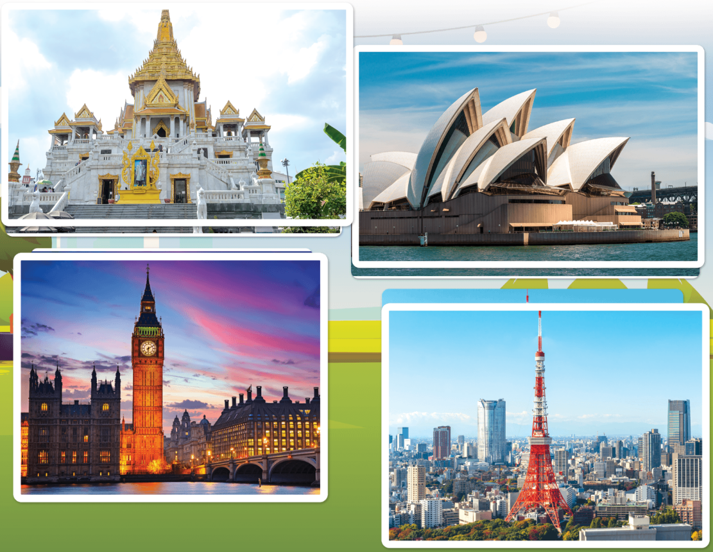
London
/ˈlʌndən/
Luân Đôn (Thủ đô của nước Anh)

Slide 3
Sydney
/ˈsɪdni/
(Thủ đô của
nước Úc)

Slide 4
Tokyo
/ˌtəʊkiəʊ/
(Thủ đô của
Nhật Bản)

Slide 5
Bangkok
/bæŋˈkɒk/
(Thủ đô của nước Thái Lan)

Slide 6

summer
/ˈsʌmər/
Mùa hè

Slide 7

Vocabulary
London
: Luân đôn
MsPham
0936082789
Tokyo
: Tô-ki-ô
Sydney
: Sydney
Bangkok
: Băng-cốc
summer
: Mùa hè

Slide 8
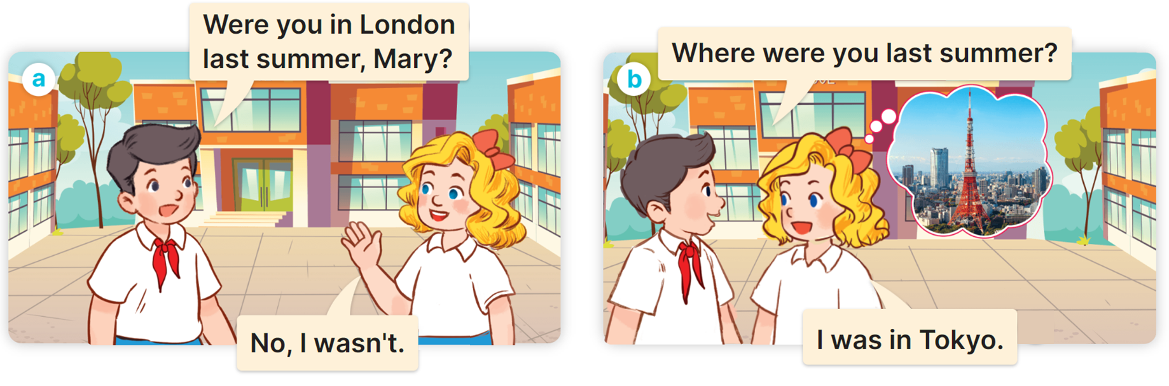

1
Look, listen and read.

Slide 9
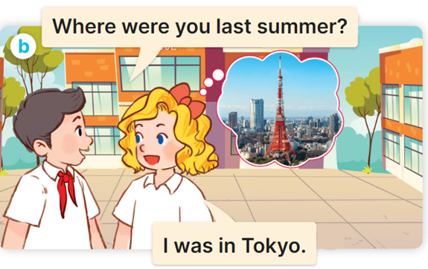
(+ month)
(Vào tháng _____.)
Where were you last summer?
(Bạn đã ở đâu vào mùa hè?)
I was in/on/at the + (địa điểm)
(Tớ đã ở _______.)
Ex:
MsPham
0936082789

Slide 10
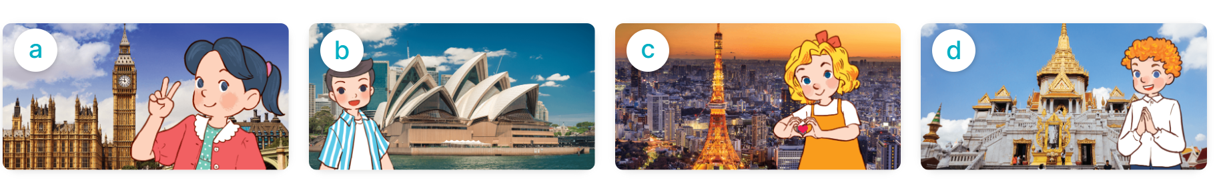
2
Listen, point and say.
Where were you last summer?
I was in ___________.
London
Sydney
Tokyo
Bangkok

Slide 11
2
Listen, point and say.
London
Where were you last summer?
I was in London.

Slide 12
2
Listen, point and say.
Sydney
Where were you last summer?
I was in Sydney.

Slide 13
2
Listen, point and say.
Tokyo
Where were you last summer?
I was in Tokyo.

Slide 14
2
Listen, point and say.
Bangkok
Where were you last summer?
I was in Bangkok.

Slide 15
2
Listen, point and say.
Where were you last summer?
I was in ___________.
London
Sydney
Tokyo
Bangkok

