Slide 1
UNIT 10:
Our summer holiday
LESSON 3 ( P2)
Made by: Nguyen thi thu phuong

Slide 2
Warm-up

Slide 3

Board race

Slide 4
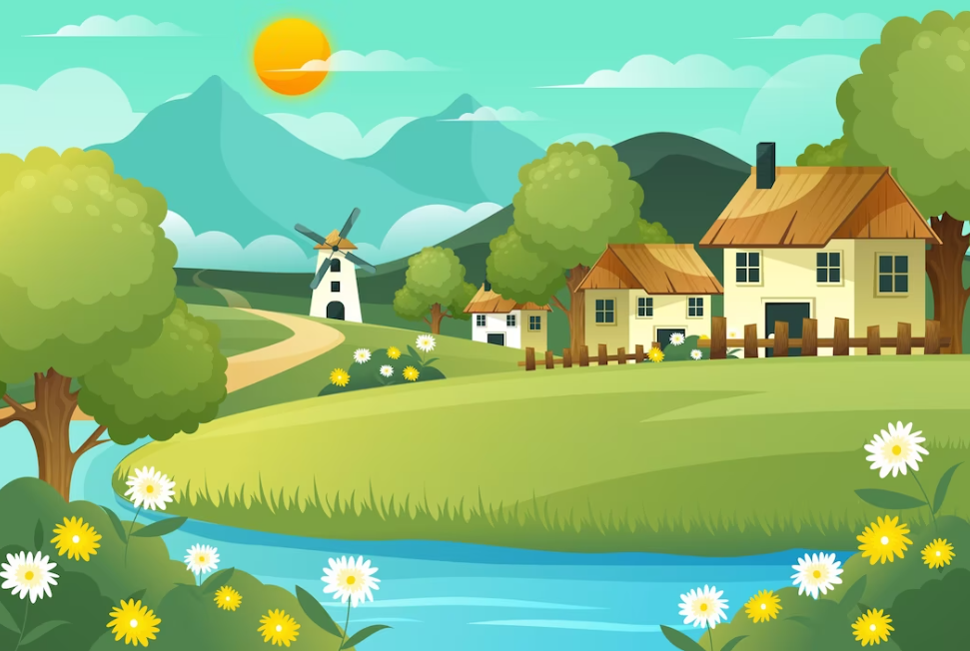
co__ntrys__de
u
i

Slide 5
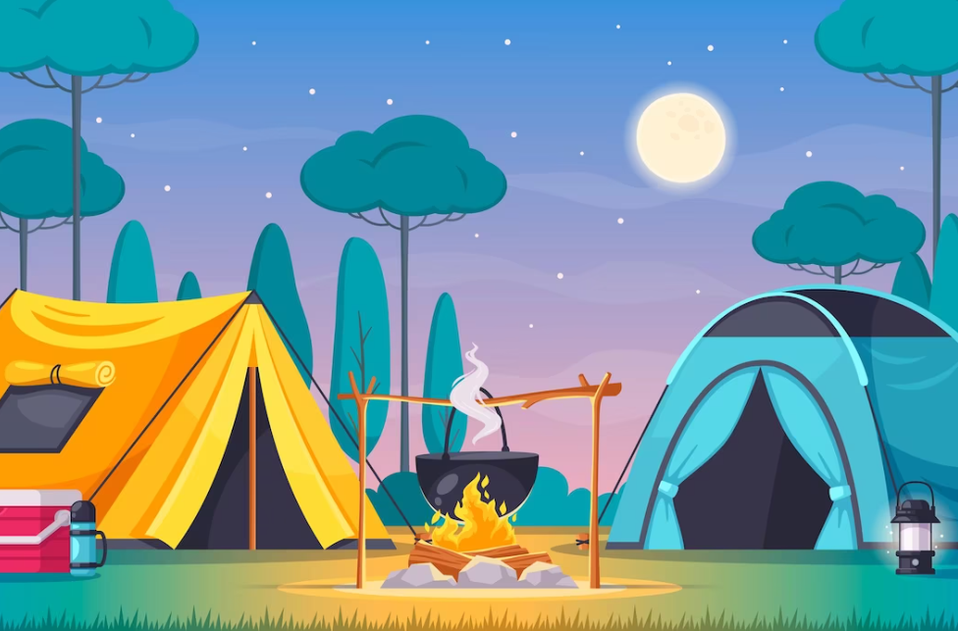
c__m__site
a
p

Slide 6
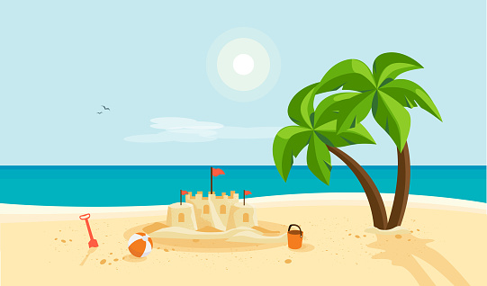
b__a__h
e
c

Slide 7
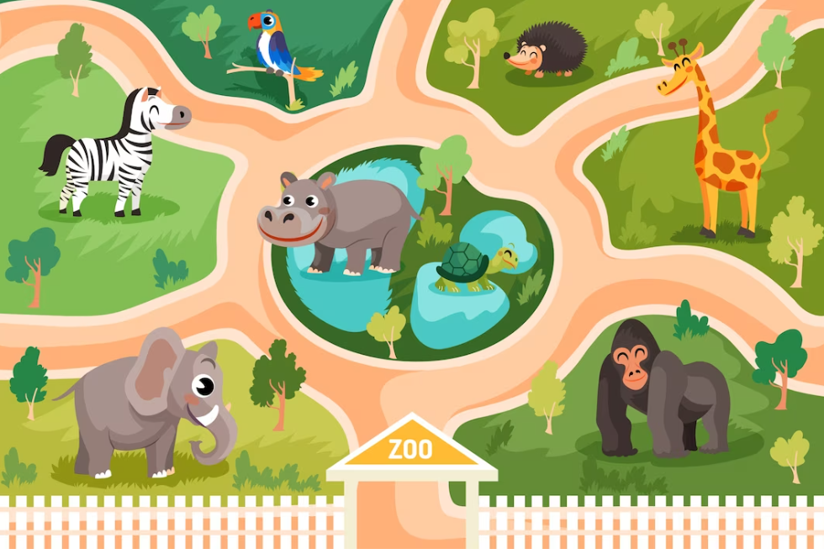
__o__
z
o

Slide 8
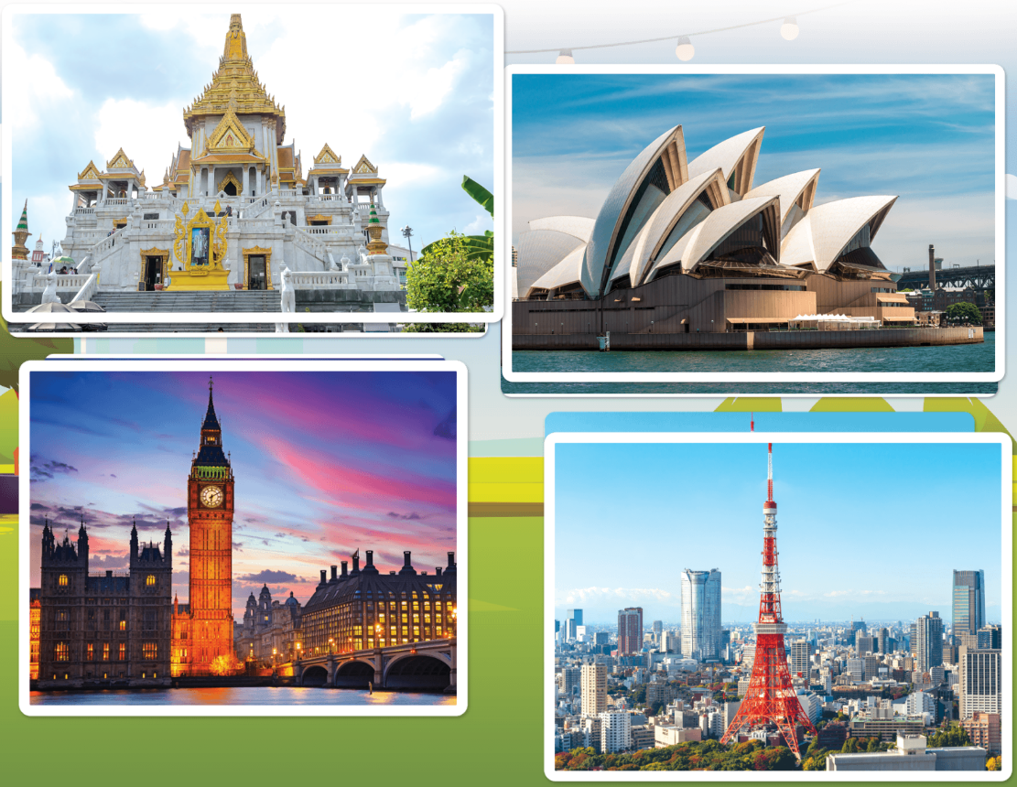
L__n__on
o
d

Slide 9
S__ __ney
y
d

Slide 10
__ang__ok
B
k

Slide 11
T__k__o
o
y

Slide 12
Welldone!

Slide 13
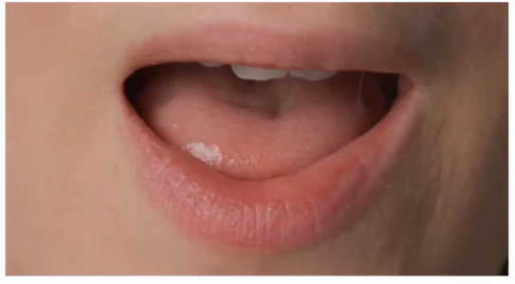
Phonics
ere
/ɜː/
were
/wɜːr/
Notes:
https://www.youtube.com/watch?v=8z3E7OM43gY&list=PL8_ETpRL2xNbJTjsq6q8ex0yMu7g61wrf

Slide 14
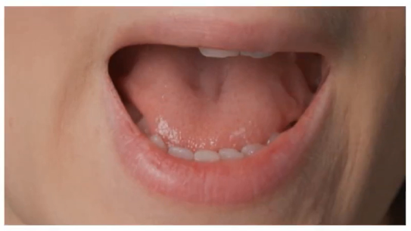
Phonics
ere
/eə/
where
/weər/
Notes:
https://www.youtube.com/watch?v=8z3E7OM43gY&list=PL8_ETpRL2xNbJTjsq6q8ex0yMu7g61wrf

Slide 15
Look and guesswere orwhere.
4
1
2
3
where
where
were
where

Slide 16
Look and guesswere orwhere.
1
2
3
4
5
were
where
were
where
where

Slide 17
Look and guesswere orwhere.
1
2
3
4
5
were
were
where
where
were
6
7
where
were

Slide 18

1
Listen and repeat.
ere
were
Were you on the beach last summer?
ere
where
Where were you last weekend?

Slide 19

2
Listen and circle.
1.
a. Were you on the beach last weekend?
b. Where were you last summer?
c. Were you in the countryside last summer?
a. Where were you last weekend?
b. Where were you yesterday?
c. Were you at the campsite yesterday?
MsPham
0936082789
MsPham
0936082789
2.

Slide 20


3
Let’s chant.
Were you at the campsite yesterday?
Yes, I was. Yes, I was.
Where were you last summer?
I was on the beach.
Were you on the beach yesterday?
No, I wasn't. No, I wasn't.
Where were you last summer?
I was in the countryside.

