Slide 1
UNIT 10:
Our summer holiday
LESSON 3 ( P1)
Made by: Nguyen thi thu phuong

Slide 2
Warm up

Slide 3



Slide 4





Choose the correct answer:
- ___ were you last summer ?
- I was in the countryside.
B. When
A. What
C. Where
D. How

Slide 5
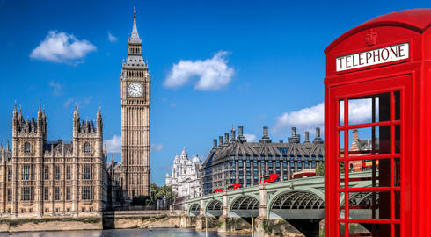
Choose the correct answer:
Were you in ________ last summer?
No, I wasn’t.
A. Sydney
B. Tokyo
C. London
D. Bangkok

Slide 6
Choose the correct answer:
Where ___ you last weekend?
I was at the zoo.
A. do
B. are
C. was
D. were

Slide 7
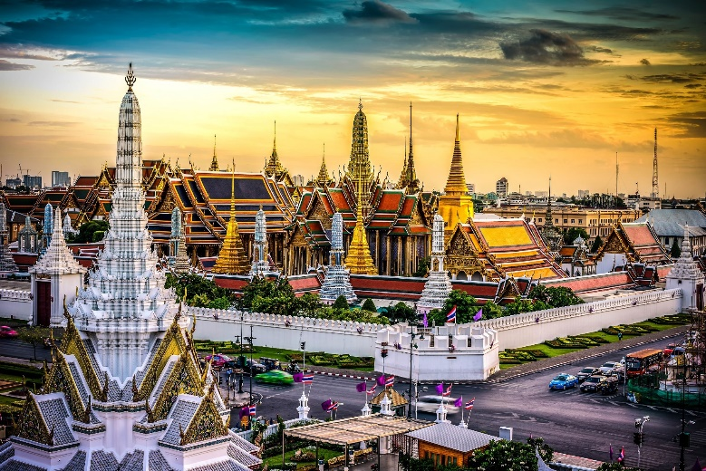
Choose the correct answer:
Were you in ________ last summer?
Yes, I was.
A. Bangkok
B. Tokyo
C. London
D. Sydney

Slide 8
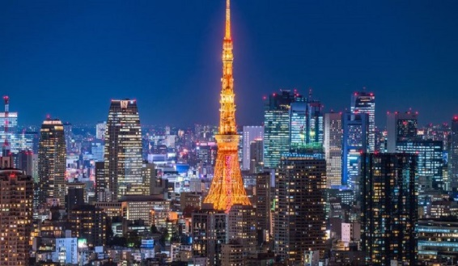
Choose the correct answer:
Were you in ________ last summer?
No, I wasn’t.
A. Bangkok
B. Tokyo
C. London
C. Sydney

Slide 9
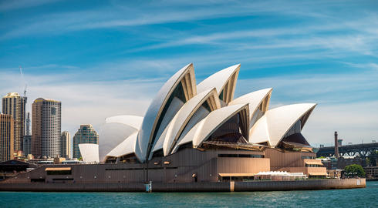
Choose the correct answer:
Were you in ________ last summer?
Yes, I was.
A. Sydney
B. Bangkok
C. Tokyo
D. London

Slide 10
Choose the correct answer:
Where were you last weekend?
I ______ in Sydney.
A. were
B. are
C. was
D. is

Slide 11
Choose the correct answer:
Were you ___ the zoo yesterday?
A. in
B. at
C. on
D. of

Slide 12
Choose the correct answer:
Where was your family ___ weekend?
A. next
B. ago
C. last
D. this

Slide 13


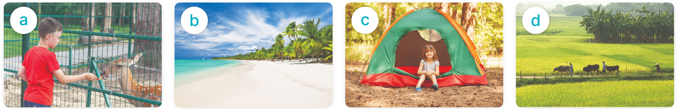
Yes, I was.
MsPham
0936082789
Were you ____ last weekend?
No, I wasn’t.
at the zoo
on the beach
at the campsite
in the countryside

Slide 14
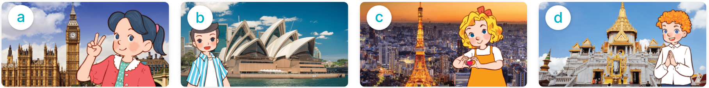
MsPham
0936082789
Where were you last summer?
I was in _________.
London
Sydney
Tokyo
Bangkok

Slide 15
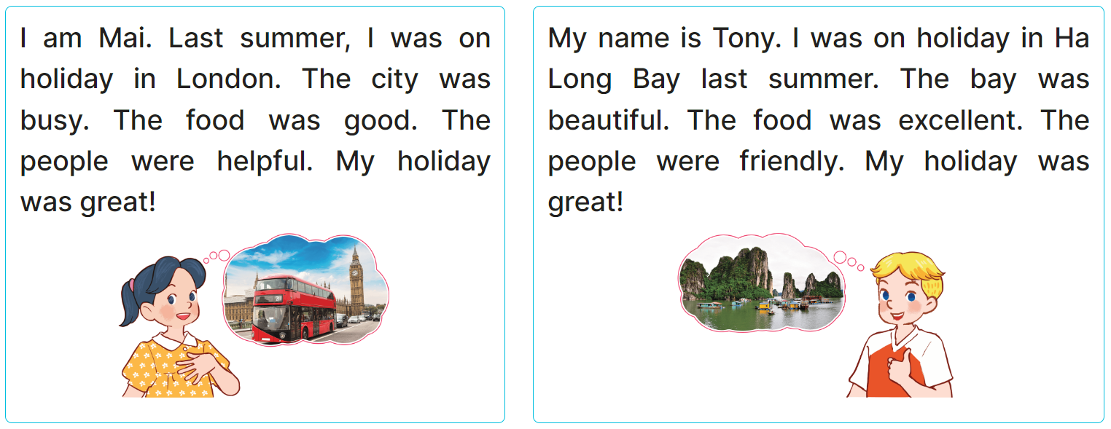
4
Read and complete.
1. Last summer, Mai was in London and Tony was in ______________.
2. London was busy and Ha Long Bay was ______________.
3. The people in London were __________ and the people in Ha Long were friendly.
4. Their holidays were ______________.
Ha Long Bay
beautiful
friendly
great

Slide 16
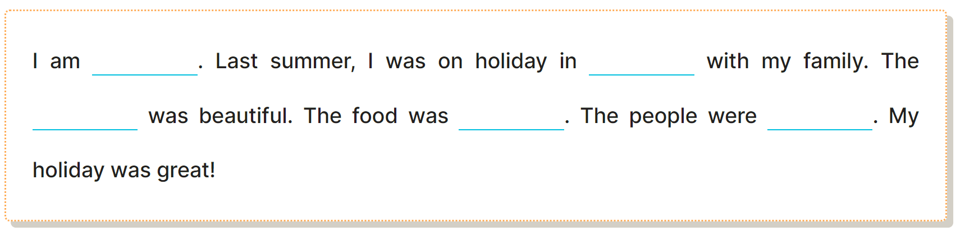

5
Let’s write
MsPham
0936082789

Slide 17
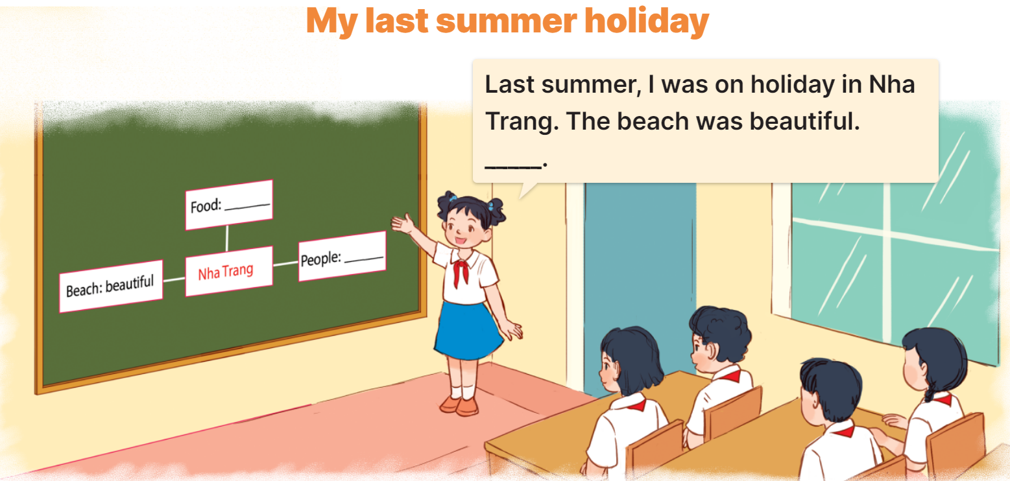
6
Project

