Slide 1
Review 2
Period 1
Made by: Nguyen Thi Thu Phuong

Slide 2
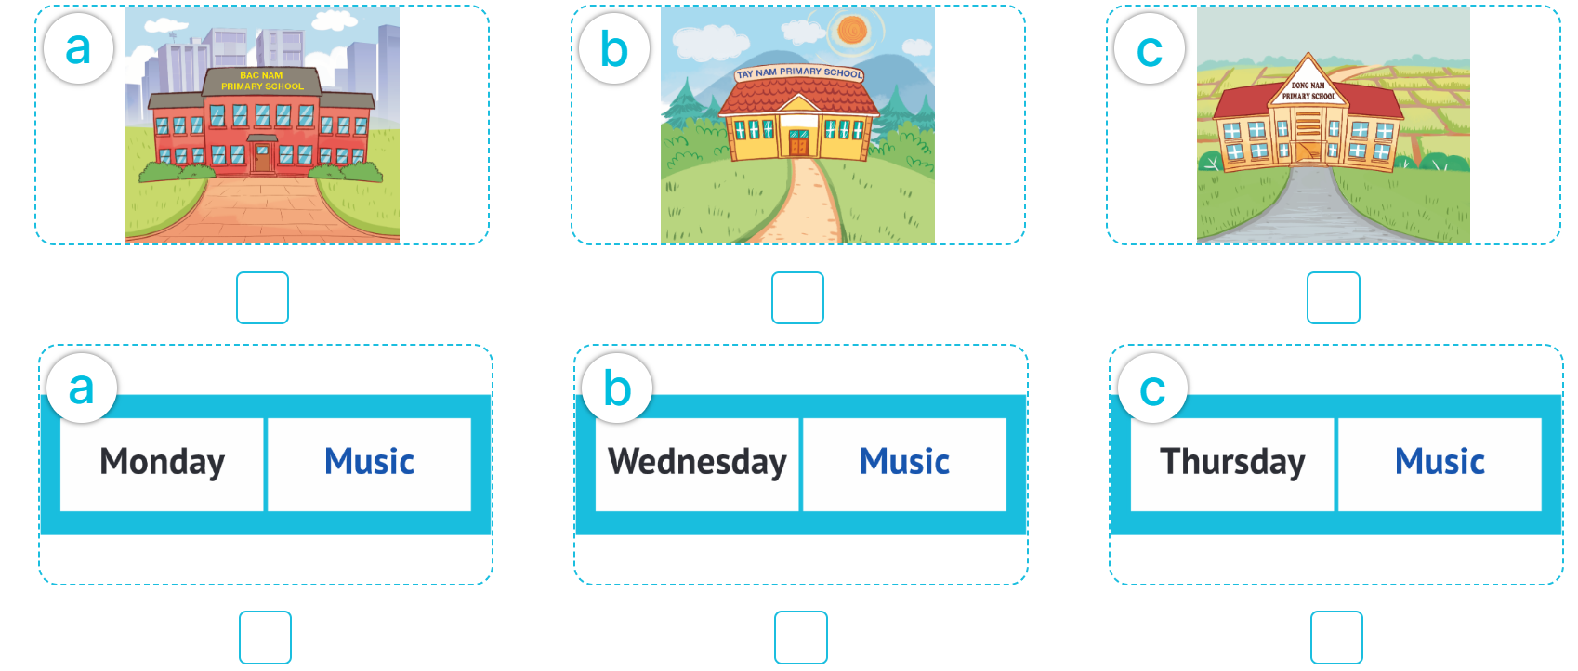
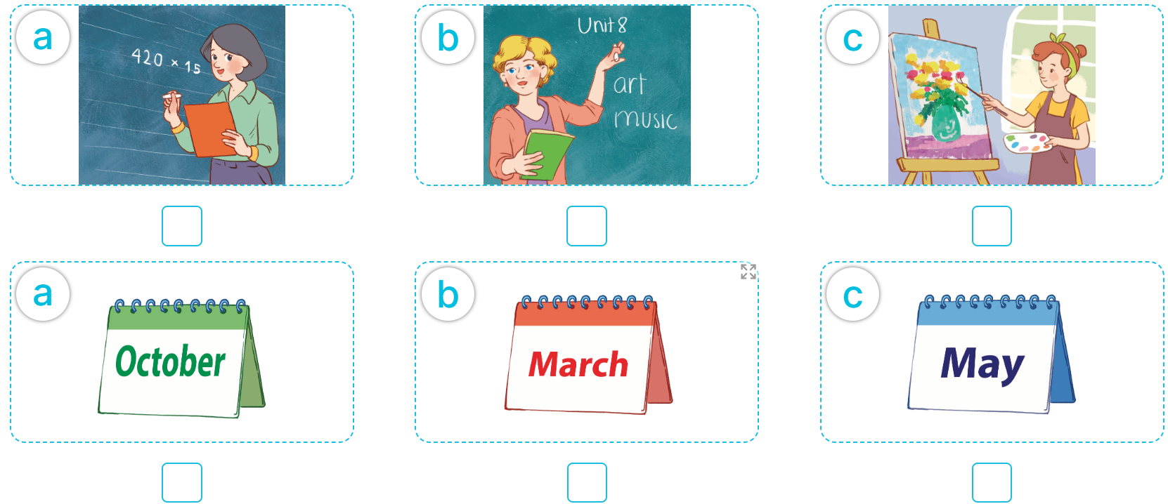
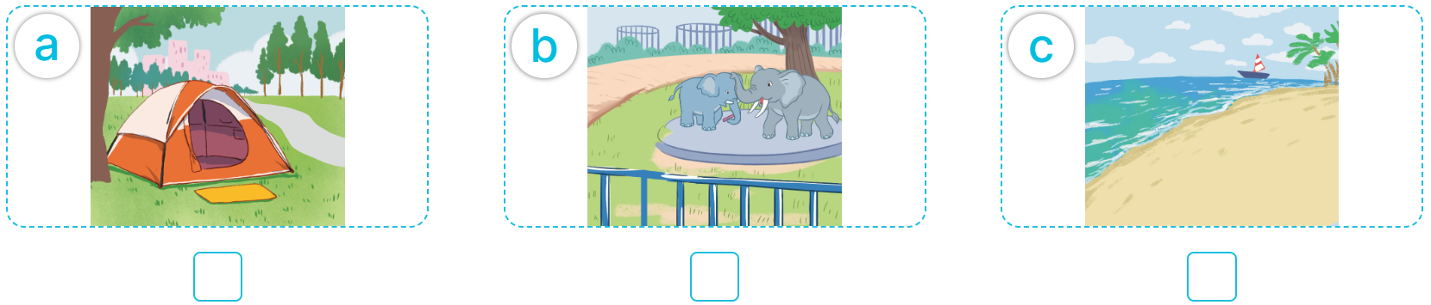

1
Listen and tick.

Slide 3

1
Listen and tick.

Slide 4
1
Listen and tick.

Slide 5
1
Listen and tick.

Slide 6
1
Listen and tick.

Slide 7
1
Listen and tick.

Slide 8
1
Listen and tick.
Answer key

Slide 9
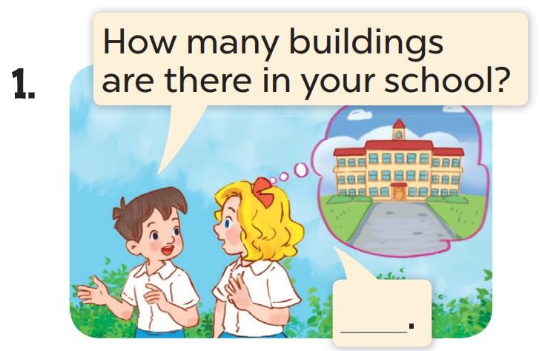
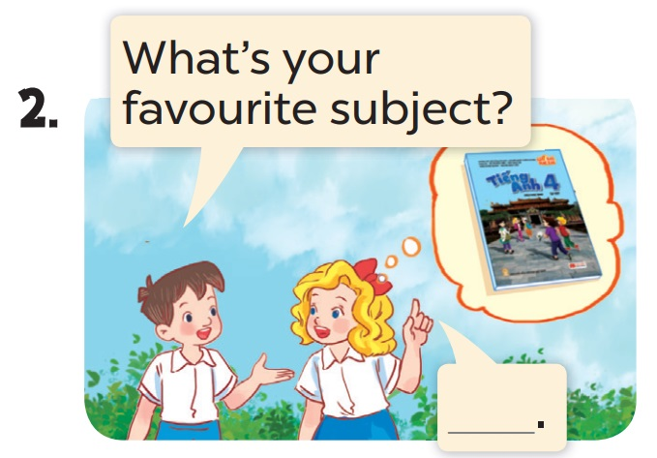
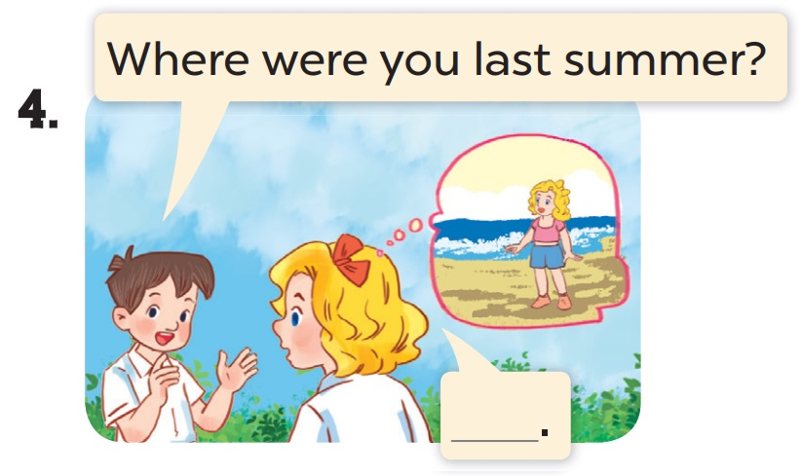
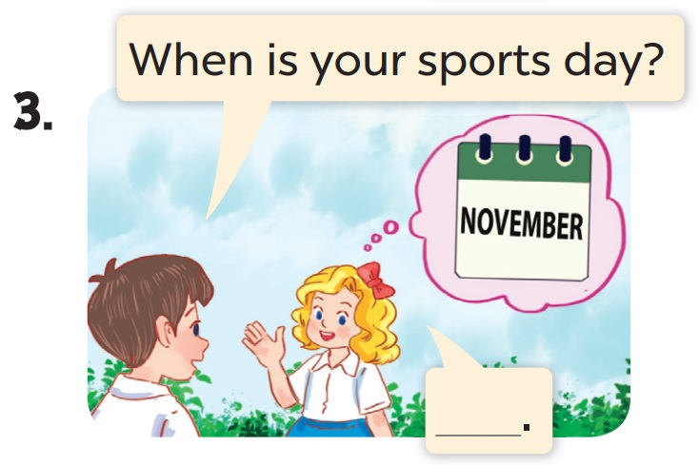
2
Ask and answer.
There is one.
It’s English.
I was on the beach.
It’s in November.

