Slide 1
Review 2
Period 3

Slide 2
Circle odd one out
English
orange
red
pink
purple

Slide 3
Circle odd one out
April
November
Maths
October
January

Slide 4
Circle odd one out
Friday
Monday
Saturday
Sunday
August

Slide 5
Circle odd one out
dance
singer
swim
ride a bike
fly a kite

Slide 6
Circle odd one out
English
art
music
painter
PE

Slide 7
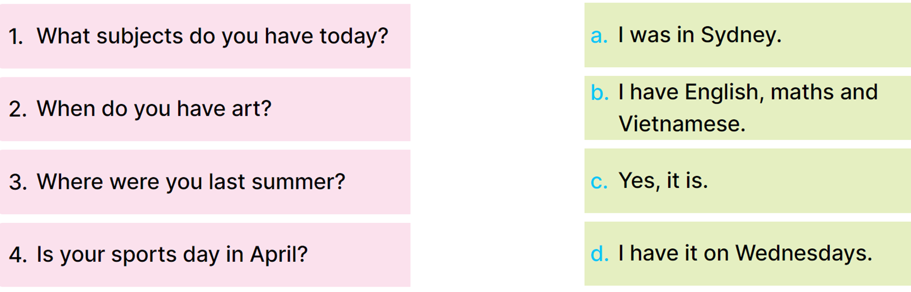
1
Read and match.

Slide 8
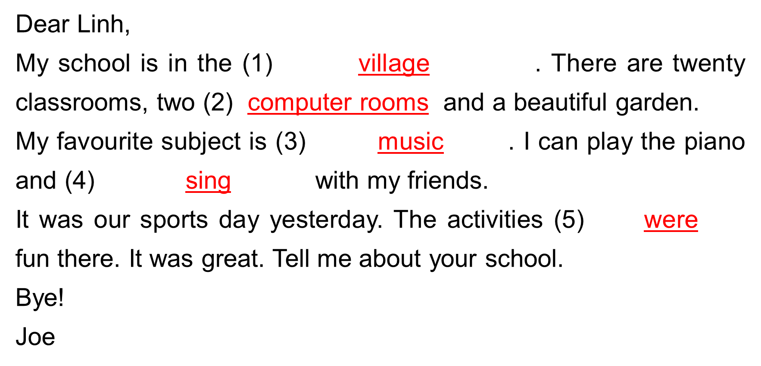
4
Read and complete.
_________________
_________________
_________________
_________________
_________________

Slide 9
5
Let’s write.
the mountains
the city
ten
fifteen
twenty
Dear Joe,
My school is in _______________. There are _______________ classrooms. My favourite subject is _______________. I like it because I _______________. I love sports. Our last sports day was in _______________.
Bye!
_______________
the village
the town
a number
a subject
want to be a………
a month
maths
music
art
English
May
October
Your name

Slide 10
Let’s read about you.
Dear Joe,
My school is in _______________. There are _______________ classrooms. My favourite subject is _______________. I like it because I _______________. I love sports. Our last sports day was in _______________.
Bye!
_______________

