Slide 1

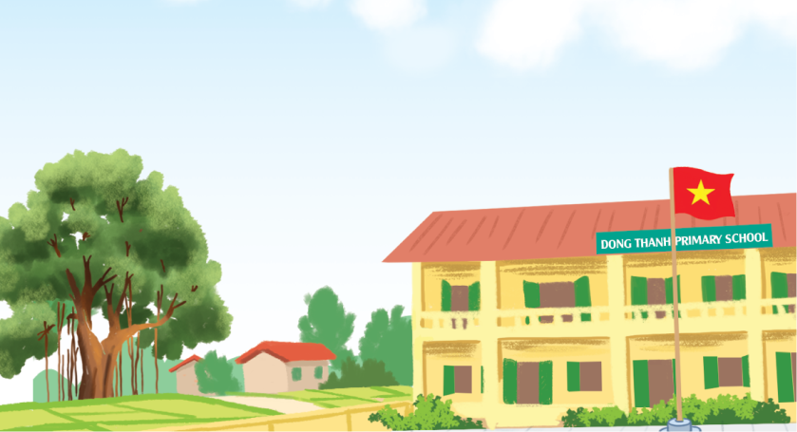
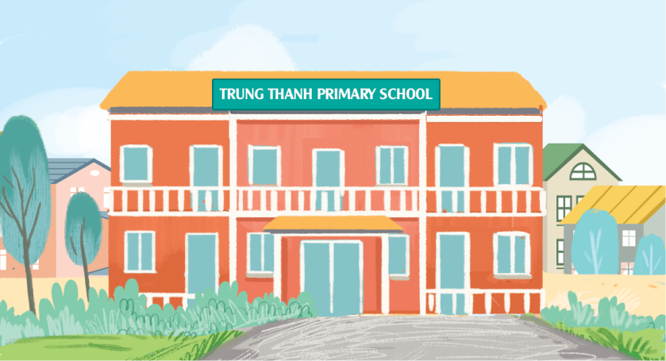
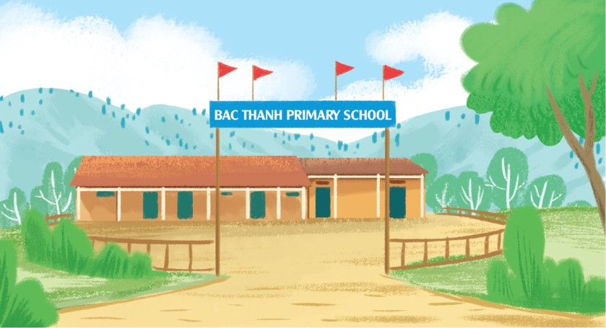
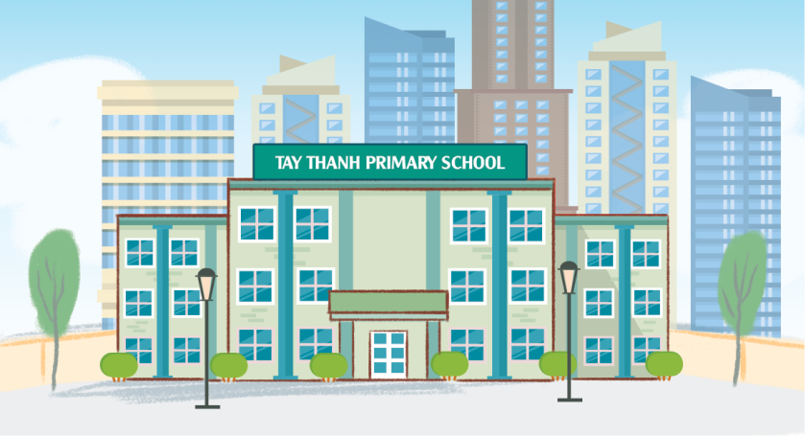
Where’s your school?
It’s in the ________.
mountains
village
city
town

Slide 2
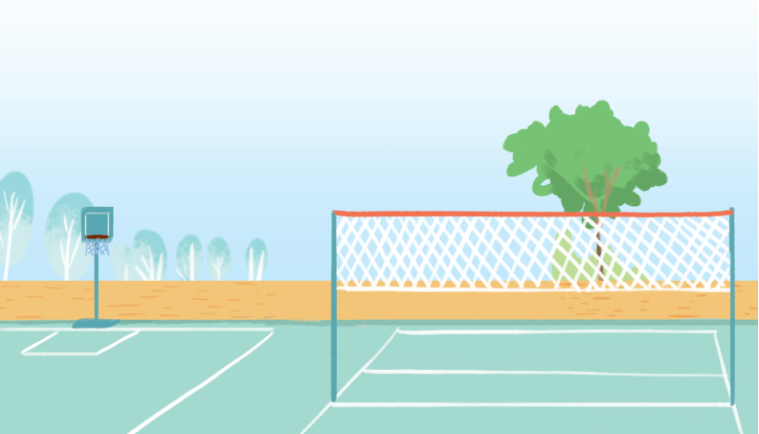
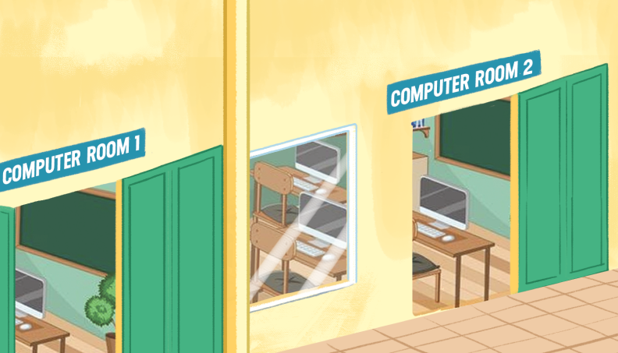
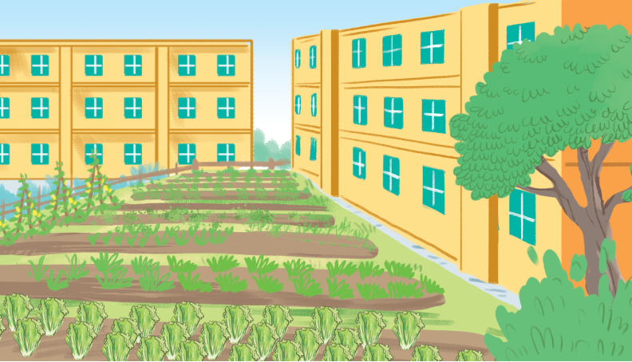
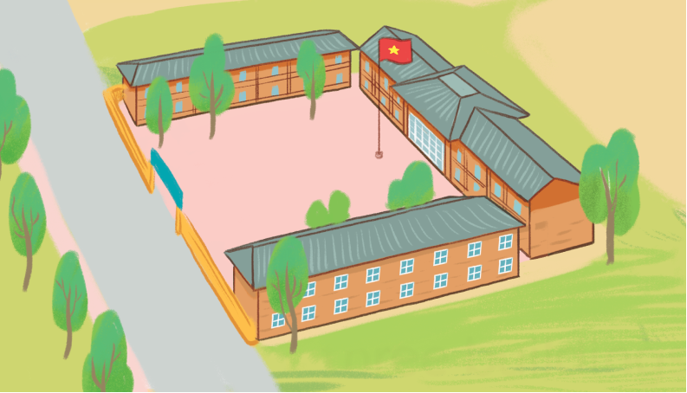
How many _________ are there
at your school?
There is/are ______.
playgrounds
computer rooms
gardens
buildings

Slide 3



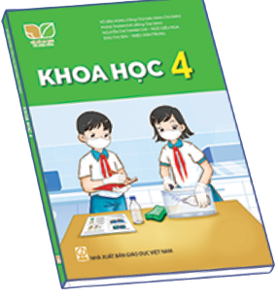
What subjects do you have today?
I have __________.
Vietnamese
English
maths
science

Slide 4
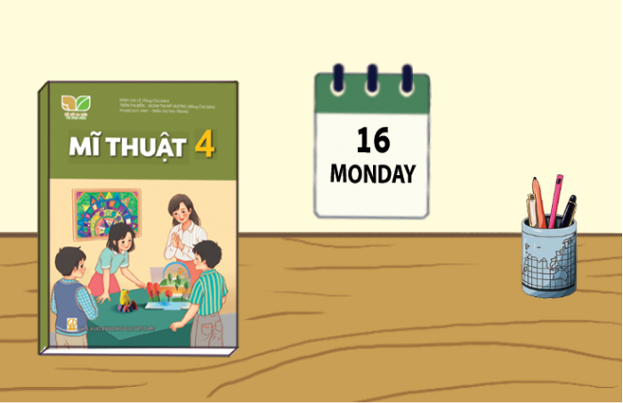
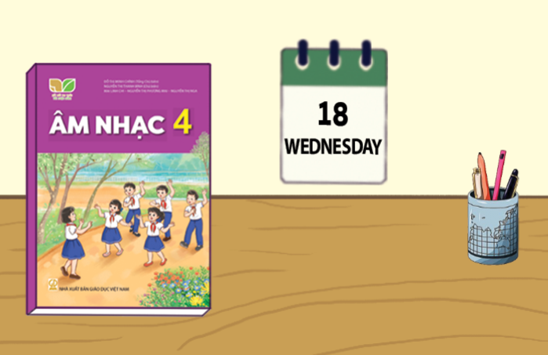
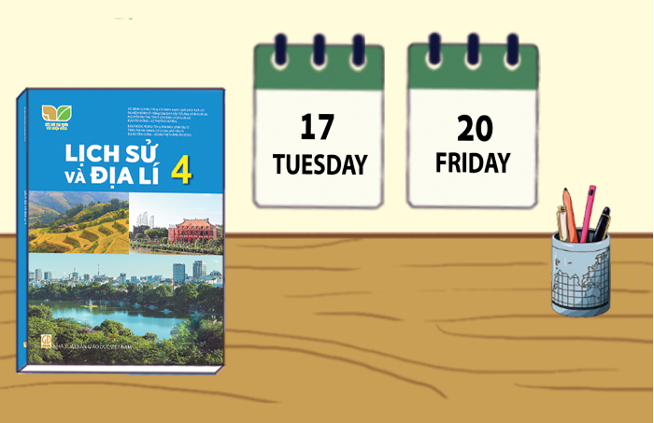
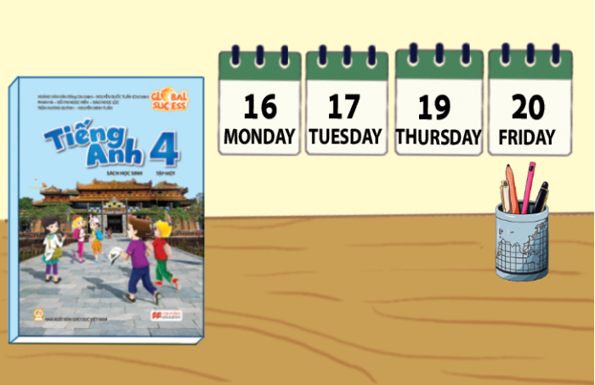
When do you have ______?
I have it on __________.
art
music
history and geography
English

Slide 5
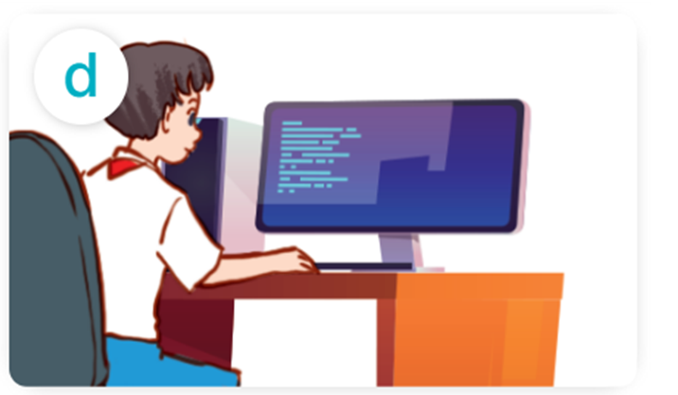
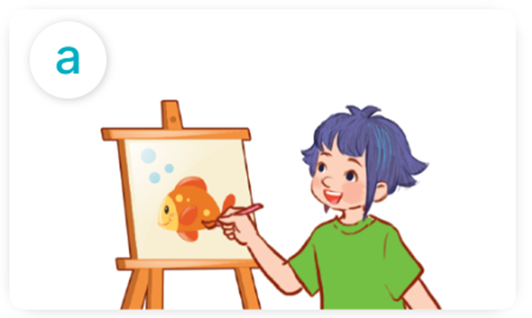
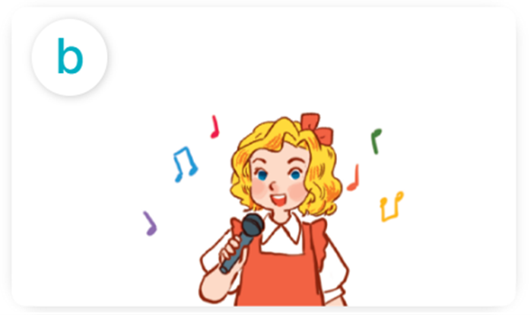
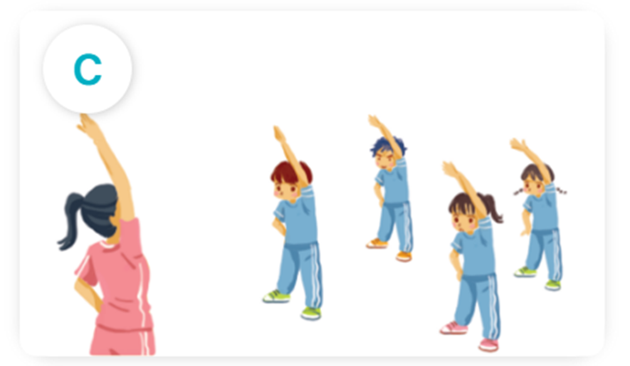
What’s your favourite subject?
It’s _________.
IT
art
music
PE

Slide 6
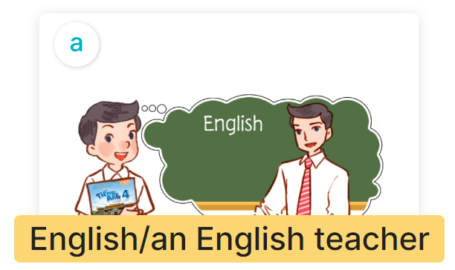
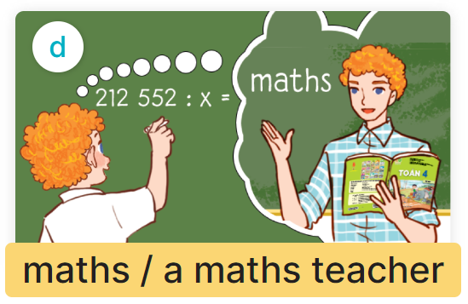
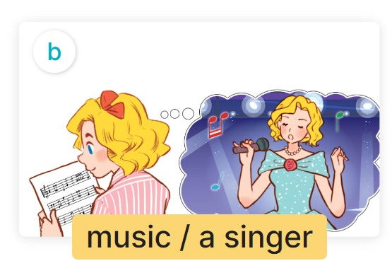
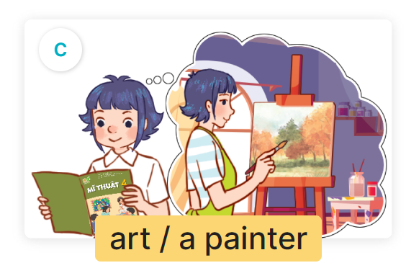
Why do you like math?
Because I want to be a/an ________.

Slide 7


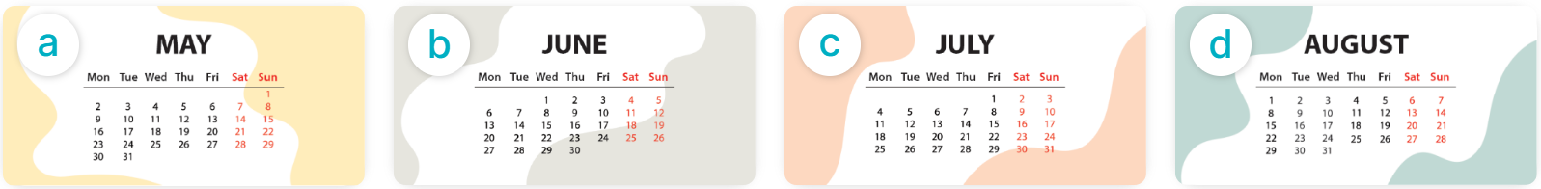
Yes, it is.
Is your sport day in _________?
No, it isn’t.
It’s in ____.
May
June
March
April

Slide 8
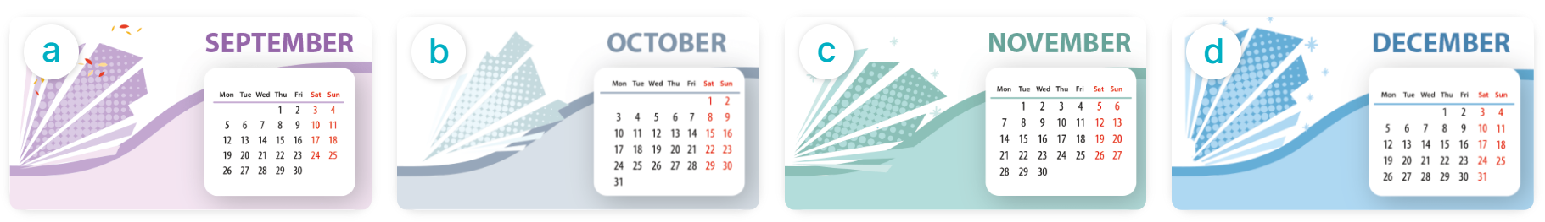
When’s your sports day?
It’s in _________.
September
Octocber
November
December

Slide 9
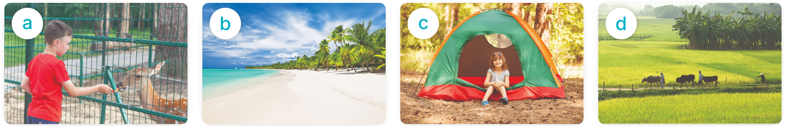
Yes, I was.
Were you ____ last weekend?
No, I wasn’t.
at the zoo
on the beach
at the campsite
in the countryside

Slide 10
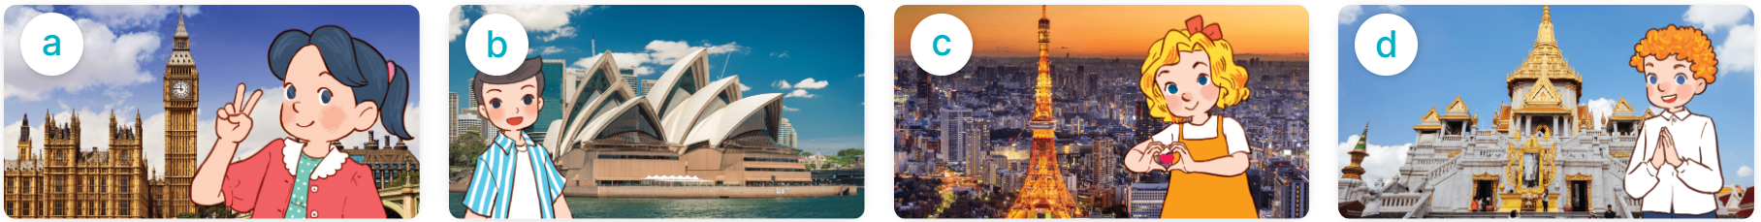
Where were you last summer?
I was in _________.
London
Sydney
Tokyo
Bangkok

