Slide 1





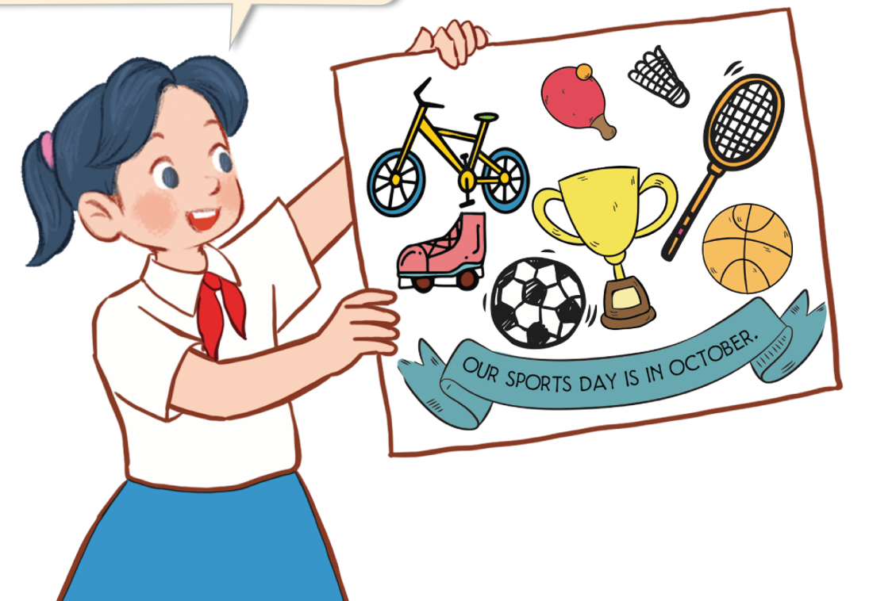
Unit 9
Our sport day
Lesson 2 – Period 2

Slide 2
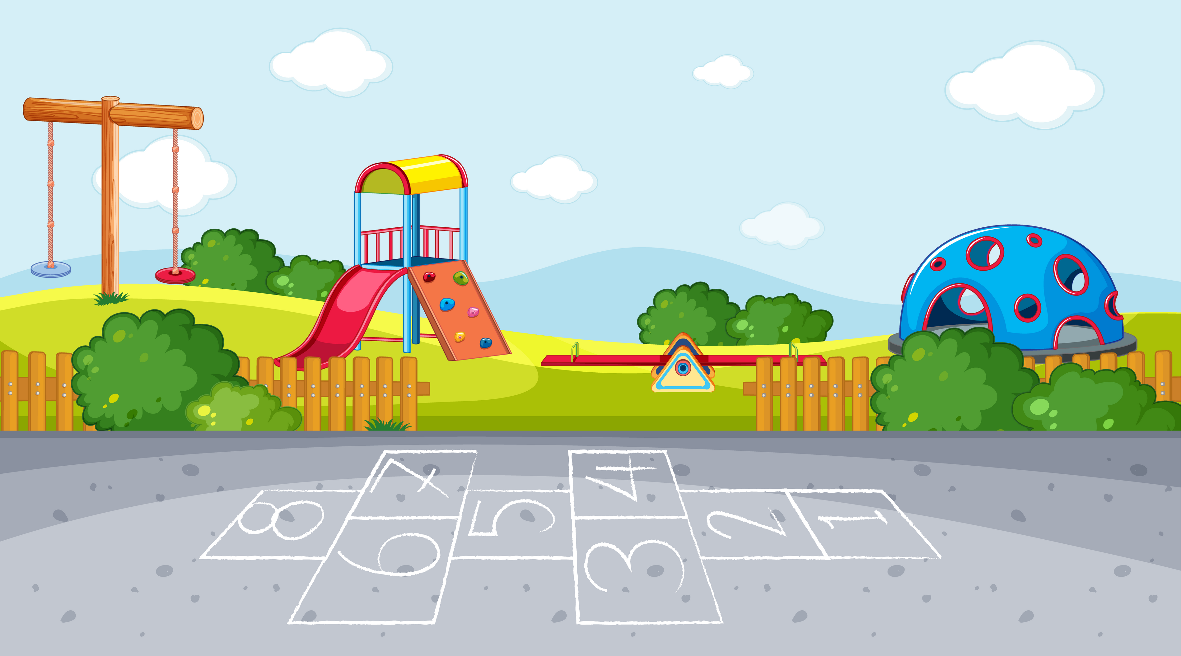
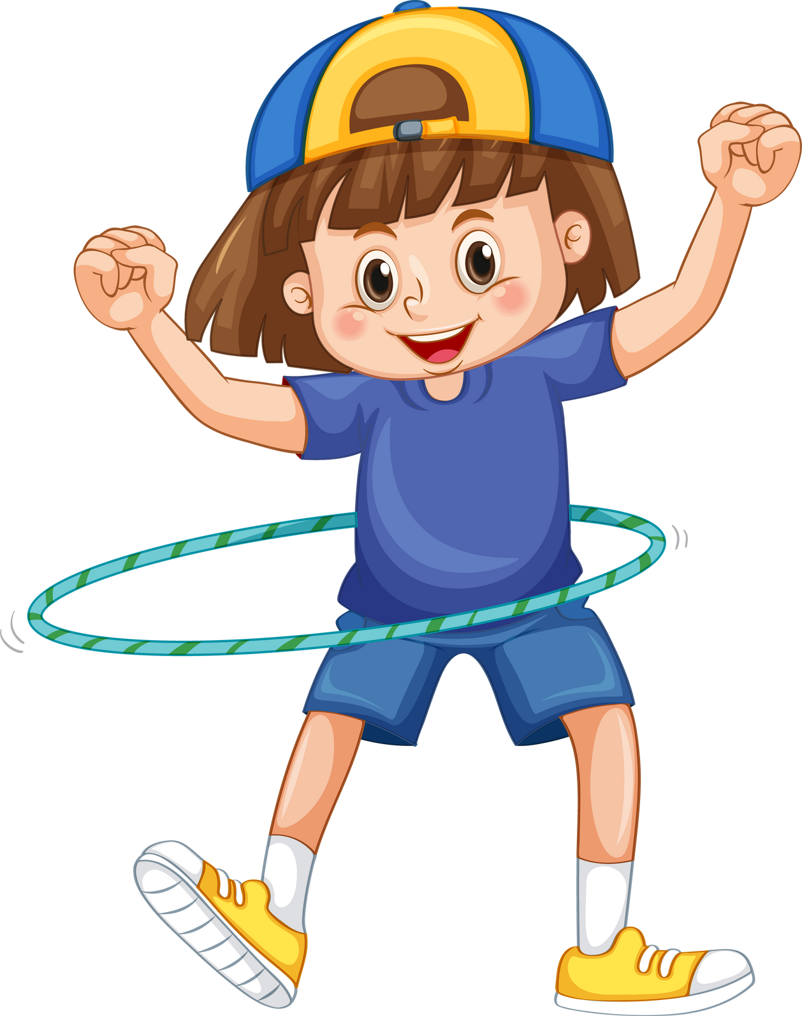
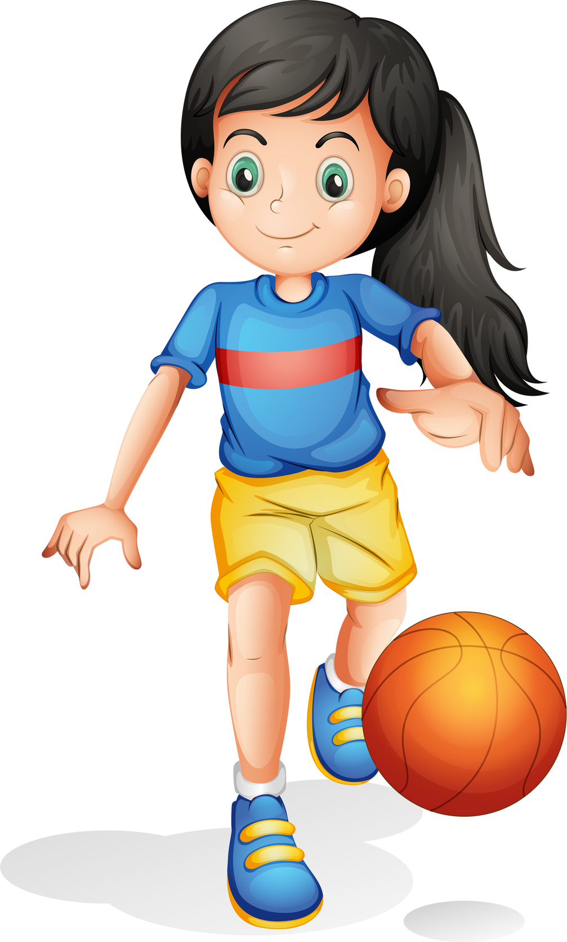
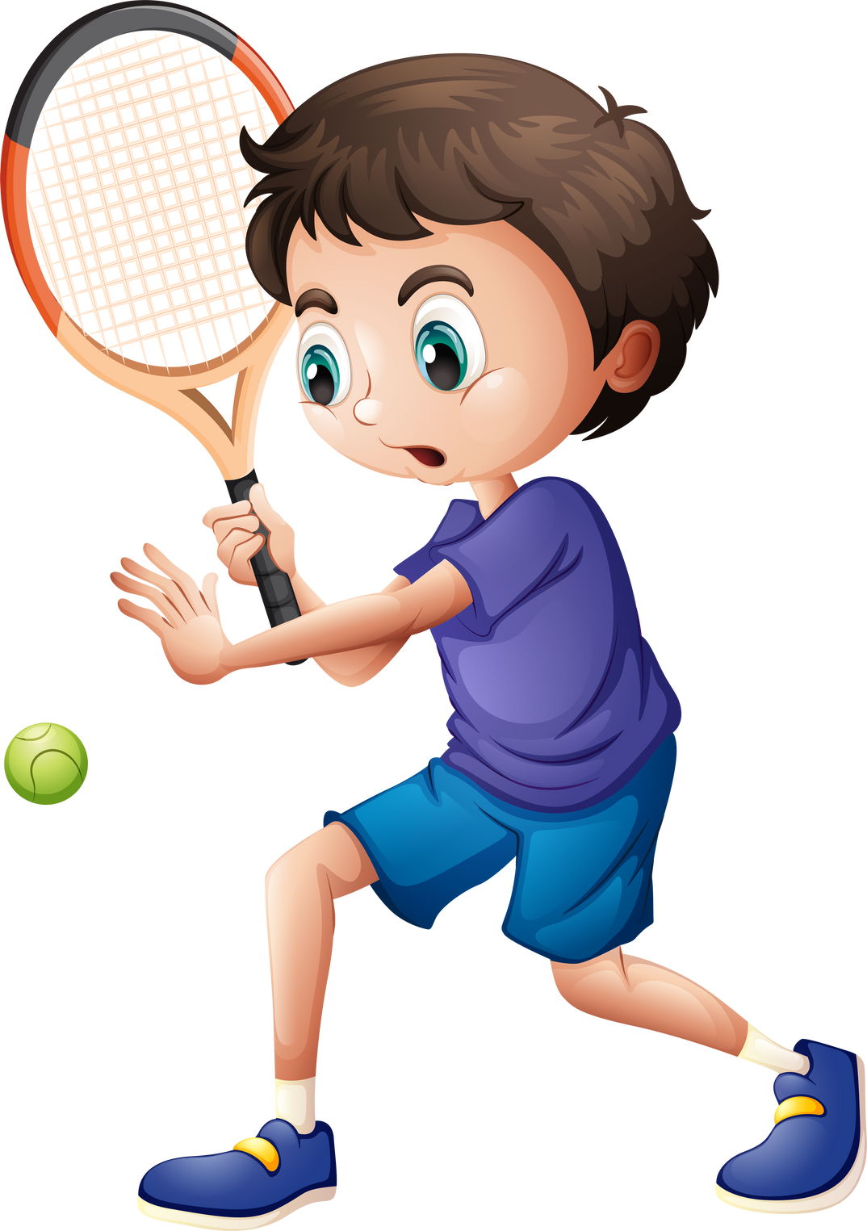
Warm-up

Slide 3

MsPham
0936082789

Slide 4








MsPham 0936082789
RACING CAR
START
MsPham
0936082789

Slide 5


Question
1
2
3
4
5
6
7
8
End
MsPham
0936082789

Slide 6

When’s your sports day?
It’s in _____.
S E P M B T E E R
September
Check!
Back

Slide 7
When’s your sports day?
It’s in _____.
B E C E M R D E
December
Check!
Back

Slide 8
When’s your sports day?
It’s in _____.
V E M B N O E R
November
Check!
Back

Slide 9
When’s your sports day?
It’s in _____.
O C B E R T O
October
Check!
Back

Slide 10
When’s your sports day?
It’s in _____.
U S T
A U G
August
Check!
Back

Slide 11
When’s your sports day?
It’s in _____.
J N U E
June
Check!
Back

Slide 12
When’s your sports day?
It’s in _____.
U L J Y
July
Check!
Back

Slide 13
When’s your sports day?
It’s in _____.
A P I L R
April
Check!
Back

Slide 14
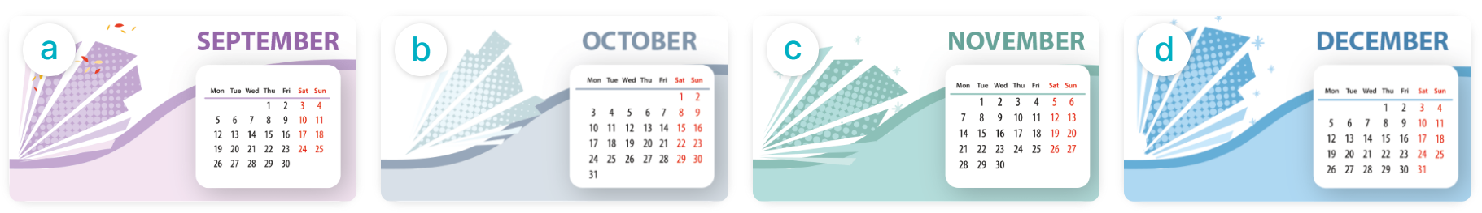
When’s your sports day?
MsPham
0936082789
It’s in _________.
MsPham
0936082789
September
Octocber
November
December

Slide 15

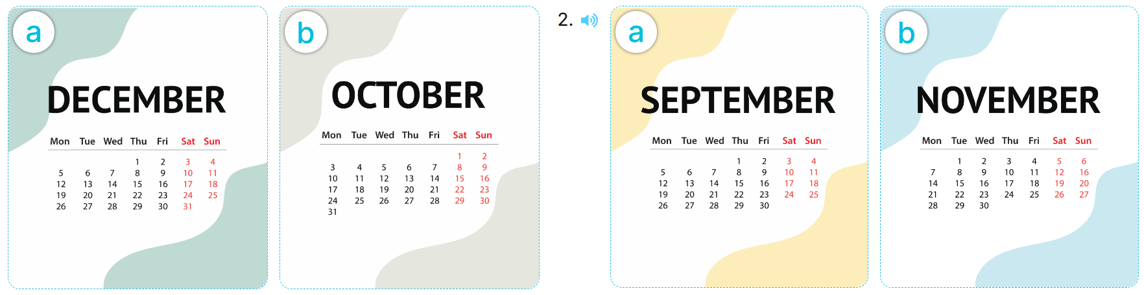

4
Listen and tick.
1
2

Slide 16
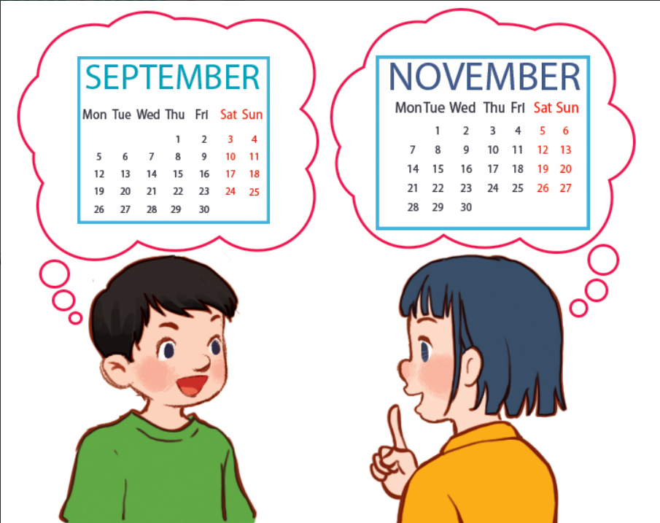
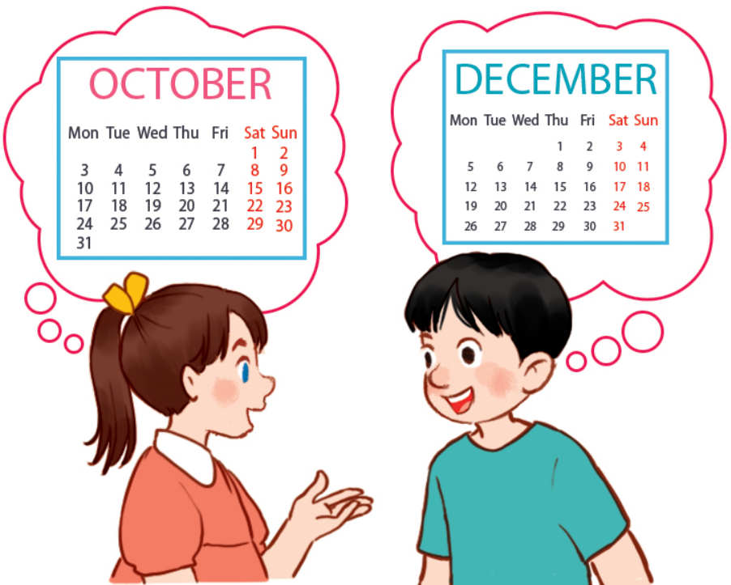
5
Look, read and complete.
1
A: Is your sports day in September?
B: _____, it is. When's your sports day?
A: It's in ___________.
Yes
November
2
Is
A: Our sports day is in October. _____ your sports day in October too?
B: No, it isn’t.
A: __________ your sports day?
B: It's in ____________.
When’s
December

Slide 17

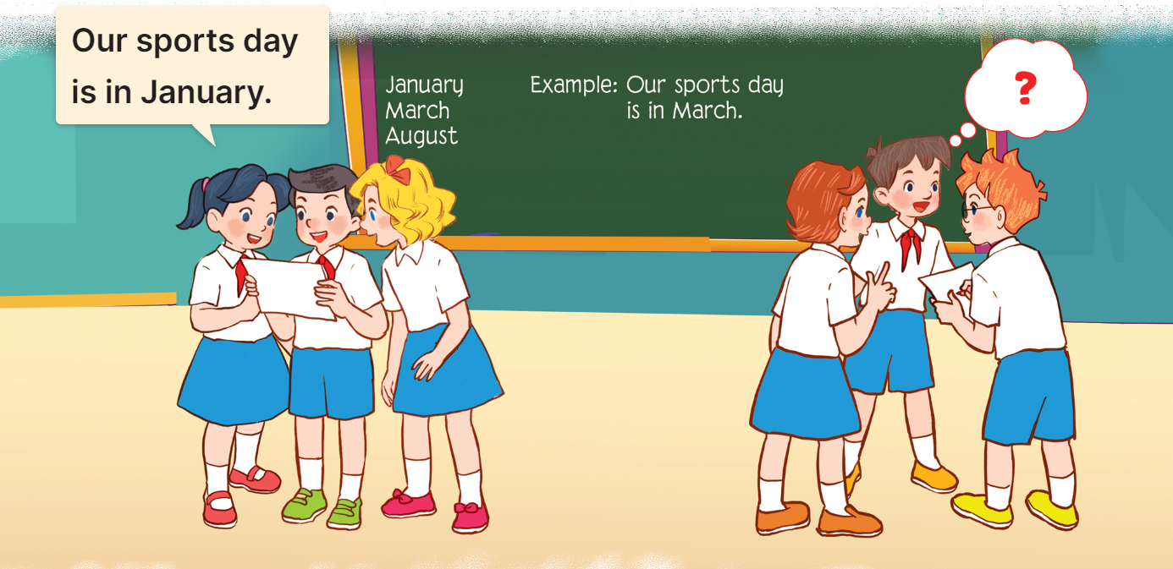
6
Let’s play.
MsPham
0936082789

Slide 18
Thank you!

