Slide 1
UNIT 8:IN OUR CLASSROOM
LESSON 1 ( 1, 2, 3)
Made by: Teacher: Nguyen Thi Thu Phuong
Notes:
Made by : Nguyen Thi Thu Phuong

Slide 2
Warm - up

Slide 3












Let's Play
The Memory Game

Slide 4





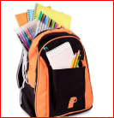

Remember and tell the name of school things
pencil
eraser
book
pencil case
pen
ruler
school bag
Made by: Teacher: Nguyen Thi Thu Phuong

Slide 5
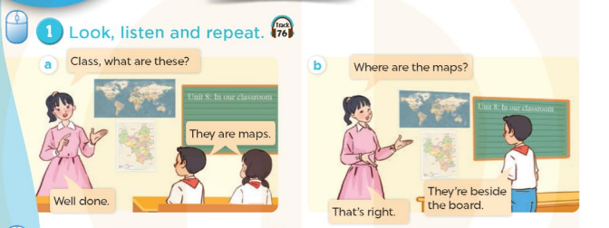


Slide 6

above/əˈbʌv/ở phía trên
Made by: Teacher: Nguyen Thi Thu Phuong

Slide 7
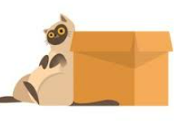
beside/bɪˈsaɪd/bên cạnh

Slide 8
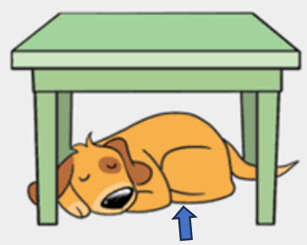
under/ˈʌndə/ở phía dưới

Slide 9
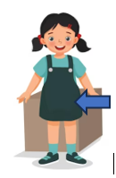
in front of /ɪn frʌnt əv/ở đằng trước
Notes:
MADE BY NGUYEN THI THU PHUONG

Slide 10

VOCABULARY
Above: ở phía trên
Beside :ở bên cạnh
under:ở phía dưới
In front of: ở đằng trước

Slide 11
Let's play
Check vocabulary
MATCHING

Slide 12
1.In front of
A
2.under
B
3.beside
C
4. above
D

Slide 13
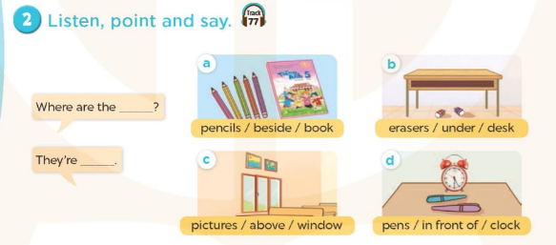
pencils ?
beside the book

Slide 14
Where are the pencils?
( Những cây bút chì ở đâu vậy?)
They’re beside the book
( Chúng ở bên cạnh quyển sách.)
Made by: Teacher: Nguyen Thi Thu Phuong

Slide 15

Where are the........................?
pencils
They’re……………………………………………….…….
beside the book

Slide 16
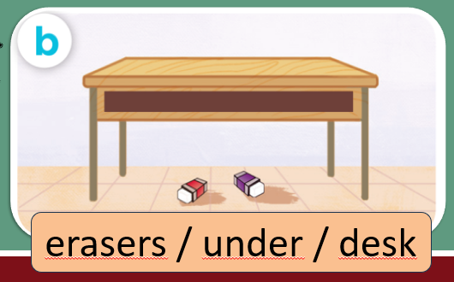
Where are the........................?
erasers
They’re……………………………………………….…….
under the desk

Slide 17
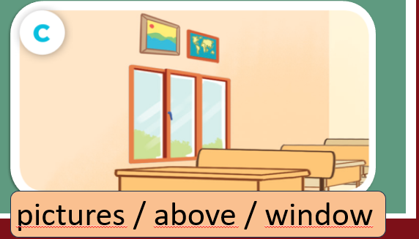
Where are the........................?
pictures
They’re……………………………………………….…….
above the window

Slide 18
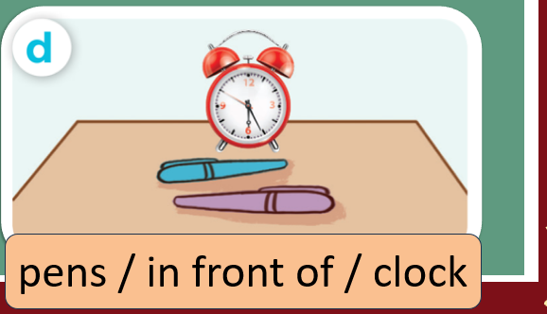
Where are the........................?
pens
They’re…............…………………………………………….…….
in front of the clock

Slide 19
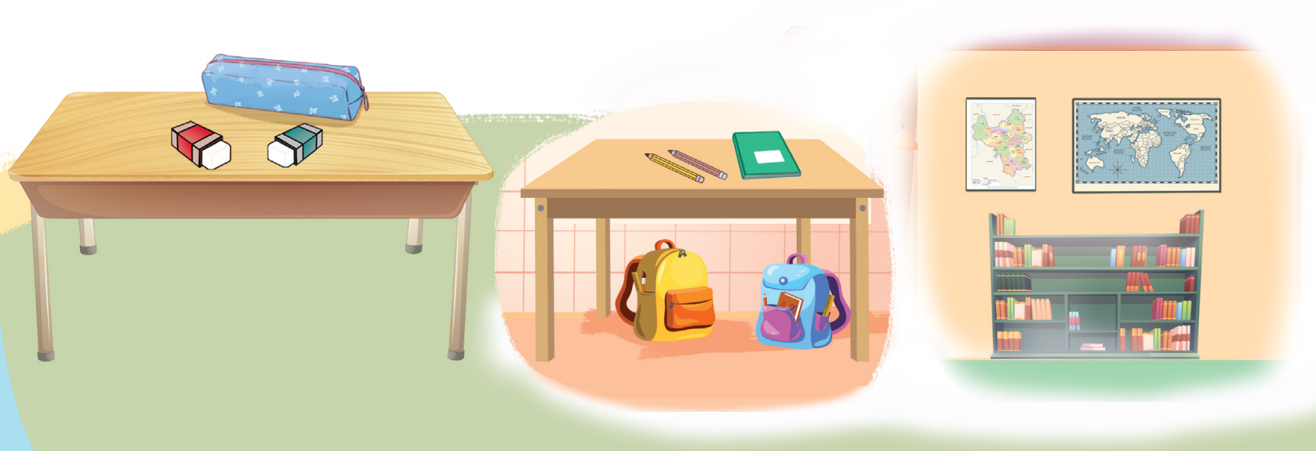
3. Let’s talk

Slide 20
Let's play
LUCKY NUMBERS

Slide 21
1
2
3
Next
4
5
6

Slide 22


Where are the........................?
pens
Well done
BACK
They’re…............…………………………………………….…….
beside the books

Slide 23
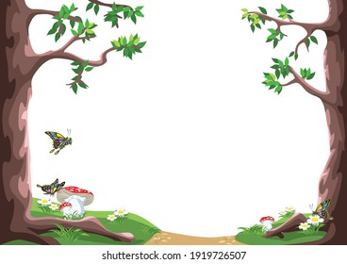
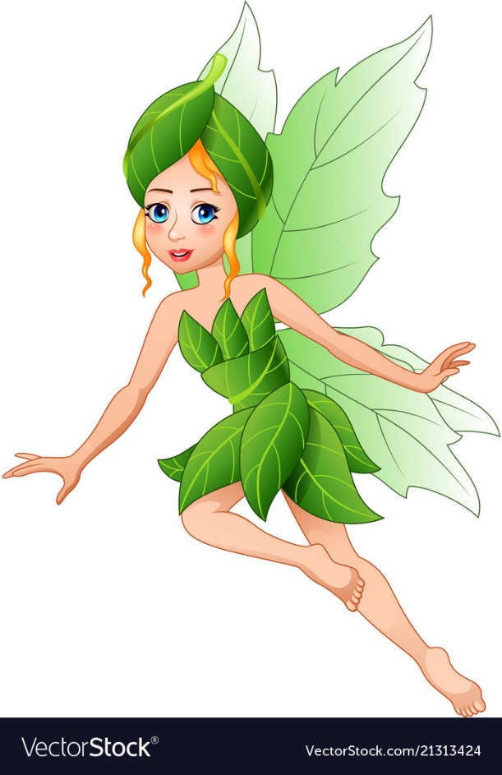
LUCKY NUMBER
BACK

Slide 24
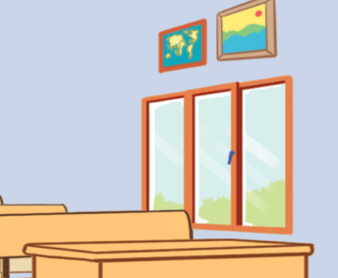
Where are the........................?
pictures
Well done
BACK
They’re……………………………………………….…….
above the window

Slide 25
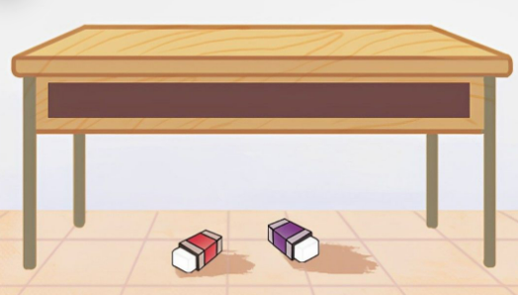
Where are the........................?
erasers
Well done
BACK
They’re……………………………………………….…….
under the desk

Slide 26
LUCKY NUMBER
BACK

Slide 27
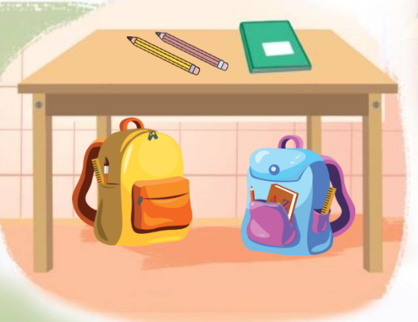

Where are the........................?
schools bags
Well done
BACK
They’re……………………………………………….…….
under the table
Notes:
Teacher says the first sentence. Student replies using the new structure. Click the rabbit to go back to question slide.

Slide 28
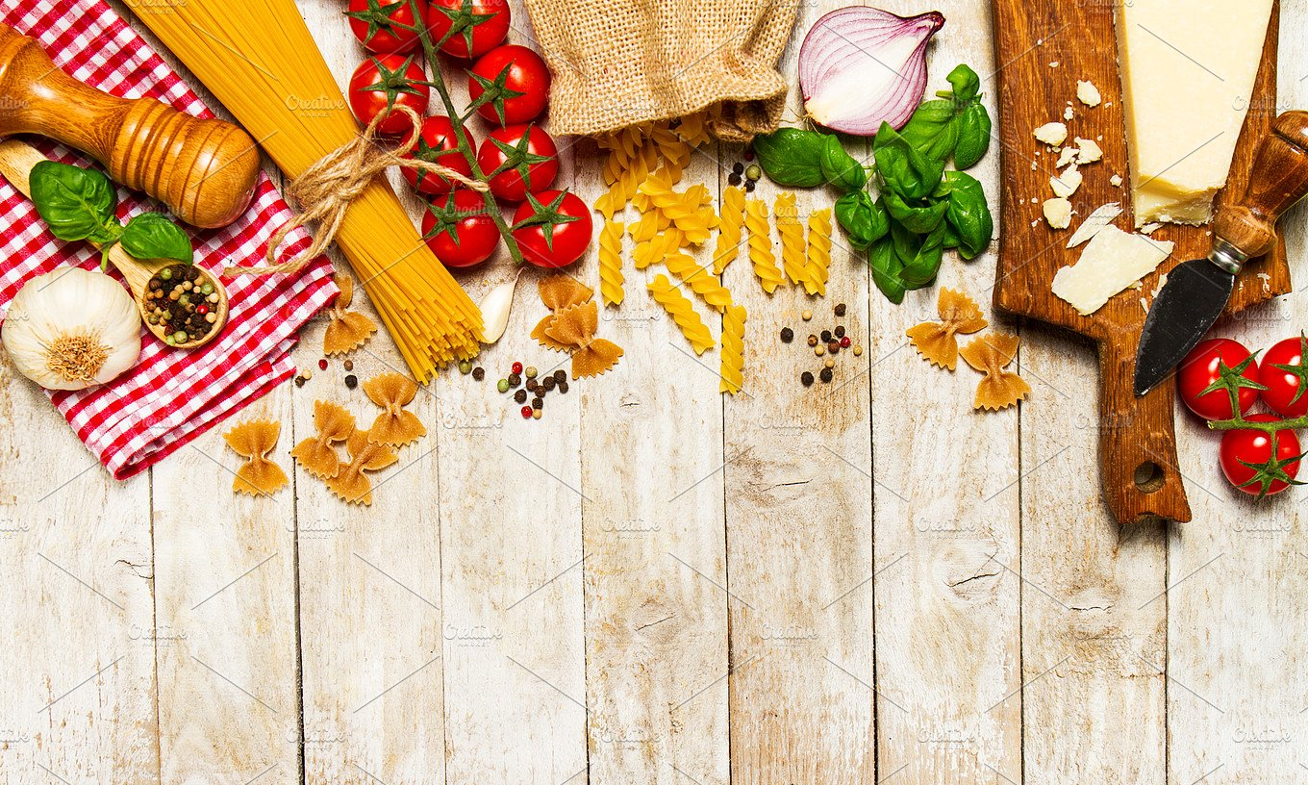
SUMMARY

Slide 29
SUMMARY
1.Vocabulary:
Above: ở phía trên
Beside :ở bên cạnh
under:ở phía dưới
In front of: ở đằng trước
2. Sentence pattern:
-Where are the pencils?
(Những cây bút chì ở đâu vậy?
-> They’re beside the book.
(Chúng ở bên cạnh quyển sách.)

Slide 30
Homework:
- Learn by heart vocabulary and sentence pattern
- Prepare Unit 8- lesson 1 ( 4, 5, 6)

Slide 31
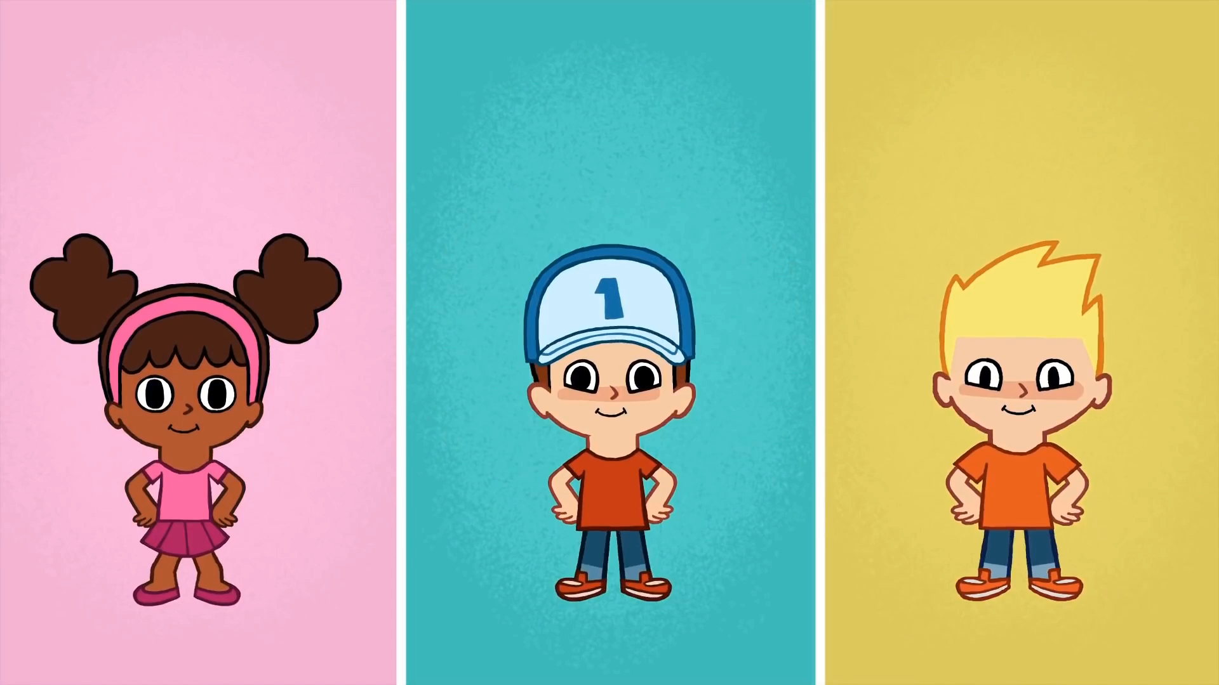
* SING AND DANCE: BYE BYE GOODBYE SONG

Slide 32




The bye bye song
Bye, bye.
See you tomorrow.
Bye, bye.
See you tomorrow.
Bye, bye.
See you tomorrow.
Bye, bye. Bye, bye.
The bye bye song

